Slide 1
Lecture 10 Gaussian Mixture Models Linear Dynamical Systems
291K Machine Learning
Lei Li and Yu-xiang Wang
UCSB

Slide 2
Recap
Bayesian networks:
Directed acyclic graph
Nodes are random variables
arcs are probabilistic dependencies
Examine dependence of two variables given observation: d-separation

Slide 3
Housing Price Pattern
Two spikes

Slide 4
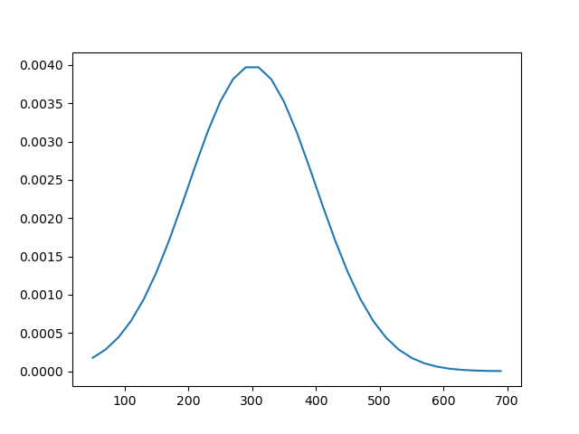
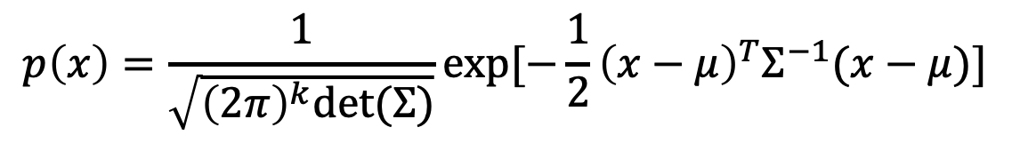
Gaussian Distribution
Only single spike
$$p\left(x\right)=\frac{1}{\sqrt{{\left(2π\right)}^{k}det⁡(Σ)}}exp⁡[−\frac{1}{2}{\left(x−μ\right)}^{T}Σ^{−1}(x−μ)]$$

Slide 5
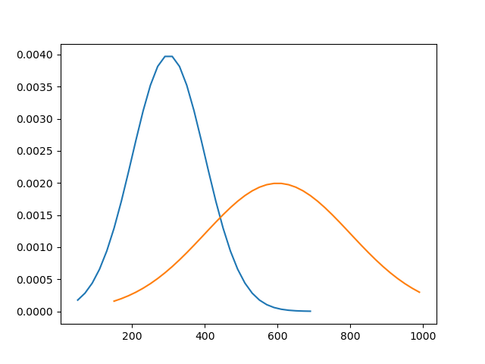
Two Underlying Patterns
It might be multiple underlying patterns of Gaussian distribution
Los Angeles and Pittsburgh have different median housing price

Slide 6

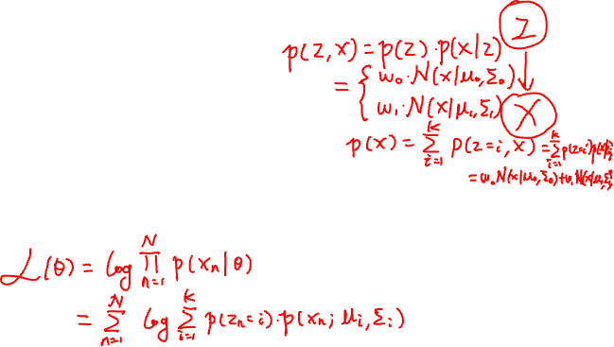
Gaussian Mixture Model
Generative process:
z ~ Categorical(K)
$x|z\sim \text{Gaussian}(μ_{z}, Σ_{z})$
Density:

Slide 7
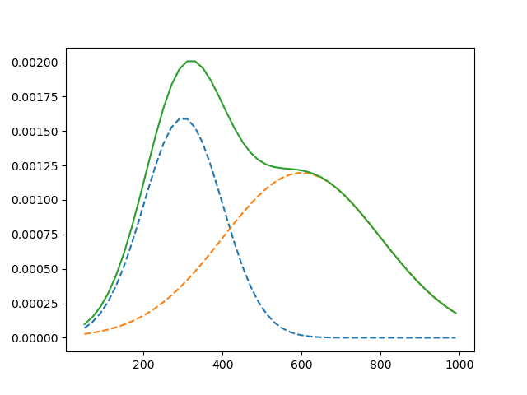
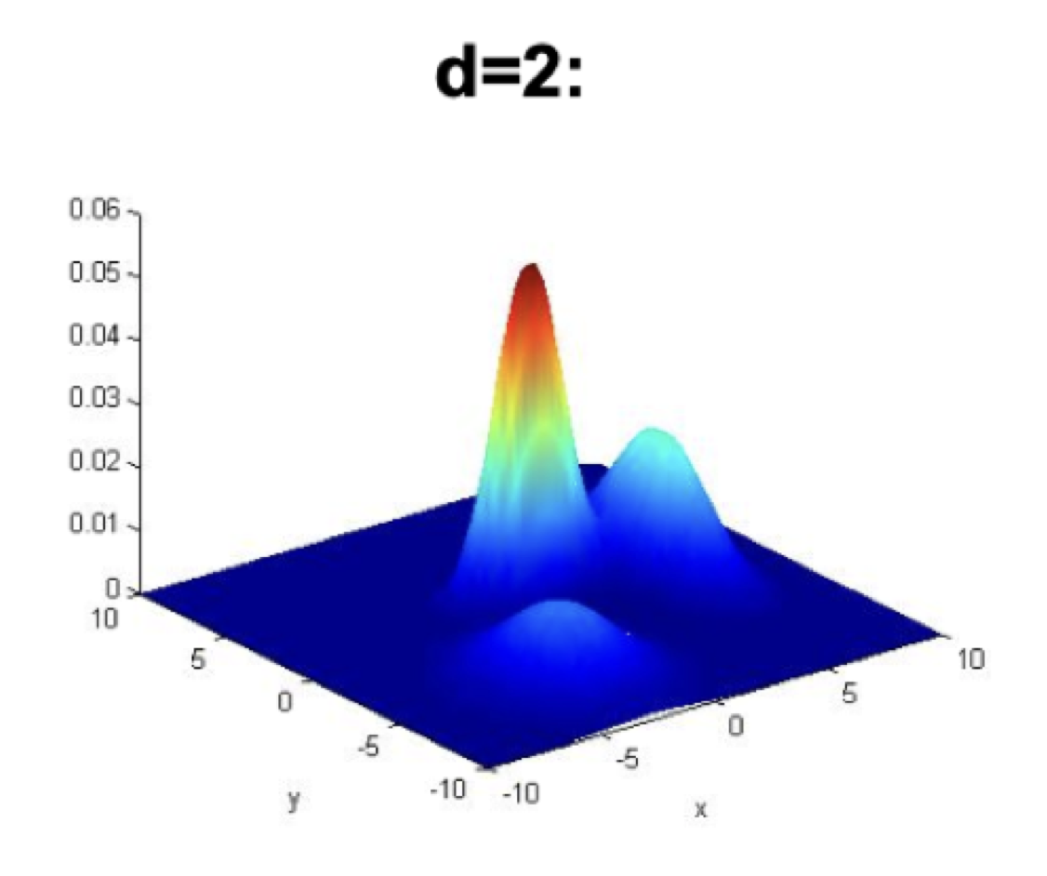
Gaussian Mixture

Slide 8

Mixture Distribution
Z: latent variable
x|z can be any distribution in parametric form (e.g. exponential distribution)

Slide 9
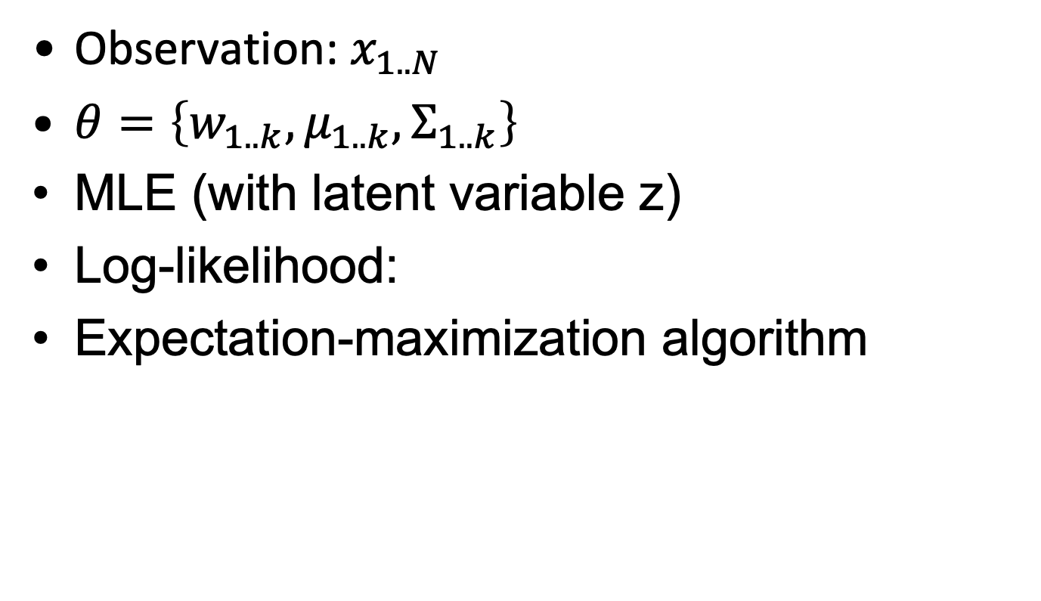


Learning Parameters for GMM
Observation: $x_{1..N}$
$θ=\left\{w_{1..k}, μ_{1..k}, Σ_{1..k}\right\}$
MLE (with latent variable z)
Log-likelihood:
Expectation-maximization algorithm
Notes:
Draw graphical model

Slide 10

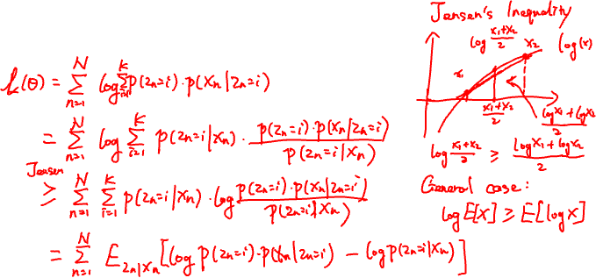
Expected log-likelihood
${L\left(θ\right)=E}_{p(z_{n}|x_{n})}\log{p(x_{n}, z_{n})}$

Slide 11

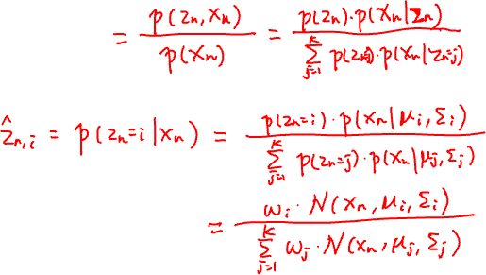
Posterior
$p(z_{n}|x_{n})$

Slide 12
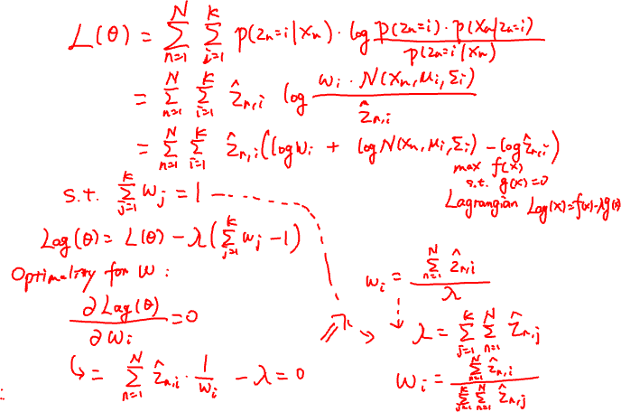
Update mixture weights

Slide 13
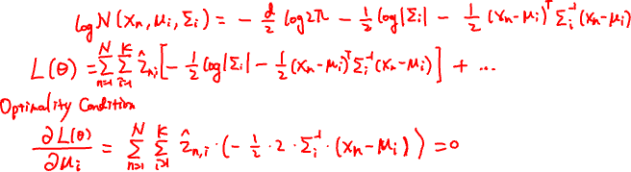
Update mean and covariance

Slide 14
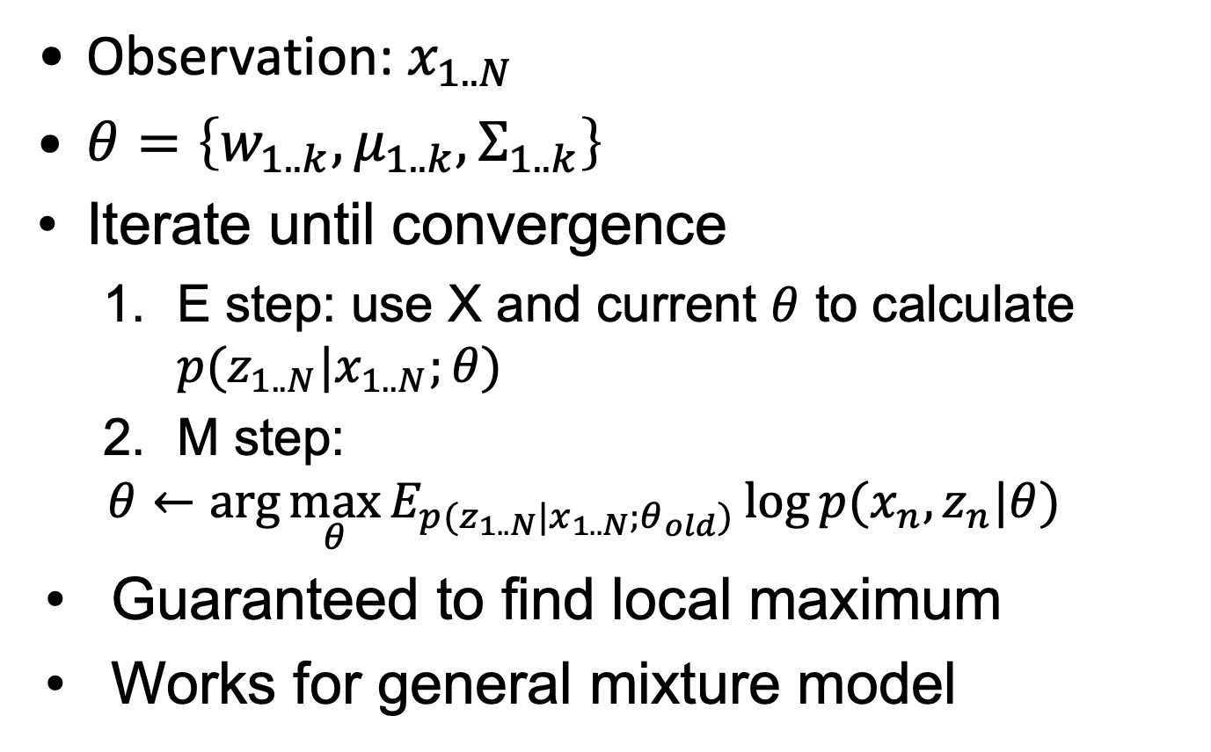
Summary of EM algorithm
Observation: $x_{1..N}$
$θ=\left\{w_{1..k}, μ_{1..k}, Σ_{1..k}\right\}$
Iterate until convergence
E step: use X and current $θ$ to calculate $p(z_{1..N}|x_{1..N};θ)$
M step:
$$θ←\arg{\max_{θ}{E_{p(z_{1..N}|x_{1..N};θ_{old})}\log{p(x_{n}, z_{n}|θ)}}}$$
Guaranteed to find local maximum
Works for general mixture model

Slide 15
Illustration of GMM

Slide 16
Property of GMM
Interpretable:
Participation weight of each data point from every component
Generative:
Able to generate new data
Handles missing values
Efficient: O(TKN)
Local optimal:
Can be viewed as coordinate descent (why?)
Need to specify K

Slide 17
K-Means vs GMM
1. Decide on a value for K, the number of clusters. 2. Initialize the K cluster centers / parameters (randomly).
K-Means
GMM
3. Decide the class memberships of the N objects by assigning them to the nearest cluster center.
3. E-step: assign probabilistic membership
4. M-step: re-estimate parameters based on probabilistic membership
4. Re-estimate the K cluster centers using the memberships found above
5. Repeat 3 and 4 until parameters do not change.

Slide 18
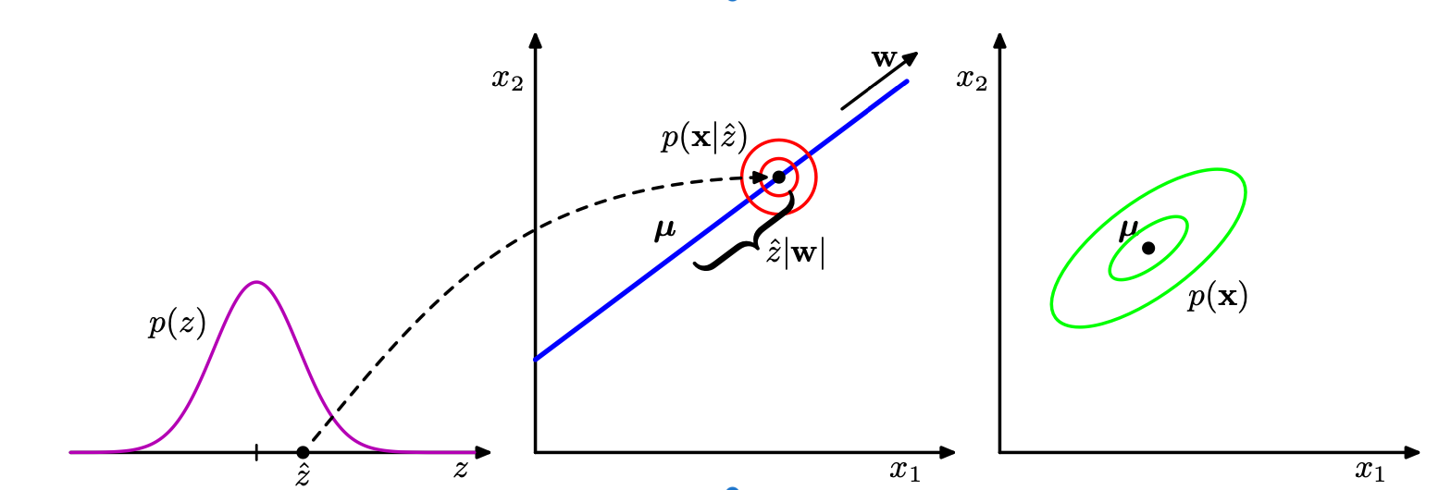

Probabilistic PCA
Continuous latent variable $z\sim N(0,I)$
Observation data $x|z\sim N(W⋅z+μ,σ^{2}I)$

Slide 19

Learning Parameters for PPCA
Again EM algorithm
$\arg{\max_{θ}{E_{p(z_{1..N}|x_{1..N};θ_{old})}\log{p(x_{1..N}, z_{1..N}|θ)}}}$

Slide 20
Dynamic Bayesian Networks
What about non-IID data / sequential data
Markov assumption
GMM => Sequential => HMM
PPCA ➔ Sequential ➔ LDS

Slide 21
Linear Dynamical Systems
z₁
transition
z₂
z₃
z₄
emission
x₁
x₂
x₃
x₄

Slide 22
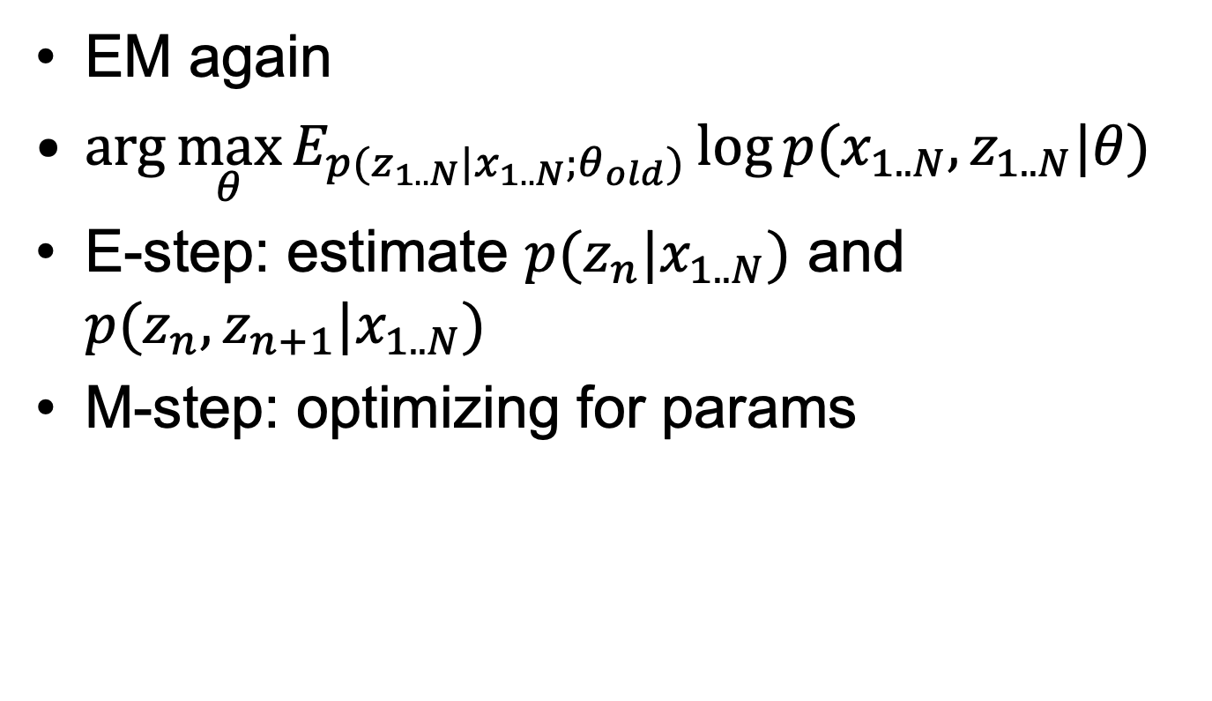
Learning LDS
EM again
$\arg{\max_{θ}{E_{p(z_{1..N}|x_{1..N};θ_{old})}\log{p(x_{1..N}, z_{1..N}|θ)}}}$
E-step: estimate $p(z_{n}|x_{1..N})$ and $p(z_{n},z_{n+1}|x_{1..N})$
M-step: optimizing for params

Slide 23

Objective: Expected log-likelihood
$E_{p(z_{1..N}|x_{1..N};θ_{old})}\log{p(x_{1..N}, z_{1..N}|θ)}$

Slide 24
Maximization

Slide 25

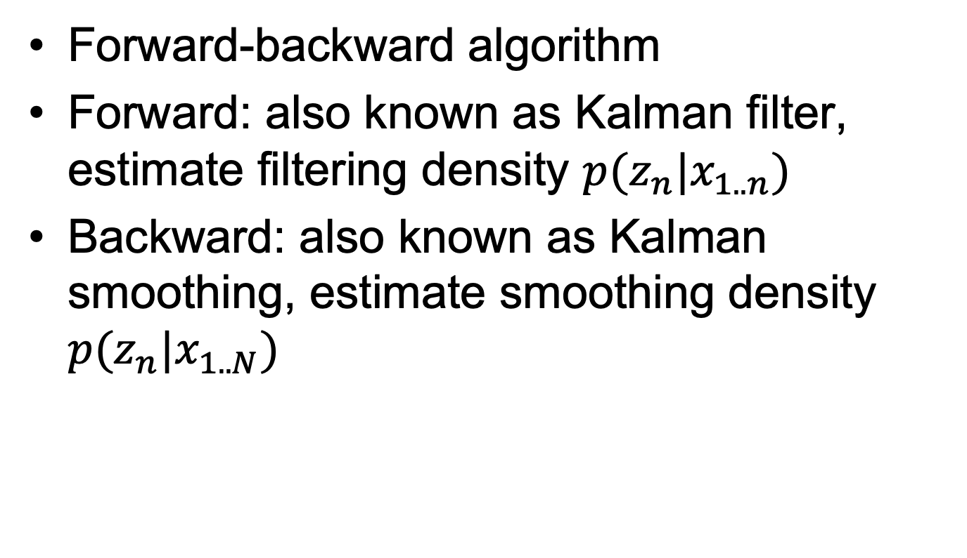
Estimating $p(z_{n}|x_{1..N})$
Forward-backward algorithm
Forward: also known as Kalman filter, estimate filtering density $p(z_{n}|x_{1..n})$
Backward: also known as Kalman smoothing, estimate smoothing density $p(z_{n}|x_{1..N})$

Slide 27
Summary
Mixture Distribution: to build more complex distribution from simple ones
Gaussian Mixture Model: k Gaussian components
Expectation-Maximization: general for graphical models with latent variables
E-step: fix parameter, estimate posterior mean/variance
M-step: update parameter
Probabilistic PCA: latent is continuous
Linear Dynamical System:
E-step: Forward-backward alg.
M-step: update parameters

Slide 28
Recommended Reading
PRML Chapter 9, 12.2, 13.3

Slide 29
Next up
Undirected Graphical Models

