Slide 1
Lecture 11 Dynamic Bayesian Networks Linear Dynamical Systems
291K Machine Learning
Lei Li and Yu-xiang Wang
UCSB

Slide 2
Recap
Bayesian networks:
Directed acyclic graph
Nodes are random variables
arcs are probabilistic dependencies
Mixture of Gaussian Model
Expectation-Maximization

Slide 3
Dynamic Bayesian Networks
What about non-IID data / sequential data
Markov assumption
GMM => Sequential => HMM
PPCA ➔ Sequential ➔ LDS

Slide 4
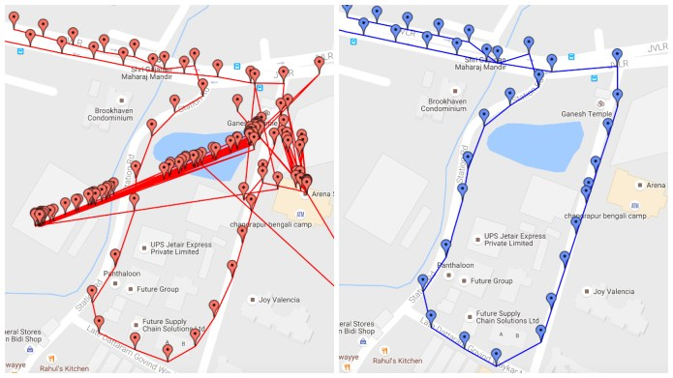
Estimating the true trajectory

Slide 5
Markov Process
x₁
x₂
x₃
x₄
Markov chain
Current value only dependent on the previous step

Slide 6
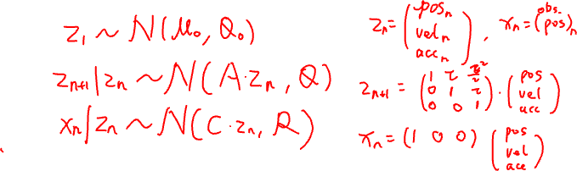
Linear Dynamical Systems
z₁
transition
z₂
z₃
z₄
emission
x₁
x₂
x₃
x₄

Slide 7
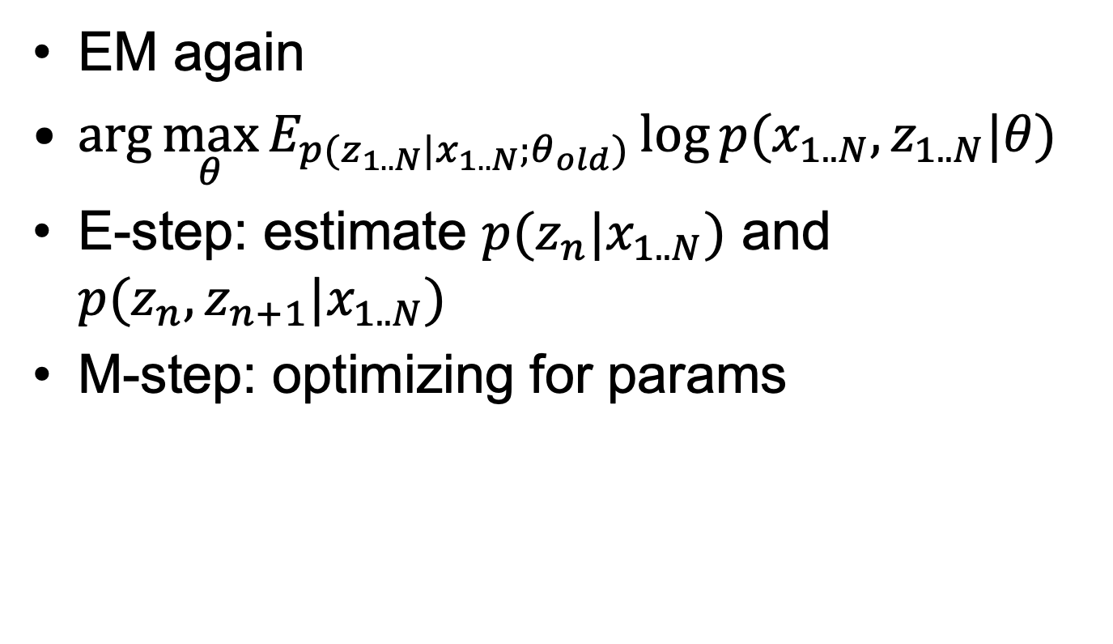
Learning LDS
EM again
$\arg{\max_{θ}{E_{p(z_{1..N}|x_{1..N};θ_{old})}\log{p(x_{1..N}, z_{1..N}|θ)}}}$
E-step: estimate $p(z_{n}|x_{1..N})$ and $p(z_{n},z_{n+1}|x_{1..N})$
M-step: optimizing for params

Slide 8

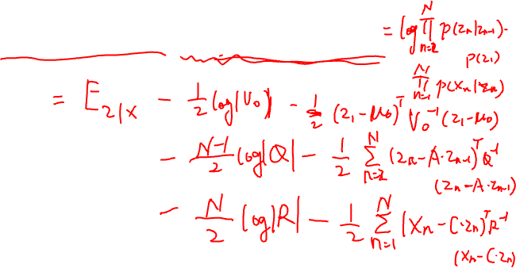
Objective: Expected log-likelihood
$E_{p(z_{1..N}|x_{1..N};θ_{old})}\log{p(x_{1..N}, z_{1..N}|θ)}$

Slide 9
Maximization

Slide 10
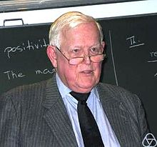

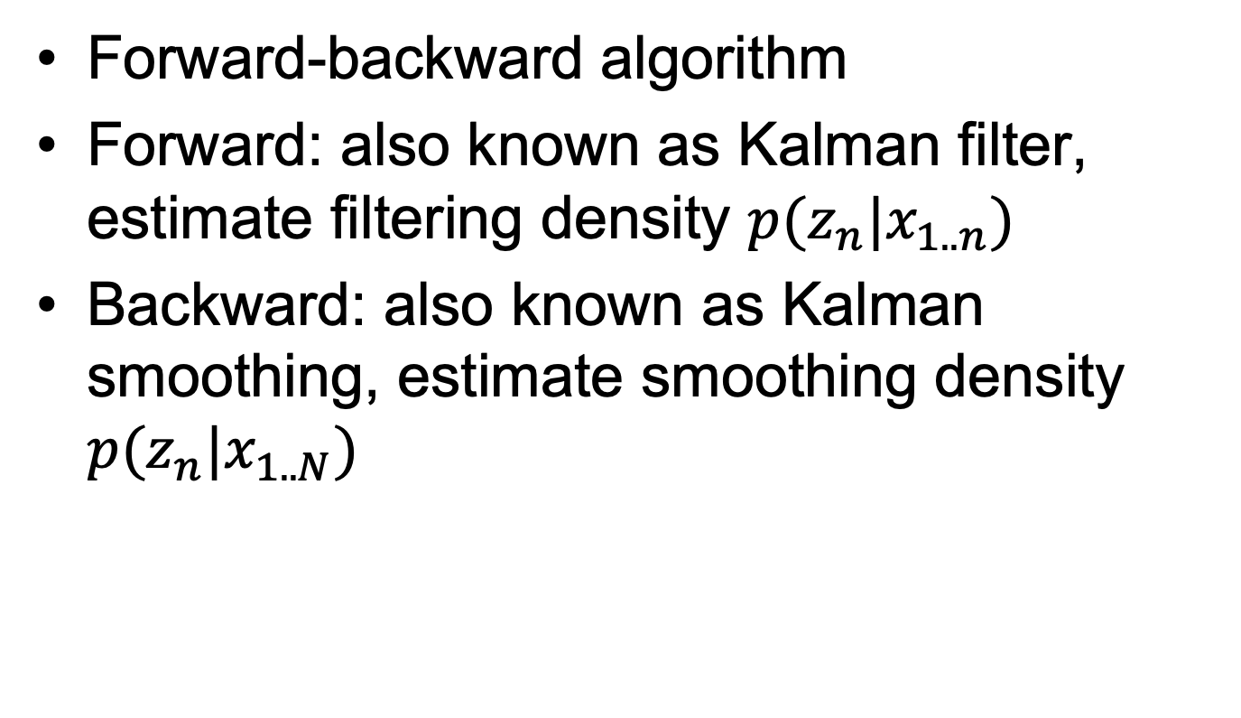
Estimating $p(z_{n}|x_{1..N})$
Forward-backward algorithm
Forward: also known as Kalman filter, estimate filtering density $p(z_{n}|x_{1..n})$
Backward: also known as Kalman smoothing, estimate smoothing density $p(z_{n}|x_{1..N})$

Slide 11

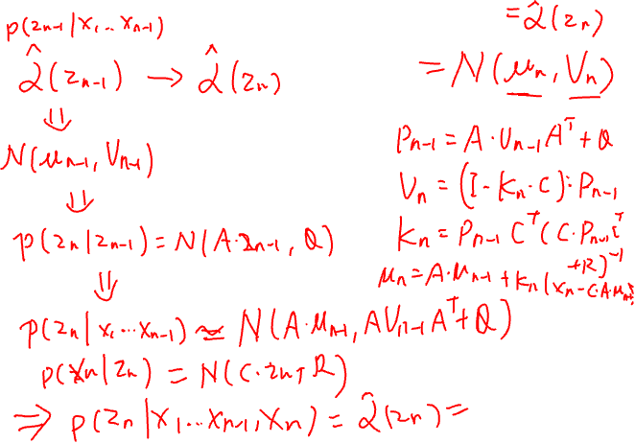
Forward: $p(z_{n}|x_{1..n})$

Slide 12
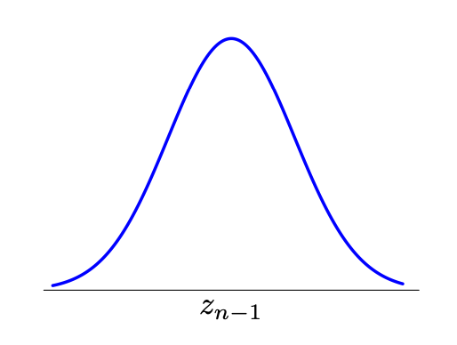
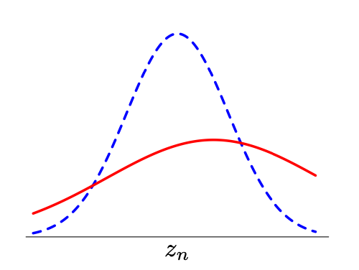
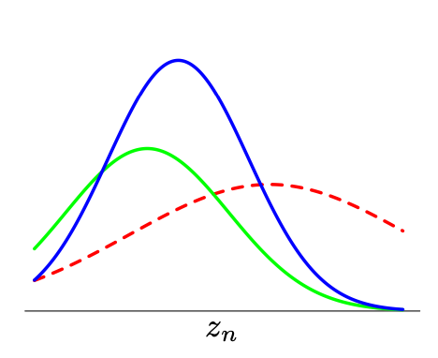





What does Kalman filter (forward-pass) do?
$$p(z_{n−1}|x_{1}…x_{n−1})$$
Predict one step
$$p(z_{n}|x_{1}…x_{n−1})$$
$$p(z_{n}|x_{1}…x_{n})$$
Update estimation given a new observation
$$p(x_{n}|z_{n})$$
$$p(z_{n}|x_{1}…x_{n−1})$$

Slide 13

Backward: $p(z_{n}|x_{1..N})$

Slide 14
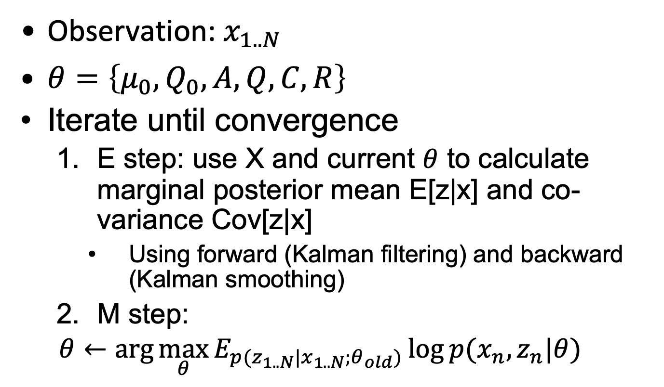
EM for LDS
Observation: $x_{1..N}$
$θ=\left\{μ_{0}, Q_{0}, A, Q, C, R\right\}$
Iterate until convergence
E step: use X and current $θ$ to calculate marginal posterior mean E[z|x] and co-variance Cov[z|x]
Using forward (Kalman filtering) and backward (Kalman smoothing)
M step:
$$θ←\arg{\max_{θ}{E_{p(z_{1..N}|x_{1..N};θ_{old})}\log{p(x_{n}, z_{n}|θ)}}}$$

Slide 15
Application of LDS
Kalman filter: Tracking object movement
Time series forecasting

Slide 16
Hidden Markov Model
z₁
transition
z₂
z₃
z₄
emission
x₁
x₂
x₃
x₄
Same graph topology, but different distribution
Sequential version of GMM
Transition: a probability matrix
Emission: Gaussian
Wide applications in Speech, Communication, Genetics

Slide 17
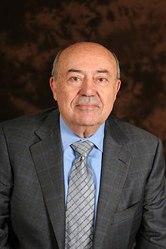
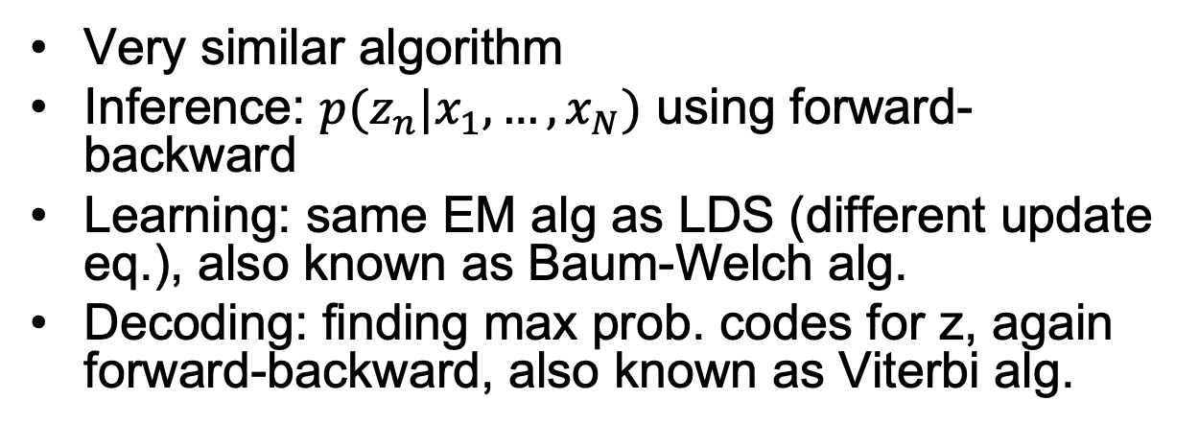
Hidden Markov Model
z₁
transition
z₂
z₃
z₄
emission
x₁
x₂
x₃
x₄
Very similar algorithm
Inference: $p(z_{n}|x_{1},…, x_{N})$ using forward-backward
Learning: same EM alg as LDS (different update eq.), also known as Baum-Welch alg.
Decoding: finding max prob. codes for z, again forward-backward, also known as Viterbi alg.
Andrew Viterbi

Slide 18
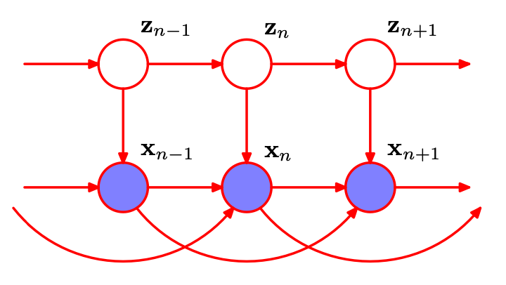
Other Variations
Observation also dependent on previous steps

Slide 19
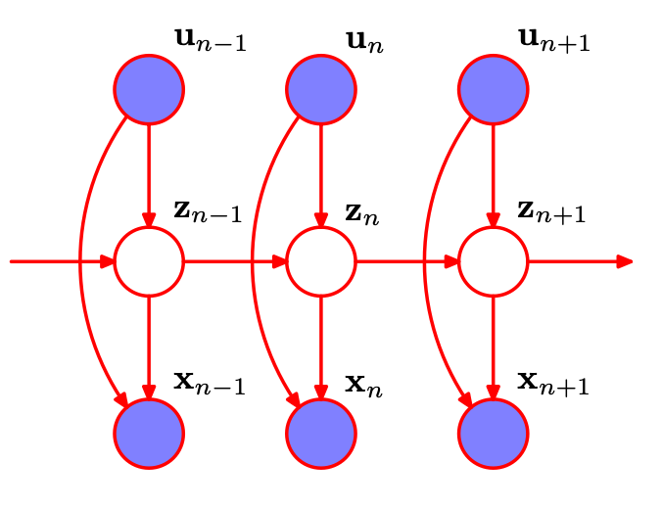
Other Variations
Input-Output HMM/LDS

Slide 20
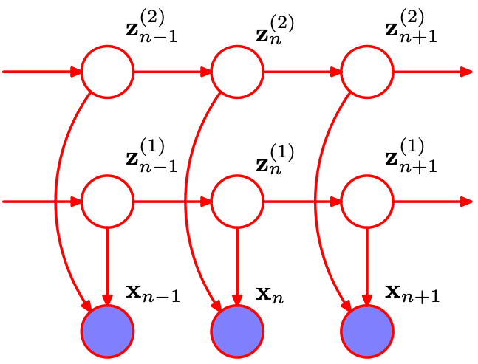
Other Variations
Factorial HMM with multiple chains

Slide 21
Summary
Mixture Distribution: to build more complex distribution from simple ones
Gaussian Mixture Model: k Gaussian components
Expectation-Maximization: general for graphical models with latent variables
E-step: fix parameter, estimate posterior mean/variance
M-step: update parameter
Probabilistic PCA: latent is continuous
Linear Dynamical System:
E-step: Forward-backward alg.
M-step: update parameters

Slide 22
Recommended Reading
PRML Chapter 9, 12.2, 13.3

Slide 23
Next up
Undirected Graphical Models
Approximate Inference
Variational Inference
Sampling

