Slide 1
Lecture 12 Undirected Graphical Models
291K Machine Learning
Lei Li and Yu-xiang Wang
UCSB
Part of slides borrowed from Alex Smola

Slide 2
Recap
Gaussian Mixture Models
Expectation-Maximization
Linear Dynamical Systems
Forward-backward algorithm (Kalman filter, Kalman smoothing)

Slide 3
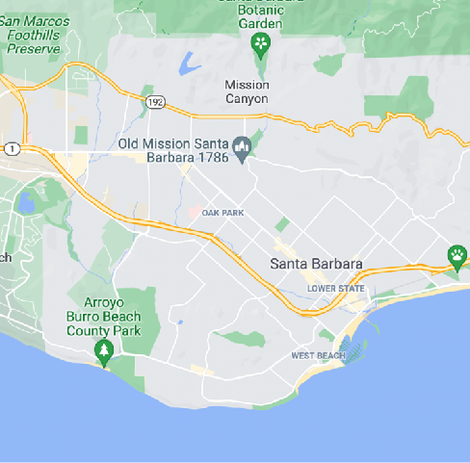
Understanding Query Intent
Building a conversational assistant for Google Map?
Noodle house near Santa Barbara
[Keyword]
[Location]
How to go from Santa Barbara to Log Angeles ?
[Origin]
[Destination]
Sequence Labelling problem

Slide 4
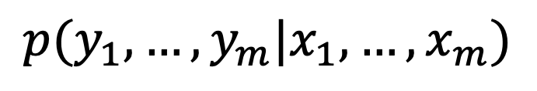
Parsing Query Intent
$$p(y_{1},…,y_{m}|x_{1},…,x_{m})$$
O O O O B-SRC I-SRC O B-DST I-DST O
Linear+Softmax
BERT
Embedding
How to go from Santa Barbara to Los Angeles ?
1640 897 45 1890 78 943 3521 782 533 13

Slide 5
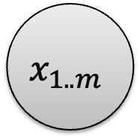
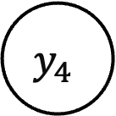

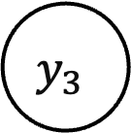
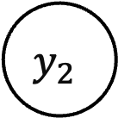
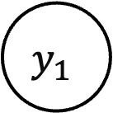
Label Independent?
Are $y_{i} y_{j}$ independent given $x_{1},…,x_{m}$?
But neighboring labels are correlated
$$x_{1..m}$$
$$y_{1}$$
$$y_{2}$$
$$y_{3}$$
$$y_{4}$$
How to go from Santa Barbara to Log Angeles ?

Slide 6
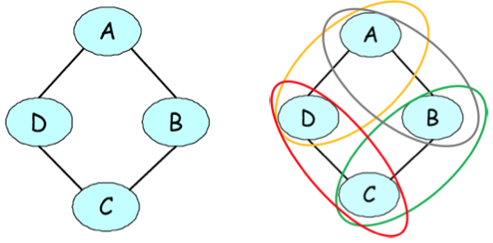
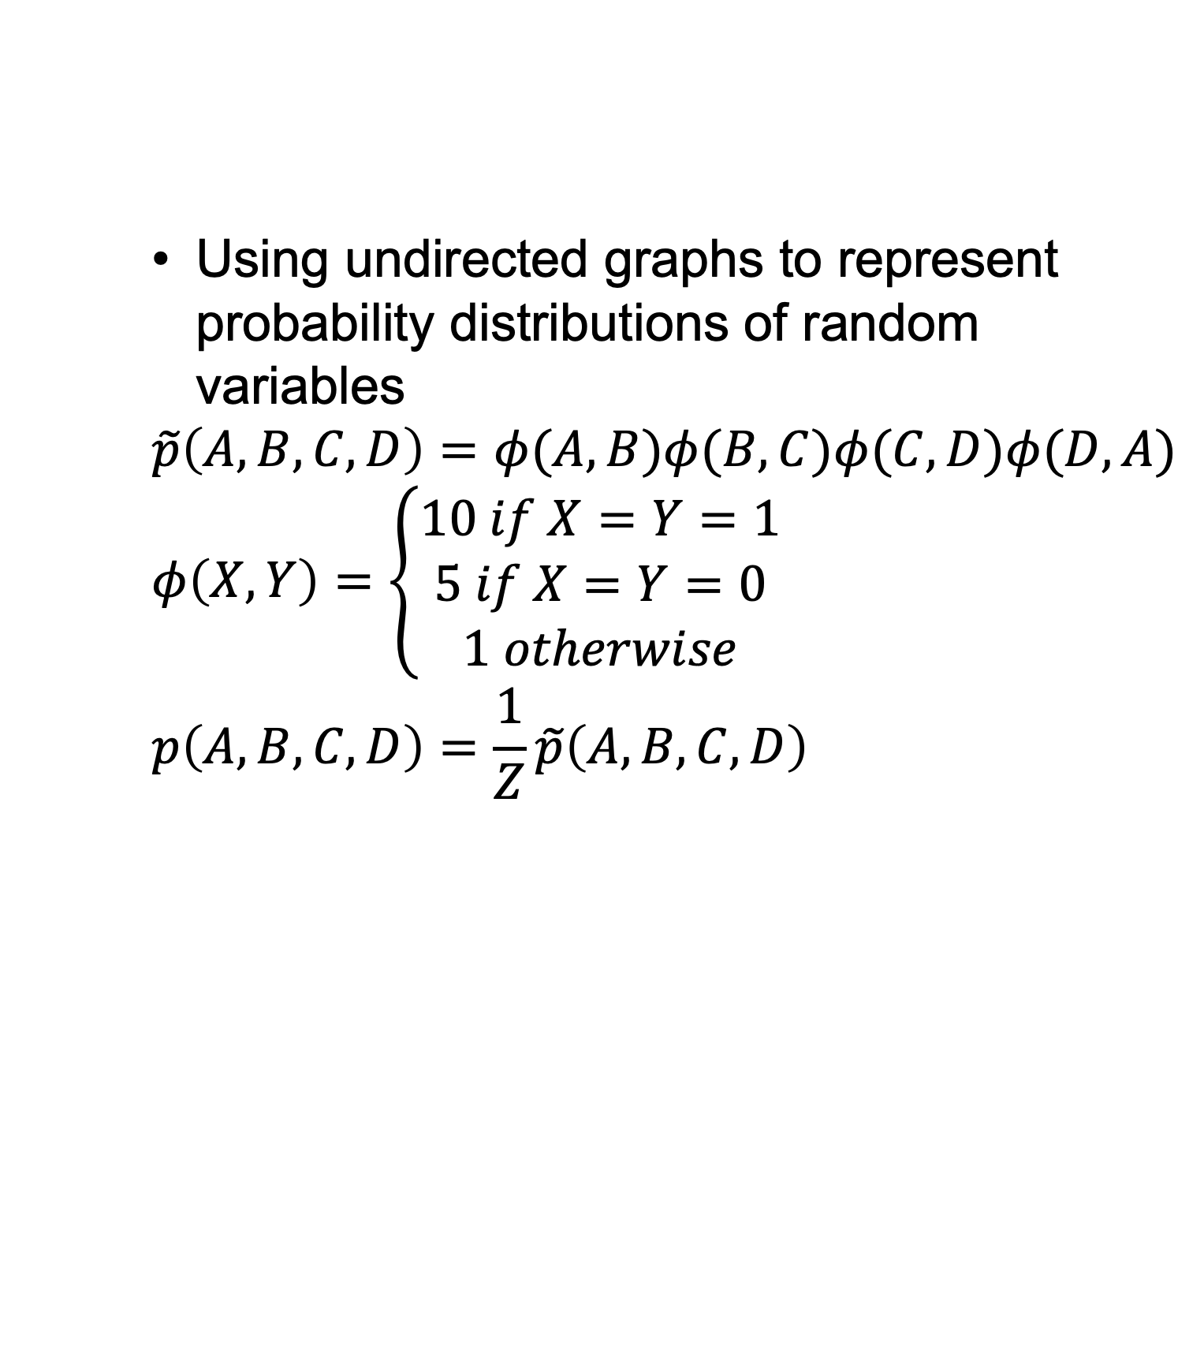
Markov Random Fields
Using undirected graphs to represent probability distributions of random variables
$$\tilde{p}\left(A,B,C,D\right)=φ(A,B)φ(B,C)φ(C,D)φ(D,A)$$
$$φ\left(X,Y\right)=\left\{\begin{aligned}10 if X=Y=1 \\ 5 if X=Y=0 \\ 1 otherwise\end{aligned}\right.$$
$$p\left(A,B,C,D\right)=\frac{1}{Z}\tilde{p}\left(A,B,C,D\right)$$
Normalizing term, also partition function

Slide 7
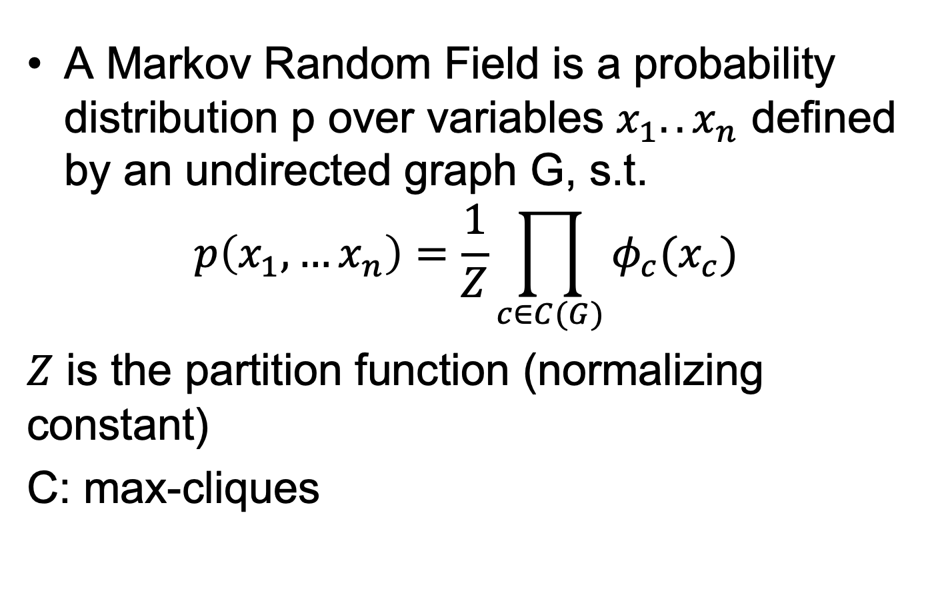
MRF
A Markov Random Field is a probability distribution p over variables $x_{1}..x_{n}$ defined by an undirected graph G, s.t.
$$p\left(x_{1},…x_{n}\right)=\frac{1}{Z}\prod_{c∈C(G)}{φ_{c}(x_{c})}$$
$Z$ is the partition function (normalizing constant)
C: max-cliques

Slide 8
Independence in MRF
Key Concept
Observing nodes makes remainder
conditionally independent

Slide 9
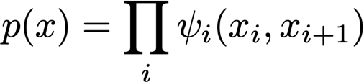
Example
x

Slide 10
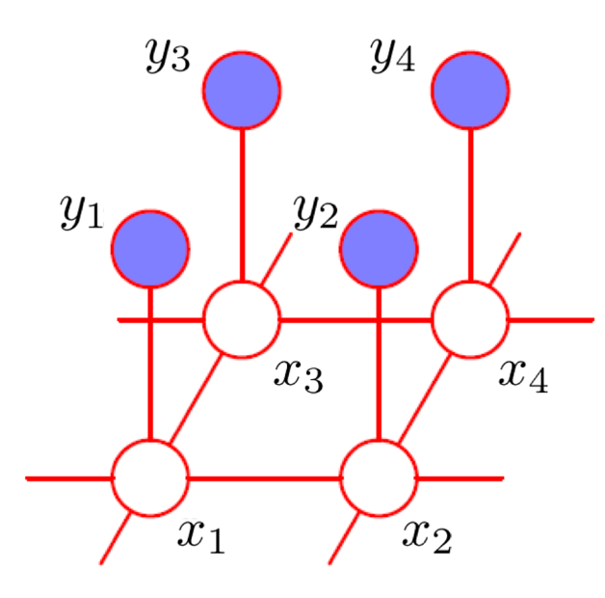
Example

Slide 11
Spin Glasses + Images
y
x
observed pixels
real image
long range interactions

Slide 12
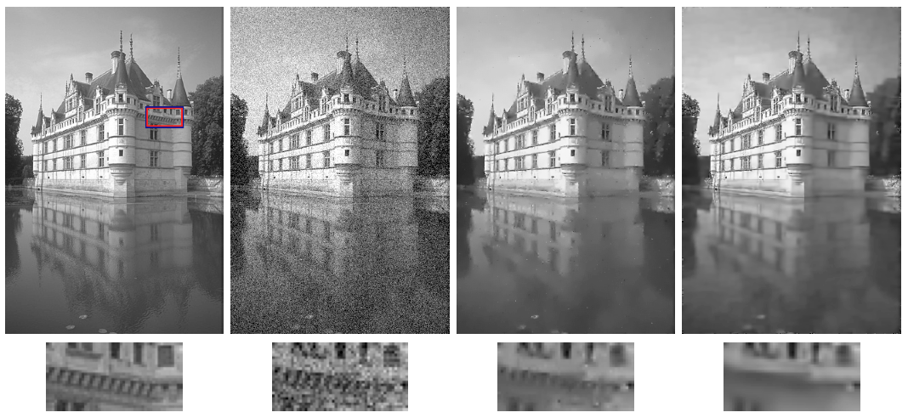
Image Denoising
Li&Huttenlocher, ECCV’08

Slide 13
Hammersley-Clifford Theorem
Set of distributions that factorize according to the graph – F
Set of distributions that respect conditional independencies implied by graph-separation – I
F ⬅➔ I

Slide 14
Directed vs. Undirected
Causal description
Normalization automatic
Intuitive
Requires knowledge of dependencies
Conditional independence tricky (d-separation)
Noncausal description (correlation only)
Intuitive
Easy modeling
Normalization difficult
Conditional independence easy to read off (graph connectivity)

Slide 15
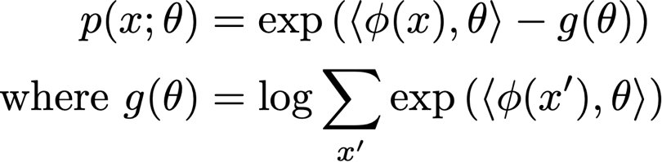
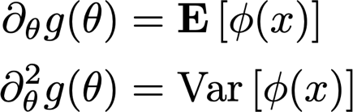
Exponential Family
Density function
Log partition function generates cumulants
g is convex (second derivative is p.s.d.)

Slide 16
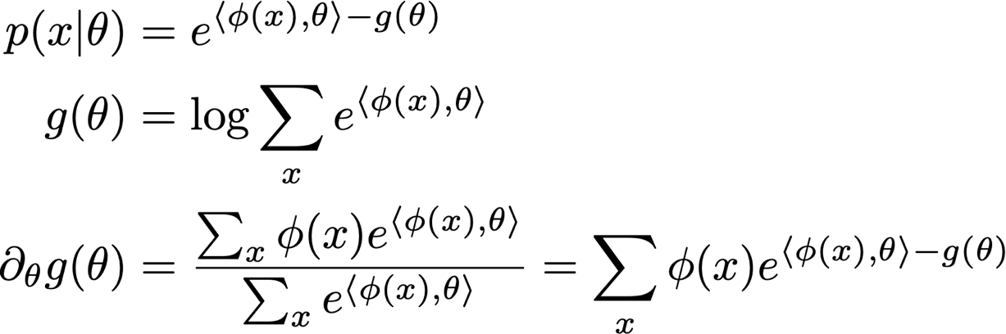
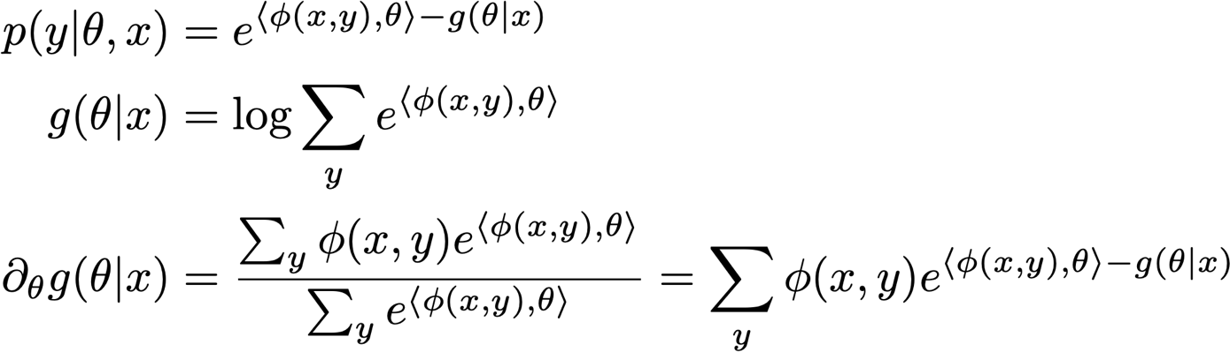
Log Partition Function
Unconditional model
Conditional model

Slide 17
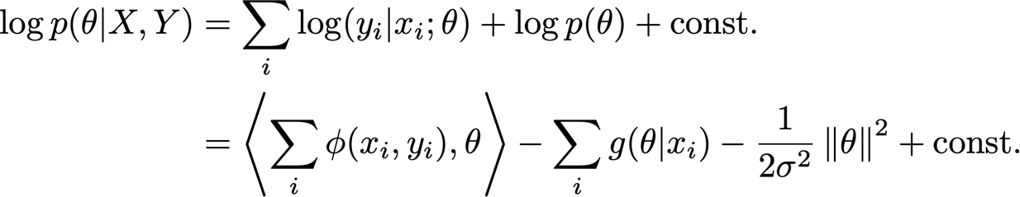
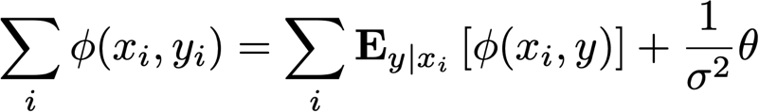
Estimation
Conditional log-likelihood
Log-posterior (Gaussian Prior)
First order optimality conditions
expensive
prior
maxent
model

Slide 18
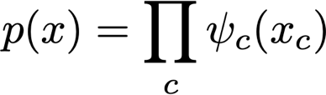
Exponential Clique Decomposition
Theorem: Clique decomposition holds in sufficient statistics
Corollary: we only need expectations on cliques

Slide 19
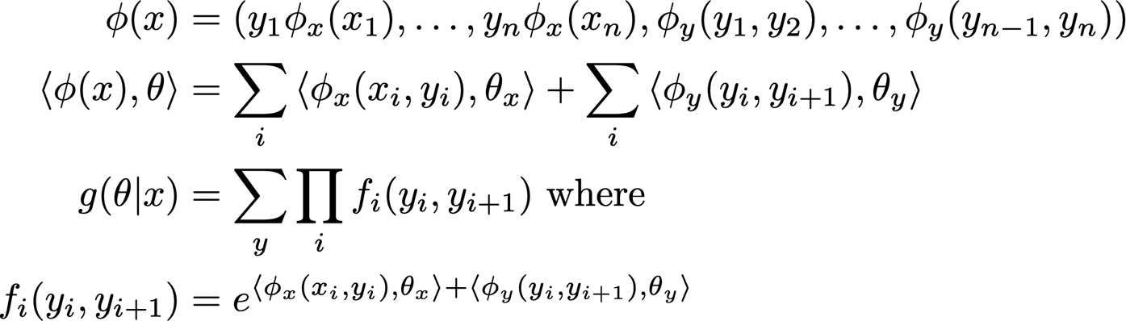
Conditional Random Fields
y
x
dynamic
Programming
(examples later)
Lafferty, McCallum, Pereira, ICML 2001

Slide 20
Conditional Random Fields
Compute distribution over marginal and adjacent labels
Take conditional expectations
Take update step (batch or online)
More general techniques for computing normalization via message passing ...

Slide 21
Combining NN and CRF
BiLSTM+CRF
BERT+CRF
CRF-loss
CRF-Decoding
Linear
Size: hidden to #label
BERT
Embedding
How to go from Santa Barbara to Los Angeles ?

Slide 22
Training BERT-CRF
Labels: K
A: transition matrix (K x K)
Using dynamic programming to compute the log-partition function

Slide 23
Decoding
Forward pass to compute last hidden layer from BERT
Using Viterbi algorithm to compute max prob. label seq

Slide 24
Case study
Building query intent parsing for Baidu Map

Slide 25
Next up
Approximate Inference
Variational Inference
Sampling

