Slide 1




























Dog
Rain
$which$category ?
d1 d2 d3 d4 d5
distance
Model
0
Clapping
3
1
0
Query example
2
Hen
Support set
(5-way 1-shot)
Cat
$$query sample$$
Support Set

Slide 2





$$S$$
${f_{ }}_{φ}$(.)
$$Q$$
$$(a)$$
Tone Timbre loudness
similarity
c1
2
c2
1
c3
2
c4
1
Query example
c5
2
Support Set(1-shot)
$$(b)$$
c3
Support Set(3-shot)

Slide 3
d1 d2 d3 d4 d5
distance
0
3
1
0
Query example
2
Support set
(5-way 1-shot)

Slide 4
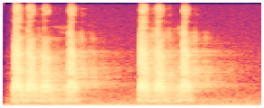
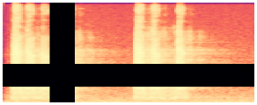
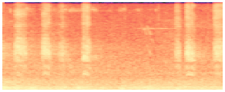







Meta-train
Meta-test
Task 1
N-way K-shot
Task 2
N-way K-shot
. . . .
Task N
N-way K-shot
Test Task
N-way K-shot
$$A_{ch}$$
$$A_{te}$$
Data Augmentation
Feature Encoder
(b)
Prototypical
Network
$$f_{φ}(S)$$
Reshaper
r(S)
Time
Frequency
masking
TAE
Projector
Loss
P
Transductive
Propagation
Network
Reshaper
Model
$$mixup\left(x_{ⅈ}^{∗},x_{j}^{∗},λ\right)$$
$$f_{φ}(Q)$$
r(Q)
Task-Adaptive Module
(a)
(c)

