Slide 1

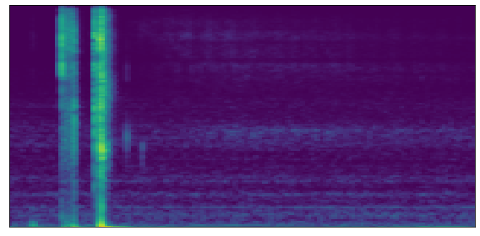



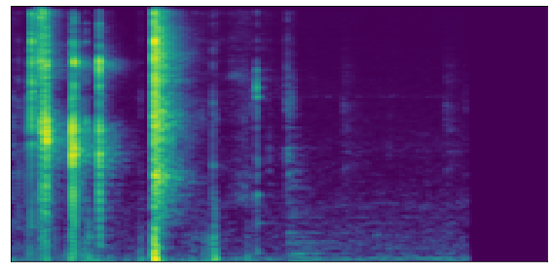



Final Model
Predicted$Spectrogram$
Server
L1 loss
Configuration
…
representation
TransformerEncoder
$$×N$$
Audio
data
…
Masked M$el Spectrogram$
(a)
(b)

Slide 2


Predicted$Spectrogram$
L1 loss
…
representation
TransformerEncoder
$$×N$$
Masked M$el Spectrogram$

Slide 3
Server
Top-k Sparsification
Ternary Quantization
Golomb encoding
Client
…

Slide 4
