Slide 1
R /python语言实践
李磊

Slide 2
语言的规范性
R：（http://r-pkgs.had.co.nz/r.html）
The formatR package, by Yihui Xie, makes it easier to clean up poorly formatted code. It can’t do everything, but it can quickly get your code from terrible to pretty good. Make sure to read the notes on the website before using it. It’s as easy as:
install.packages("formatR") formatR::tidy_dir("R")
A complementary approach is to use a code linter. Rather than automatically fixing problems, a linter just warns you about them. The lintr package by Jim Hester checks for compliance with this style guide and lets you know where you’ve missed something. Compared to formatR, it picks up more potential problems (because it doesn’t need to also fix them), but you will still see false positives.
install.packages("lintr") lintr::lint_package()
Python：（https://github.com/google/styleguide/blob/gh-pages/pyguide.md）
2.1 Lint
Run pylint over your code.
2.1.1 Definition
pylint is a tool for finding bugs and style problems in Python source code. It finds problems that are typically caught by a compiler for less dynamic languages like C and C++. Because of the dynamic nature of Python, some warnings may be incorrect; however, spurious warnings should be fairly infrequent.

Slide 3
R style Guide (https://google.github.io/styleguide/Rguide.xml) python style guide （http://pep8.org/）

Slide 4
R
File Names：File names should end in .R and, of course, be meaningful. GOOD: predict_ad_revenue.R BAD: foo.R
Identifiers：
variable.name is preferred, variableName is accepted GOOD: avg.clicks OK: avgClicks BAD: avg_Clicks
FunctionName GOOD: CalculateAvgClicks BAD: calculate_avg_clicks , calculateAvgClicks Make function names verbs. Exception: When creating a classed object, the function name (constructor) and class should match (e.g., lm).
kConstantName

Slide 5
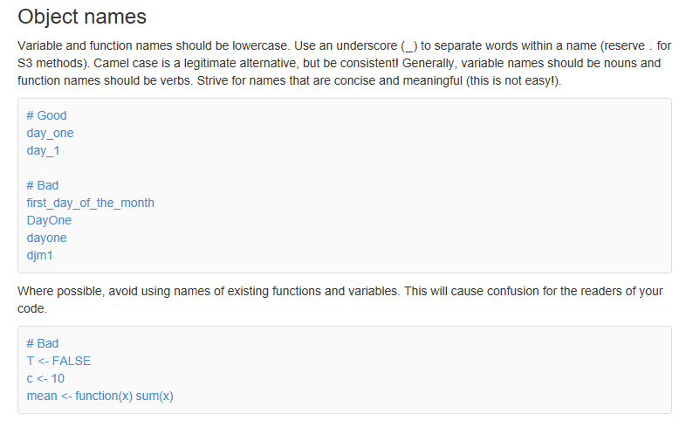
http://r-pkgs.had.co.nz/r.html

Slide 6
Python

