Slide 1


Midterm Presentation

Slide 2
Study area and midterm scope
Case study
Feltre, a medium-sized municipality with a compact urban core and dispersed peripheral settlements.
Midterm focus
demand–supply reading, zoning interpretation, major mobility generators and preliminary service logic.
Output at this stage
a first line concept connecting the main demand poles through the core network.
Next phase
cycle time, frequencies, fleet sizing and assignment-based capacity checks.

Slide 3
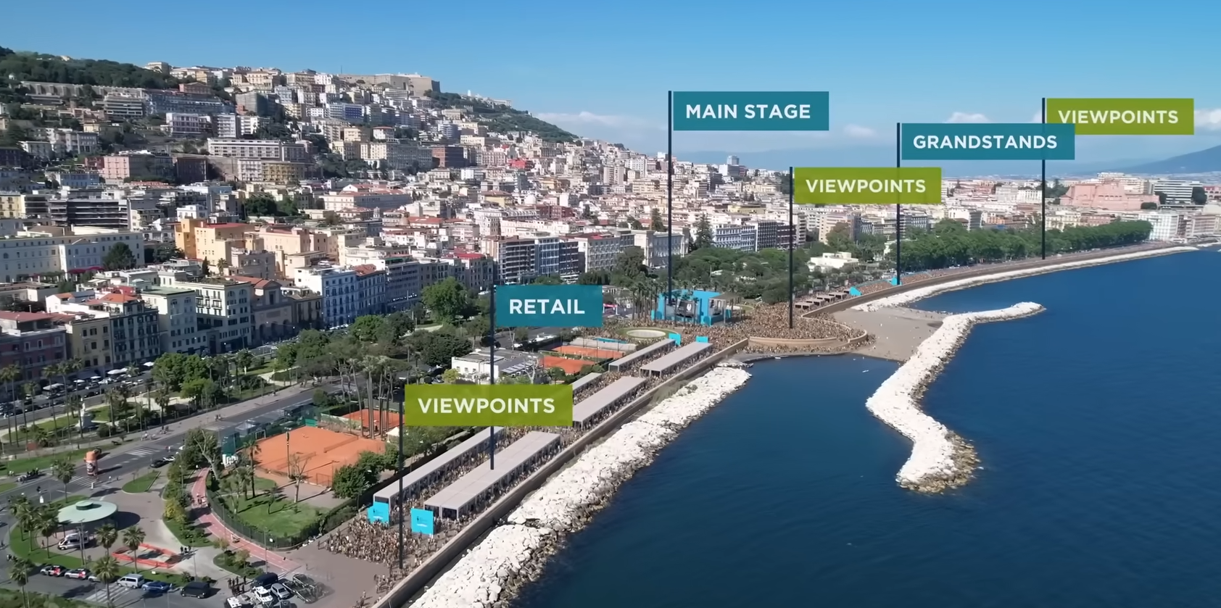
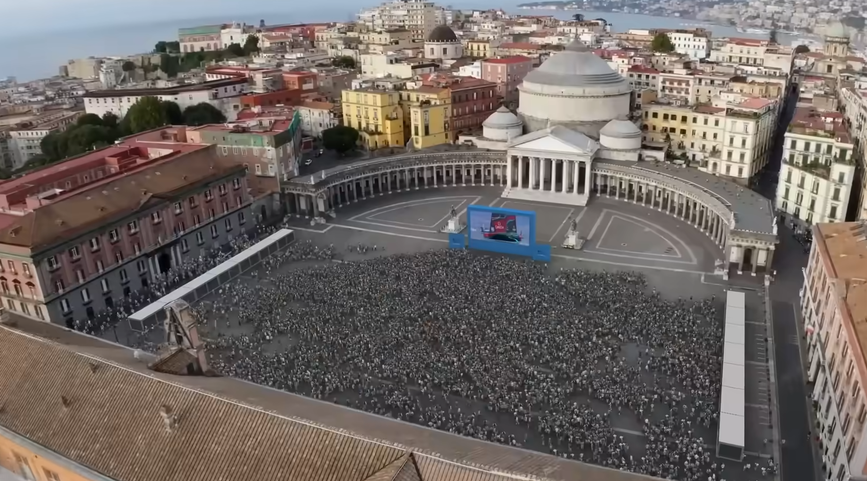
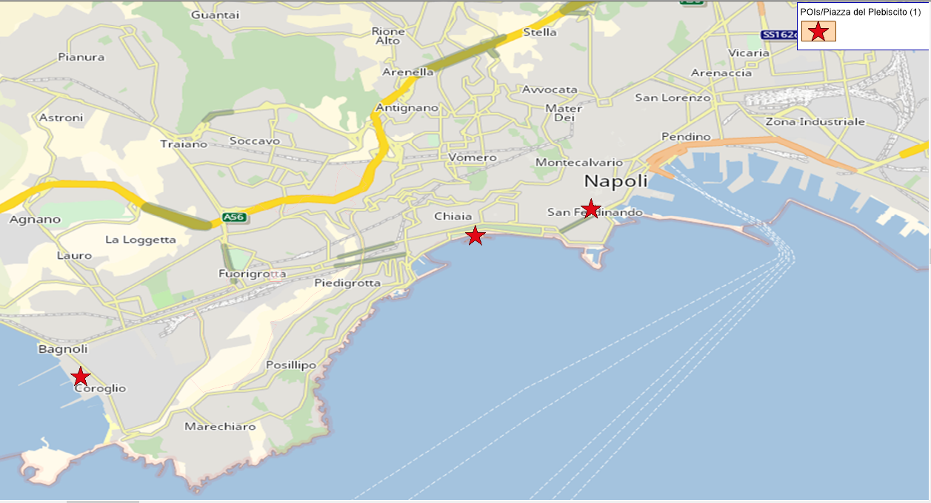
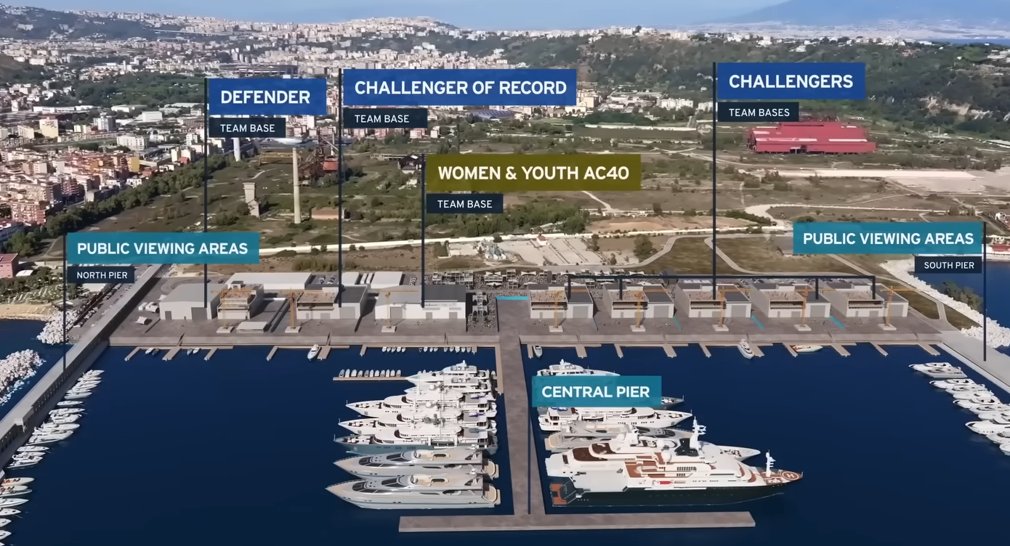
POI
Main Stage
Live Screen
Team Bases

Slide 4
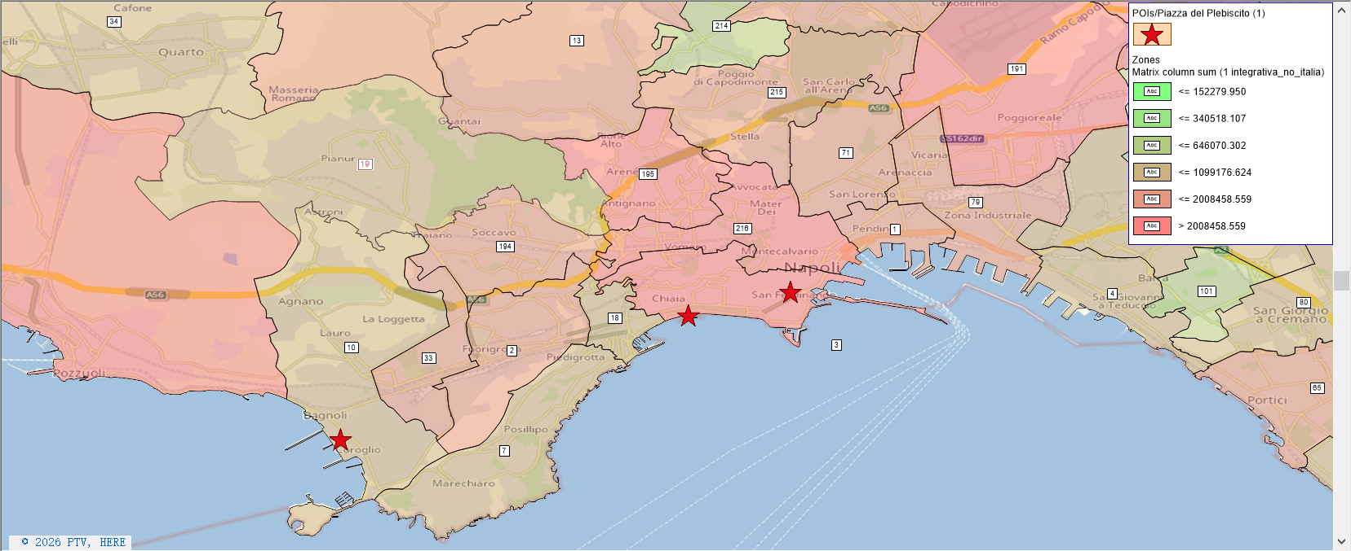
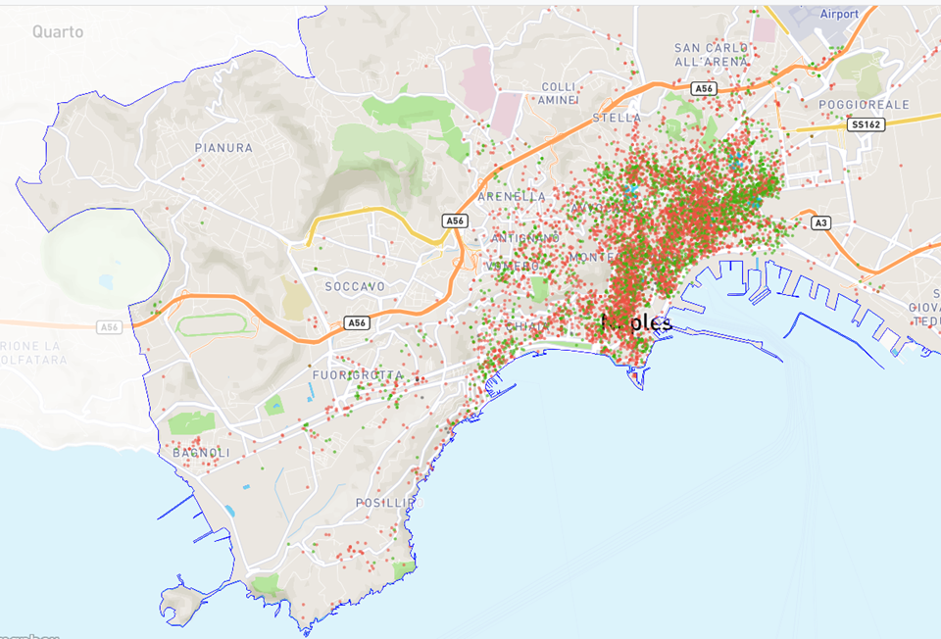
Accommodation Facilities
Airbnb mainly located in Zone 3, 216, 1, 71, 79
Data Source: Naples | Inside Airbnb

Slide 5
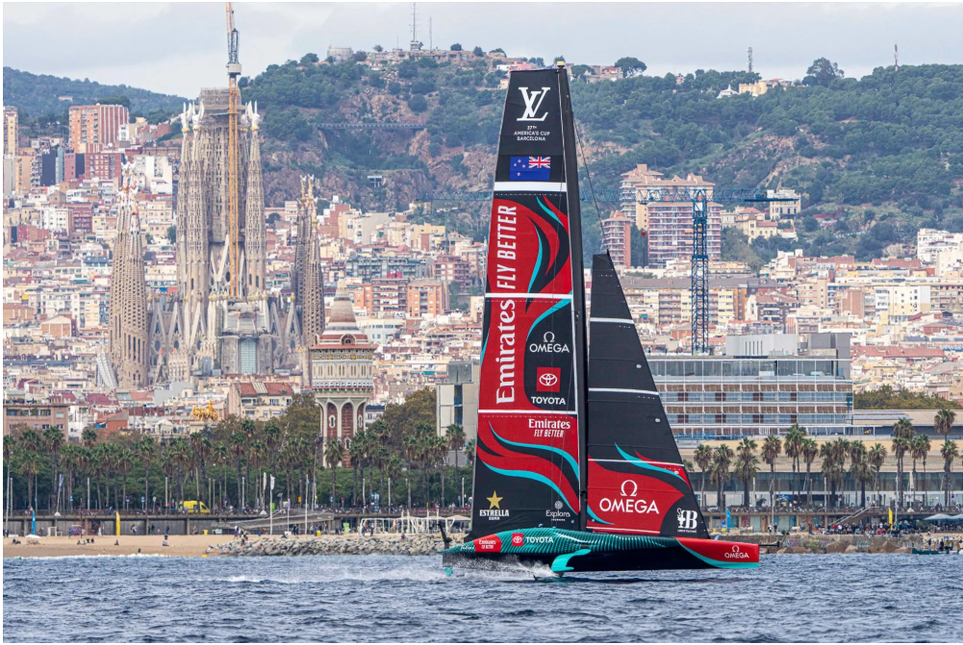

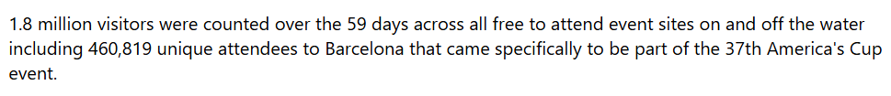
Forecasting
Barcelona Population: 1,702,547
VS.
Naples Population: 1,061,644
App. 1.1 million visitors, 300,000 Tourists not from naples

Slide 6
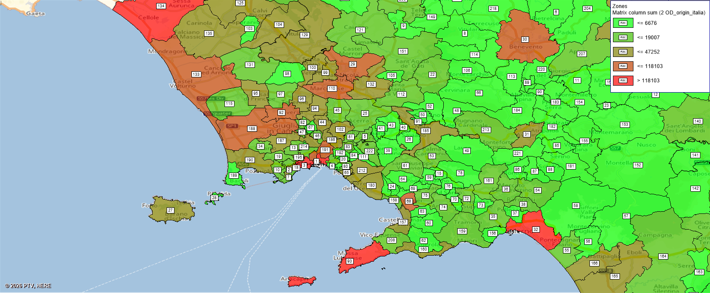
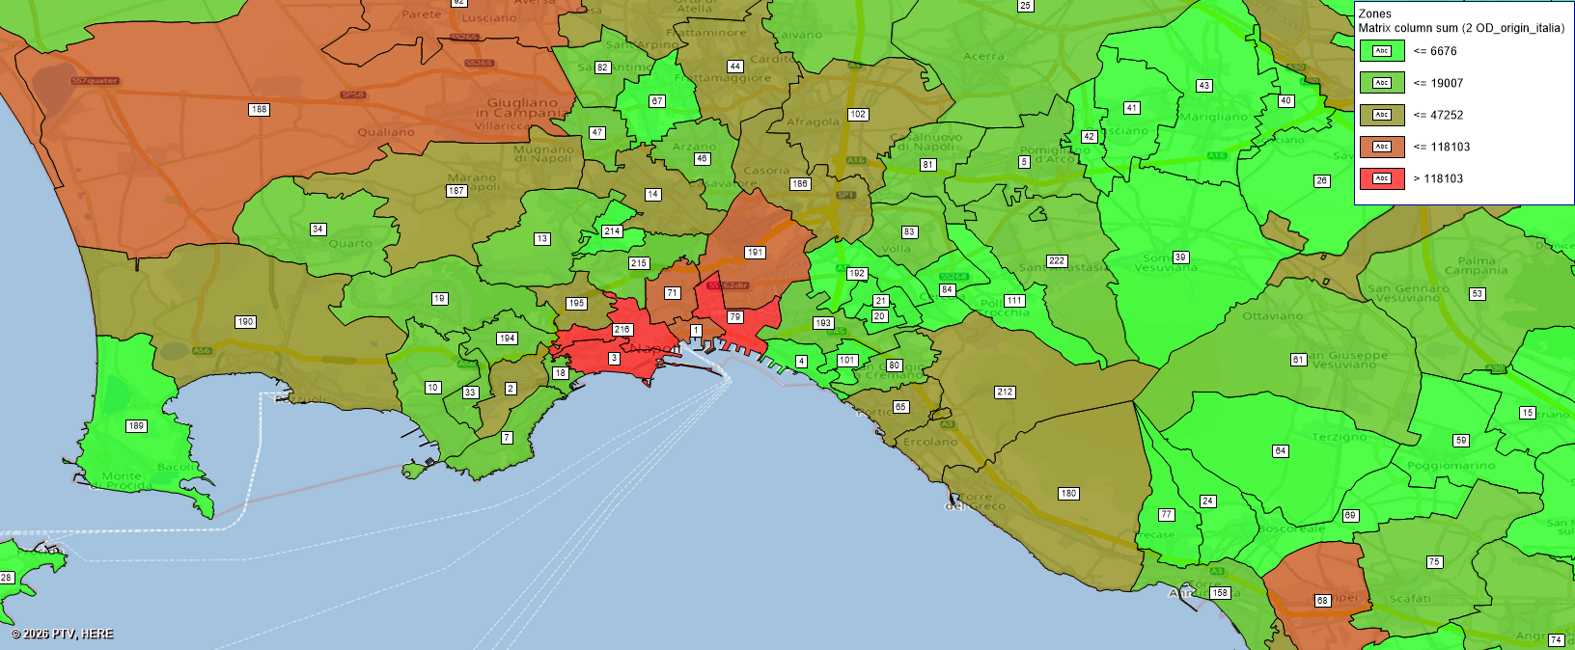
POI
From italia (non Camp) to Camp

Slide 7
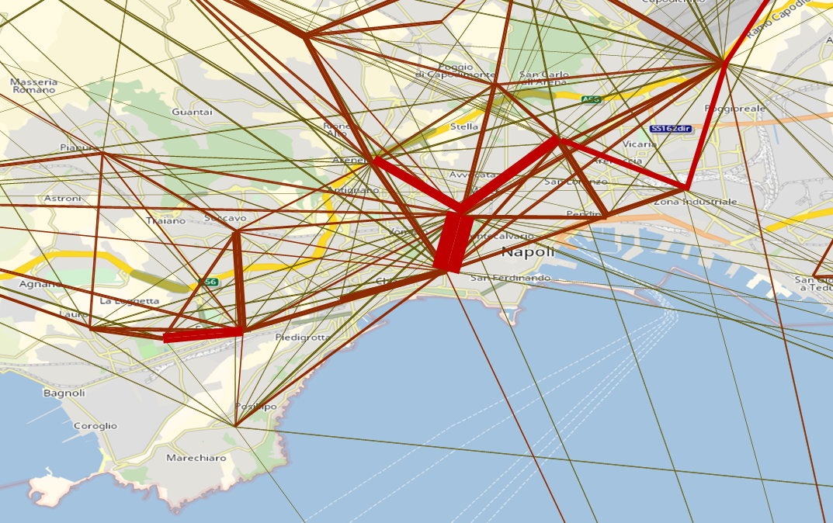
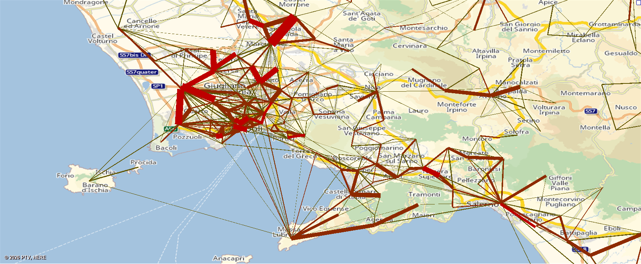
POI
Desire line

Slide 8
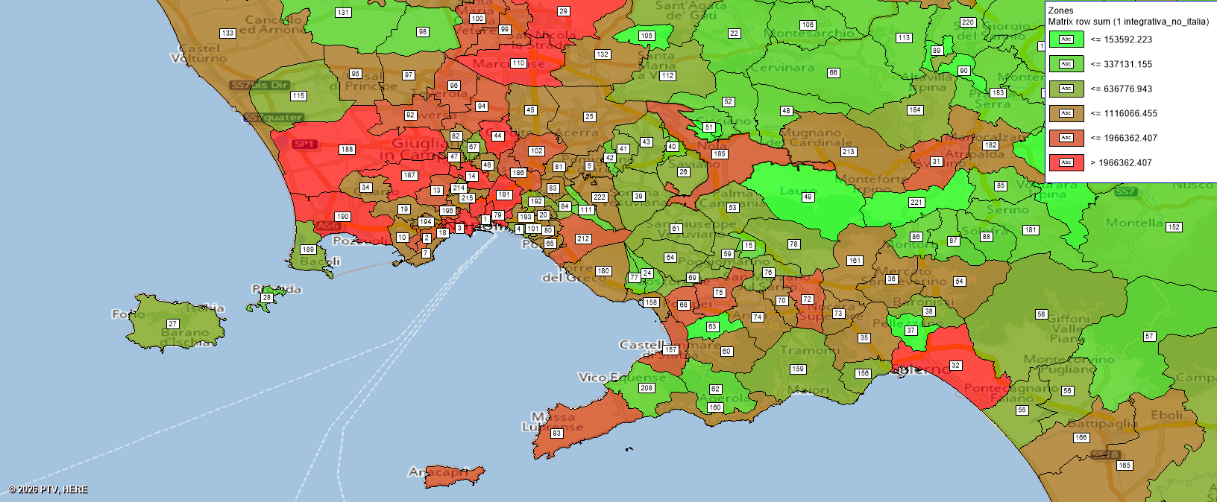
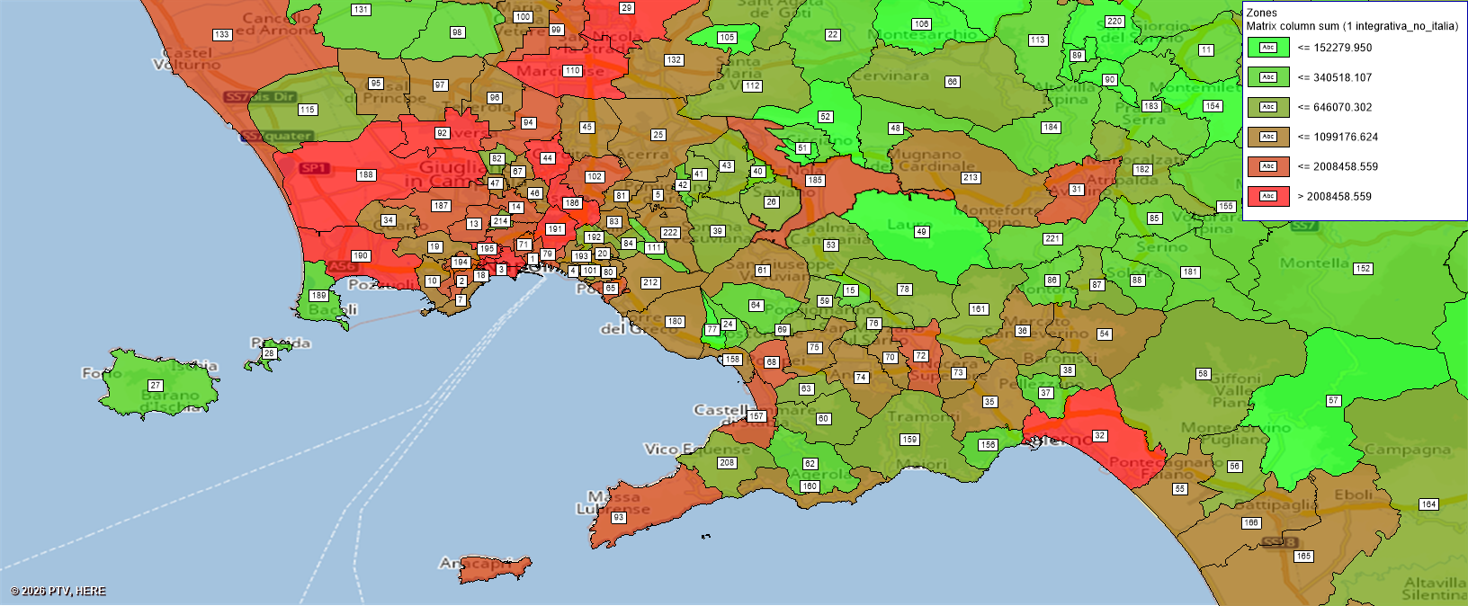
POI
Origin Zone
Destination Zone

Slide 9
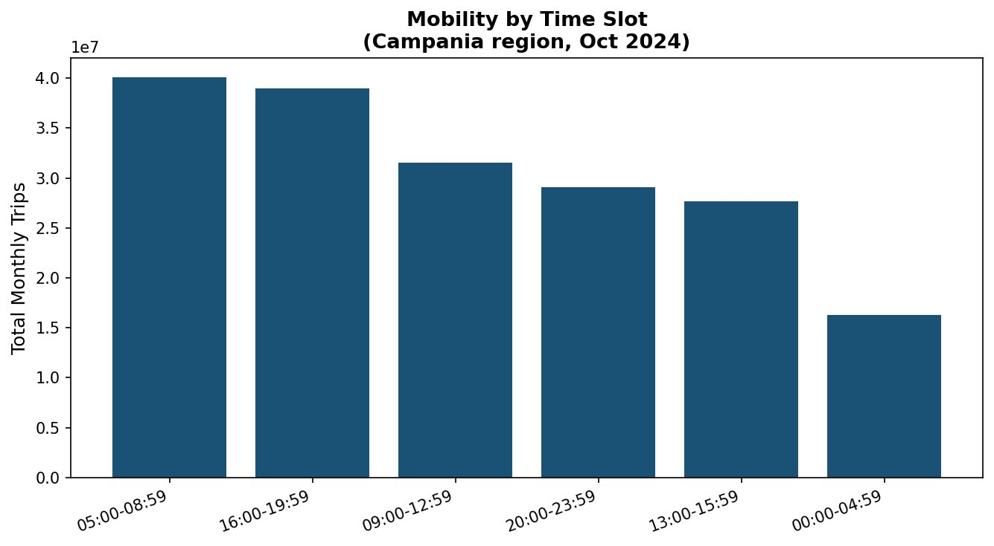
Mobility Patterns – Peak Hours Analysis
Key Findings
Morning peak (05:00-09:00): ~40M monthly trips, the busiest slot
Evening peak (16:00-20:00) equally intense strong commuter patterns
Night slot (00:00-05:00) quietest at ~16M trips
America’s Cup will add pressure in the 09:00-20:00 window

Slide 10
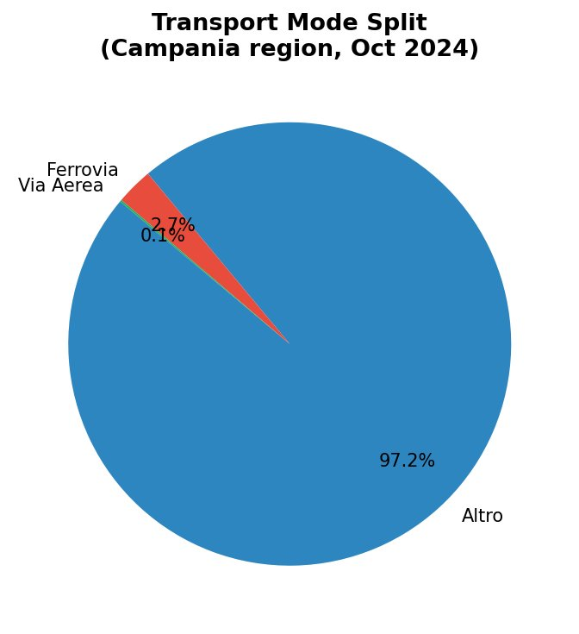
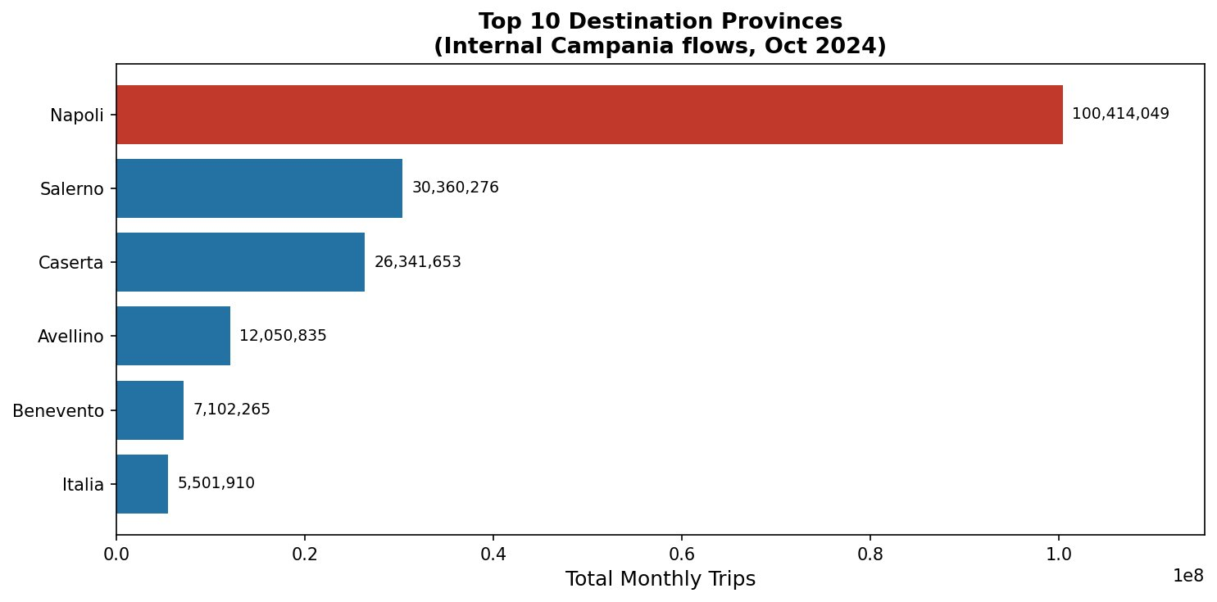
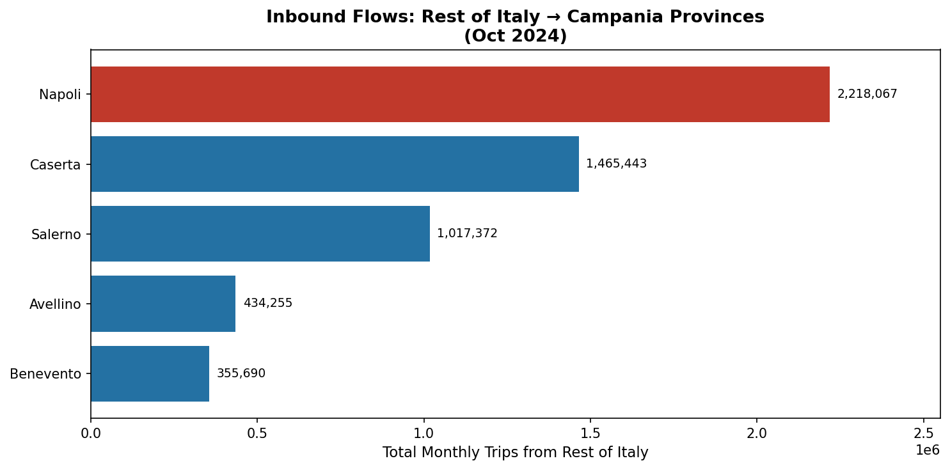
Transport Mode Split & Demand Concent ration
Implication for the America’s Cup: 97.2% of trips currently use non-rail modes. Naples absorbs 100M+ internal trips/month and 2.2M from the rest of Italy. The event will concentrate additional demand on an already-saturated network, so public transport enhancement is critical.

Slide 11
Midterm takeaways and next steps
Completed at midterm
Study area and zoning interpretation
Reading of mobility demand and activity poles
Identification of the core bus corridor
Draft line routes and preliminary service concept
To be developed for the final
Stop / terminal refinement
Cycle time and frequency calculation
Fleet sizing, technical constraints and capacity checks
Scenario comparison and economic sustainability

Slide 12
POI

Slide 13
POI

