Slide 1
[F-18] Improving Singing Aid System for Laryngectomees with Statistical Voice Conversion and VAE-SPACE
ISMIR2019@Delft, Netherlands
Nov. 7th, 2019
◎Li Li¹, Tomoki Toda² ,
Kazuho Morikawa², Kazuhiro Kobayashi², Shoji Makino¹
¹ University of Tsukuba, Japan
² Nagoya University, Japan

Slide 2
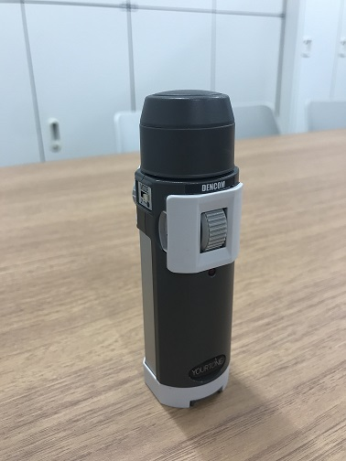
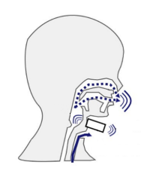
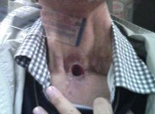

Research backgrounds
Laryngectomees using electrolarynx
Laryngectomees: people whose larynx has been removed
Electrolarynx: external medical device producing mechanical vibrations
Electrolaryngeal (EL) speech

Slide 3
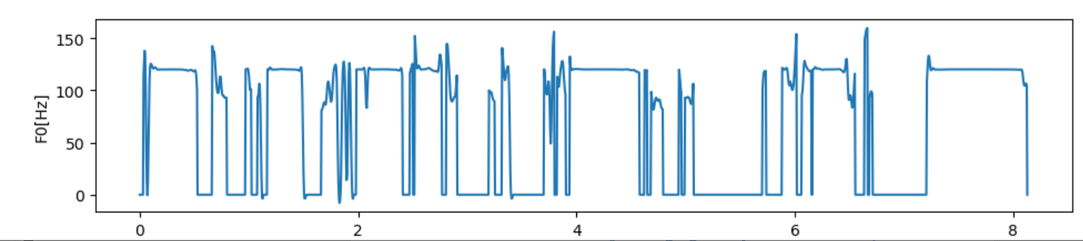

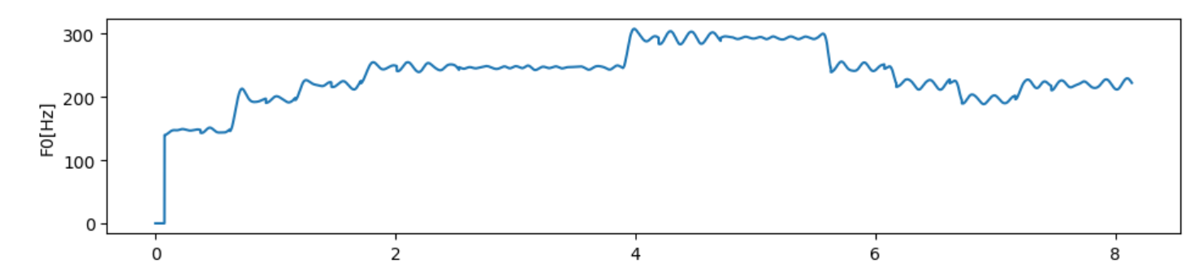
Objectives of this work
contour of EL speech
contour of singing voice
Limited capability of electrolarynx to assist laryngectomees in singing
Singing aid system based on pitch control
To improve the naturalness of the generated singing voices and extend the capability of modeling different singing styles of the conventional singing aid system

Slide 4
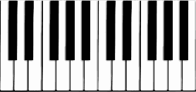
Proposed system
Overview of system
Laryngectomees with musical instruments
Statistical VC
To remove noise and eliminate the adverse impacts of spectrograms extracted from EL speech
Speaking
Playing
EL speeches
Musical scores
Voice quality enhancement
Pitch control
VAE-SPACE
Data-driven method
To improve the capability and flexibility in modeling various singing characteristics and styles
statistical VC
VAE-SPACE
Synthesis
Singing voices

Slide 5
Thank you for your attention!
More details at [F-18]

Slide 6
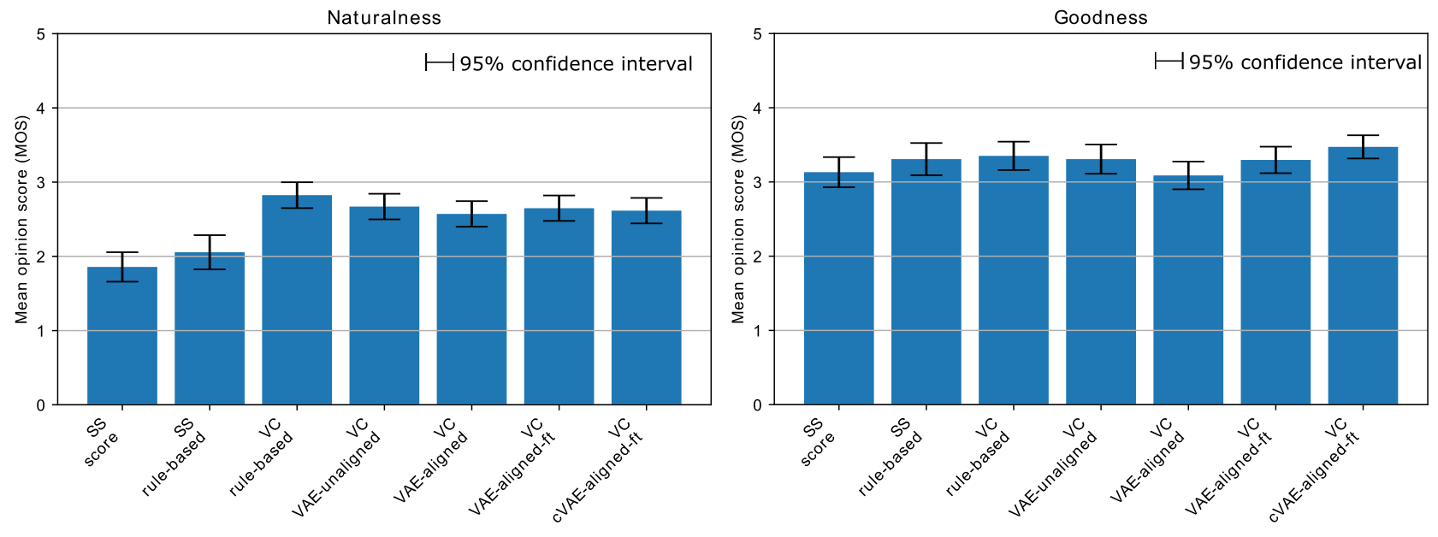
SS: spectral subtraction
VC: voice conversion
ft: fine tuning
DEMO
 | EL speech | SS score | SS rule-based | VC rule-based | VC VAE-unaligned | VC VAE-aligned | VC VAE-aligned-ft | VC CVAE- aligned-ft
Sample 1
Sample 2
Style 1 & 2

