Slide 1
Linux Network Kernel
k100/yili

Slide 2
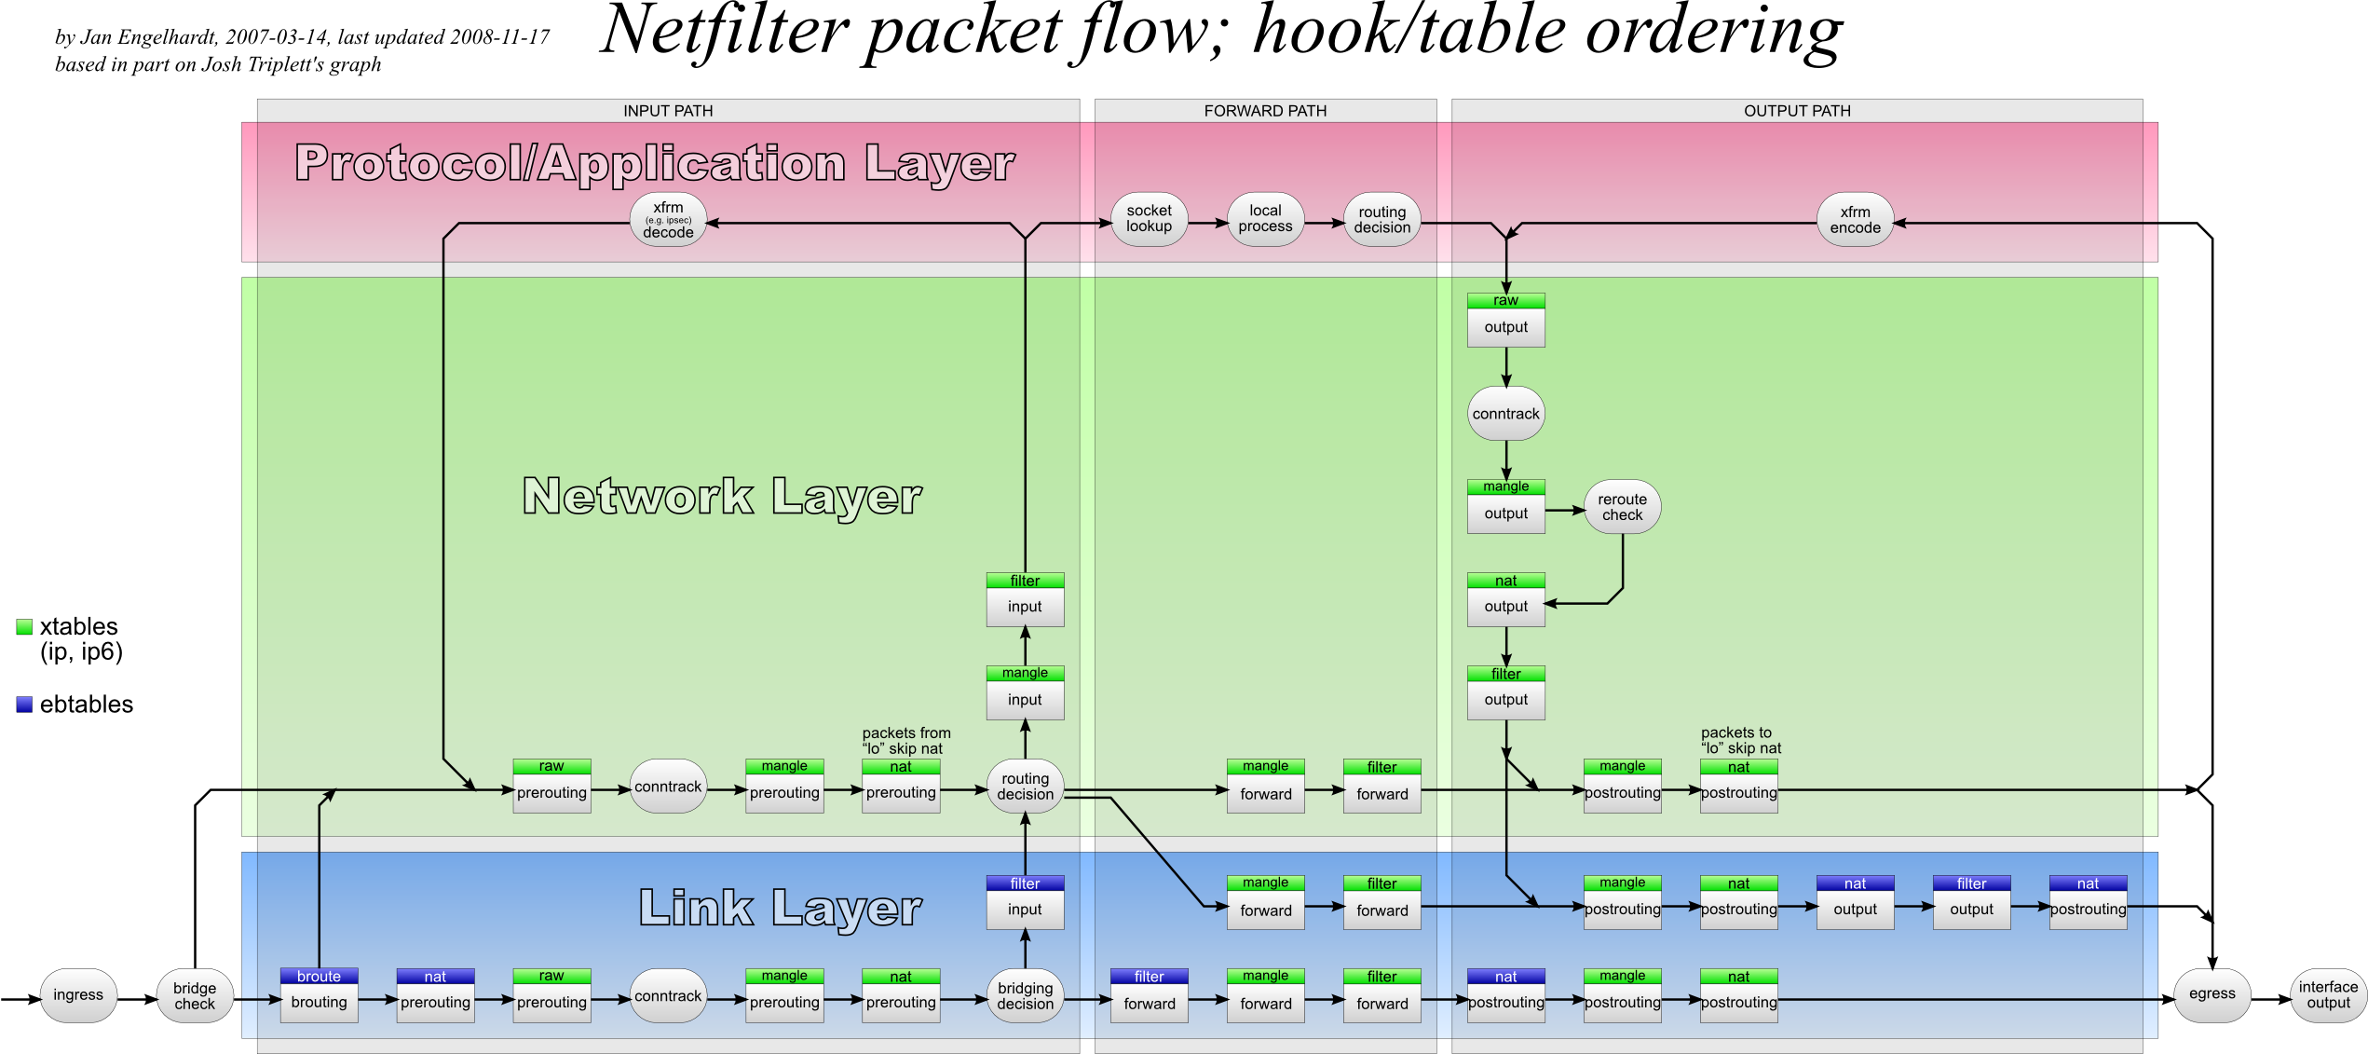
Netfilter- hook point

Slide 3
Hook Point Definition in Linux
NF_IP_PRE_ROUTING
在完整性檢驗之後 選路確定之前
NF_IP_LOCAL_IN
選路確定之後 且封包目的地是本端主機
NF_IP_FORWARD
選路確定之後 且封包目的地是其他主機
NF_IP_LOCAL_OUT
The packet is coming from local process
NF_IP_POST_ROUTING
The packet is about to hit the wire
http://lxr.free-electrons.com/source/include/uapi/linux/netfilter_ipv4.h#L45

Slide 4
Netfilter implement in Linux

Slide 5
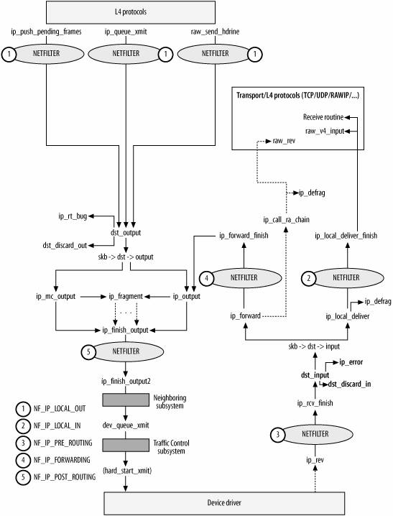

Slide 6
Netfilter- hook point
NF_IP_PRE_ROUTING

Slide 7
Before Prerouting – device driver
http://lxr.free-electrons.com/source/include/linux/netdevice.h#L3001
Netif_receive_skb -> netif_receive_skb_sk ->netif_receive_skb_internal ->__netif_receive_skb() -> __netif_receive_skb_core
list_for_each_entry_rcu(ptype, &ptype_all, list)
{if (pt_prev)
ret = deliver_skb(skb, pt_prev, orig_dev);
}
In deliver_skb
http://lxr.free-electrons.com/source/net/core/dev.c#L1788
it will call pt_pre->func
Ip_rcv()

Slide 8
From pt_pre->func to ip_rcv()
http://lxr.free-electrons.com/source/net/ipv4/af_inet.c
Declare if the packet type is ETH_P_IP, the func is ip_rcv function.

Slide 9
Ip_rcv()
http://lxr.free-electrons.com/source/net/ipv4/ip_input.c#L378
Check ip packet
Checksum
Header length
Others
Check the hook point on NF_INET_PRE_ROUTING
NF_HOOK(NFPROTO_IPV4, NF_INET_PRE_ROUTING, NULL, skb, dev, NULL, ip_rcv_finish);
這個封包有沒有特殊的pre-routing的 rule 如果沒有就會去ip_rcv_finish function
Notes:
http://blog.chinaunix.net/uid-22577711-id-3216938.html

Slide 10
Ip_rcv_finish
http://lxr.free-electrons.com/source/net/ipv4/ip_input.c#L314
Check packet route
ip_rcv_options ->ip_options_rcv_srr ->ip_route_input->ip_route_input_noref ->ip_route_input_slow()
Ip_route_input_slow
fib_lookup
http://lxr.free-electrons.com/source/net/ipv4/route.c#L1548
if (res.type == RTN_LOCAL) -> rth->dst.input= ip_local_deliver;
ip_mkroute_input() ->__mkroute_input()
rth->dst.input = ip_forward;
rth->dst.output = ip_output;
Notes:
How to call ip_ local_deliver
http://blog.sina.com.cn/s/blog_52355d840100b6rs.html
http://blog.chinaunix.net/uid-22577711-id-3216949.html

Slide 11
Cont.
In ip_rcv_finish
Return dst_input(skb);
http://lxr.free-electrons.com/source/include/net/dst.h#L467
skb_dst(skb)->input(skb);
If local -> ip_local_deliver;
If forward ->ip_forward;
Notes:
http://blog.chinaunix.net/uid-20788636-id-4398392.html

Slide 12
Netfilter- hook point
NF_IP_LOCAL_IN

Slide 13
Ip_local_deliver
http://lxr.free-electrons.com/source/net/ipv4/ip_input.c#L246
Reassemble fragment packet
If packet is not fragment or complete
NF_HOOK(NFPROTO_IPV4, NF_INET_LOCAL_IN, NULL, skb, skb->dev, NULL, ip_local_deliver_finish);
Notes:
http://blog.chinaunix.net/uid-22577711-id-3218535.html

Slide 14
Ip_local_deliver_finish
http://lxr.free-electrons.com/source/net/ipv4/ip_input.c#L191
找到對應的protocl 並且把strucuture 傳回
const struct net_protocol * ipprot = rcu_dereference(inet_protos[protocol]);
使用此protocol的handler
ret = ipprot->handler(skb);
If it is udp packet, will lead to udp_rcv()
Notes:
http://blog.sina.com.cn/s/blog_52355d840100b6rs.html

Slide 15
How to direct to udp_rcv
在初始化的時候af_inet.c在inet_init()透過inet_add_protocol會把對應的protocol struct (包含要怎麼處理等等）加入inet_proto[]中 在af_inet.c中定義了每一種不同種類的封包的handler
Inet_init()
http://lxr.free-electrons.com/source/net/ipv4/af_inet.c#L1691
if (inet_add_protocol(&icmp_protocol, IPPROTO_ICMP) < 0)
pr_crit("%s: Cannot add ICMP protocol\n", __func__);
if (inet_add_protocol(&udp_protocol, IPPROTO_UDP) < 0)
pr_crit("%s: Cannot add UDP protocol\n", __func__);
if (inet_add_protocol(&tcp_protocol, IPPROTO_TCP) < 0)
pr_crit("%s: Cannot add TCP protocol\n", __func__);
Inet_add_protocol()
http://lxr.free-electrons.com/source/net/ipv4/protocol.c#L35
cmpxchg((const struct net_protocol **)&inet_protos[protocol], 44 NULL, prot);
Tcp, udp, icmp handler define
http://lxr.free-electrons.com/source/net/ipv4/af_inet.c#L1513
static const struct net_protocol udp_protocol = {
.early_demux = udp_v4_early_demux,
.handler = udp_rcv,
.err_handler = udp_err,
.no_policy = 1, 1527 .netns_ok = 1,
};
Notes:
/* socket level */
http://lxr.free-electrons.com/source/net/ipv4/tcp_ipv4.c#L2335
Struct proto tcp_prot /udp_prot 是上次 socket對應到kernel 的 行為 和這裡沒關西

Slide 16
Udp _rcv
http://lxr.free-electrons.com/source/net/ipv4/udp.c#L1763
If it is the udp packet, it will point to udp_rcv function
Check是否有socket要收這個封包
__udp4_lib_lookup_skb(skb, uh->source, uh->dest, udptable);
將此封包放入對應socket的recv queue
udp_queue_rcv_skb(sk, skb); ->__udp_queue_rcv_skb(sk, skb);
->sock_queue_rcv_skb(sk, skb);
Notes:
http://blog.chinaunix.net/uid-22577711-id-3220834.html
/* socket level */
http://lxr.free-electrons.com/source/net/ipv4/tcp_ipv4.c#L2335
Struct proto tcp_prot /udp_prot 是上次 socket對應到kernel 的 行為 和這裡沒關西

Slide 17
sock_queue_rcv_skb(sk, skb)
取得此socket的 receive queue
struct sk_buff_head *list = &sk->sk_receive_queue;
如果queue沒有滿的話，就放到queue tail
__skb_queue_tail(list, skb);

Slide 18
How to replace the udp_rcv by myudp_rcv ?

Slide 19
How to Add Own udp_handler
Delete the original udp_rcv
http://lxr.free-electrons.com/source/net/ipv4/protocol.c#L55
Inet_del_protocol
remove struct net_protocol udp_protocol on inet_protos[]
Declaire your own net_protocol and its handler
http://lxr.free-electrons.com/source/net/ipv4/af_inet.c#L1522
static const struct net_protocol myudp_protocol = {
.early_demux = udp_v4_early_demux,
.handler = myudp_rcv,
.err_handler = udp_err,
.no_policy = 1,
.netns_ok = 1};
Add our own net_protocol
inet_add_protocol(&myudp_protocol, IPPROTO_UDP) < 0)
pr_crit("%s: Cannot add UDP protocol\n", __func__);

Slide 20
Netfilter- hook point
NF_IP_FORWARD

Slide 21
Forward
ip_forward()
http://lxr.free-electrons.com/source/net/ipv4/ip_forward.c#L78
TTL check, route check
Check hook point on NF_INET_FORWARD, if nothing, go to ip_forward_finish
NF_HOOK(NFPROTO_IPV4, NF_INET_FORWARD, NULL, skb, 147 skb->dev, rt->dst.dev, ip_forward_finish);
ip_forward_finish()
http://lxr.free-electrons.com/source/net/ipv4/ip_forward.c#L64
update header
dst_output_sk(sk, skb);
skb_dst(skb)->output(sk, skb);
Skb_dst(skb) return type is struct dst_entry *
Unicast 则是 ip_output()
Notes:
http://simohayha.iteye.com/blog/420370

Slide 22
How to link to ip_output()
In Ip_route_input_slow
http://lxr.free-electrons.com/source/net/ipv4/route.c#L1548
fib_lookup
if (res.type == RTN_LOCAL) -> rth->dst.input= ip_local_deliver;
ip_mkroute_input() ->__mkroute_input()
rth->dst.input = ip_forward;
rth->dst.output = ip_output;

Slide 23
Netfilter- hook point
NF_IP_POST_ROUTING

Slide 24
Post Routing
In ip_ouput function it will checkout last hook point NF_IP_POST_ROUTING, then called ip_finish_output
http://lxr.free-electrons.com/source/net/ipv4/ip_output.c#L347
NF_HOOK_COND(NFPROTO_IPV4, NF_INET_POST_ROUTING, sk, skb, NULL, dev, ip_finish_output,!(IPCB(skb)->flags & IPSKB_REROUTED));
Ip_finish_output
http://lxr.free-electrons.com/source/net/ipv4/ip_output.c#L266
Ip_finish_output-> ip_fisnish_output2
find neighbor: neigh = __ipv4_neigh_lookup_noref(dev, nexthop);
If find the neighbor will call this function : dst_neigh_output(dst, neigh, skb);
Notes:
http://blog.csdn.net/minghe_uestc/article/details/7819925

Slide 25
Cont.
In dst_neigh_output
http://lxr.free-electrons.com/source/include/net/dst.h#L404
Call neigh_hh_output
http://lxr.free-electrons.com/source/include/net/neighbour.h#L449
dev_queue_xmit(skb);

Slide 26
dev_queue_xmit
devices layer
dev_queue_xmit_sk(skb->sk, skb)-> __dev_queue_xmit -> dev_hard_start_xmit()
In dev_hard_start_xmit
xmit_one -> netdev_start_xmit-> __netdev_start_xmit
In ops->ndo_start_xmit(skb, dev) call ops->ndo_start_xmit(skb, dev);
需要去找NIC的驅動程式 當在init NIC的時候 會有function pointer 去做設定 different from each NIC

Slide 27
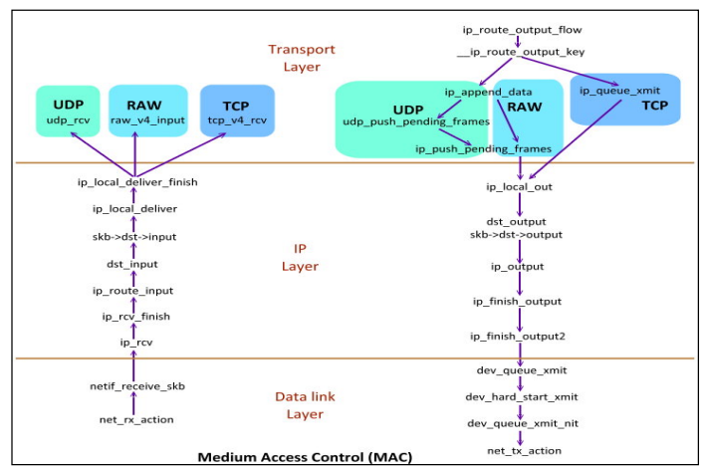

Slide 28
How to add the hook function

Slide 29
Netfilter - add hook function
hook structure definition
http://lxr.free-electrons.com/source/include/linux/netfilter.h#L84
.hooknum
Hook point ( local_in …etc)
.hook
Hook function ( self define function)
.pf
Protocol family such as PF_INET
Notes:
http://neokentblog.blogspot.tw/2009/09/howto-linux-netfilter-module.html

Slide 30
Cont.
Step1
declare hook structure definition
Step2
nf_register_hook(&hook structure);
Step3
implement your own hook function

Slide 31
Example Code
static unsigned int hook_func(unsigned int hooknum, struct sk_buff *skb,
const struct net_device *in, const struct net_device *out,
int (*okfn) (struct sk_buff *)){
printk(" hook in pre-route");
return NF_ACCEPT;
}
static struct nf_hook_ops test_hook = {
.owner = THIS_MODULE,
.hook = hook_func,
.hooknum = NF_INET_PRE_ROUTING,
.pf = PF_INET,
.priority = NF_IP_PRI_RAW,
};
int init_test(void){
printk("=====start test====");
nf_register_hook(&test_hook);
return 0;
}
module_init(init_test);
module_exit(exit_test);
MODULE_LICENSE("GPL");
Step3 : implement hook function
Step1 : declare struct nf_hook
Step2: register hook struct

Slide 32
Makefile
TARGET = add_hook ( name of your .c)
KDIR := /lib/modules/$(shell uname -r)/build
PWD := $(shell pwd)
obj-m := $(TARGET).o
default:
make -C $(KDIR) M=$(PWD) modules
clean:
rm -rf *.o *.ko

Slide 33
Show Kernel Message
insmod ./test.ko
Use lsmod to check whether the module add to kernel
Once insert module success, can use command “dmesg” to show the message
Note:
In kernel program use printk instead of printf

Slide 34
Reference
中文詳解每一個函數which mentioned above
http://blog.chinaunix.net/uid-22577711-id-3216949.html
Netfilter packet flow
http://darkk.net.ru/redsocks/doc/iptables-packet-flow-ng.png
Kernel code online tracking
http://lxr.free-electrons.com/
Network data flow through kernel
http://www.linuxfoundation.org/images/1/1c/Network_data_flow_through_kernel.png
Example code
https://github.com/erinus/NetworkDeviceDevelopment/blob/master/02.%20First%20Netfilter%20Kernel%20Module/main.c

Slide 35
Q & A

