Slide 1


Slide 2


Slide 3




Slide 4


Slide 5
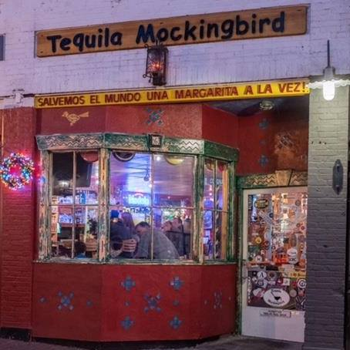
Address: 6 Forest St, New Canaan, CT 06840

Slide 6


