Slide 1

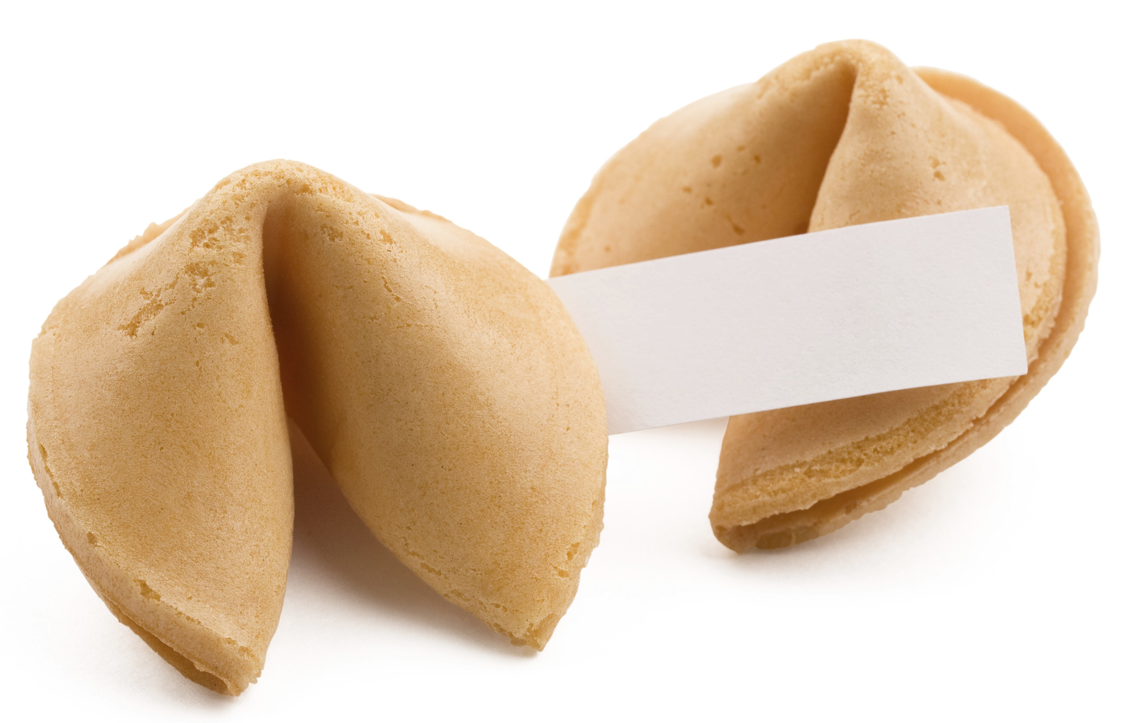
FORTUNATOR 3000
LILI MOLLOY
FIONA TOLLIDAY

Slide 2

Project Purpose
FORTUNATOR
3000
To display expertise within the terminal (CLI) by writing a compelling and entertaining application.

Slide 3
Brainstorming ideas
FORTUNATOR
3000
Calorie counter
=> Predict in a week, a month or a year how many kg’s you will gain by eating that chocolate bar each day
=> Suggested exercises to burn those calories
Fortune cookie
=> Based on consumer mood, computer generates fortunes.
=> Consumers can create an account to save their fortune.
=> Consume can also select to email a fortune to a loved one
Alarm
clock
Fortune
cookie
Calorie
counter
OUR AMAZING APP IDEAS
TOP
4
IDEAS
Travel
app
Black
Jack
Higher or
lower game
=> Computer generates a random number.
=> Consumer guesses number and computer says higher or lower until they hit the bullseye
Rate
my pet
Travel app
=> Notepad for travel plans. Space allows for costs, activities and shortlists of your hotels/flights
Higher or lower game

Slide 4
Million $$ idea
FORTUNATOR
3000
All our lives we have searched for wisdom and meaning!
Introducing “The Fortunator 3000” where we enlighten and bring joy and wisdom to your day.
=> Just select your mood and The Fortunator 3000 will give your fortune for the day.
=>Feel like a loved one needs some wisdom?
=> Send them a cookie today.

Slide 5
Challenges
FORTUNATOR
3000
=> Not being able to set up arrays in a new Ruby file before linking them to a method in another Ruby file. Solution was to create a CSV that we require on the page.
=> In testing, we found that sending emails via the pony gem Hotmail was blocking the fortune from coming to the inbox. Fortunes arrived at the Gmail inbox, but with a malware warning.
=> Figuring out how to use CSV as a mini database that can be created and updated.
=> We had difficulty verifying password with username using &&. Our work around was to compare indexes.

Slide 6
Instructions for use
FORTUNATOR
3000
=> Select who the fortune cookie is for
=> Select the mood
=> Get your fortune
=> Share the love by tweeting your fortune
=> Email your fortune to a friend
=> Save the wisdom in your account for another day

