Slide 1
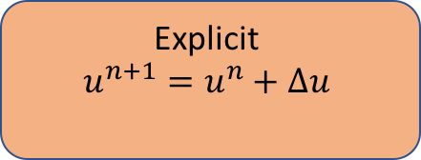
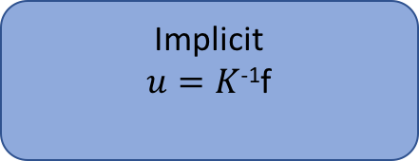
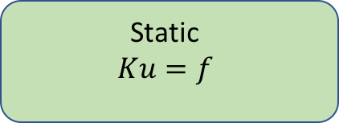
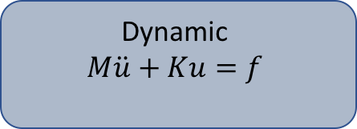
Dynamic
$$M\ddot{u}+Ku=f$$
Explicit
$$u^{n+1}=u^{n}+∆u$$
Finite Element Method
Implicit
$u=K$⁻¹f
Static
$$Ku=f$$

