Slide 1
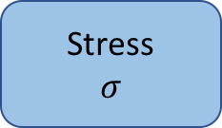
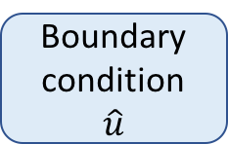
Strain-displacement
relation
Stress-strain
relation
Displacement
u
Strain
E
Stress
$$σ$$
Discretization
Stiffness Matrix
K
Loading force
f
Boundary condition
$$\hat{u}$$
Solution

