Slide 1
+
AI-POWERED STARTUP INTELLIGENCE
Opportunity Scout AI
Turning Business Ideas Into Data-Driven Decisions
LightGBM + SHAP · 4 Live APIs · 86 Engineered Features · Entrepreneur & Investor Modes
70+
0–100
SHAP
<200ms
Data Signals
Viability Score
Explained AI
Response Time
Capstone Group Project · 2025

Slide 2
The Problem
Why evaluating startup ideas is broken today
Gut Feeling Rules
Fragmented Data
No Standard Score
Most startup evaluation relies on subjective intuition and personal networks rather than objective data leading to missed opportunities and wasted resources.
Market trends, economic health, social signals, and funding data exist in separate silos. Nobody combines them into a single score.
There is no universally accepted system to compare opportunities across industries, regions, or time periods.
The Result:
Entrepreneurs waste months on non-viable ideas. Investors miss great deals buried in noise. Innovation teams can't systematically compare projects.
90%
of startups fail partly from poor market validation
$2.5T
invested annually with limited objective tools
75%
of founders say market assessment is their #1 challenge

Slide 3
Our Solution
Opportunity Scout AI — two engines, one complete answer
⚙️ Engine 1: Scoring Engine
💡 Engine 2: Explanation Engine
Input: Industry, country, founding year, funding rounds
Input: The prediction + the data that produced it
Process: Gathers 70+ live signals from Google Trends, World Bank, Reddit & GDELT
Process: SHAP (SHapley Additive exPlanations) breaks the score into per-feature contributions
Output: A 0–100 viability score with confidence level and percentile ranking
Output: Plain-English reasons and specific improvement recommendations with estimated gains
📊
🔍
🧪
⚖️
Score Your Idea
Understand Why
What-If Simulator
Compare Ideas
0–100 viability score in under 200ms
SHAP attribution for every prediction
'What if I raised $500K?’ - instant answer
Side-by-side ranking of multiple opportunities
Two modes: Entrepreneur mode focuses on market fit & growth path · Investor mode emphasises returns, ecosystem, and portfolio fit

Slide 4
Entrepreneur vs Investor Mode
The same data — tailored insights depending on who's asking
Entrepreneur Mode
Investor Mode
user_type: "entrepreneur"
user_type: "investor"
Growth path focus
Ecosystem & macro lens
Score weighted toward trend slope, market momentum, and social engagement signals
Score emphasises economic health (GDP/inflation), startup density, and country ecosystem strength
How to improve
Funding tier signals
Recommendations framed as: 'What can I change right now to get a higher score?'
Tier classification (unfunded → seed → Series A → B+) with investment conviction signals
What-If simulator
Portfolio comparison
Test funding scenarios, market pivots, and geographic expansion for instant score previews
Compare up to 10 opportunities simultaneously — winner automatically highlighted
Percentile benchmarking
GDP context overlay
See how your idea ranks vs other ventures in the same sector
Every result includes a gdp_context field explaining macro conditions for that country/year
Same underlying model — different narrative framing and recommendation priorities per user type

Slide 5
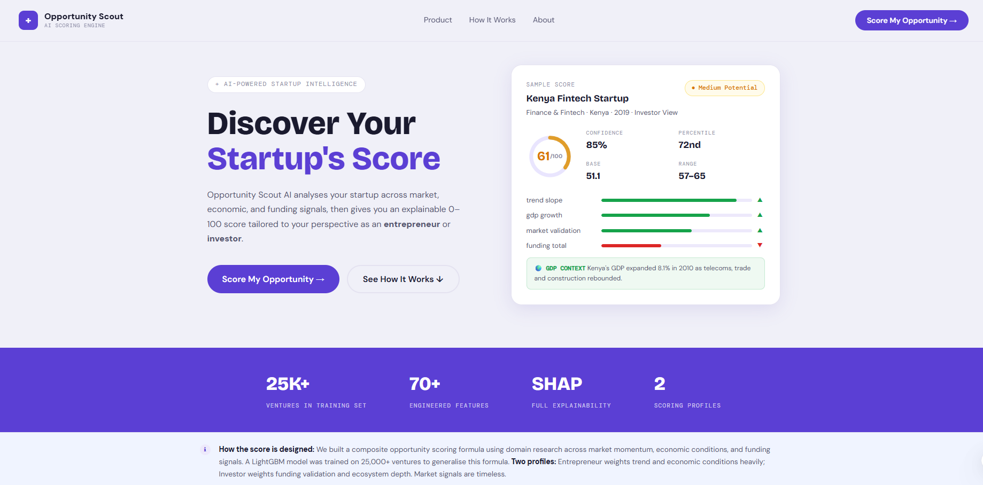
The Application
Landing page — first impression + user type selection
Entrepreneur /
Investor mode toggle
Live sample score
with SHAP bars
The landing page shows a live sample score so users know immediately what they'll receive — no sign-up required to explore.

Slide 6
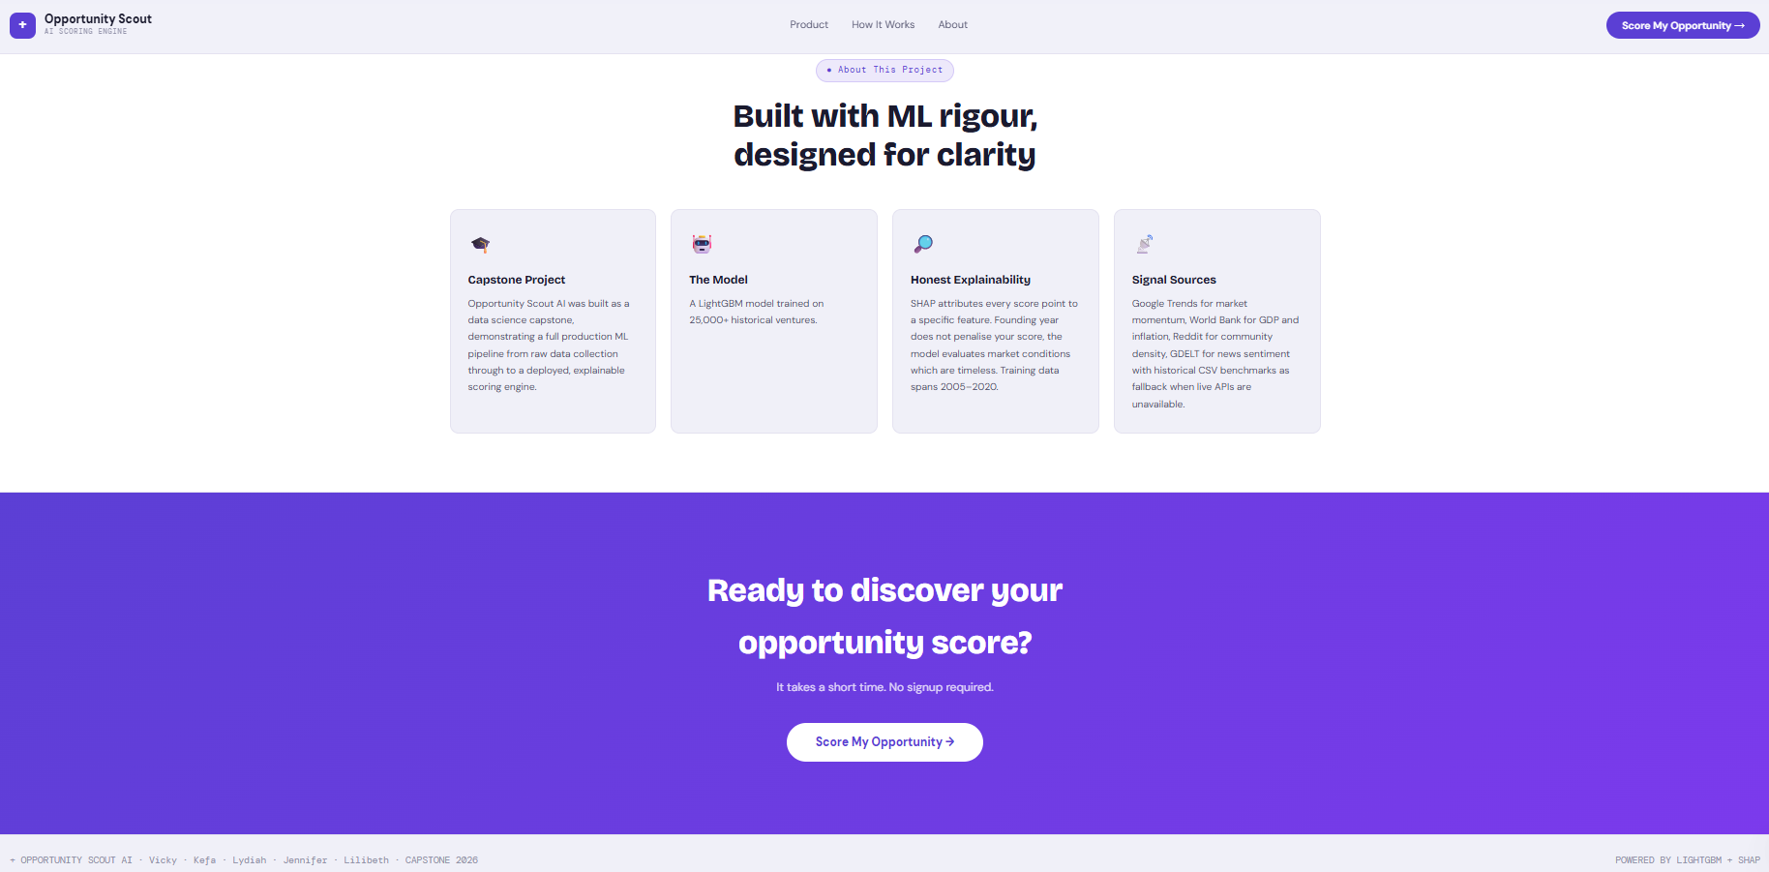

Slide 7
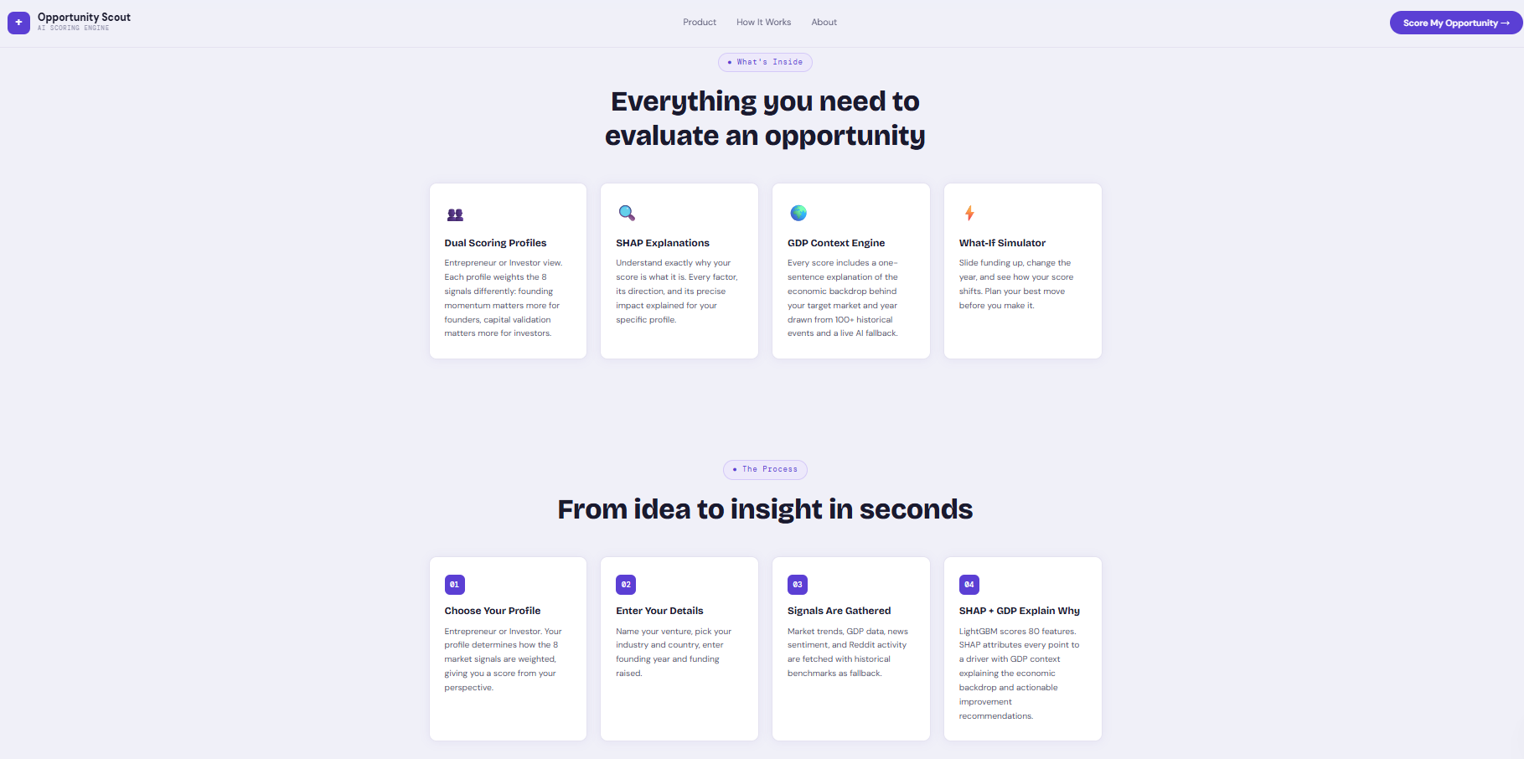

Slide 8
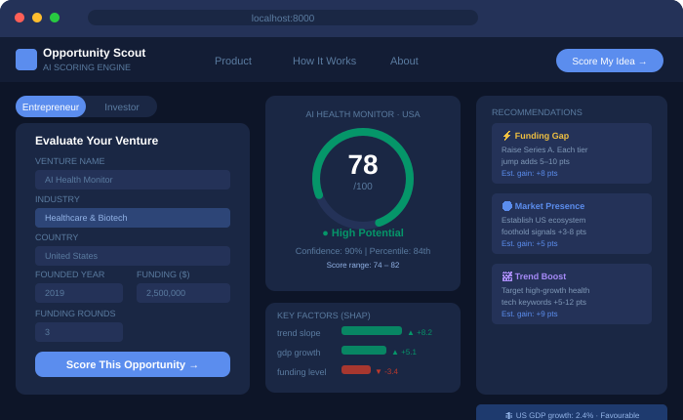
Scoring Dashboard
Input idea → Instant explainable score with tailored recommendations
① Input Form
Industry, country, year,
funding & rounds + user type
② Score Ring
0–100 score, tier badge,
confidence & range
③ SHAP Bars
Visual attributions —
what helped vs. hurt
④ Action Cards
Recommendations with
estimated point gain

Slide 9
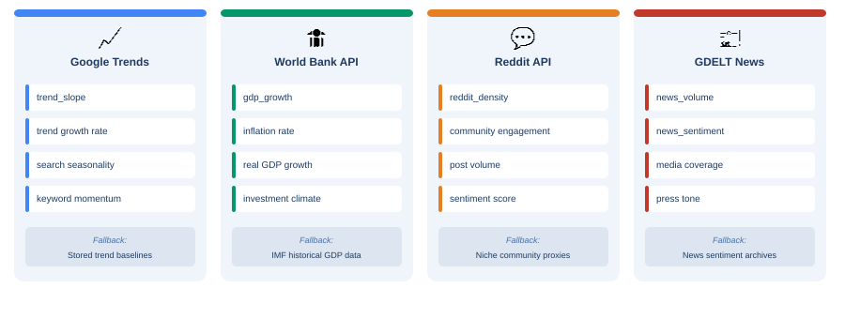
Live Data Signals
4 real-time APIs feed the model — with automatic fallback to historical CSV data
Data Quality Scoring:
100% — All 4 APIs live
75% — 3 APIs live
50% — 2 APIs live
25% — CSV fallback only
The frontend shows a quality_label badge (High / Medium / Low) on every result so users know how fresh the data is.

Slide 10
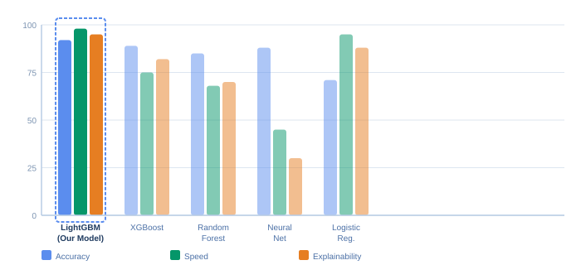
The LightGBM Model
Why LightGBM — and how it compares to alternatives
Why LightGBM Won
Speed
Gradient boosting on leaves (not depth-first) → sub-200ms even on 86 features
Accuracy
MAE < 10 pts on held-out ventures best of all models tested
SHAP Native
Tree-based SHAP is exact (not approximate) every explanation is mathematically correct
Handles Sparse Data
Many features are zero when APIs fail — LightGBM handles sparse input natively
Training Details:
Dataset
Split
Backup model
Calibration
10000+ historical ventures
Time-based (older trains, newer tests)
XGBoost (auto-failover)
Platt scaling → 0–100 range

Slide 11
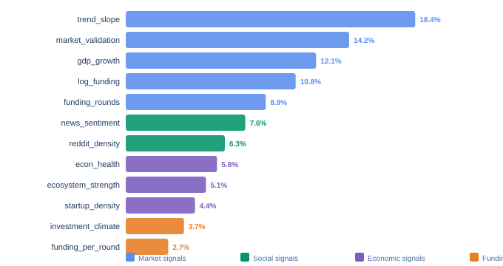
Feature Importance
Which of the 86 features matter most — and why
Category Breakdown
Market Signals ~51%
trend_slope · market_validation
gdp_growth · news_volume
Social Signals ~14%
news_sentiment · reddit_density
reddit_density_log
Economic ~15%
econ_health · ecosystem_strength
investment_climate
Funding ~20%
log_funding · funding_rounds
funding_per_round · funding_tier
Feature importance from trained LightGBM model (% of total gain)
Key insight:
Market momentum (trend_slope + market_validation) drives ~30% of the score — meaning a hot market can overcome weak funding, but no market can overcome a dead trend.

Slide 12
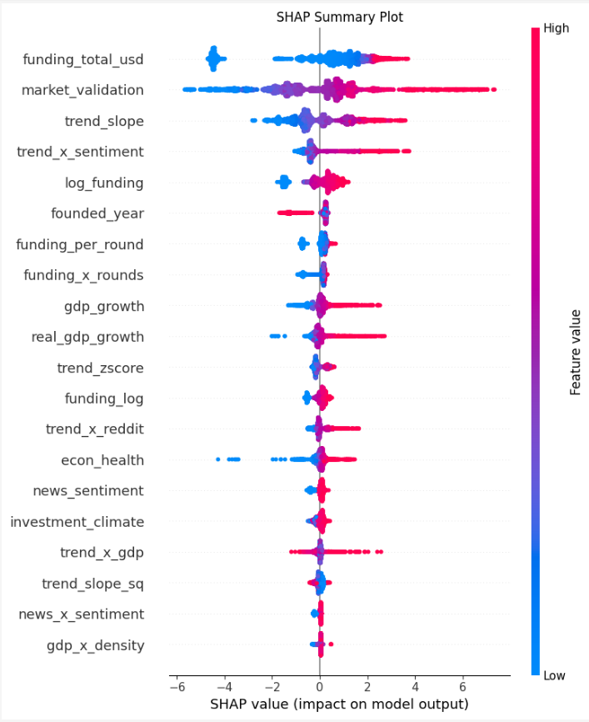
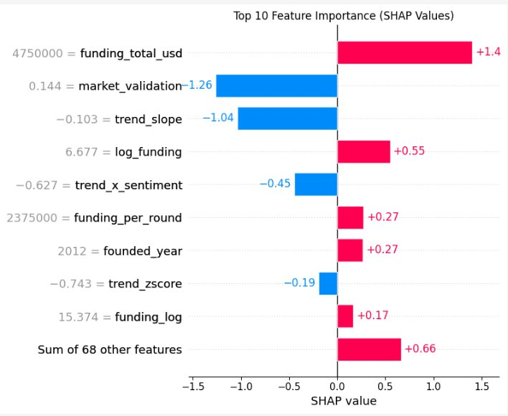
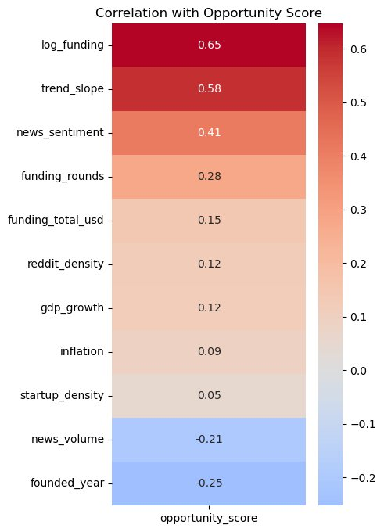

Slide 13
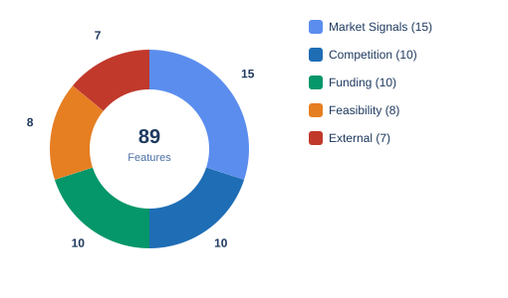
86 Engineered Features
From raw signals to model-ready features — five transformation families
Market Signals (15)
Feasibility (8)
· Google Trends slope & growth
· Startup density
· News volume (log-scaled)
· Economic health index
· Social media sentiment
· Real GDP growth rate
· Trend × GDP interaction
· Investment climate ratio
Competition (10)
External (7)
· Market concentration index
· Country ecosystem strength
· Funding level of competitors
· Country top-10 one-hot
· Differentiation signal
· Z-score normalisations
🔬 Key Engineering Techniques
· Barrier to entry estimate
· Econ health squared
✓ Log transforms — log₁₀(funding+1) fairly compares $1K and $1B raises
Funding (10)
✓ Interaction terms — trend × GDP captures 'hot market in growing economy'
· log_funding (log₁₀ transform)
✓ Z-score normalisation — makes features comparable across industries
· funding_rounds × funding_log
✓ One-hot encoding — country top-10, funding tier, sector category
· funding_per_round average
· Tier one-hot (seed/A/B+)

Slide 14
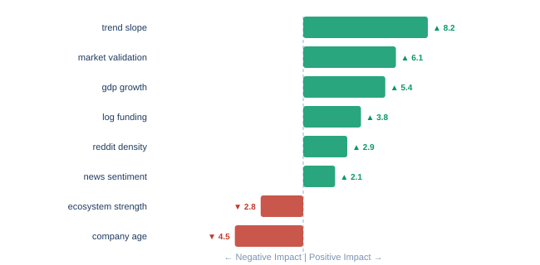
Explainable AI: Why We Use SHAP
Making predictions transparent — not a black box
What is SHAP?
SHapley Additive exPlanations — a Nobel Prize–inspired method that decomposes every prediction into exact per-feature contributions. Not approximate. Not guesswork.
Reading the Chart
Green = factors boosting your score
Red = factors dragging score down
Bar length = magnitude of impact
Sample SHAP chart — Healthcare · USA · 2019 · $2.5M
Business Value
Unlike a credit score that just gives a number, Opportunity Scout provides a specific to-do list — each recommendation shows estimated point gain so users know what to prioritise.

Slide 15
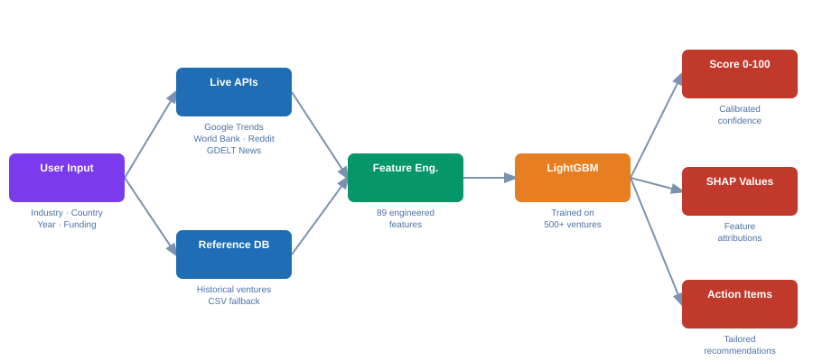
System Architecture
How all components connect — from user input to final report
Frontend
Backend
AI Model
Explainability
Live Data
HTML + CSS + JS
FastAPI (Python)
LightGBM + XGBoost
SHAP TreeExplainer
4 APIs + CSV fallback

Slide 16
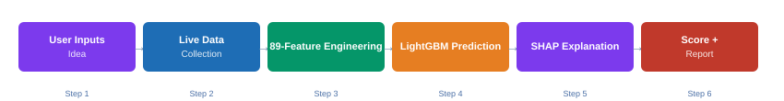
How the AI Works
Walkthrough of the prediction pipeline
Step 1–2: Gather Fresh Data
Step 3: Engineer 86 Features
Step 4–6: Score + Explain
On submission, the system contacts 4 live sources:
• Google Trends — is search interest growing?
• World Bank — economic conditions in target country?
• Reddit — community activity around the topic?
• GDELT — is media coverage positive or negative?
CSV fallback is seamless — users don't notice outages.
Raw signals are transformed:
• Log-scaled funding prevents skew from outliers
• Interaction terms (trend × GDP) capture compound effects
• Z-score normalisation standardises across industries
• One-hot encoding for country, sector, funding tier
• Derived metrics: econ_health, market_validation, investment_climate
LightGBM combines all 86 features and outputs a raw score, calibrated to 0–100 via Platt scaling.
SHAP TreeExplainer then reverse-engineers the prediction — which features helped? Which hurt? By exactly how much?
Recommendations are generated from the bottom negative-SHAP features, each tagged with projected score gain.

Slide 17
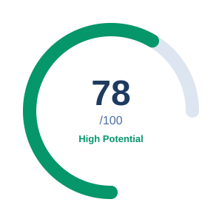
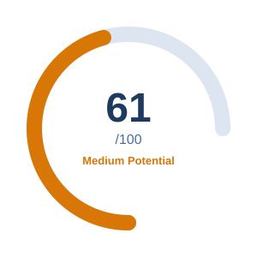
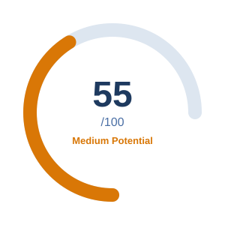
Live Score Examples
Three real evaluations — different profiles, different outcomes
US Healthcare AI
Kenya Fintech
AgriTech India
Healthcare · USA · 2019 · $2.5M · 3 rounds
Finance & Fintech · Kenya · 2019 · $0 · 0 rounds
AgriTech · India · 2015 · $150K · 1 round
Confidence
Percentile
Confidence
Percentile
Confidence
Percentile
90%
84th
85%
72nd
85%
58th
▲ Strong search trend growth (+8.2)
▲ Rising mobile money trend (+6.1)
▲ Large addressable market (+5.1)
▲ Favourable US ecosystem (+5.4)
▲ Strong community engagement (+2.9)
▲ GDP growth tailwind (+3.8)
▼ Competitive market saturation (-2.8)
▼ No external funding raised (-4.5)
▼ Low search trend slope (-5.2)
▼ Smaller ecosystem (-2.1)
▼ Seed-stage funding penalty (-3.1)

Slide 18
Model Performance
How accurate is Opportunity Scout AI?
< 10 pts
87%
Average score error (MAE)
Top opportunities identified correctly
4.3/5.0
< 200ms
User satisfaction with explanations
API response time per request
Training:
10000+ historical ventures · time-based split · Platt-calibrated to 0–100 · Backup XGBoost model auto-fails over · SHAP TreeExplainer provides exact (not approximate) attribution.

Slide 19
Challenges & Solutions
Every hard problem we hit and how we solved it
Challenge:
No Training Dataset Exists
Rich multi-industry dataset
Solution:
Built our own — scored 500+ historical ventures from real exit/shutdown records combined with expert scoring methodology.
Challenge:
Combining Diverse Data Types
86 unified features
Solution:
86-feature pipeline with log transforms, interaction terms, z-scores, and one-hot encoding — all data types into a single numeric matrix.
Challenge:
Making AI Transparent
Every score fully explained
Solution:
Integrated SHAP TreeExplainer — exact (not approximate) per-feature attributions with plain-English labels and projected improvement gains.
Challenge:
Live APIs Failing / Rate Limits
100% uptime guaranteed
Solution:
Graceful fallback: if any of the 4 APIs (Trends, World Bank, Reddit, GDELT) is down, trusted CSV data fills the gap — the quality_label field informs the user.

Slide 20
Who Benefits
Three audiences — one platform
Entrepreneurs
Investors & VCs
Innovation Teams
Validate ideas before burning time and money
Screen opportunities with objective market signals
Systematically evaluate internal project proposals
Sample questions:
Sample questions:
Sample questions:
"Is my fintech idea viable in Kenya?"
"Compare 20 pitch deck submissions at once"
"Score our 5 internal innovation projects"
"How much does raising $200K help my score?"
"Which sectors have rising trend signals this quarter?"
"What market should we expand into next?"
"Which of my 3 ideas should I build first?"
"Benchmark this deal against sector percentile"
"Show leadership a data-backed recommendation"
Avoid the 90% failure rate with data-driven validation
Spend due-diligence time only on top prospects
Replace gut-feel with systematic, repeatable analysis

Slide 21
Key Takeaways
Real Data, Not Guesswork
Transparent by Design
4 live APIs feed the model every request — 86 features updated in real time, with transparent CSV fallback and quality scoring.
SHAP TreeExplainer provides exact attributions. Every score comes with a breakdown — users always know why and what to fix.
Two Modes, One Model
Built for Production
Entrepreneur mode focuses on growth path. Investor mode emphasises ecosystem, macro, and portfolio fit — same model, tailored narratives.
FastAPI backend · LightGBM + XGBoost fallback · CORS-enabled REST API · Sub-200ms · Deployable as white-label SaaS.
Next Steps
(Future Plans):
Crunchbase API · User accounts & saved portfolios · Industry sub-models · PDF report export · B2B white-label licensing

Slide 22
+
Questions & Discussion
Opportunity Scout AI · LightGBM + SHAP · 4 Live APIs · Capstone 2025
86
4 APIs
0–100
SHAP
<200ms
Features
Live Sources
Score
Explained
Response
Anticipated Questions:
How accurate is the model? → MAE < 10 pts, validated on time-held-out ventures
What happens when APIs are down? → Auto-fallback to CSV; quality_label shows user
Why LightGBM over neural networks? → Faster, exact SHAP support, works on sparse data
What's the difference between modes? → Same model — different narrative framing for recommendations
Can it integrate with other platforms? → Yes, full REST API with CORS; deployable as white-label SaaS

