Slide 1

«
Compréhension Illustration UseCase
La nature est comme un immense
livre […] écrit en langue mathématique, et ses caractères sont des triangles, des cercles et des figures géométriques, sans lesquels il serait impossible à tout homme [ou une Intelligence Artificielle] d'en saisir le sens.
Galilée
Il saggiatore,1623
1

Slide 2
Bénéfices
Data Preparation

Slide 3
Bénéfices
Plan of the Lecture
Duplicates
Missing data
Outliers
Scaling
Balancing
Encoding
Discretizing
Feature creation
Feature selection

Slide 4
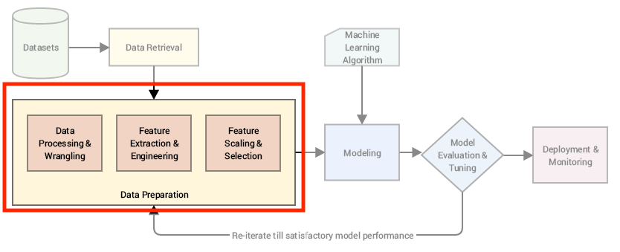
Bénéfices

Slide 5
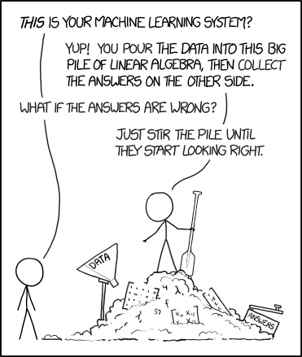
Bénéfices
Why Preprocessing?
Raw data is dirty and noisy
Machine learning algorithms have certain constraints regarding input data
Transformations can improve the model performance
Source

Slide 6
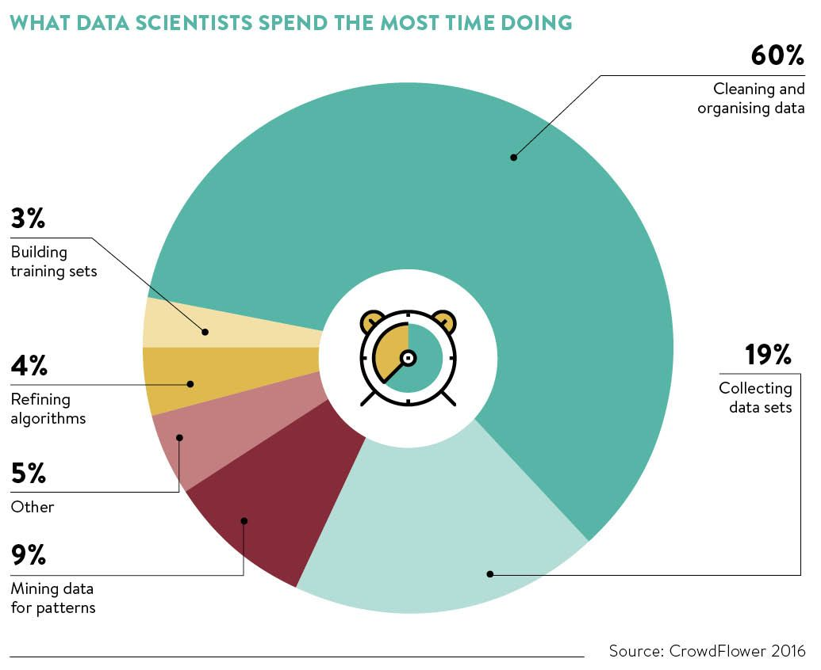
Bénéfices

Slide 7
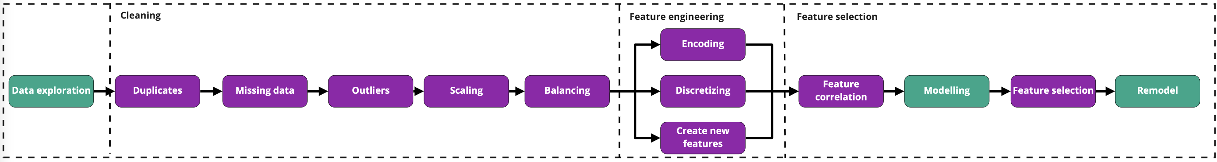
Bénéfices

Slide 8
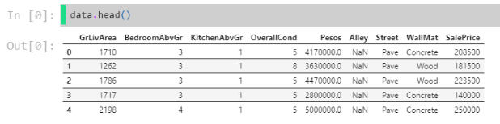
Bénéfices
Consider the Houses dataset we used in the previous lecture.
Now we are going to include some new features in our modelling: Alley,Street, WallMat, Pesos, and MoSold.

Slide 9
Bénéfices
1. Duplicates

Slide 10
Bénéfices
❓ Unwanted duplicated observations can discredit the performance evaluation of a model. Why?

Slide 11
Bénéfices
⚠️ Data Leakage

Slide 12
Bénéfices
💻 drop_duplicates

Slide 13

Bénéfices

Slide 14
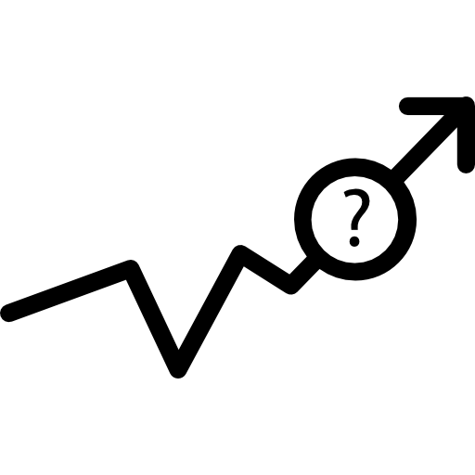
Bénéfices
2. Missing Data

Slide 15
Bénéfices
Common reasons for missing data
Programming error
Failure of measurement (e.g. a patient in a clinical study misses a scheduled visit)
Random events (e.g. meteorological data collection device runs out of power)

Slide 16
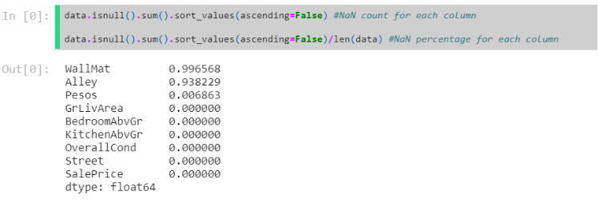
Bénéfices
💻 Detecting missing data

Slide 17
Bénéfices
Handling missing data
How you handle missing values will differ from field to field and dataset to dataset.
What might have caused the missing values?
Do the missing values represent a particular story or event?
Can I replace them by another value?
Can I afford to lose any data?

Slide 18
Bénéfices
🚨Some of these questions require domain knowledge. Ensure you are aware of what each column truly represents before starting any machine learning task!

Slide 19
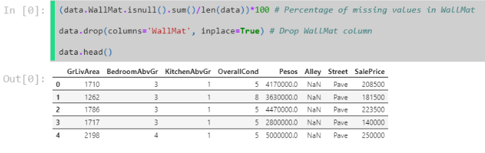
Bénéfices
WallMat

Slide 20
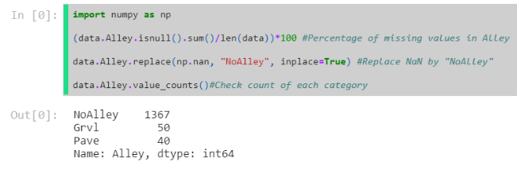
Bénéfices
Alley

Slide 21
Bénéfices
🚨Missing data does not necessarily mean no information!

Slide 22
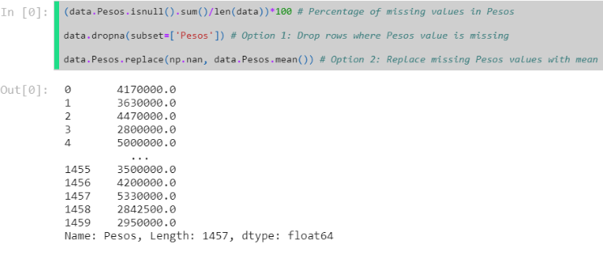
Bénéfices
Pesos

Slide 23
Bénéfices
💡Suggestion:
Greater than 30% of values missing: Potentially drop feature or row
Less than 30% of values missing: impute a value that makes sense e.g. Median, mean, mode.

Slide 24
Bénéfices
🚨Keep in mind that imputing an approximation creates noise.
Inferring replacement values for missing data can introduce human bias into our dataset
Filling missing data only leads to fixing our dataset at the column level, we may lose relationships between columns

Slide 25
Bénéfices
🖥 Sklearn's SimpleImputer
SimpleImputer is a tool to replace missing values by a strategy of your choice
e.g. mean.
👉Sklearn SimpleImputer() documentation

Slide 26
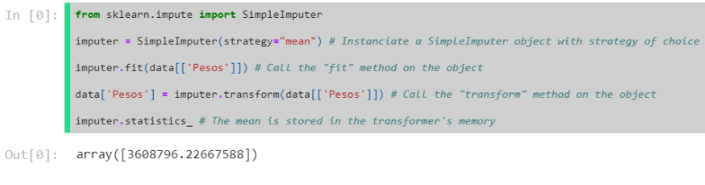
Bénéfices

Slide 27
Bénéfices
How did the SimpleImputer work?

Slide 28
Bénéfices
How did the SimpleImputer work?
Computes the strategy for that feature
Stores the strategy value as an attribute

Slide 29
Bénéfices
How did the SimpleImputer work?
Computes the strategy for that feature
Stores the strategy value as an attribute
Identifies missing values
Replaces missing value with previously calculated strategy value

Slide 30
Bénéfices
This type of tool is called a transformer
Learns and stores constants in memory upon fit()
Uses those constants when transform() is called

Slide 31

Bénéfices
3. Outliers

Slide 32
Bénéfices
Outliers are data points which deviate from the rest of the data.

Slide 33
Bénéfices
Common reasons for outliers
Data entry errors
Measurement errors
Data manipulation and preprocessing errors
Novelties (not errors)

Slide 34
Bénéfices
Outliers affect
Dataset distributions and patterns
Central tendency metrics e.g. mean and standard deviation
Machine learning models' performances

Slide 35
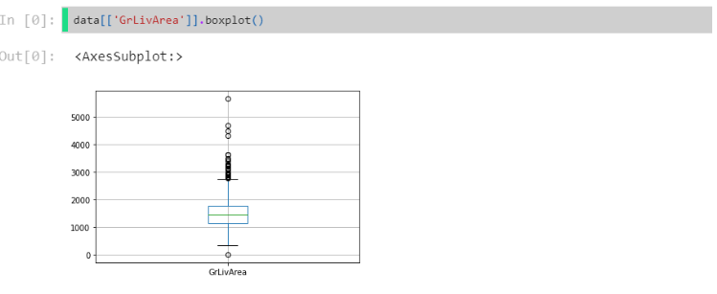
Bénéfices
Detecting Outliers - Boxplot
We can use boxplots to easily visualize outliers within our dataset.

Slide 36
Bénéfices
Does this look insensible?

Slide 37
Bénéfices
Handling Outliers
Is the outlier evidently false?
Could it be a novelty?
Could it be used as a feature?

Slide 38
Bénéfices
🚨Outliers can be an opinion.
We must fully comprehend what an outlier is before removing.

Slide 39
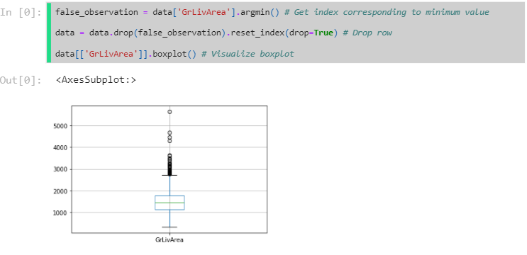
Bénéfices
Dropping Outliers
If data is evidently false: a house cannot have a living area of -1 ft2

Slide 40
Bénéfices
4. Feature Scaling

Slide 41
Bénéfices
ℹ️ Transforming continuous features into a common,
smaller range.

Slide 42
Bénéfices
🚨Remember, not all numerical columns are continuous,
always think about what the data represents in real life.

Slide 43
Bénéfices
Why Scaling ?
Features with large magnitudes can incorrectly outweigh
features of small magnitudes
Scaling to smaller magnitudes improves computational efficiency
Increases interpretability of feature coefficients

Slide 44
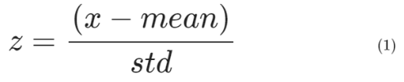
Bénéfices
Standardizing
Transforms a feature so that it has a mean value of 0 and
a standard deviation of 1.
👉 Sklearn StandardScaler() documentation

Slide 45
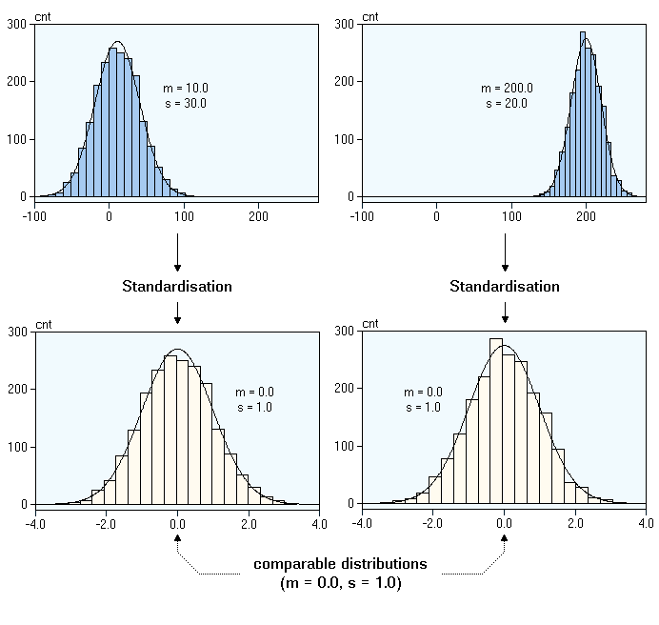
Bénéfices
The effect of standardization

Slide 46
Bénéfices
Standardization
Most efficient when data is normally distributed
Does not ensure an exact common range
Sensitive to outliers
Can distort relative distances between feature values

Slide 47
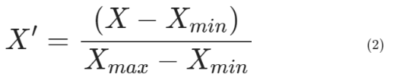
Bénéfices
Normalizing
The feature values are compressed in a fixed range [0,1].
👉 Sklearn MinMaxScaler() documentation

Slide 48
Bénéfices
Min – Max Scaling
Ensures a fixed range, important with distance based algorithms
like the K-Nearest Neighbours (cf. Performance Metrics lecture!)
Efficient regardless of distribution
Doesn't reduce the affect of outliers
Doesn't correct the skewness of a distribution

Slide 49
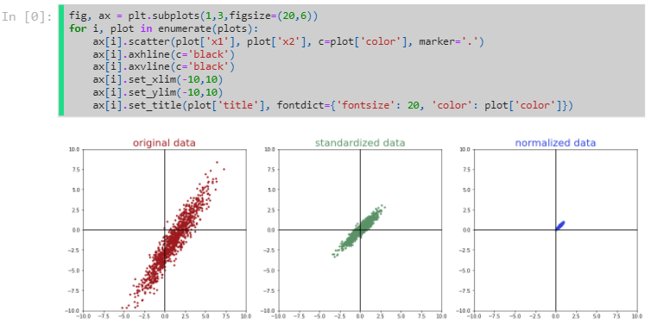
Bénéfices
Scaling effects

Slide 50
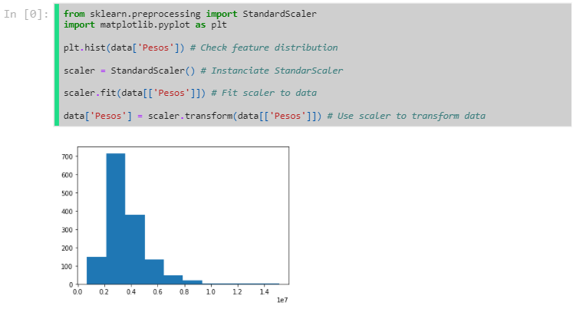
Bénéfices
💻 Scaling in Sklearn

Slide 51
Bénéfices
What if you're concerned with outliers? 🧐

Slide 52
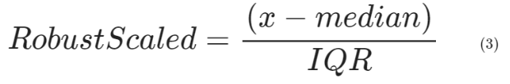
Bénéfices
Robust Scaling
Robust Scaling uses central tendency metrics that are less sensitive to outliers.
👉 Sklearn RobustScaler() documentation

Slide 53
Bénéfices
💻 Robust scaling GrLivArea

Slide 54
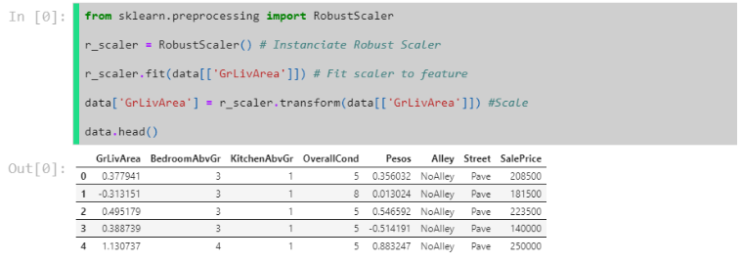
Bénéfices

Slide 55
Bénéfices
5. Dataset balancing

Slide 56
Bénéfices
In a classification dataset, the number of data points representing each class is often unequal (or imbalanced).
Disease prevalency
Race
Gender
E-commerce or advertising

Slide 57
Bénéfices
🧐It's not just labels that can be imbalanced, remember to check for imbalance within cohorts of your dataset🧐

Slide 58
Bénéfices
Why balacing ?
ML algorithms learn by example
Will tend to predict under represented class poorly
~30:70 split for binary classification would be considered imbalanced

Slide 59
Bénéfices
Balancing strategies
Over-sampling of minority class
Under-sampling of majority class
Computation of new minority class instances

Slide 60
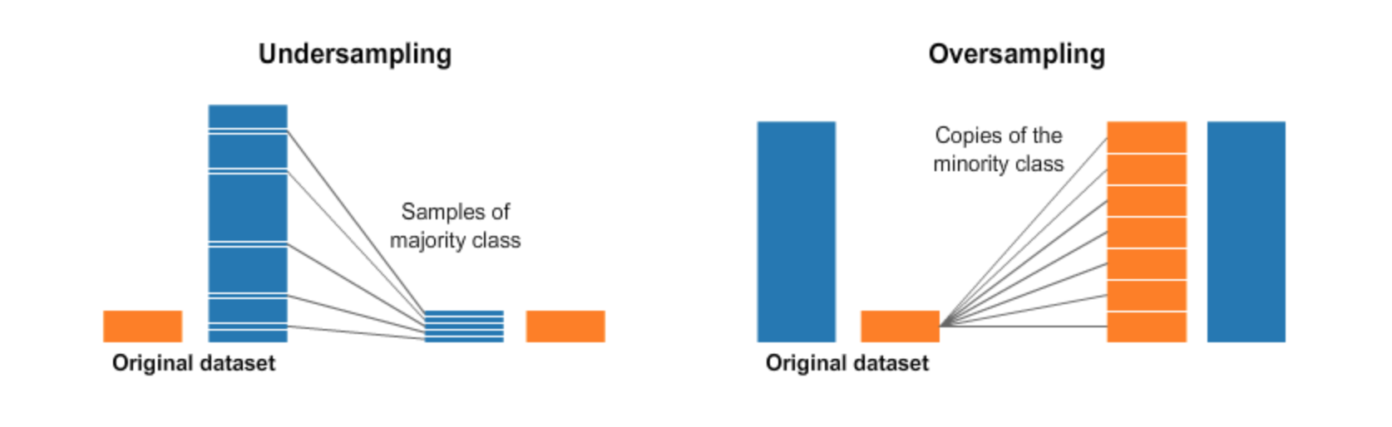
Bénéfices
Oversampling or Undersampling
Duplicating instances of the minority class or sampling down the majority class.
Source

Slide 61
Bénéfices
🚨Oversampling can cause data leakage between training and testing.

Slide 62
Bénéfices
Synthetic Minority Over-sampling TEchnique – SMOTE
SMOTE is an oversampling algorithm that generates new minority instances from existing minority instances based on linear combinations of existing points.
Source

Slide 63
Bénéfices
👉 SMOTE documentation

Slide 64
Bénéfices
🚨Only use balancing techniques on the training set.
We want to keep our test set as representative of real life as possible.

Slide 65
Bénéfices
6. Encoding

Slide 66
Bénéfices
Encoding consists of transforming non-numerical data to an equivalent numerical form.

Slide 67
Bénéfices
Why encoding?
Data may be represented as words, letters, or symbols
Most Machine Learning algorithms only process numerical data

Slide 68
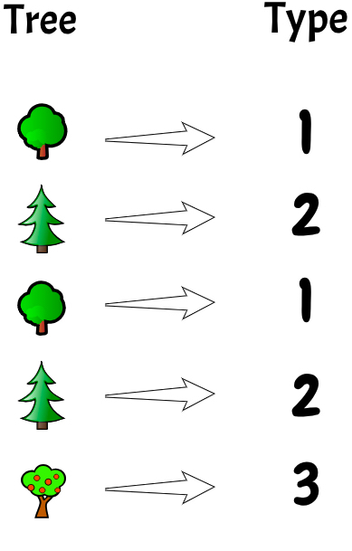
Bénéfices
Target Encoding
Assign a number to each category.
👉 Sklearn LabelEncoder() documentation

Slide 69
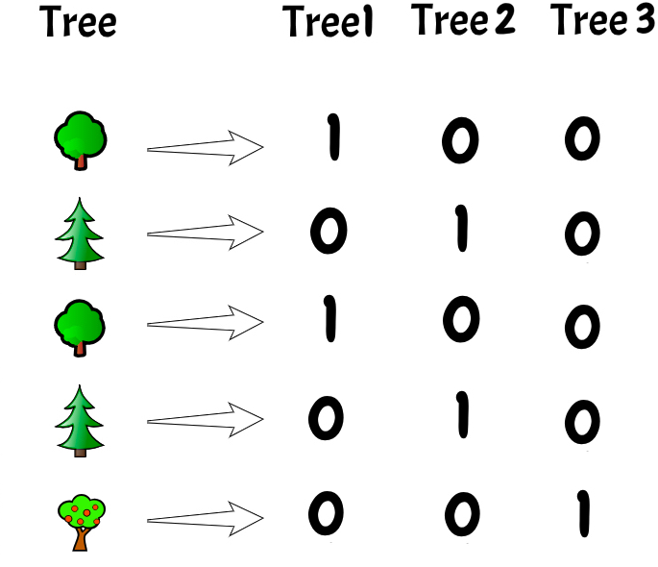
Bénéfices
Feature Encoding
Create a binary column for each possible category.
This is also known as One Hot Encoding.
👉 Sklearn OneHotEncoder() documentation

Slide 70
Bénéfices
❓ Why not use label encoder for a feature?

Slide 71
Bénéfices
❓ Why not use label encoder for a feature?
It would create a false relation of order between the categories
ML algorithms assume order for features but not for targets

Slide 72
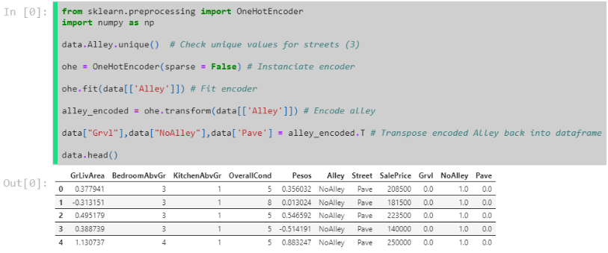
Bénéfices
💻 One-hot-Encoding Alley

Slide 73
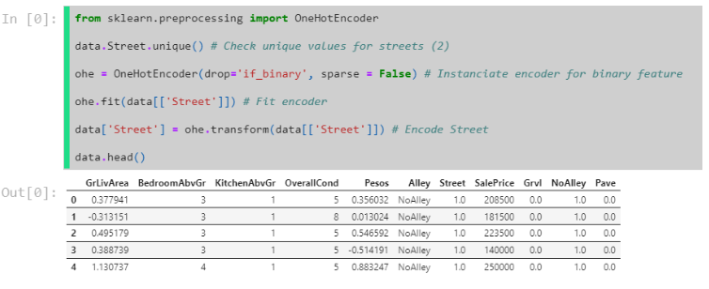
Bénéfices
💻 One-hot-Encoding Street

Slide 74
Bénéfices
7. Discretizing

Slide 75
Bénéfices
Discretizing is the process of turning continuous data into discrete data using bins.
Turn a regression task into a classification task
Perform feature engineering
👉 Pandas cut() documentation

Slide 76
Bénéfices
🖥 Discretizing Sale Price
Let's turn this dataset into a classification task, Cheap or Expensive, according to the mean.

Slide 77
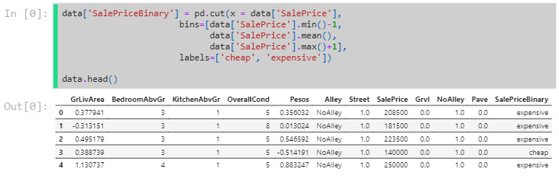
Bénéfices
🖥 Discretizing Sale Price
Let's turn this dataset into a classification task, Cheap or Expensive, according to the mean.

Slide 78
Bénéfices
8. Feature creation

Slide 79
Bénéfices
We can introduce our domain knowledge into a dataset in order to drive more signal for our models to learn 💪

Slide 80
Bénéfices
Why create new features ?
Create additional information
Potentially improve model performance

Slide 81
Bénéfices
Examples of creating new features
bedroom to total_room ratio
height divided by weight² for Body Mass Index
delivered_date - dispatch_date for lag time between events
Categorize date as either weekday or weekend

Slide 82
Bénéfices
💡Encoding, discretizing and creating new features fall under a category of preprocessing known as feature engineering.

Slide 83
Bénéfices
Sklearn has many more preprocessing tools!

Slide 84
Bénéfices
9. Feature Selection

Slide 85
Bénéfices
Preparation Order

Slide 86
Bénéfices
Feature selection is the process of eliminating non-informative features.
There are 2 main types of statistical feature selection:
Univariate feature selection
Multivariate
Now, we'll show you one of each:
Feature Correlation (Univariate)
Feature Permutation (Multivariate)

Slide 87
Bénéfices
Why feature selection ?
Garbage in, garbage out
The curse of dimensionality
Reducing complexity

Slide 88
Bénéfices
Garbage in, garbage out
Poor quality input will induce noise, destabilize the model,
and produce a poor quality output.

Slide 89
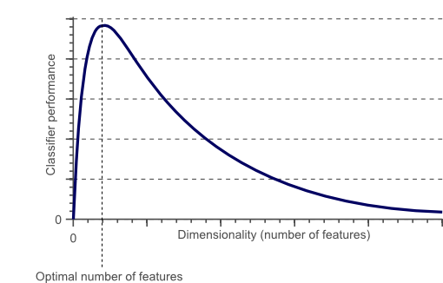
Bénéfices
The curse of dimensionality
Not observing enough data to support a meaningful relationship.
Source

Slide 90
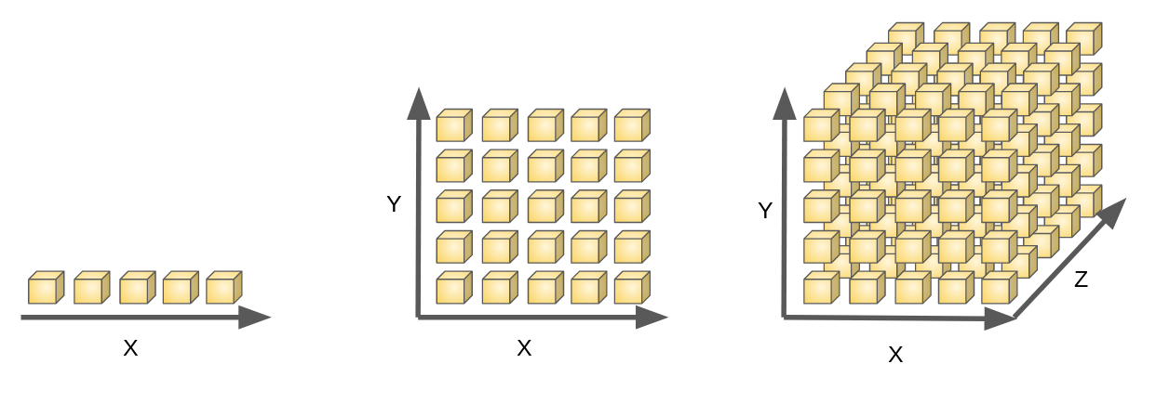
Bénéfices
As the number of features or dimensions grows, the amount of data we need to generalise accurately grows exponentially e.g 5¹, 5², 5³, 5^{n}
Source

Slide 91
Bénéfices
As the number of features or dimensions grows, the amount of data we need to generalise accurately grows exponentially e.g 5¹, 5², 5³, 5^{n}
Source
🚨Be careful which features you one hot encode. High variation within a categorical feature ➡️ more binary column ➡️more data required.

Slide 92
Bénéfices
Feature Correlation
A first selection technique is to remove one of two features that are highly correlated to each other.
High correlation = redundant information

Slide 93
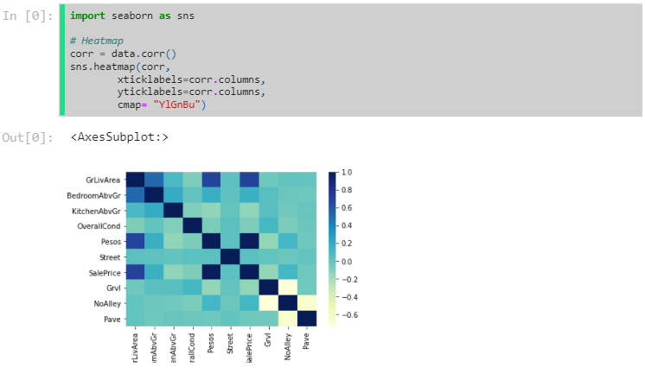
Bénéfices
🖥 Pearson Correlation

Slide 94
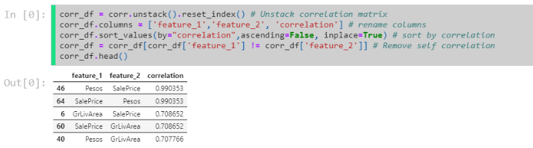
Bénéfices

Slide 95
Bénéfices
👉 Our suggestion: remove as many feature as you want, starting from those with the highest correlation, until your model performance starts to drop too significantly.
❓ The feature Pesos is perfectly correlated to the target SalePrice. What are we observing?

Slide 96
Bénéfices
⚠️ Data Leakage
SalePrice is a direct conversion from pesos to dollars. We should drop pesos
.

Slide 97
Bénéfices
⚠️ Data Leakage
SalePrice is a direct conversion from pesos to dollars. We should drop pesos
.

Slide 98
Bénéfices
Reducing complexity
🔪The most simple solution is normally the best solution🔪
Reducing the number of features makes the model:
More interpretable
Faster to train
Easier to implement and maintain in production

Slide 99
Bénéfices
preparation order recap 😅

