Slide 1
Hospital Appointment System
4 x 4 Challenge
Kungfu Panda
February 19, 2015

Slide 2

Do you know the average wait time in the hospital ?

Slide 3


In 2012 – 2013, more than 40 per cent of the 161 hospitals have a three-hour wait time for patients to get assessed by an emergency room physician.
Some hospitals — three in Winnipeg and one in Ontario — saw double or even triple the suggested three-hour wait.

Slide 4
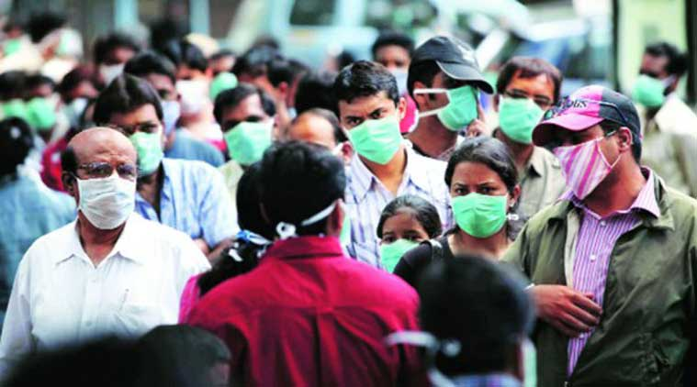
Furthermore !!!
“
An estimated 650,000 patients per year in the U.S. develop an infection while in the hospital, and almost 75,000 die as a result
”

Slide 5
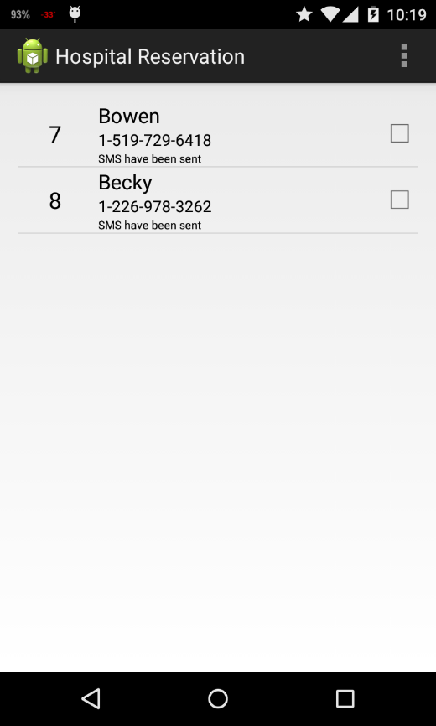
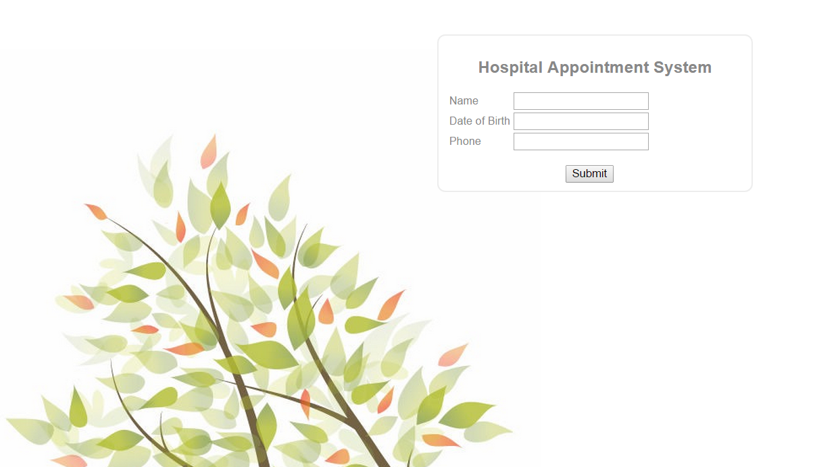
Clinic Appointment System

Slide 6

What is Clinic Appointment System
A software system that saves patients’ time of waiting, by sending patients SMS text message 20 minutes before their doctor can see them
The system consists of
Frontend Web application
Android application
MySQL Database

Slide 7
What is Clinic Appointment System
Target market:
Clinics, pharmacies, agencies, any offices where long queues exists
Facts:
72,500 medical doctors (2011)
9843 Pharmacies (2015)
(In Canada)

Slide 8
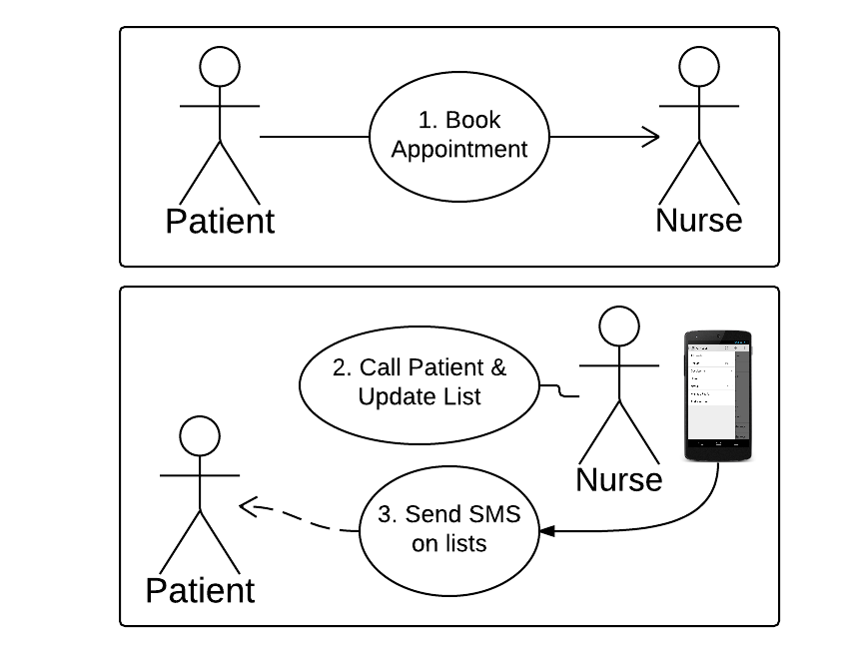
How does it work?

Slide 9

Why Choosing Clinic Appointment System
Easy to maintain
Easy to install and setup
Low Pricing

Slide 10

Data is highly secured
Very limited amount of data is required
All private data is purged at 12 am every night
Data are stored locally, no un-authorized access is permitted

Slide 11
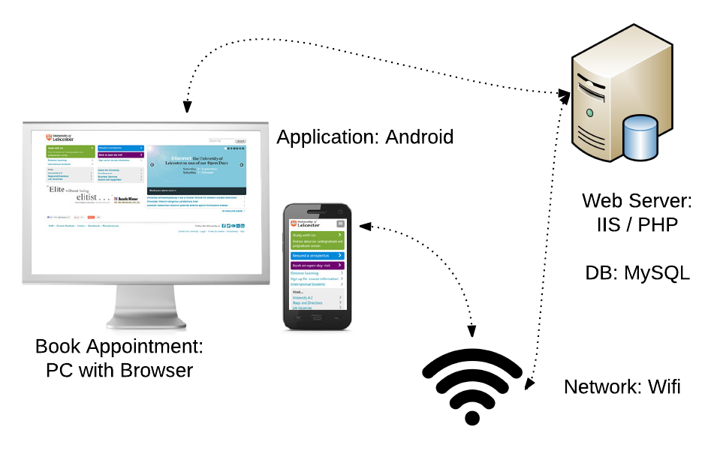
System Diagram

Slide 12
Reference
http://www.cbc.ca/news/health/hospital-er-times-reveal-some-disturbing-waits-1.2767867
http://www.consumerreports.org/cro/news/2015/02/consumer-reports-gave-california-hospital-with-deadly-infection-a-low-score/index.htm
http://napra.ca/pages/Practice_Resources/National_Statistics.aspx?id=2104

