Slide 1
PILOTS
Process sharing workshop
Wout Slabbinck & Julian Rojas
IDLab - Ghent University - imec
Notes:
Homework: Representing Invoice Events & Service Profiles -> exercise from Birger

Slide 2
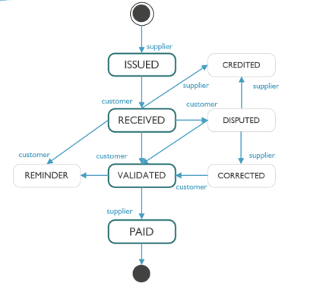
Exercise: Invoicing process model
Properties:
InvoiceID
State: ISSUED, RECEIVED,...
Timestamp (of start current state)
Signature over payload data
  Integrity

Slide 3
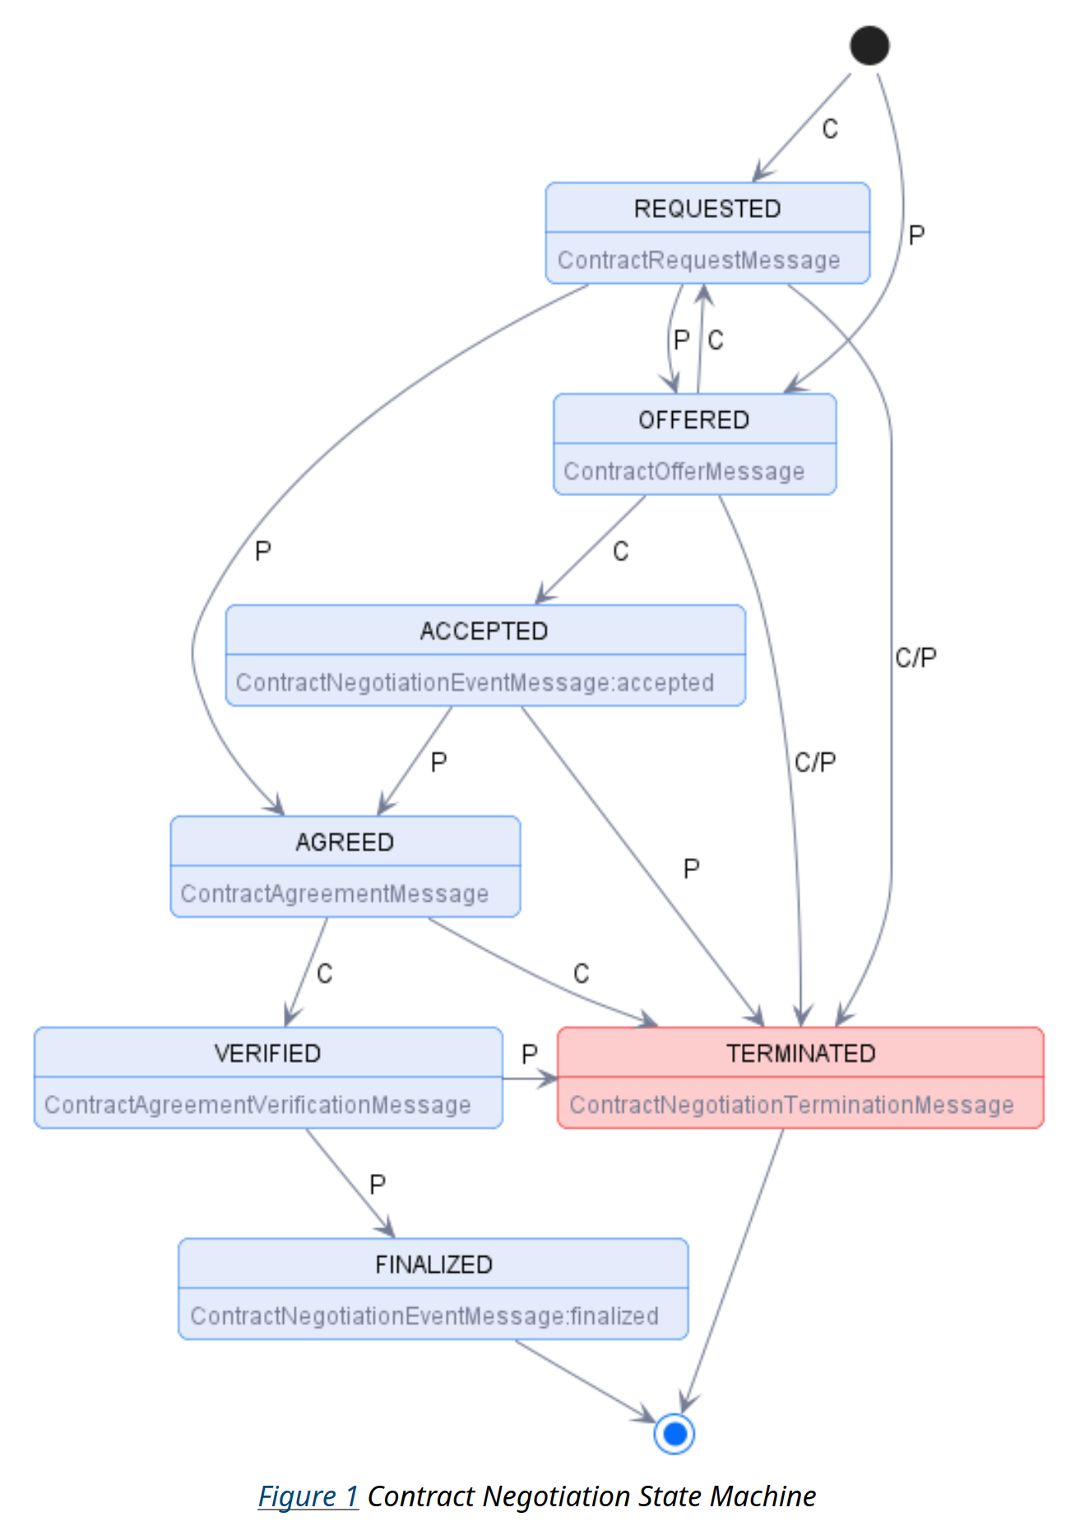
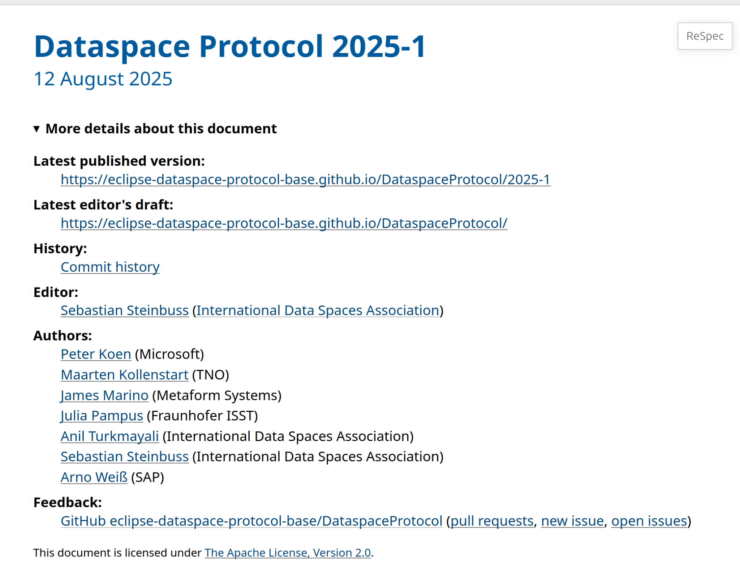
A perspective from the current Dataspace Protocol

Slide 4
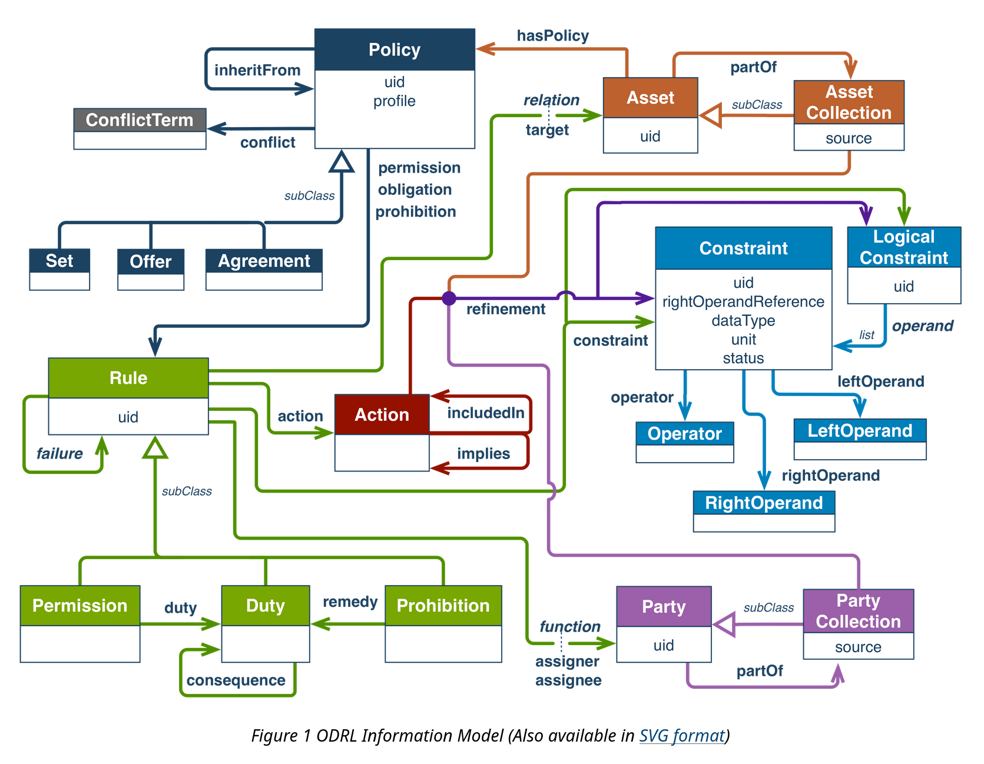
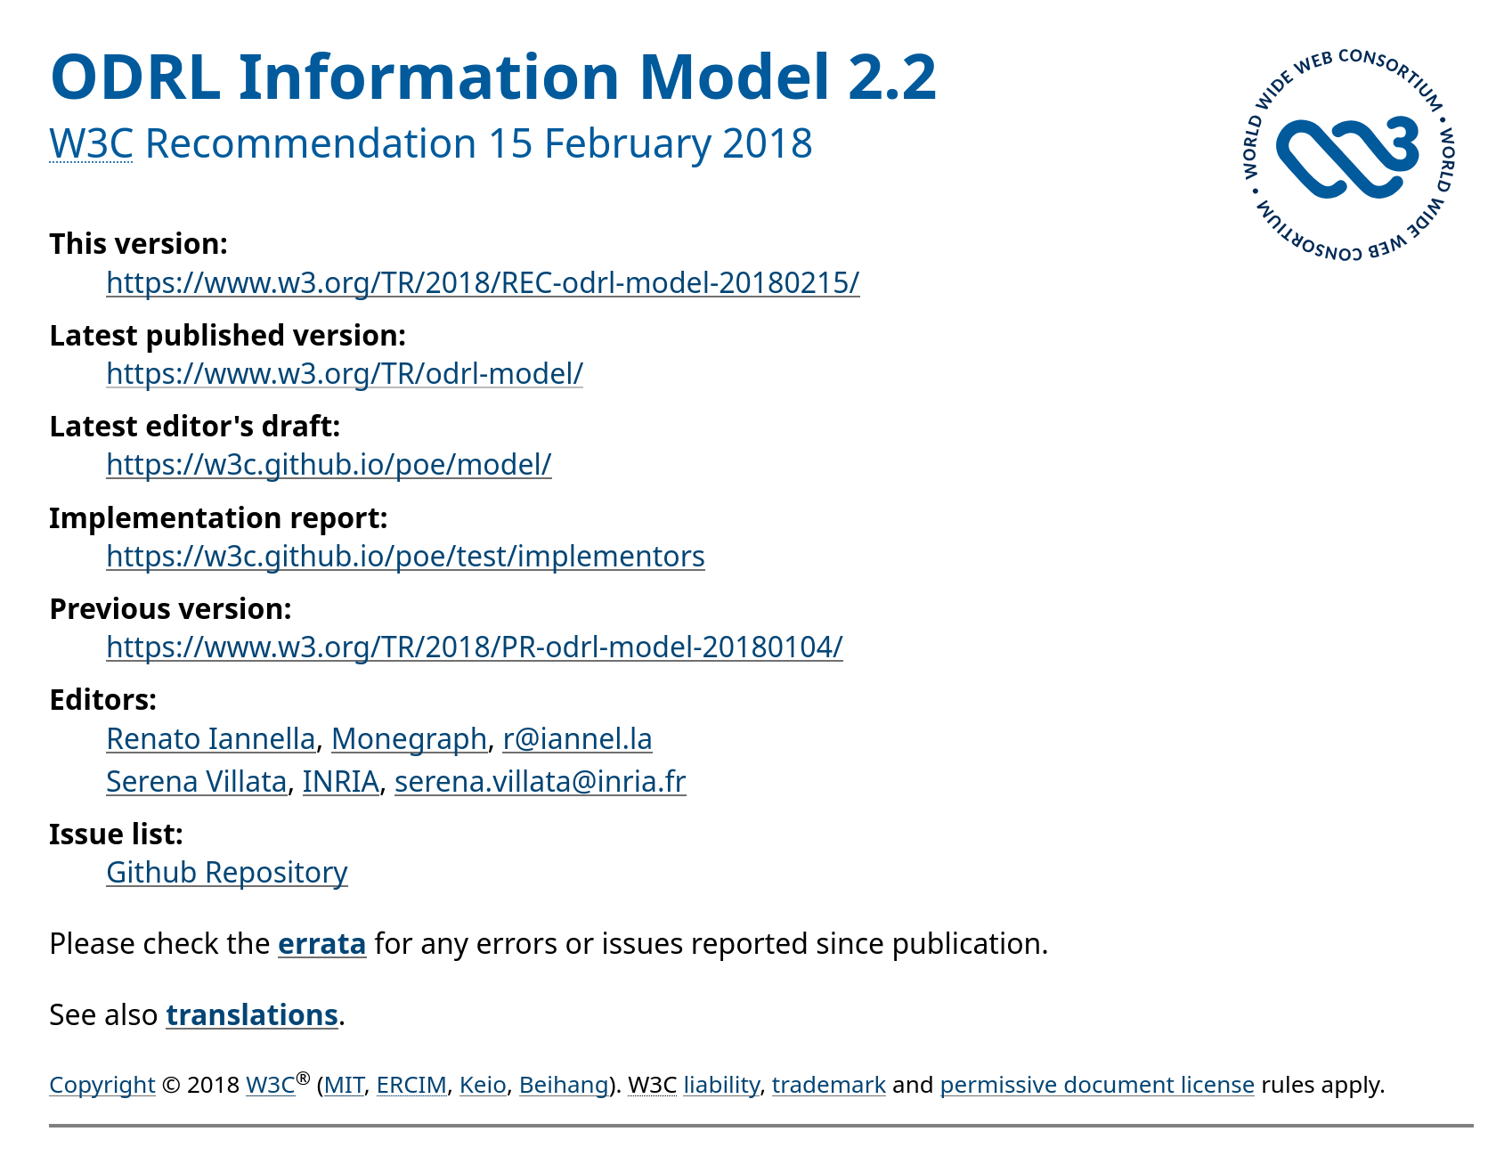

Slide 5
A perspective from the current Dataspace Protocol
{
"ContractRequestMessage": {
"@id": "dspace:ContractRequestMessage",
"@context": {
"@version": 1.1,
"@protected": true,
"@import": "https://w3id.org/dspace/2025/1/odrl-profile.jsonld",
"@propagate": true,
"callbackAddress": "dspace:callbackAddress",
"providerPid": {
"@type": "@id",
"@id": "dspace:providerPid"
},
"consumerPid": {
"@type": "@id",
"@id": "dspace:consumerPid"
},
"offer": {
"@type": "@id",
"@id": "dspace:offer"
}
}
}
}

Slide 6
A perspective from the current Dataspace Protocol
{
"ContractAgreementMessage": {
"@id": "dspace:ContractAgreementMessage",
"@context": {
"@version": 1.1,
"@protected": true,
"@import": "https://w3id.org/dspace/2025/1/odrl-profile.jsonld",
"@propagate": true,
"providerPid": {
"@type": "@id",
"@id": "dspace:providerPid"
},
"consumerPid": {
"@type": "@id",
"@id": "dspace:consumerPid"
},
"agreement": {
"@id": "dspace:agreement",
"@type": "@id"
},
"timestamp": "dspace:timestamp"
}
}
}

Slide 7
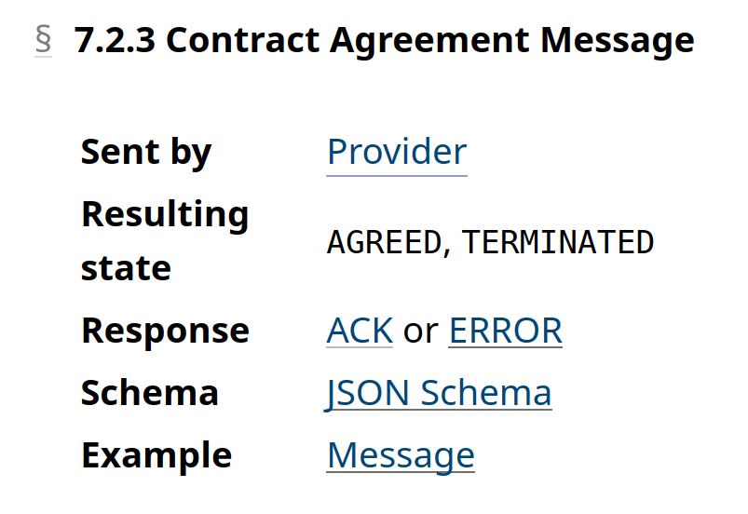
A perspective from the current Dataspace Protocol
{
"ContractAgreementMessage": {
"@id": "dspace:ContractAgreementMessage",
"@context": {
"@version": 1.1,
"@protected": true,
"@import": "https://w3id.org/dspace/2025/1/odrl-profile.jsonld",
"@propagate": true,
"providerPid": {
"@type": "@id",
"@id": "dspace:providerPid"
},
"consumerPid": {
"@type": "@id",
"@id": "dspace:consumerPid"
},
"agreement": {
"@id": "dspace:agreement",
"@type": "@id"
},
"timestamp": "dspace:timestamp"
}
}
}

Slide 8
A perspective from the current Dataspace Protocol
Process modelling is limited to a flat definition of messages/events that hold no relation among each other
Process state machine (for contract negotiation) is only described in the spec as text and needs to be manually encoded in agents/connector
A modeling approach focused on the finite state machines of processes may be a more generic and scalable

Slide 9
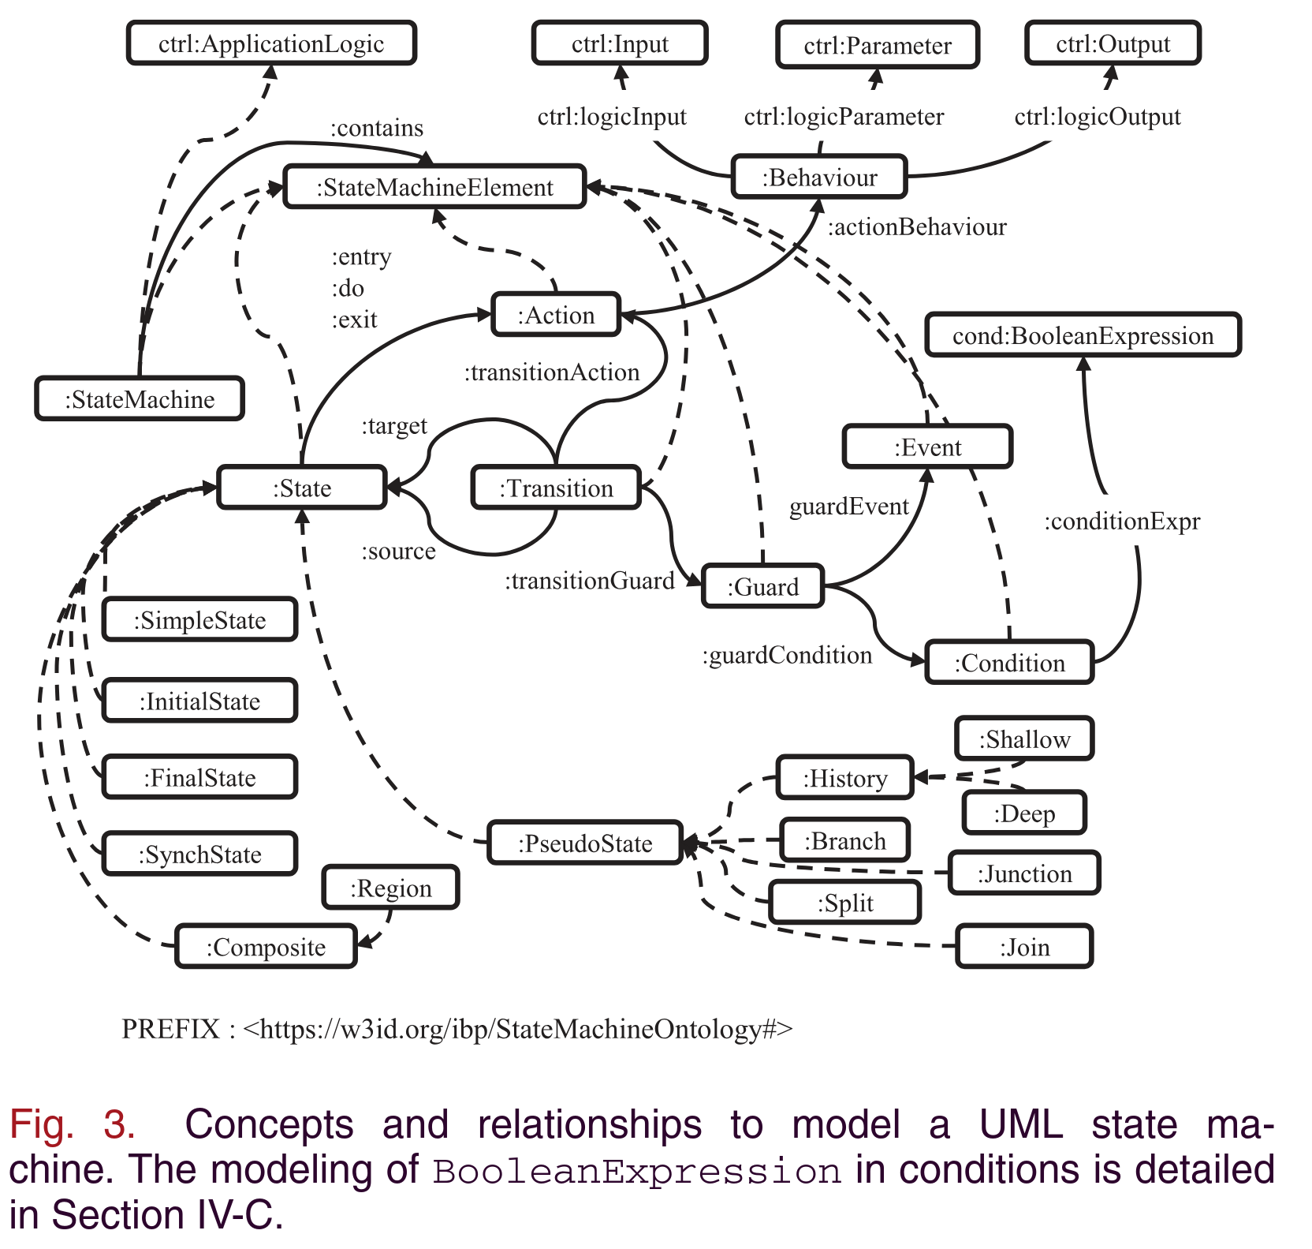
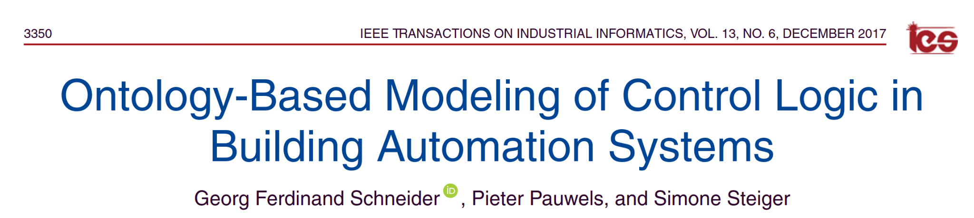
A FSM modeling approach

Slide 10
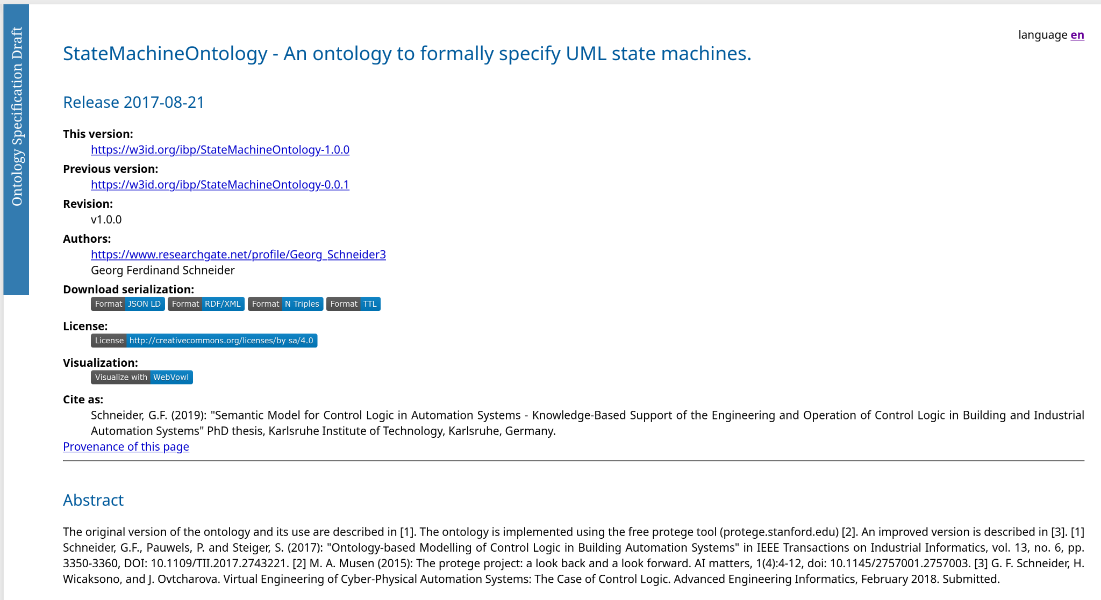

Slide 11
Example of FSM-based model for the invoicing process
smo:Transition
rdfs:subClassOf
odrl:Policy
io:InvoiceIssuedMessage
smo:transitionGuard
smo:target
smo:InitialState
rdf:type
io:ISSUED

Slide 12
smo:Transition instance (InvoiceIssuedMessage) example
{
"@context": [
"https://w3id.org/dspace/2025/1/context.jsonld",
"https://w3id.org/ibp/StateMachineOntology#",
"https://w3id.org/process/invoicing/",
"https://example.org/peppol/invoice#"
],
"@type": "InvoiceIssuedMessage",
"providerPid": "https://ex.org/actors/uuid:3dd1add8-4d2d-569e-d634-8394a8836a88",
"consumerPid": "https://ex.org/actors/uuid:32541fe6-c580-409e-85a8-8a9a32fbe833",
"payload": {
"@id": "https://ex.org/invoices/uuid:3dd1add8-4d2d-569e-d634-8394a8836a88",
"@type": "Invoice",
"invoiceId": "INV-2025-0001",
"issueDate": "2025-03-15",
"dueDate": "2025-04-14",
"currency": "EUR",
...
},
"smo:target": "io:ISSUED",
"transitionGuard": {
"@type": "Policy",
"@id": "https://ex.org/policies/uuid:d526561f-528e-4d5a-ae12-9a9dd9b7a815",
"odrl:target": "https://ex.org/invoices/uuid:3dd1add8-4d2d-569e-d634-8394a8836a88",
"permission": [...]
}
}

Slide 13
Lifecycle Invoice Events
Invoice data
Lifecycle Event data
Data that gets changed during process: Lifecycle state (Event data)
Access rights differ based on Lifecycle state
Supplier
Invoice data
Invoice data
Consumer
Event data
Event data

Slide 14
Trusted Third Party Architecture
Policies
Trusted Third Party
Invoice data
Event data
Issue Invoice:
Invoice payload
Process lifecycle
Supplier
Consumer
Notes:
Based on process and creator of payload (invoice): decision has been made who can change the data
Process really dictate the policies
Similarities to SWIFT for notifications between banks
https://en.wikipedia.org/wiki/SWIFT

Slide 15
Policy rule calculation
Payload (Invoice)
Permission(Supplier & Consumer, read, Invoice)
Permission(Consumer, write, Event)
Permission(Supplier, read, Event)
Permission(Supplier & Consumer, read, Invoice)
Permission(Consumer, write, Event)
Permission(Supplier, read, Event)
Permission(Supplier & Consumer, read, Invoice)
Permission(Consumer, read, Event)
Permission(Supplier, write, Event)
Permission(Supplier & Consumer, read, Invoice)
Permission(Supplier & Consumer, read, Event)
ISSUED
RECEIVED
VALIDATED
PAID

Slide 16
Trusted Third Party Architecture
Auditor
Assumption: there is a list of trusted auditors
Policies
Permission(Auditor, read, Invoice & Event)
Trusted Third Party
Invoice data
Event data
Supplier
Consumer
Notes:
That rule is agnostic of payload

