Slide 1
FASTQC
Documentation

Slide 2
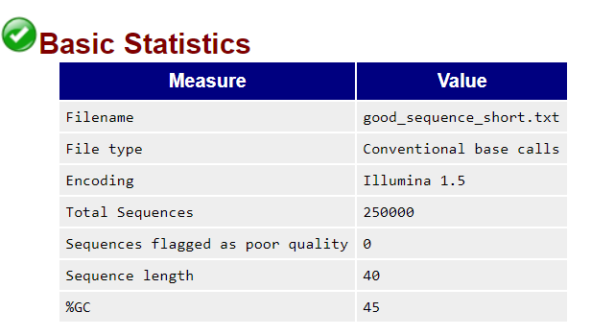
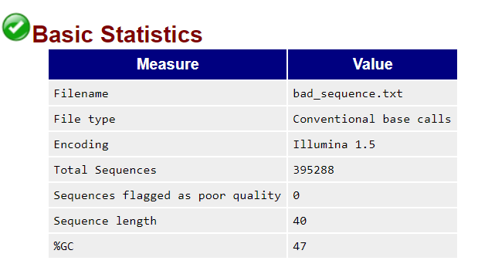
Basic statistics
Good Illumina data
Bad Illumina data
Warning
Basic Statistics never raises a warning.
Failure
Basic Statistics never raises an error.
Common reasons for warnings
This module never raises warnings or errors

Slide 3
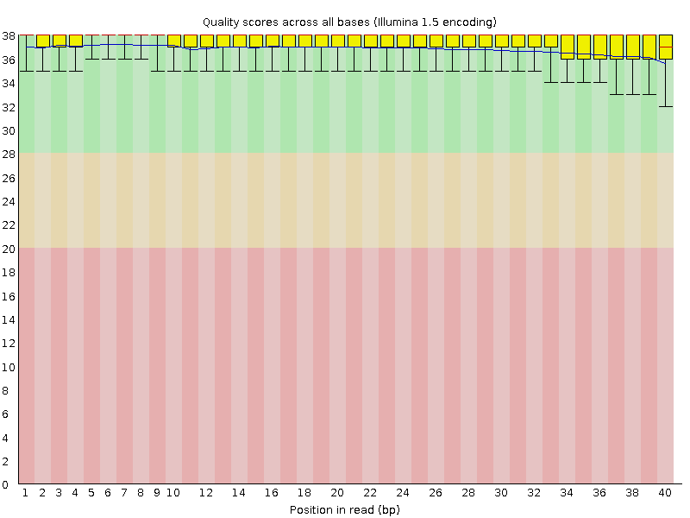
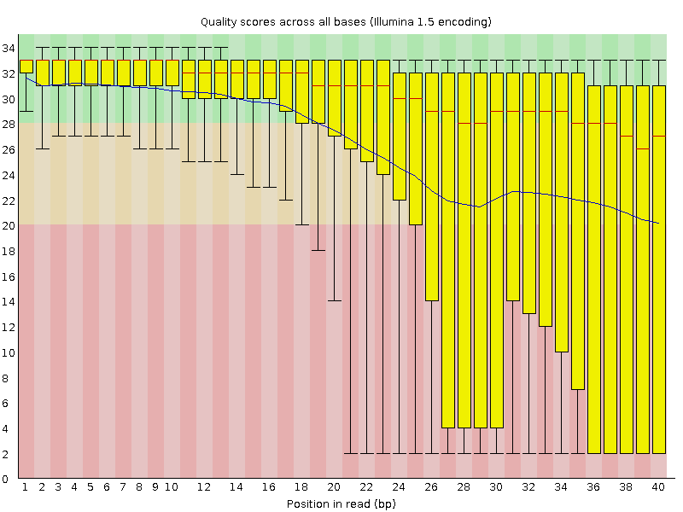
Per Base Sequence Quality
Good Illumina data
Bad Illumina data
FastQC attempts to automatically determine which encoding method was used, but in some very limited datasets it is possible that it will guess this incorrectly (ironically only when your data is universally very good!)
Good
Reasonable
Poor quality
Warning
lower quartile for any base is less than 10
median for any base is less than 25
Failure
lower quartile for any base is less than 5
median for any base is less than 20
Common reasons for warnings
general degradation of quality over the duration of long runs
Solution: quality trimming = read truncation
a short loss of quality earlier in the run, because of
Transient problems: e.g. bubbles
Solution: masking ; trimming not advisable
Reads of varying length:
Solution: check the read length distribution module

Slide 4
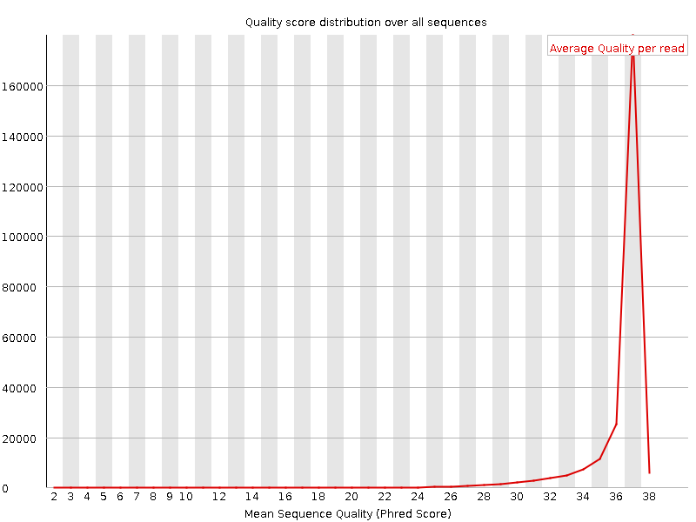
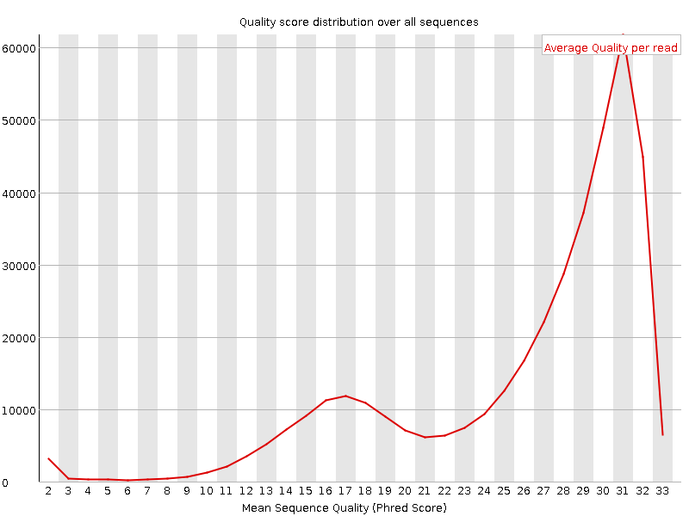
Per Sequence Quality Scores
Good Illumina data
Bad Illumina data
Warning
most frequently observed mean quality is below 27 (0.2% error rate)
Failure
most frequently observed mean quality is below 20 (1% error rate)
Common reasons for warnings
Systematic problems – e.g. one end of flowcell
Solution: look at per-tile sequence quality module, check modality of the distribution
general loss of quality within a run
Solution: For long runs this may be alleviated through quality trimming

Slide 5
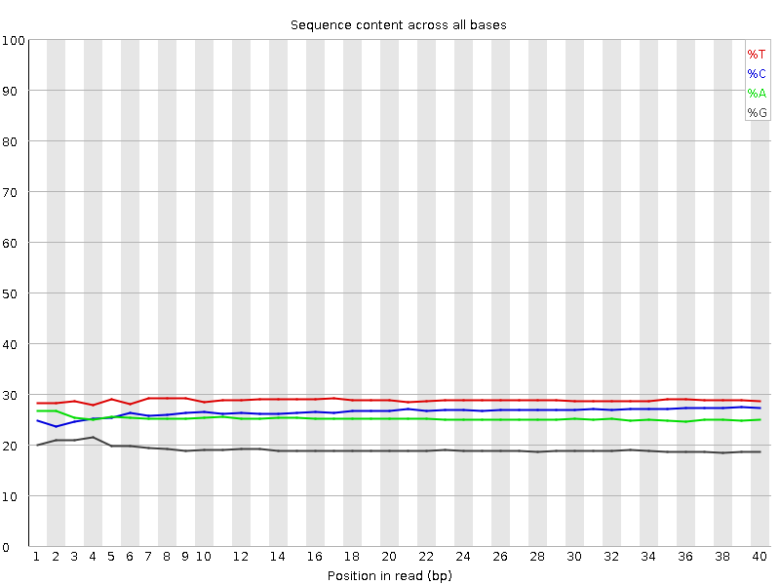
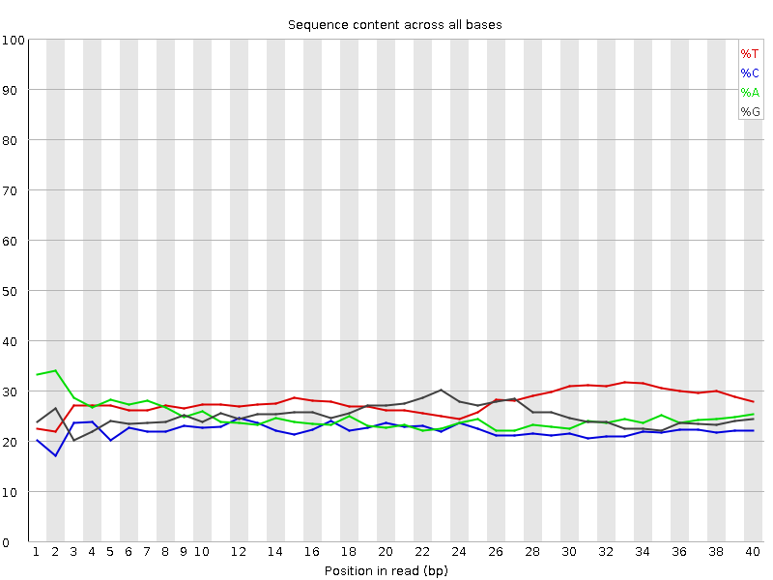
Per Base Sequence Content
Good Illumina data
Bad Illumina data
Common reasons for warnings
Biased fragmentation: biased sequences in the start of the read for some libraries:
produced by random hexamer trimming (Nearly all RNA-seq libraries )
Or fragmented using transposases
Overrepresented sequences:
Adapter dimers, rRNA
Biased composition libraries
sodium bisulphite converting cytosines to thymines
Aggressive adapter trimming
Bias at the end
Warning
difference between A and T, or G and C is greater than 10% in any position
Failure
difference between A and T, or G and C is greater than 20% in any position

Slide 6


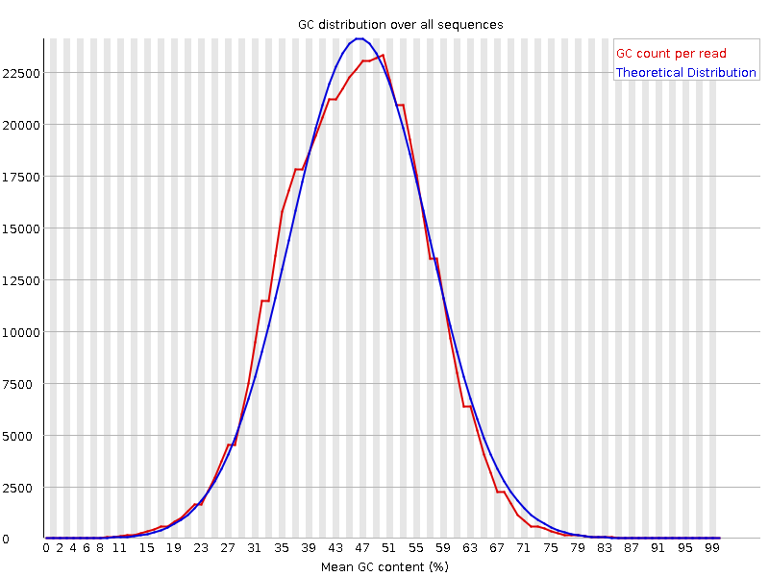
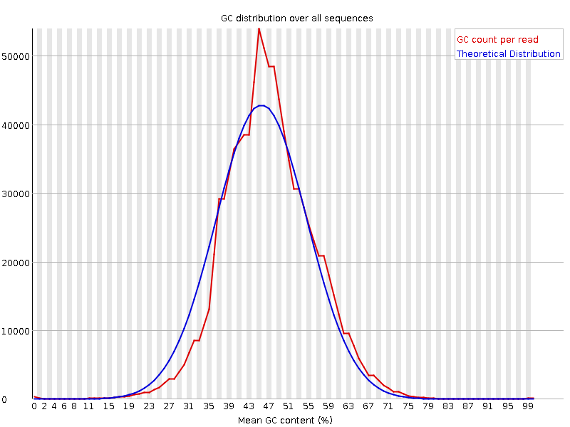
Per Sequence GC Content
Good Illumina data
Bad Illumina data
Common reasons for warnings
Systematic biases will shift the distribution but will not produce warnings
Warnings are thrown because of deviation from normal distribution
Sharp peaks on an otherwise smooth distribution
Contamination with adapter dimers
Broader peaks
may represent contamination with a different species.
Warning
sum of the deviations from the normal distribution represents more than 15% of the reads
Failure
sum of the deviations from the normal distribution represents more than 30% of the reads

Slide 7
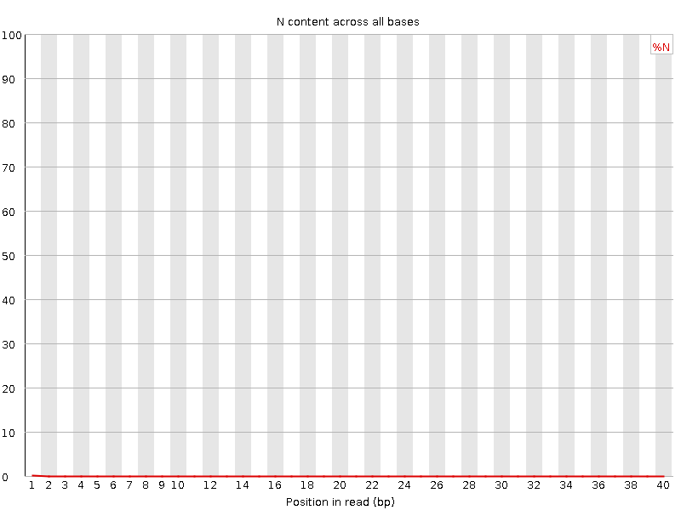
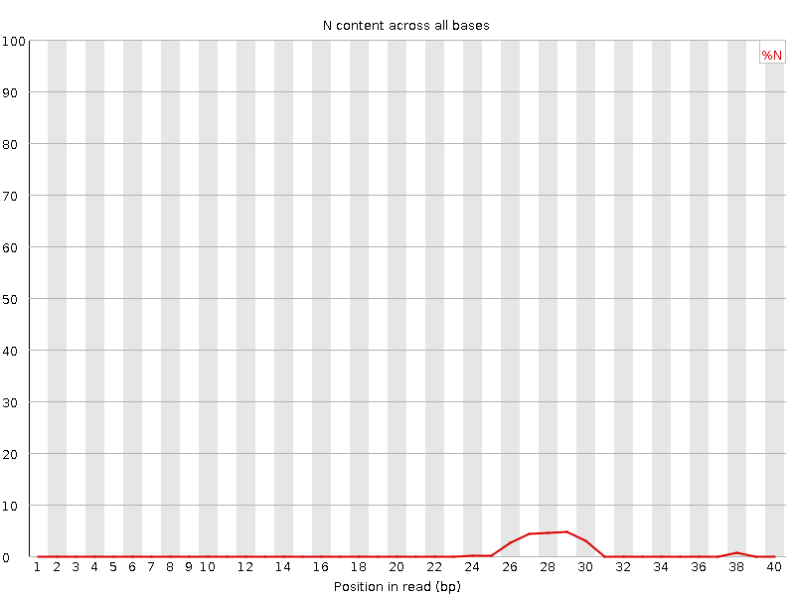
Per Base N Content
Good Illumina data
Bad Illumina data
Common reasons for warnings
general loss of quality
Solution: Look at other quality modules
high proportions of N at a small number of positions early in the library, against a background of generally good quality
very biased sequence composition in the library to the point that base callers can become confused and make poor calls ??
Warning
N content of any position >5%.
Failure
N content of any position >20%.

Slide 8
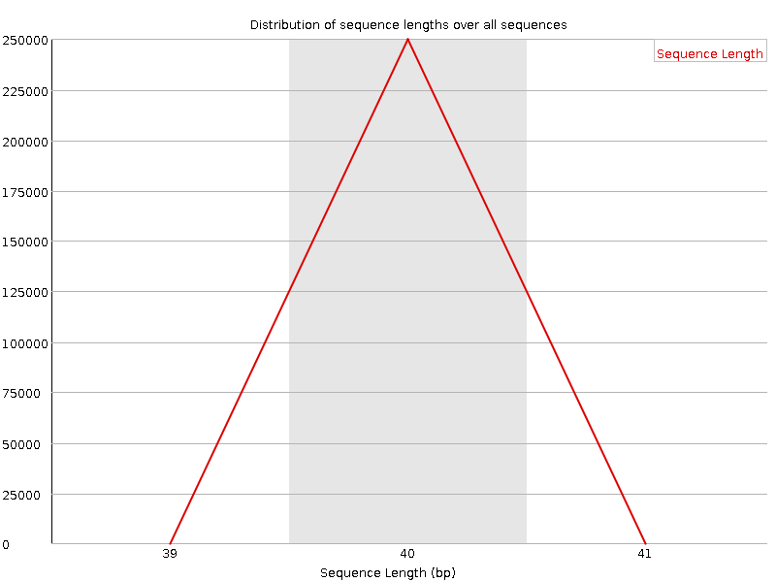
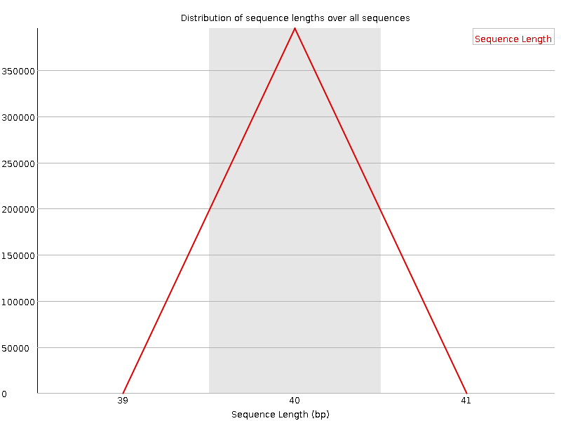
Sequence Length Distribution
Good Illumina data
Bad Illumina data
Warning
all sequences are not the same length
Failure
any of the sequences have zero length
Common reasons for warnings
For some sequencing platforms it is entirely normal to have different read lengths so warnings here can be ignored.

Slide 9
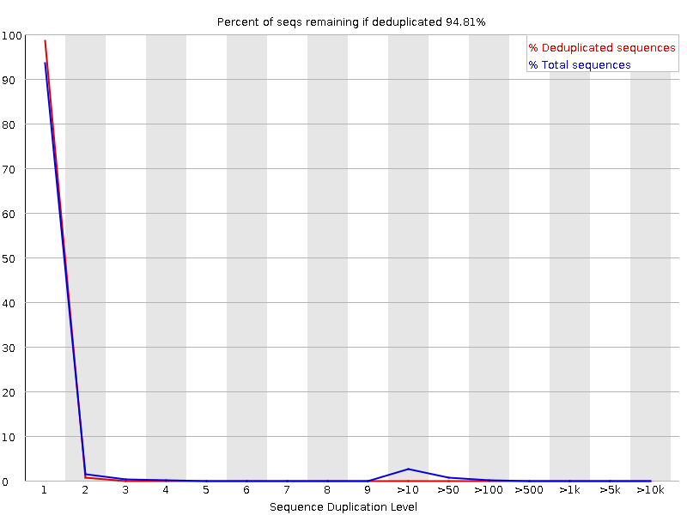
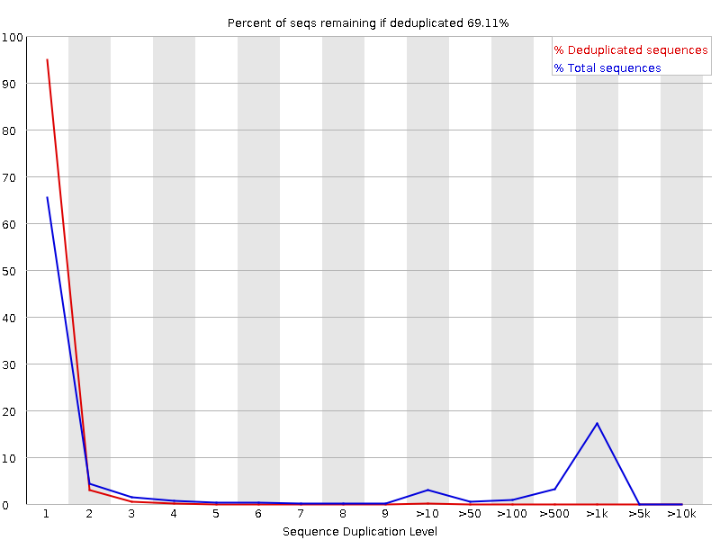
Duplicate Sequences
Good Illumina data
Bad Illumina data
Warning
non-unique sequences make up more than 20% of the total
Failure
non-unique sequences make up more than 50% of the total
Common reasons for warnings
technical duplicates arising from PCR artefacts
biological duplicates (repeated DNA sequences)
RNA-seq
Check: the distribution of duplicates in a specific genomic region (after alignment)
Constrained start site?

Slide 10
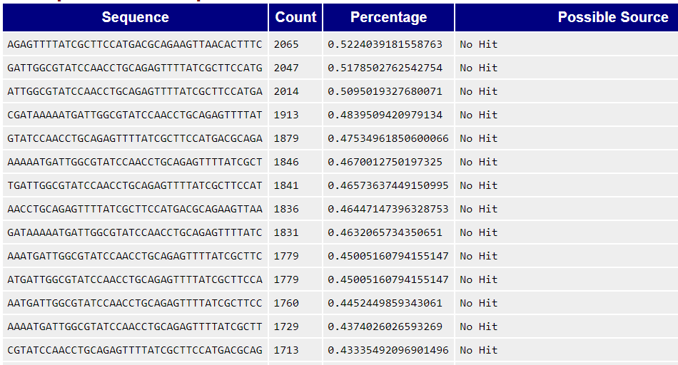
Overrepresented Sequences
Good Illumina data
Bad Illumina data
No overrepresented sequences
This module lists all of the sequence which make up more than 0.1% of the total
Warning
any sequence is found to represent more than 0.1% of the total
Failure
any sequence is found to represent more than 1% of the total
Common reasons for warnings
Biological significance
Technical contamination
small RNA libraries (generated without fragmentation)

Slide 11
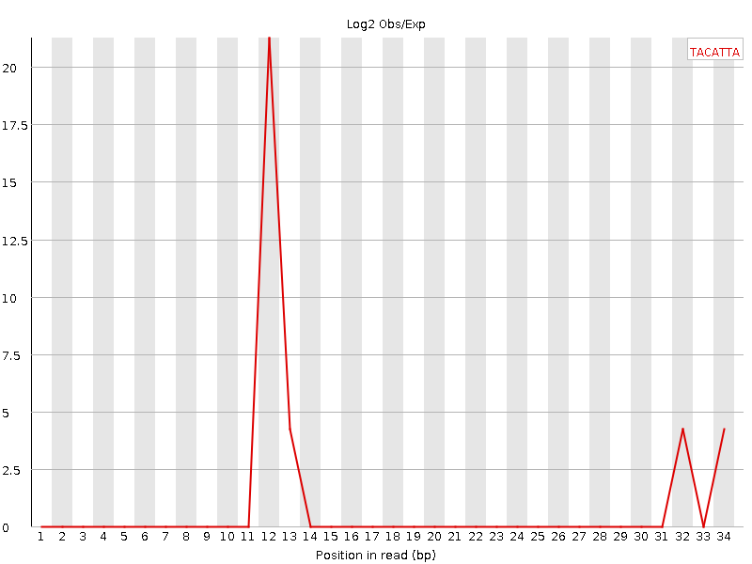
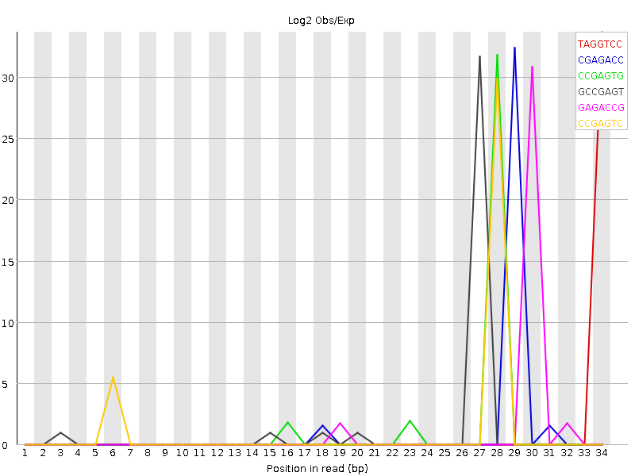
Kmer Content
Good Illumina data
Bad Illumina data
Common reasons for warnings
assumption that any small fragment of sequence should not have a positional bias in its apearance within a diverse library
random priming will nearly always show Kmer bias at the start
If you have very long sequences with poor sequence quality then random sequencing errors will dramatically reduce the counts for exactly duplicated sequences.
If you have a partial sequence which is appearing at a variety of places within your sequence then this won't be seen either by the per base content plot or the duplicate sequence analysis.
Warning
any k-mer is imbalanced with a binomial p-value <0.01.
Failure
ny k-mer is imbalanced with a binomial p-value < 10^-5.

