Slide 1
Coding DOJO
Test Driven Development by Andy Li

Slide 2
DOJO
Many programmer
Dojo(place)
Learn from each other(including other programmer’s mistakes)
Sum up experiences

Slide 3
Kata
Fixed pattern
The best practice
Repeat the exercise

Slide 4
TDD
Red
Green
refactor

Slide 5
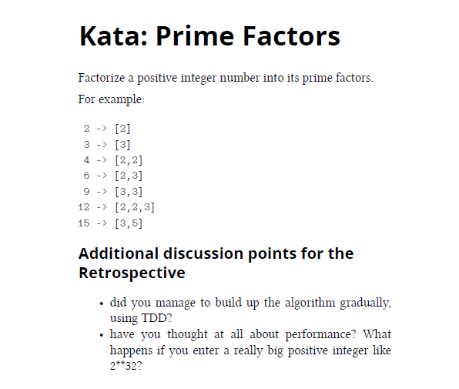
Kata : Prime Factors

Slide 6
Kata : Which are in
Given two arrays of strings a1 and a2 return a sorted array r in lexicographical order of the strings of a1 which are substrings of strings of a2.
#Example 1:
a1 = ["arp", "live", "strong"]
a2 = ["lively", "alive", "harp", "sharp", "armstrong"]
returns ["arp", "live", "strong"]
#Example 2:
a1 = ["tarp", "mice", "bull"]
a2 = ["lively", "alive", "harp", "sharp", "armstrong"]
returns []
Notes:
Arrays are written in "general" notation. See "Your Test Cases" for examples in your language.
In Shell bash a1 and a2 are strings. The return is a string where words are separated by commas.
Beware: r must be without duplicates.

Slide 7
Kata: Phone Numbers
Given a list of phone numbers, determine if it is consistent. In a consistent phone list no number is a prefix of another. For example:
Bob 91 12 54 26
Alice 97 625 992
Emergency 911
In this case, it is not possible to call Bob because the phone exchange would direct your call to the emergency line as soon as you dialed the first three digits of Bob's phone number. So this list would not be consistent.

