Slide 1
Decision Trees

Slide 2
Reading material
Main reading
”Machine Learning: A Probabilistic Perspective” by Murphy [ch. 16.2]
Extra reading
”Pattern Recognition and Machine Learning” by Bishop [ch. 14.4]

Slide 3
The 20-Questions Game
Does it have fur?
Does it bark?
Does it fly?
Dog
Cat
Bird
Fish

Slide 4
Tennis dataset
Outlook | Temperature | Humidity | Windy | PlayTennis
Sunny | Hot | High | False | No
Sunny | Hot | High | True | No
Overcast | Hot | High | False | Yes
Rainy | Mild | High | False | Yes
Rainy | Cool | Normal | False | Yes
Rainy | Cool | Normal | True | No
Overcast | Cool | Normal | True | Yes
Sunny | Mild | High | False | No
Sunny | Cool | Normal | False | Yes
Rainy | Mild | Normal | False | Yes
Sunny | Mild | Normal | True | Yes
Overcast | Mild | High | True | Yes
Overcast | Hot | Normal | False | Yes
Rainy | Mild | High | True | No

Slide 5
Tennis dataset: decision tree
Outlook | Temperature | Humidity | Windy | PlayTennis
Sunny | Hot | High | False | No
Sunny | Hot | High | True | No
Overcast | Hot | High | False | Yes
Rainy | Mild | High | False | Yes
Rainy | Cool | Normal | False | Yes
Rainy | Cool | Normal | True | No
Overcast | Cool | Normal | True | Yes
Sunny | Mild | High | False | No
Sunny | Cool | Normal | False | Yes
Rainy | Mild | Normal | False | Yes
Sunny | Mild | Normal | True | Yes
Overcast | Mild | High | True | Yes
Overcast | Hot | Normal | False | Yes
Rainy | Mild | High | True | No
Outlook?
Overcast
Sunny
Rainy
Yes

Slide 6
Tennis dataset: final decision tree
Outlook?
Sunny
Overcast
Rainy
Humidity?
Yes
Wind?
Normal
High
Weak
Strong
Yes
No
Yes
No

Slide 7
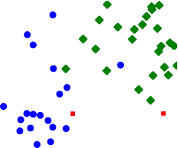

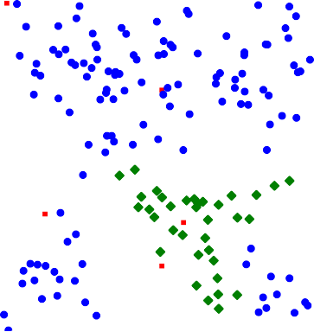
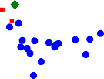
Numerical features
6
5
4
3
2
1
0
x₂
0
2
4
6
8
10
x₁
Example: data X with two features x₁ and x₂ and class labels y

Slide 8

Binary split
6
5
4
3
2
1
0
^{x}2
0
2
4
6
8 10
^{x}1
True
^{x}2 ^{≤ 3}
False
^{x}2 ^{≤ 1.7}
^{x}1 ^{≤ 7.8}
^{x}1 ^{≤ 3.7}
. . . . . . . . .
(2, 3, 112)
^{x}1 ^{≤ 1.7}
^{x}2 ^{≤ 3.9}
(4, 0, 1) (0, 24, 1)
(10, 0, 2)
Simplest decision: binary split on a single feature, x_{i} ≤ a
Distribution of classes in leaf: (red,green,blue)

Slide 9
Interpretation of a decision tree
. . .
^{x}2 ^{≤ 3.9}
True
False
(4, 0, 1)
(0, 24, 1)
Node =^ feature test → leads to decision boundaries.
Branch =^ different outcome of the preceding feature test.
Leaf =^ region in the input space and the distribution of samples in that region.
Decision trees partition the input space into cuboid regions.

Slide 10
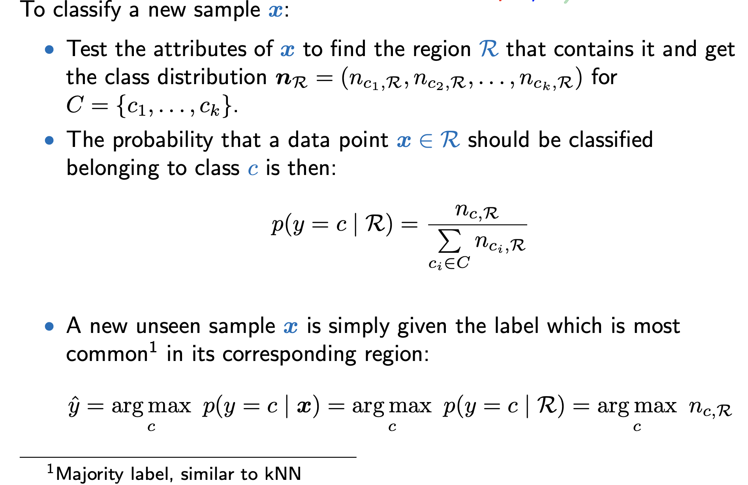
Inference on decision trees

Slide 11
Example prediction
6
5
4
3
2
1
x₂
Classification of x = (8.5, 3.5)^{T}
0
0
2
4
6
8
10
x₁
^{x}2 ^{≤ 3}
True
False
^{x}2 ^{≤ 1.7}
^{x}1 ^{≤ 7.8}
^{x}1 ^{≤ 3.7}
^{x}1 ^{≤ 1.7}
(2, 3, 112)
^{x}2 ^{≤ 3.9}
(4, 0, 1) (0, 24, 1)
. . .
. . .
(10, 0, 2)
. . .

Slide 12
Optimal decision tree
Generalization:Find a DT that performs well on new (unseen) data.
Again, split the dataset:
^{Training set D}T
^{Validation set D}V
^{Test set D}t
Learning set
D
build tree from training set D_{T} ,
predict validation set labels yˆ_{i} using the tree,
evaluate by comparing predictions yˆ_{i} to true labels y_{i}.
pick the tree that performs the best on the validation set
report final performance on the test set

Slide 13
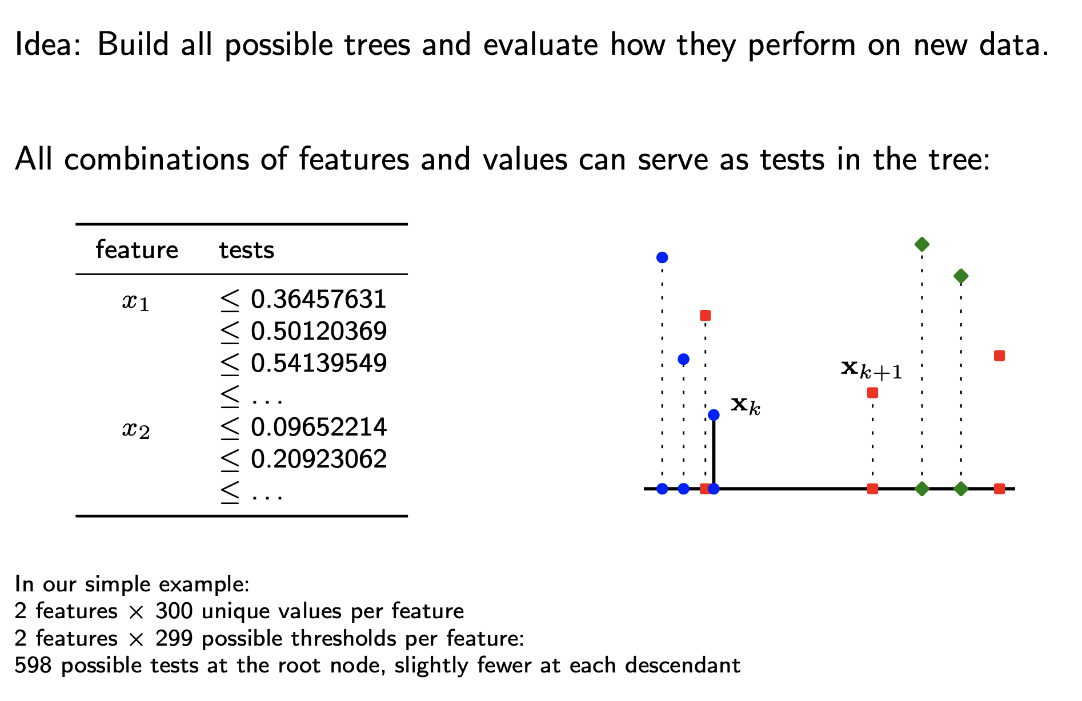
Naive idea

Slide 14
Building the optimal decision tree is intractable
Iterating over all possible trees is possible only for very small examples because the number of trees quickly explodes.
Finding the optimal tree is NP-complete ².
Instead: Grow the tree top-down and choose the best split node-by-node using a greedy heuristic on the training data.
²Optimal in the sense of minimizing the expected number of tests required to classify an unknown sample. Even the problem of identifying the root node in an optimal strategy is NP-hard. And several other aspects of optimal tree construction are known to be intractable.

Slide 15
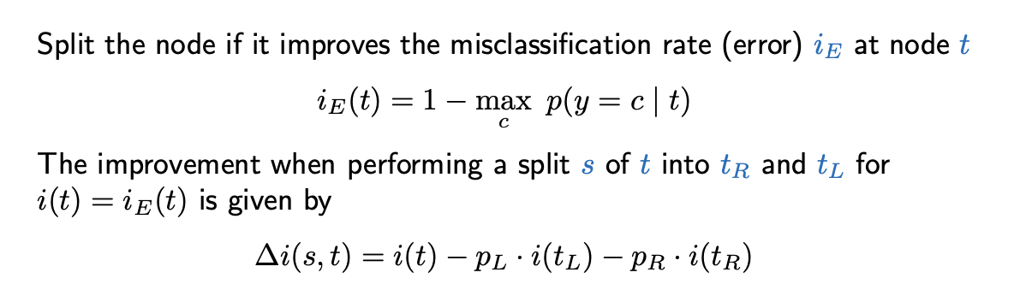
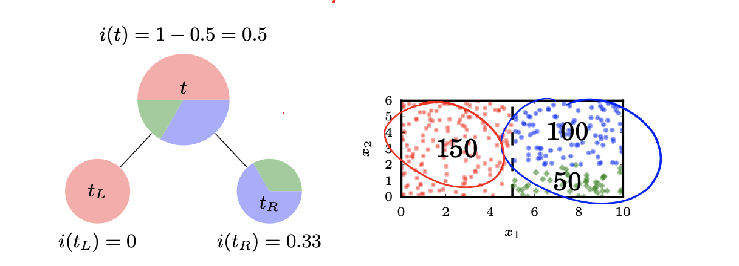
Example heuristic: misclassification rate

Slide 16



By repeatedly applying the heuristic
The distribution of labels becomes progressively more pure³...
^{x}2 ^{≤ 3}
^{x}2 ^{≤ 1.7}
^{x}1 ^{≤ 7.8}
True
False
^{x}1 ^{≤ 3.7}
^{x}1 ^{≤ 1.7}
x ≤ 3.9
2
(2, 3, 112)
. . .
. . .
(10, 0, 2)
. . .
(4, 0, 1) (0, 24, 1)
³ meaning we mostly have instances of the same class

Slide 17
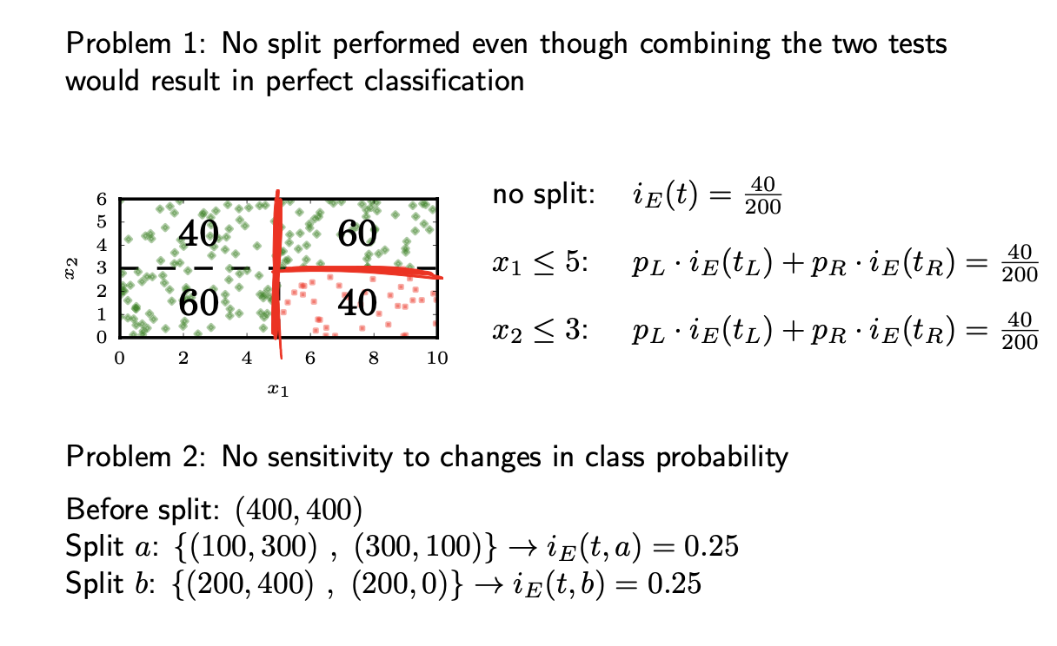
Problems with misclassification rate

Slide 18
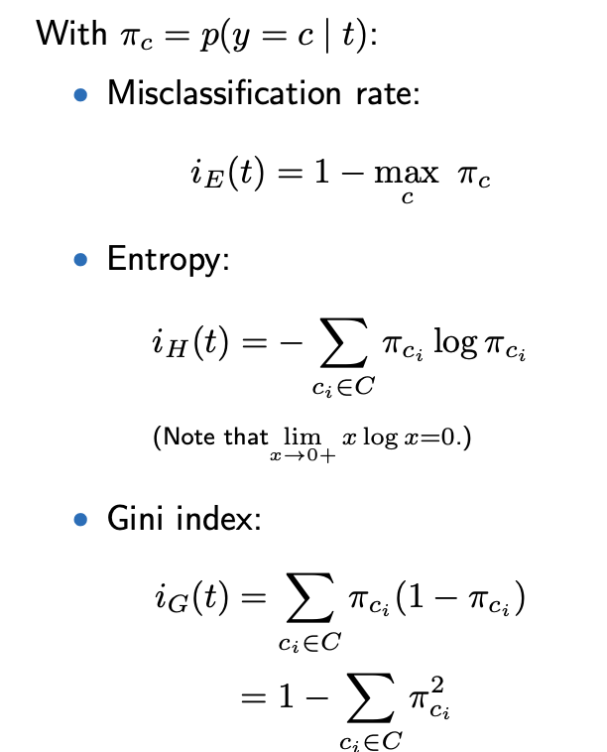
Impurity measures

Slide 19
Detour: Information Theory
Information theory is about encoding and transmitting information
We would like to encode four messages:
m₁ = “There is free beer.”
m₂ = “You have an exam.”
m₃ = “You have a lecture.”
m₄ = “Nothing happening.”

Slide 20
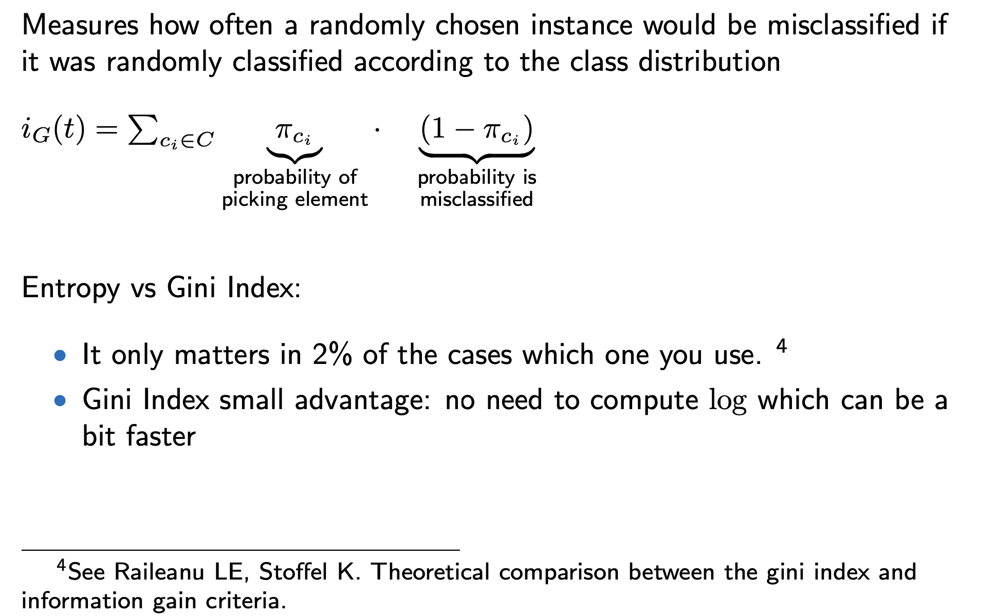
Gini Index

Slide 21
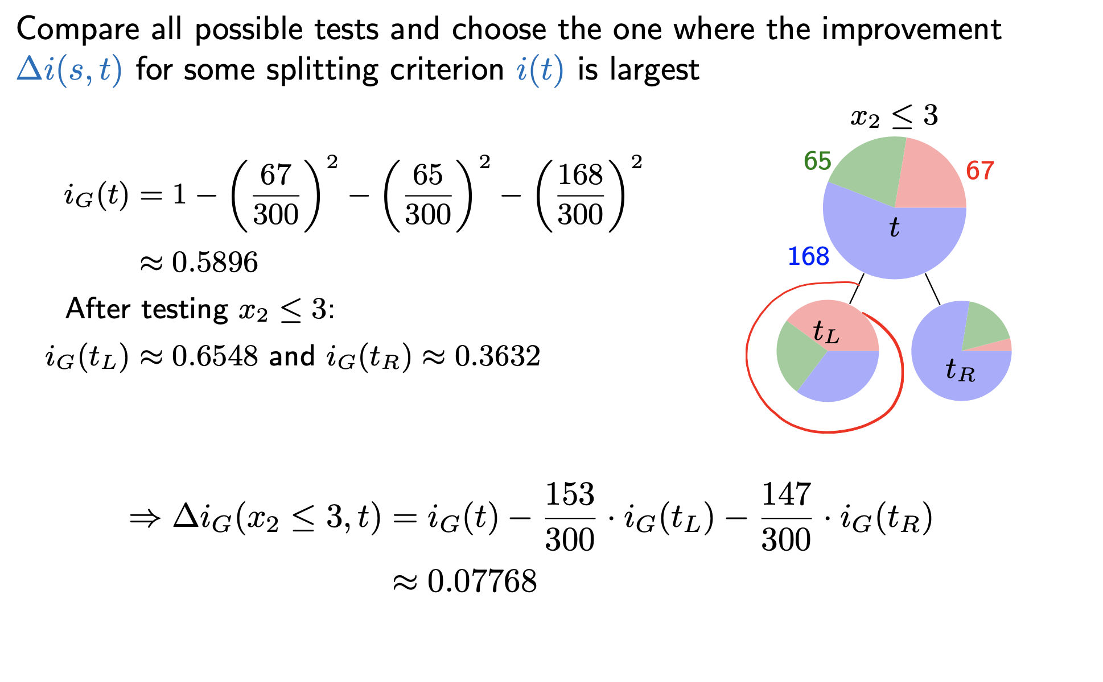
Building a decision tree

Slide 22
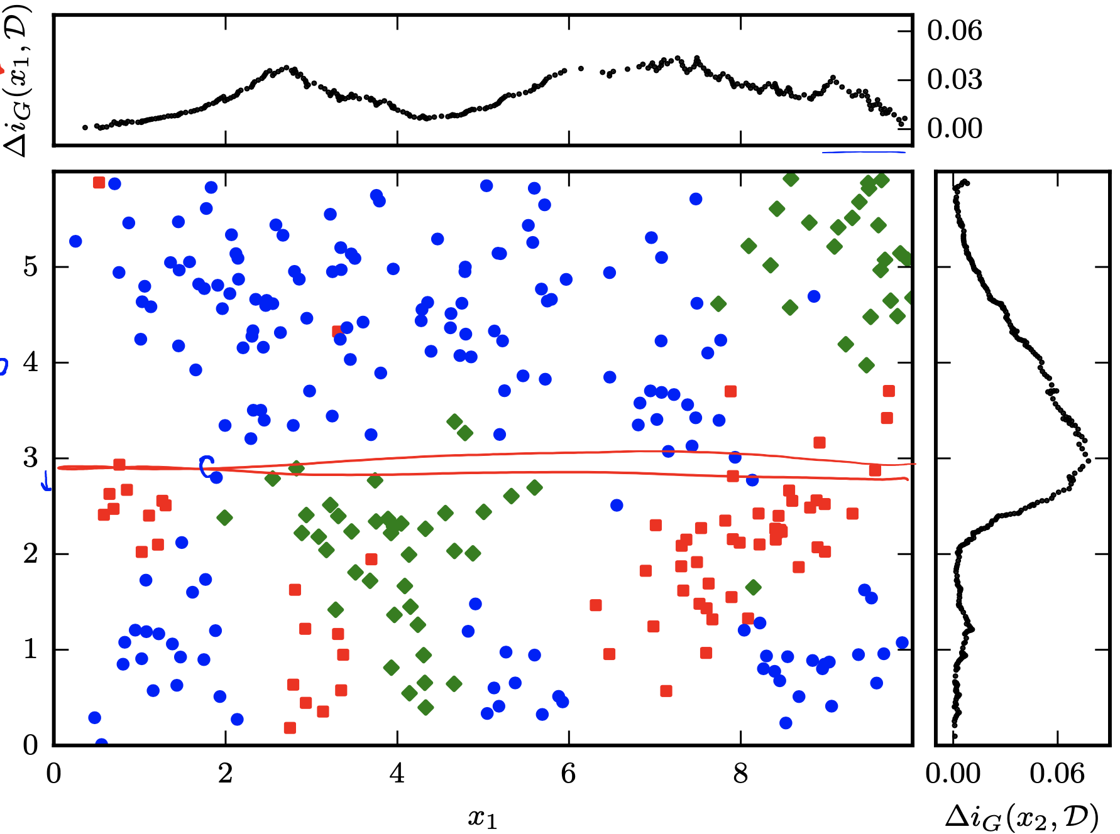

Slide 23



Decision boundaries at depth 1
6
5
4
3
2
1
0
x₂
0
2
4
6
8
10
x₁
Accuracy on the whole data set: 58.3%

Slide 24

Decision boundaries at depth 2
6
5
4
3
2
1
0
x₂
0
2
4
6
8
10
x₁
Accuracy on the whole data set: 77%

Slide 25

Decision boundaries at depth 3
6
5
4
3
2
1
0
x₂
0
2
4
6
8
10
x₁
Accuracy on the whole data set: 84.3%

Slide 26

Decision boundaries at depth 4
6
5
4
3
2
1
0
x₂
0
2
4
6
8
10
x₁
Accuracy on the whole data set: 84.3%

Slide 27
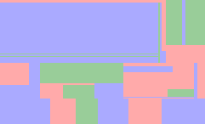
Decision boundaries of a maximally pure tree
6
5
4
3
2
1
0
x₂
0
2
4
6
8
10
x₁
Accuracy on the whole data set: 100%

Slide 28
Decision boundaries of a maximally pure tree
6
5
4
3
2
1
0
x₂
0
2
4
6
8
10
x₁
Accuracy on the whole data set: 100% → Good generalization?

Slide 29
Overfitting
Overfitting typically occurs when we try to model the training data perfectly.
Overfitting means poor generalization!

Slide 30
Overfitting
Overfitting typically occurs when we try to model the training data perfectly.
Overfitting means poor generalization! How can we spot overfitting?
low training error, possibly 0
validation error is comparably high

Slide 31
1.0
0.9
Overfitting
0.8
0.7
Accuracy
0.6
Underfitting
5 10
Train Validation
0.5
15 20 25
30
Number of leaf nodes
The training performance monotonically increases with every split.
The validation performance tells us how well our model generalizes, not the training performance!

Slide 32
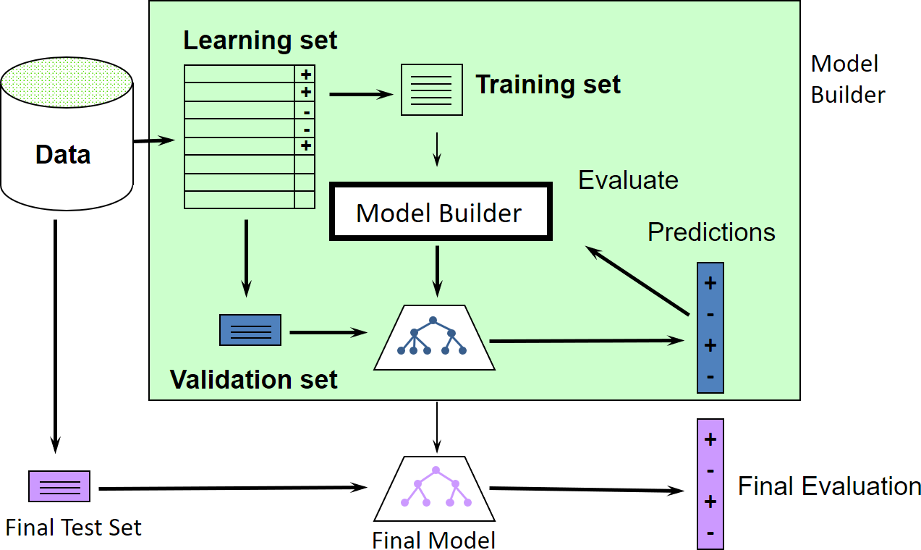
Good data science
How to do model selection / battle overfitting?
Only touch the test set once at the end to report final performance!

Slide 33
K-fold Cross-Validation
^{D}T₁
^{D}V₁
^{D}T₂ | ^{D}V₂ | ^{D}T₂
^{D}V₃
^{D}T₃
^{Learning set D}L
^{Test set D}t
D

Slide 34
K-fold Cross-Validation
^{D}T₁
^{D}V₁
^{D}T₂ | ^{D}V₂ | ^{D}T₂
^{D}V₃
^{D}T₃
^{Learning set D}L
^{Test set D}t
D
Split your learning data into K folds (10-fold CV is common).
Use K − 1 folds for training and the remaining for evaluation.
Average over all folds to get an estimate
of the error for a setting of your hyper-parameters
or the model for your model selection
Try different settings for your hyper-parameters.
Use all your training data and the best hyper-parameters for final training (and testing) of your model.

Slide 35
The extreme case - LOOCV
In leave-one-out-cross validation (LOOCV) we train on all but one sample.
If we have N samples, this is the same as N -fold cross-validation.
LOOCV is interesting if we do not have a lot of data and we want to use as much of it for training as possible but still get a good estimate of model performance.

Slide 36
The extreme case - LOOCV
In leave-one-out-cross validation (LOOCV) we train on all but one sample.
If we have N samples, this is the same as N -fold cross-validation.
LOOCV is interesting if we do not have a lot of data and we want to use as much of it for training as possible but still get a good estimate of model performance.
But it also means that we need to train our model N times...
If we have sufficiently large amounts of data and training our model is computationally expensive, we better stick to lower numbers of K or a single validation set.

Slide 37
Back to Decision Trees

Slide 38
Stopping criterion
We are recursively splitting the data, thereby growing the DT. When to stop growing?
Possible stopping (or pre-pruning) criteria:
distribution in branch is pure, i.e i(t) = 0
maximum depth reached
number of samples in each branch below certain threshold t_{n}
benefit of splitting is below certain threshold ∆i(s, t) < t∆
accuracy on the validation set

Slide 39
Stopping criterion
We are recursively splitting the data, thereby growing the DT. When to stop growing?
Possible stopping (or pre-pruning) criteria:
distribution in branch is pure, i.e i(t) = 0
maximum depth reached
number of samples in each branch below certain threshold t_{n}
benefit of splitting is below certain threshold ∆i(s, t) < t∆
accuracy on the validation set
Or we can grow a tree maximally and then (post-)prune it.

Slide 40
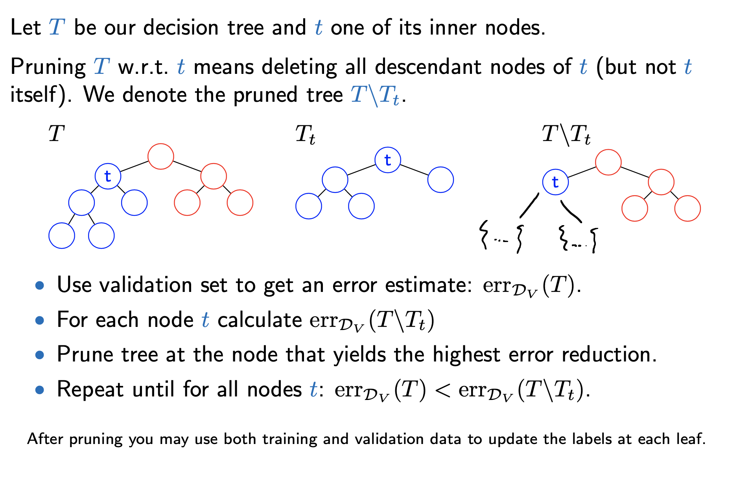
Reduced error pruning

Slide 41
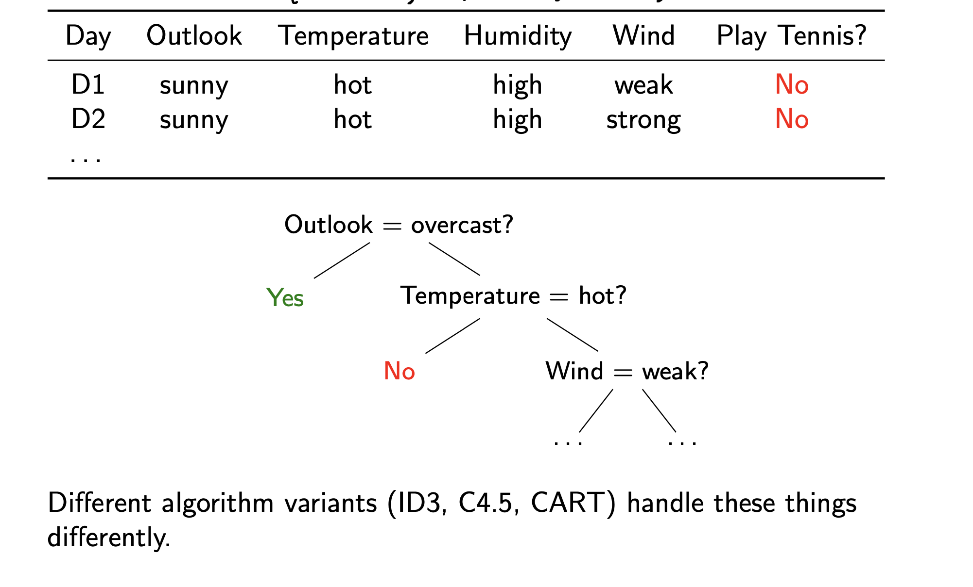

Slide 42
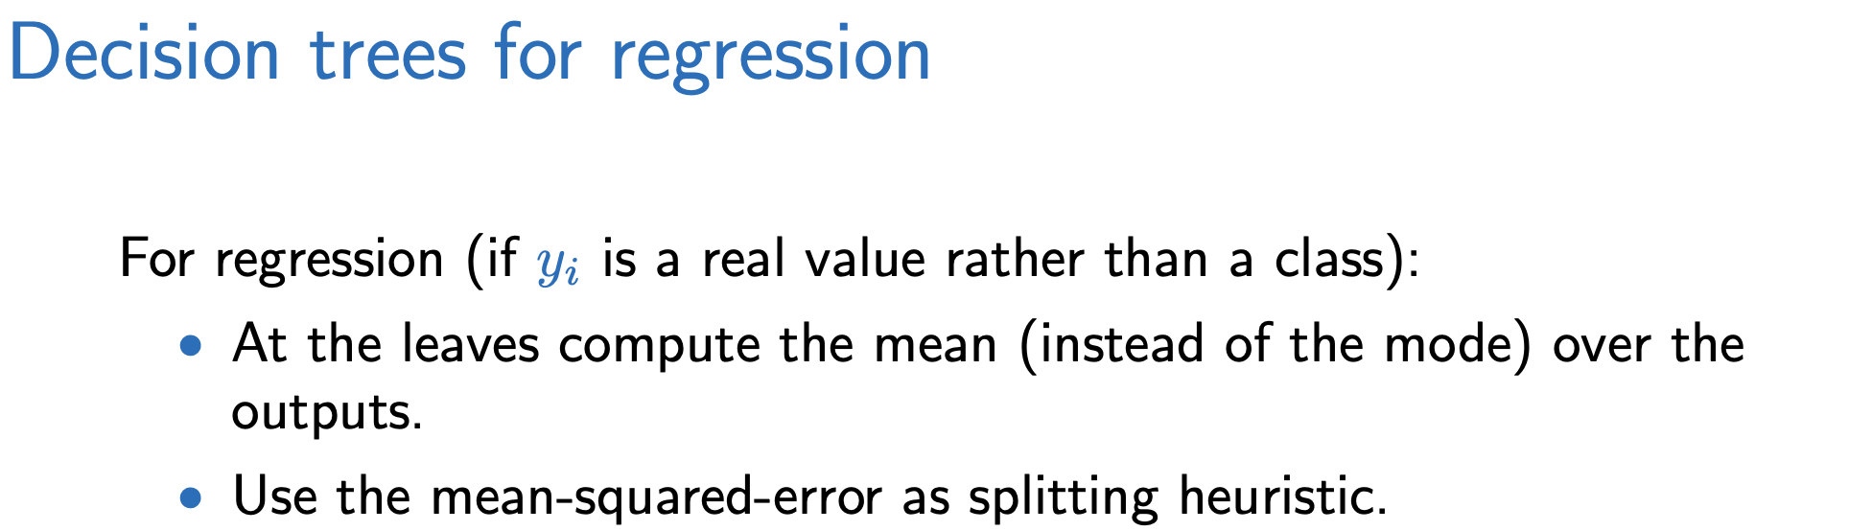

Slide 43
Considerations
Human interpretable
Can handle any combination of numerical and categorical features and targets
Extensions (e.g. random forests, boosted trees) have very competitive performance (e.g. Kaggle competitions)
Compared to k-NN:
Much better complexity w.r.t. memory/storage and inference
More flexible decision function

Slide 44
What we learned
Interpretation and building of Decision Trees
Impurity functions / Splitting heuristics
Overfitting
Good data science

