Slide 1
KNN

Slide 2
Reading material
Main reading
”Machine Learning: A Probabilistic Perspective” by Murphy [ch. 1.4.1 - 1.4.3]
Extra reading
”Bayesian Reasoning and Machine Learning” by Barber [ch. 14]

Slide 3
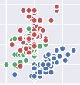
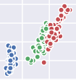
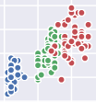
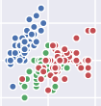
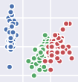
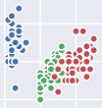
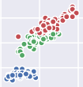
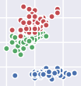
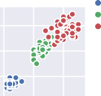
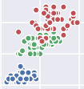
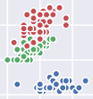
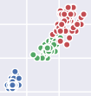
Iris dataset
8
7
6
5
4
sepal_length
4
3
2
sepal_width
species setosa versicolor virginica
6
petal_length
4
2
2
1
0
petal_width
4 6
sepal_length
8
2 3 4
sepal_width
2.5 5.0
petal_length
0 1 2
petal_width

Slide 4
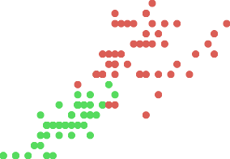

Iris dataset: 2 features
2.5
2.0
1.5
1.0
0.5
0.0
1
2
3
4
5
6
7
How do we intuitively label new samples by hand?
Look at the surrounding points. Do as your neighbor does.

Slide 5
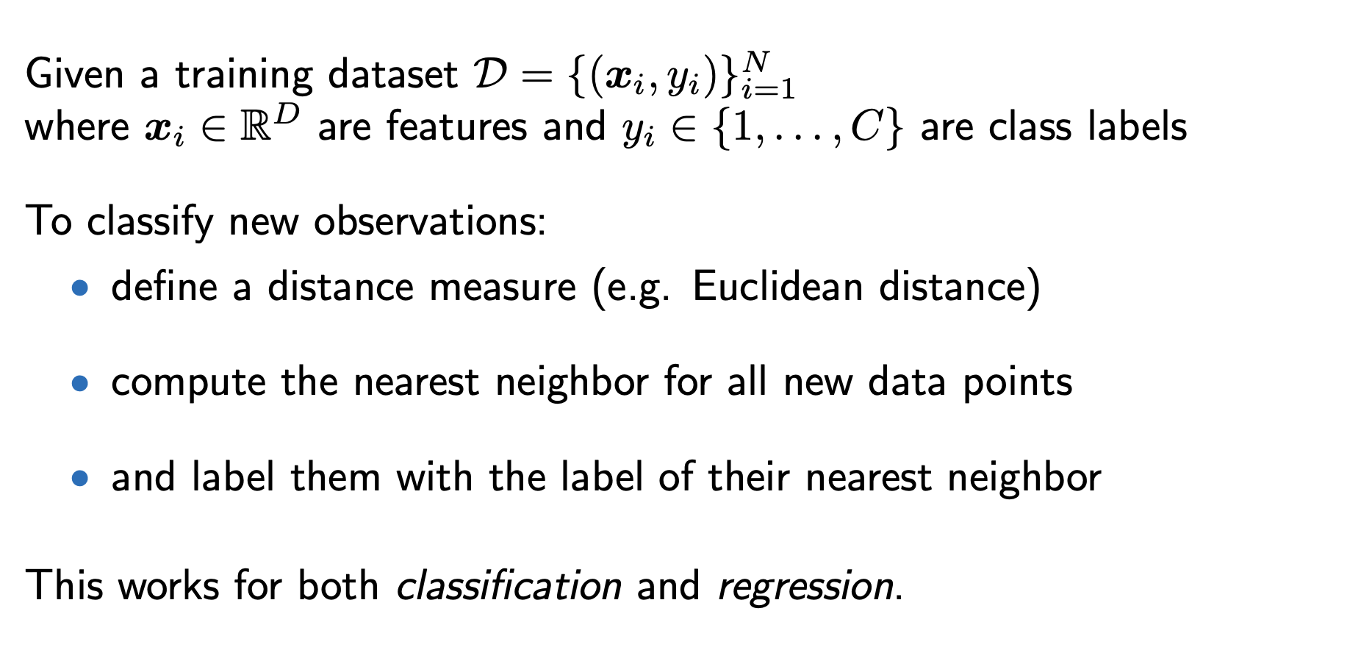
1-NN algorithm

Slide 6
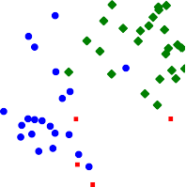

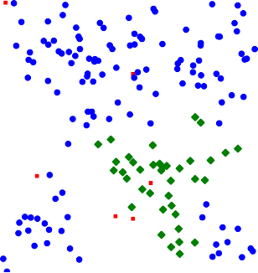

1-NN
6
5
4
3
2
1
0
^{x}2
0
2
4
6
8
10
^{x}1

Slide 7
k-Nearest Neighbor classification
More robust against errors in the training set:
Look at multiple nearest neighbors and pick the majority label.

Slide 8
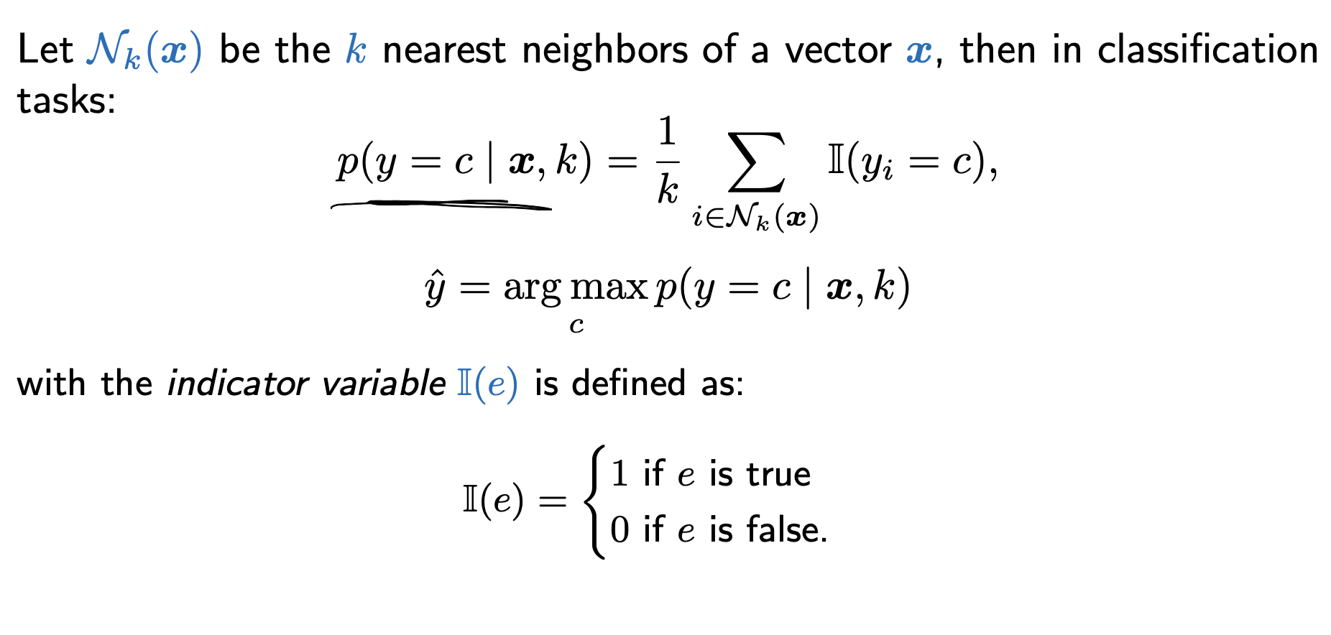
k-Nearest Neighbor classification

Slide 9
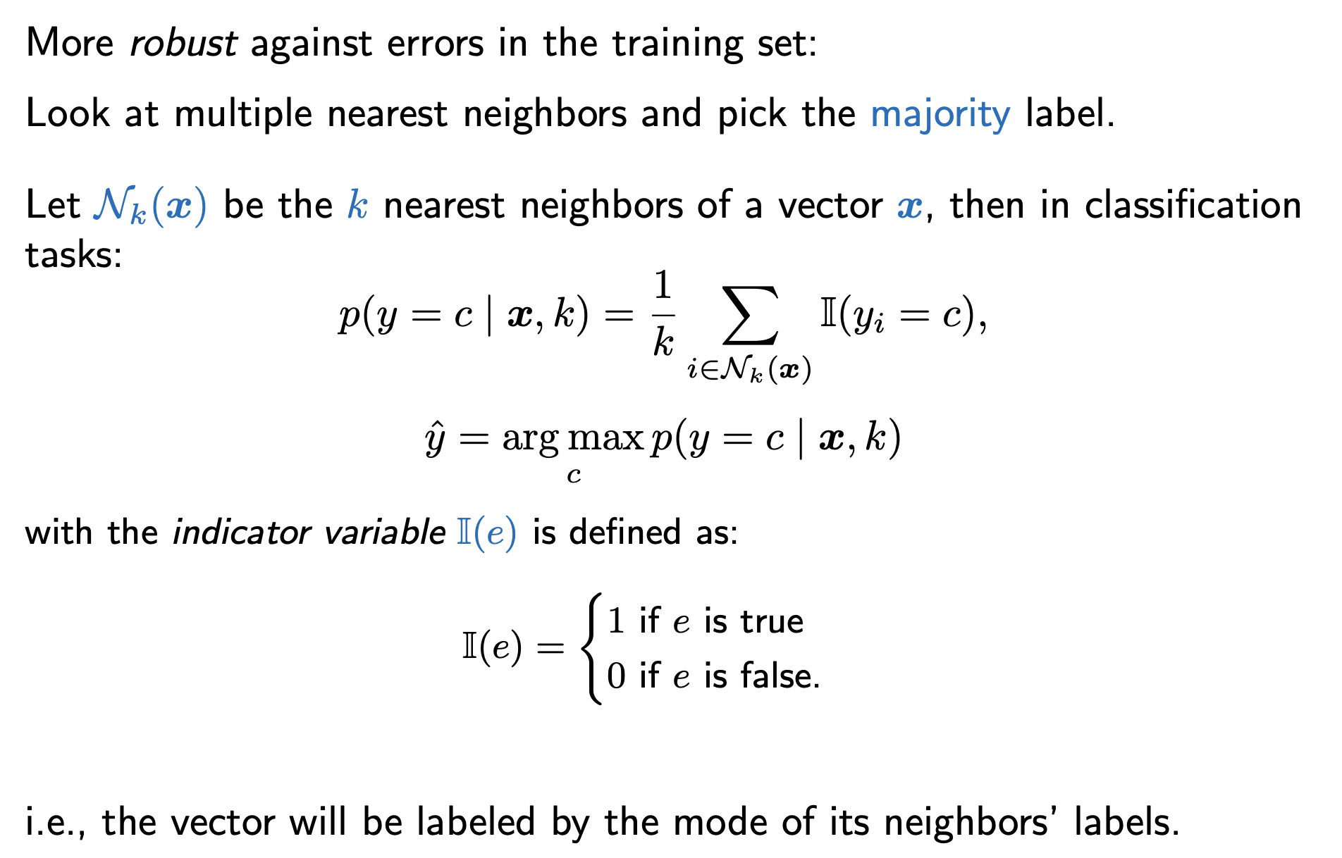
k-Nearest Neighbor classification

Slide 10
k-Nearest Neighbor classification: weighted
Look at multiple nearest neighbors and pick the weighted majority label.

Slide 11
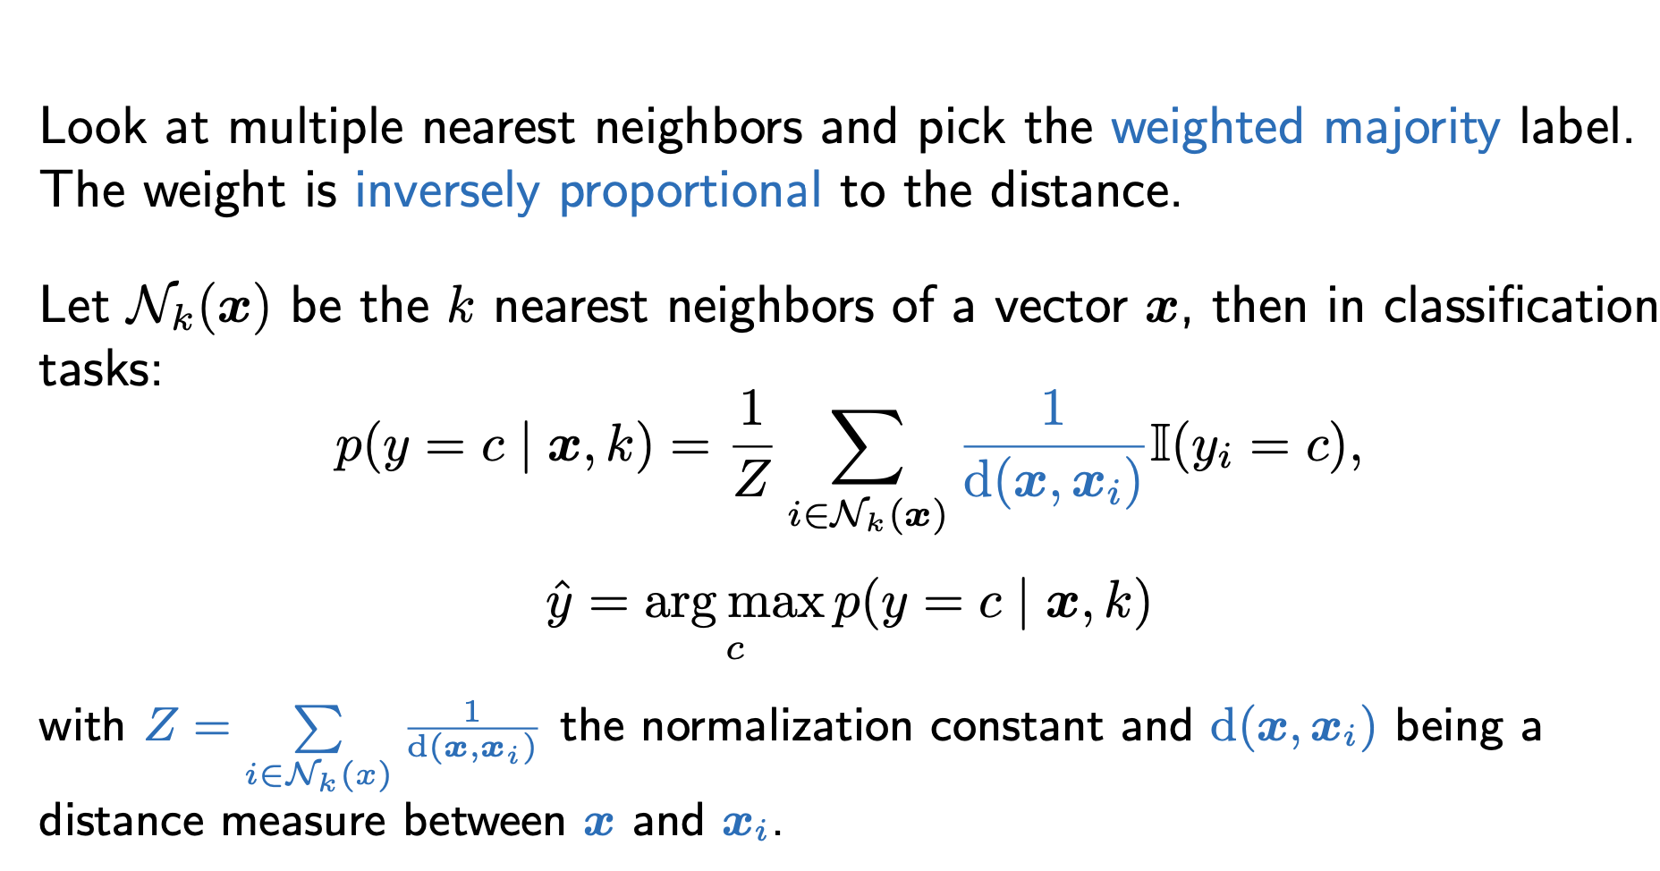
k-Nearest Neighbor classification: weighted

Slide 12




3-NN
6
5
4
3
2
1
0
^{x}2
0
2
4
6
8
10
^{x}1
So, how many neighbors are best?

Slide 13
1-NN
6
5
4
3
2
1
0
^{x}2
0
2
4
6
8
10
^{x}1
Compare the decision boundaries of 1-NN and 3-NN

Slide 14
Choosing k
Goal is generalization: pick k (called a hyper-parameter) that performs best on unseen (future) data.
Unfortunately, no access to future data, so split the dataset D:
^{Training set D}T
^{Validation set D}V
^{Learning set D}L
^{Test set D}t
D
Hyper-parameter tuning procedure
Learn the model using the training set
Evaluate performance with different k on the validation set
picking the best k
Report final performance on the test set.

Slide 15
Using validation set to choose k
1.0
validation accuracy
0.9
0.8
0.7
Accuracy
5
10 15 20
25
30
Number of neighbors
We choose k = 7.

Slide 16
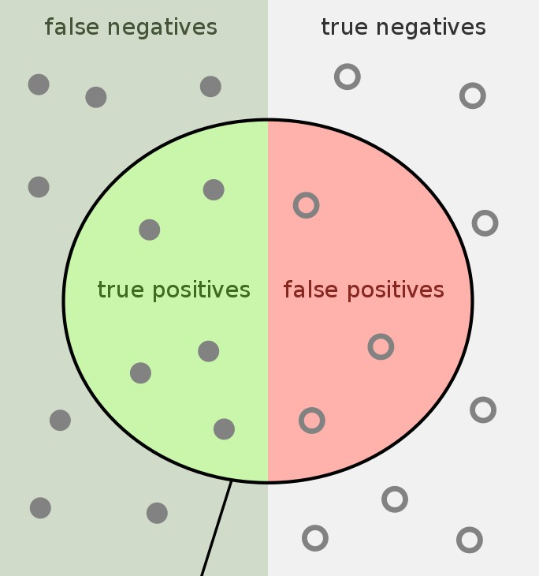
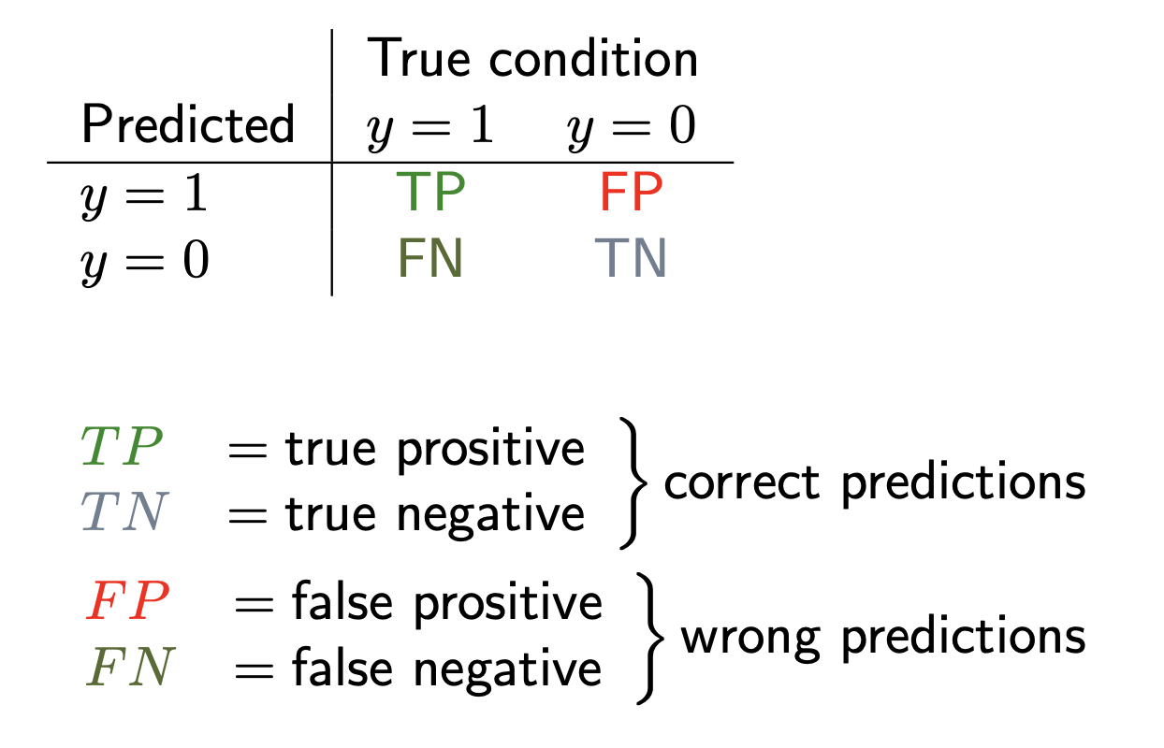
Measuring classification performance
How can we assess the performance of a (binary) classification algorithm?
⇒ Confusion table

Slide 17
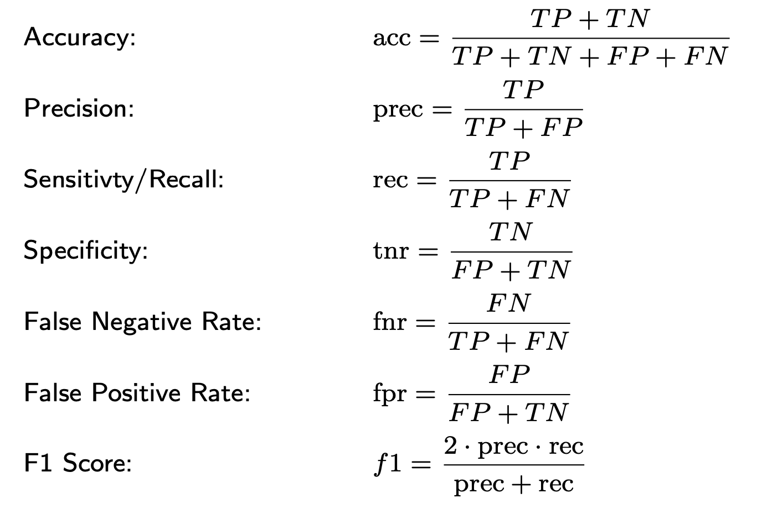
Measuring classification performance
⇒ Trade-off between precision and recall: increasing one (most often) leads to decreasing the other
General note: Be careful when you have imbalanced classes!

Slide 18
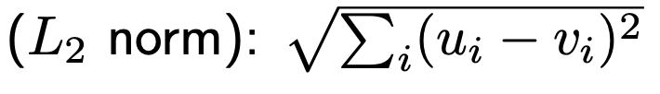
Distance measures
K-NN can be used with various distance measures → highly flexible
Euclidean distance

Slide 19
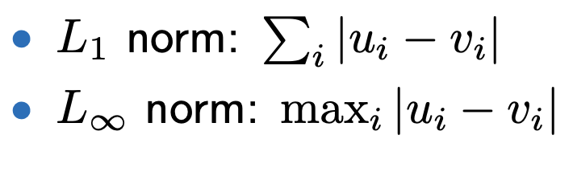
Distance measures
K-NN can be used with various distance measures → highly flexible
Euclidean distance

Slide 20
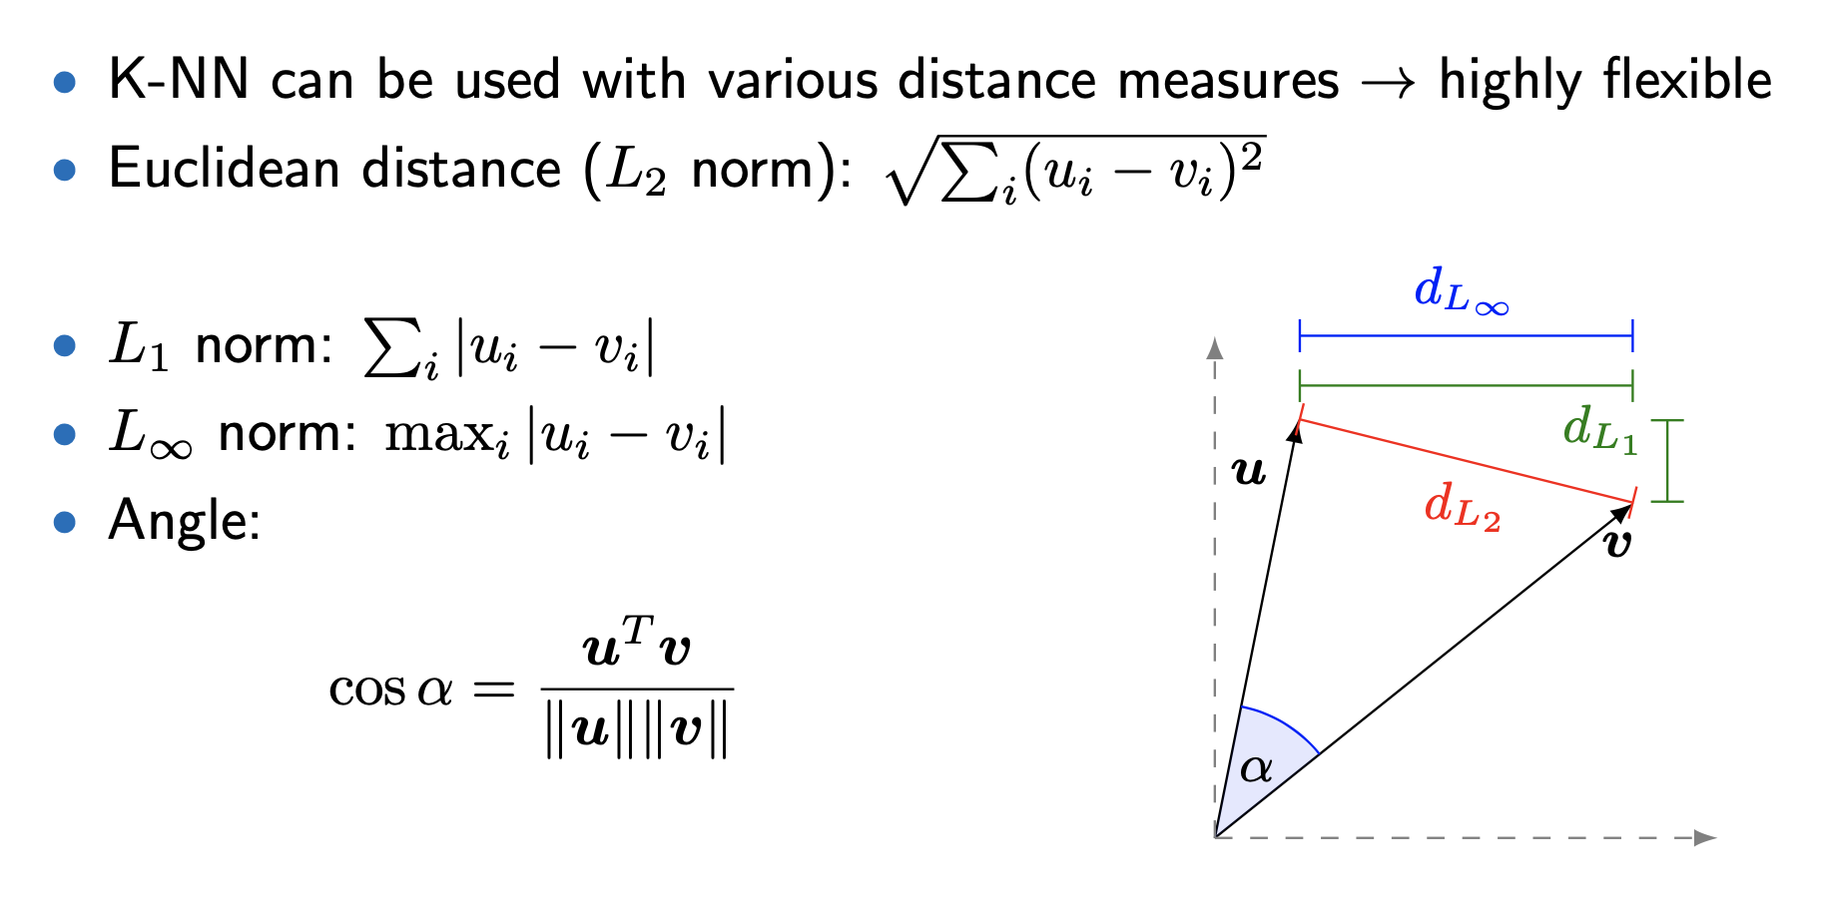
Distance measures
https://montjoile.medium.com/l0-norm-l1-norm-l2-norm-l-infinity-norm-7a7d18a4f40c

Slide 21
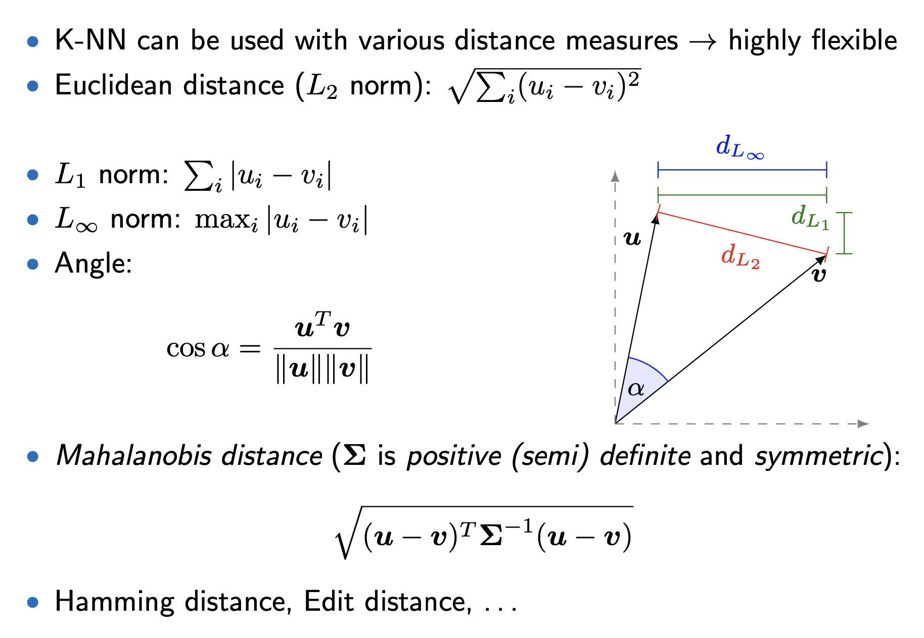
Distance measures

Slide 22
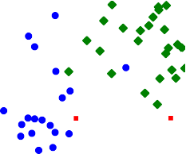

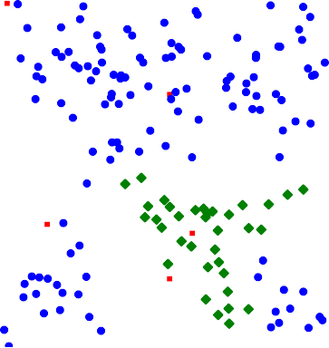
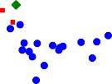
Scaling issues
6
5
4
3
2
1
x₂
0
0
10
20
30
40
50
x₁
The same old example but one of our features is in the order of meters,
the other in the order of centimeters. (k = 1)

Slide 23
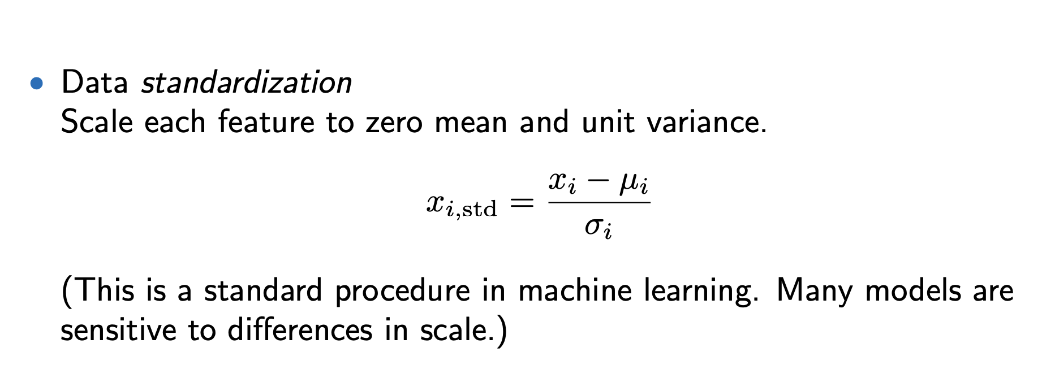
Circumventing scaling issues

Slide 24
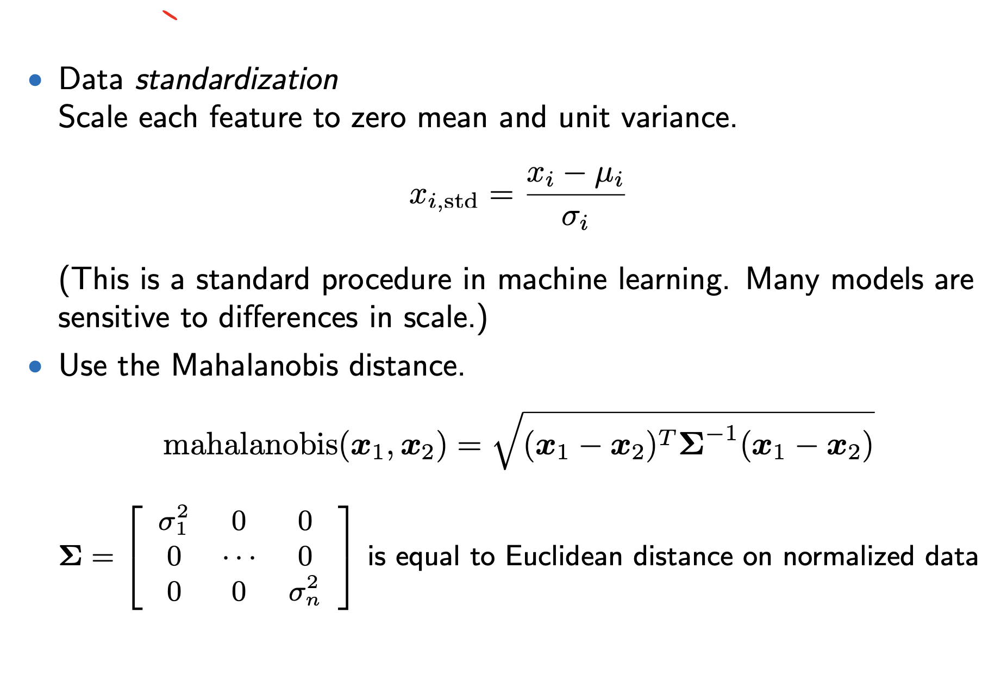
Circumventing scaling issues

Slide 25
Practical considerations
Expensive: memory and naive inference are both O(N ):
we need to store the entire training data and compare with all training instances to find the nearest neighbor
Solution: use tree-based search structures (e.g. k-d tree) for efficient (approximate)

Slide 26
What we learned
k-NN Algorithm
Train-validation-test split
Measuring classification performance
Distance metrics

