Slide 1
Security Engineering Week 1 Engineering Lecture (COMP6441/COMP6841) Rahat Masood @Term 2, 2025, UNSW Sydney

Slide 2

Agenda
Admin Stuff
Security Engineering
Security Terminologies
Security Theatre
Security-By-Design
CIA and CIANA
Data in Attacks

Slide 3
Consent/Ethics
Course content may include ideas that could cause harm or disruption if misused
Students must follow the Good Faith Policy in all courses
Do not act in ways that disrepute the course, staff, students, school, university, or ICT profession
Be a good citizen in all academic and professional conduct
Policy details: sec.edu.au/good-faith-policy
Maintain a high standard of professionalism
Show respect for others and consider the impact of your actions

Slide 4
Switching between COMP6441 & COMP6841
You can only swap via myUNSW if a spot opens up (School policy requires use of central system)
COMP6441
For students interested in security
No need for advanced technical skills
Focus on design, risk, and analysis
No requirement to “break” things
COMP6841
Covers all COMP6441 content + wargames
Designed to simulate breaking systems
Requires more technical knowledge
Fewer Core Engineer Activities to make room for wargames
Optional: COMP6441 students may try 6841 wargames (no marks awarded)

Slide 5
What is Security Engineering
What Do Engineers Do?
Engineers solve real-world problems that impact society.
They develop practical, innovative solutions to complex challenges.
Provide recommendations, designs, and consider multiple factors (cost, risk, usability, etc.).
Think of Other Engineers
Civil Engineers – Design bridges, roads, and infrastructure.
Aerospace Engineers – Solve problems related to flight and space travel.
Biomedical Engineers – Tackle health issues with medical tech and innovation.
Notes:
Engineers solve problems which exist within society. We develop solutions to tackle complex issues which exist in the world.
They provide recommendations, potential designs and other factors at play. Think about other engineers such as Civil Engineers, Aerospace Engineers, Biomedical Engineers and what problems they try to solve and how they go about doing it. They each have their own speciality which you call them upon when there is a problem within their domain.

Slide 6
What is Security Engineering
Security Engineers do the same - solving risks in digital and physical systems.
Security Engineering
Security Engineering is the discipline of designing systems, infrastructures, and protocols that protect information, people, and assets from harm, misuse, or failure, across both physical and digital domains.
Notes:
Security Engineering is the discipline of designing systems, infrastructures, and protocols that protect information, people, and assets from harm, misuse, or failure—across both physical and digital domains.

Slide 7
What is Security Engineering
What Security Engineers Do
Design secure systems: Build and maintain secure architectures.
Anticipate threats: Think like attackers to uncover vulnerabilities.
Conduct risk assessments: Identify and prioritize security risks.
Develop countermeasures: Implement controls and mitigations.
Incident response: Investigate and remediate breaches or attacks.
Notes:
Security Engineering is the discipline of designing systems, infrastructures, and protocols that protect information, people, and assets from harm, misuse, or failure—across both physical and digital domains.

Slide 8
Security Engineering Lifecycle
Identify Assets
Assess Threats & Risks
Design Controls
Implement Solutions
Test & Audit
Monitor & Update Continuously
Notes:
Security Engineering is the discipline of designing systems, infrastructures, and protocols that protect information, people, and assets from harm, misuse, or failure—across both physical and digital domains.

Slide 9
Some Professional Skills of an Engineer
Measurement
Skepticism
Testing
Review
Openness/
Transparency
Treatment of errors
Standards
Professionalism
Closing the loop

Slide 10
Engineering Lectures
Physical World = Easier to Understand
Real-world incidents are less abstract than cyber ones
Fewer obscurities and complexities
More transparent examples of what went right or wrong
Physical → Cyber Learning
Case studies help us transfer lessons from physical events to cyber contexts
Protocols, incidents, and mitigations often mirror one another
Security is Everywhere
- You make hundreds of security decisions daily:
Crossing a street
Gates, fences, locks
Building access and surveillance
Notes:
Although these lectures are more technical (than the Core) - but not as technical as the Extended Lectures, it is important to understand why we use Case Studies and a lot of analogies
A lot of incidents which are easier to understand (without so many obscurities, complexities and lack of transparencies) is within the physical domain
We better understand incidents and protocols which are successful and failures through real-world known events which then teach us how to deal with incidents within the cyber domain
We see Physical Examples of Security Everywhere much easier than cyber – you likely made hundreds of decisions today on your own security
Decisions Crossing Roads
Gates and Fences you see around you – who determines what height they should be or if they are the right type for the situation

Slide 11
Security Terminologies
What is the difference between Bugs, Vulnerabilities, and Exploitation?

Slide 12
Security Terminologies
Bugs Vs Vulnerabilities Vs Exploitation
Bugs are mistakes which programmers usually make
Vulnerabilities are Bugs which cause Security Incidents
Exploitation is when someone takes advantage of a vulnerability
Bugs | Vulnerabilities | Exploitation
Buffer overflow | BlueKeep | Remote code execution
Race condition | Shellshock | Authentication bypass
Access violation | Dirty COW | Sensitive information disclosure
Infinite loop | Heartbleed | Denial of Service
Division by zero | EternalBlue | Security feature bypass
Off-by-one error | SQL injection | Privilege escalation
Null pointer dereference | Code injection | User session takeover
Input validation error | Directory traversal | Man-in-the-middle
Resource leak | XSS, CSRF, SSRF | Malicious file upload

Slide 13
Security Terminologies
Data | Information
A collection of facts or figure | The result of analyzing and interpreting the data
Unorganized | Has context
Without Context | Can be used to help make decisions
Can be quantitative (numerical) or qualitative (descriptive) | Examples: Customer sentiments, user tracking from sensors, network logs reports, user identification
Examples: sensors data, demographics, bank account numbers, web browsing activity
Data/Information
Data is usually unorganised facts
Information is data that has been processed
Notes:
Data represents raw elements or unprocessed facts, from numerical values and symbolic representations to textual content and visual imagery. When collected and observed without interpretation, these elements remain mere data points—discrete and disorganized entities lacking inherent meaning or significance.
You get information when data is processed, organized, interpreted, and structured. The comprehensible output derived from raw data helps inform decisions, strategies, and actions. Information is data made valuable and accessible—an integral component of decision-making.

Slide 14
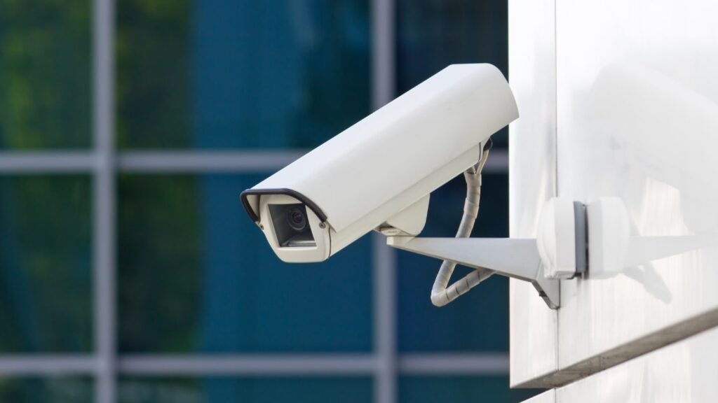
Security Theatre: The Illusion of Security
What is Security Theatre?
The appearance of security without real effectiveness
Makes people feel safer, not be safer
Common Examples:
- Signs saying “CCTV in operation 24/7”
Is the camera even installed?
Is it monitored or just for show?
Notes:
Security Theatre is the allusion that Security Exists
It is the presentation of security which makes people feel safer without much actual improvements in Security
Organisations may create the allusion that security is at the forefront of their minds, yet lack actionables to backup their claims
Security Theatre also exists around us – For example, a sign which says CCTV monitored 24/7
Is there even a CCTV?
Is it actually being monitored or decommissioned?

Slide 15
Security Theatre: The Illusion of Security
Why It Matters:
- Organisations may claim security is a priority…
But without real actions, it’s only a facade
- Can lead to complacency and false trust

Slide 16
Security Theatre in Code
How the Security Theatre Can Happen in Code?
Notes:
An Example of this:
Sometimes, developers may choose to obscure a vulnerability by obfuscating code for instance, so it is harder for attackers to read any piece of code which they can use to exploit
By making the code harder to read by using obfuscation techniques, less people may be motivated enough to break the code (much like if they saw a CCTV sign)
Despite this, this still leaves the application vulnerable as it does not fix the underlying issues and root causes within the code

Slide 17
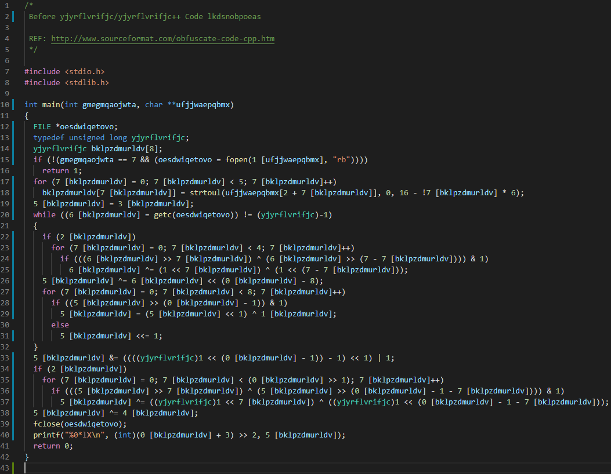
Security Theatre in Code
What Does It Look Like?
Developers obfuscate code to make vulnerabilities less visible
Appears like a security measure, but doesn't fix actual flaws
Similar to putting up a CCTV sign without a real camera
Notes:
An Example of this:
Sometimes, developers may choose to obscure a vulnerability by obfuscating code for instance, so it is harder for attackers to read any piece of code which they can use to exploit
By making the code harder to read by using obfuscation techniques, less people may be motivated enough to break the code (much like if they saw a CCTV sign)
Despite this, this still leaves the application vulnerable as it does not fix the underlying issues and root causes within the code

Slide 18
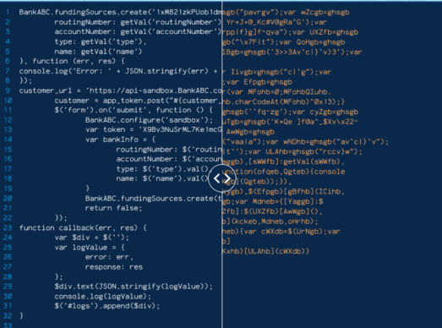
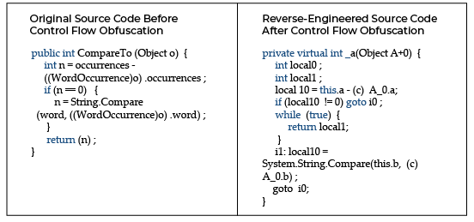
Security Theatre in Code
Notes:
In this example, the JavaScript code has been transformed to obscure its functionality. Techniques such as variable renaming, string encoding, and control flow alterations are commonly used in code obfuscation. While these methods can deter casual inspection, they do not address underlying vulnerabilities and can give a false sense of security.

Slide 19
Security Theatre in Code
Why Code Obfuscation is a Problem?
Notes:
An Example of this:
Sometimes, developers may choose to obscure a vulnerability by obfuscating code for instance, so it is harder for attackers to read any piece of code which they can use to exploit
By making the code harder to read by using obfuscation techniques, less people may be motivated enough to break the code (much like if they saw a CCTV sign)
Despite this, this still leaves the application vulnerable as it does not fix the underlying issues and root causes within the code

Slide 20
Security Theatre in Code
Why Code Obfuscation is a Problem?
Only hides the vulnerability, doesn’t resolve it
Attackers with skill can still break it
Creates a false sense of protection
Notes:
An Example of this:
Sometimes, developers may choose to obscure a vulnerability by obfuscating code for instance, so it is harder for attackers to read any piece of code which they can use to exploit
By making the code harder to read by using obfuscation techniques, less people may be motivated enough to break the code (much like if they saw a CCTV sign)
Despite this, this still leaves the application vulnerable as it does not fix the underlying issues and root causes within the code

Slide 21
Is Having Open-Source Code Safe?
Notes:
An Example of this:
Sometimes, developers may choose to obscure a vulnerability by obfuscating code for instance, so it is harder for attackers to read any piece of code which they can use to exploit
By making the code harder to read by using obfuscation techniques, less people may be motivated enough to break the code (much like if they saw a CCTV sign)
Despite this, this still leaves the application vulnerable as it does not fix the underlying issues and root causes within the code

Slide 22
Is Having Open-Source Code Safe?
Advantages:
Transparency: Anyone can audit the code for vulnerabilities or backdoors.
Community Contributions: Bugs are often discovered and fixed faster by a large community.
Customizability: Users can tailor the code to meet their specific needs.
Reusability: Open-source libraries save time and promote standardization.

Slide 23
Is Having Open-Source Code Safe?
Risks:
Public Exploits: Attackers can study the code to find and exploit vulnerabilities.
Supply Chain Risks: Malicious code can be introduced through compromised dependencies.
Lack of Maintenance: Some projects may be abandoned, leaving security flaws unpatched.

Slide 24
Is Having Open-Source Code Safe?
Risks:
Public Exploits: Attackers can study the code to find and exploit vulnerabilities.
Supply Chain Risks: Malicious code can be introduced through compromised dependencies.
Lack of Maintenance: Some projects may be abandoned, leaving security flaws unpatched.
How do we ensure that open-source projects remain secure and trustworthy?

Slide 25
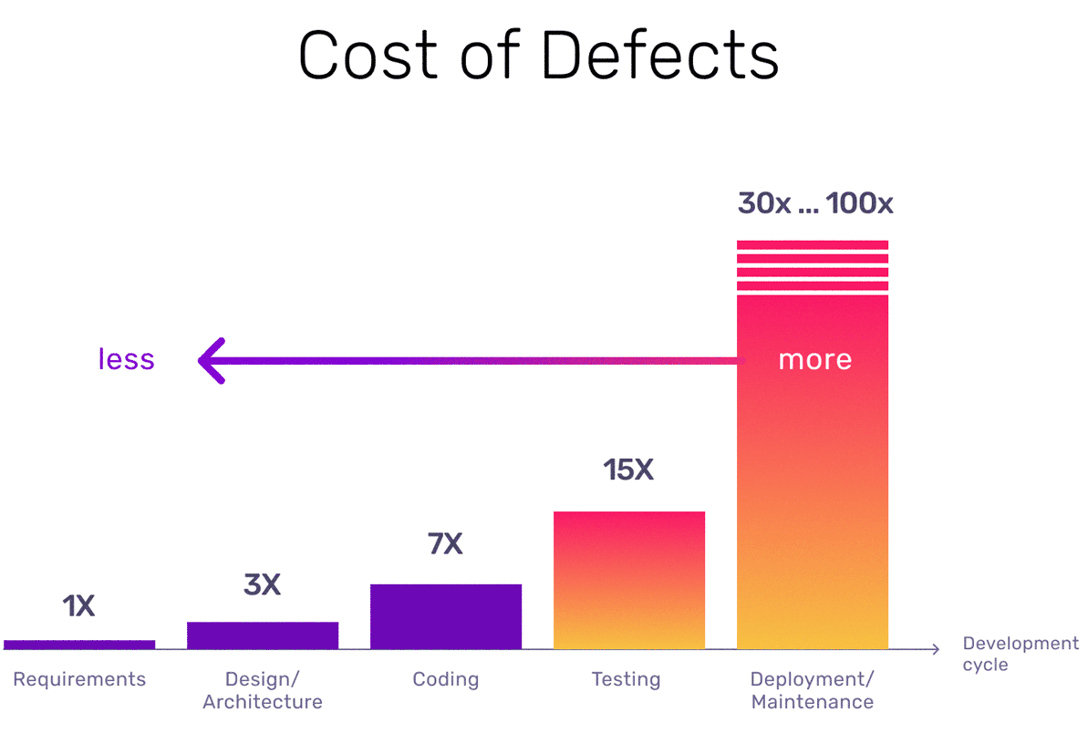
Security-by-Design
By National Institute of Standards and Technology (NIST)
Why It's Important:
Fix Early, Save Cost: Catching vulnerabilities during the ideation stage is far more cost-effective than during development or post-release bug fixes.
Integrated Thinking: Embeds security into every phase i.e., from design to deployment.
Safer Products: Proactive security results in more robust and trustworthy systems for users.
Notes:
Having Security at the Forefront of your Design
Having Security at the initial stages of design allows mistakes to be fixed within the ideation stage which is more cost-effective and not as timely as within the development or bug fixing stages
Ensures that Security is considered within every stage of the creation process to have a safer product

Slide 26
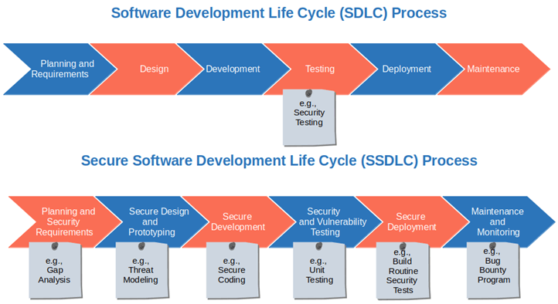
Security-by-Design
Notes:
Having Security at the Forefront of your Design
Having Security at the initial stages of design allows mistakes to be fixed within the ideation stage which is more cost-effective and not as timely as within the development or bug fixing stages
Ensures that Security is considered within every stage of the creation process to have a safer product

Slide 27
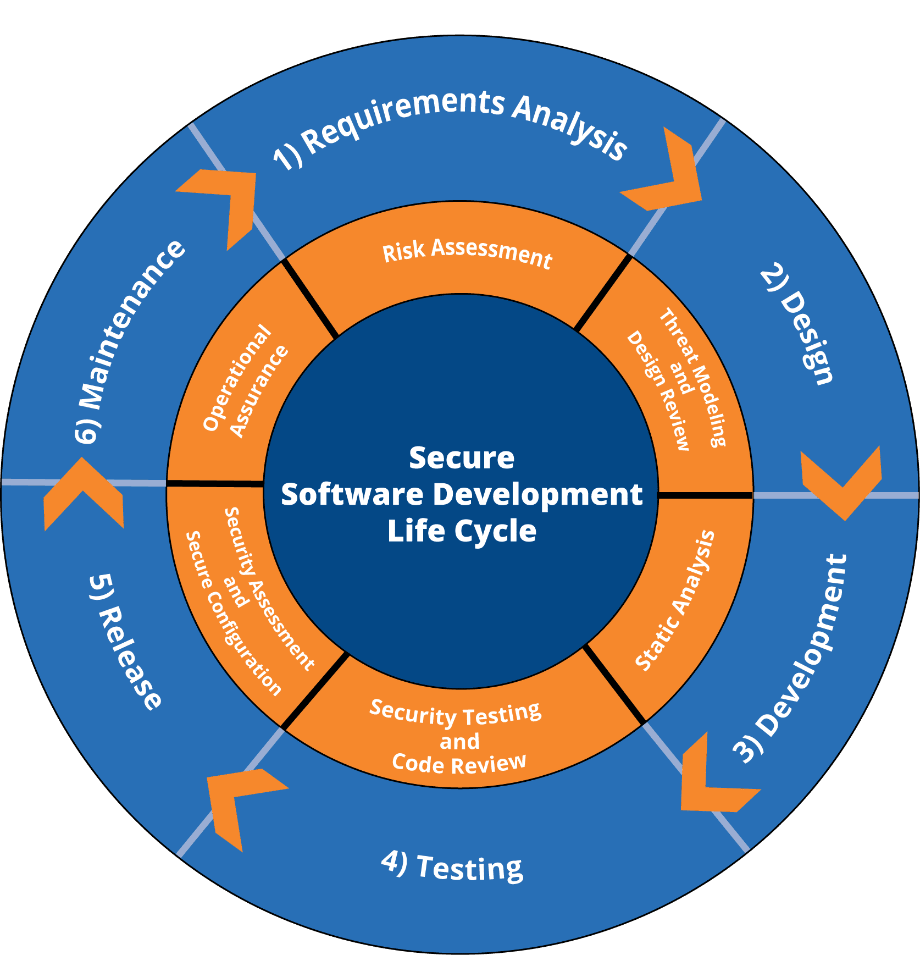
Security-by-Design
Think Like a Security Engineer:
What are the risks if this feature fails?
How can this system be abused?
Are we storing or transmitting sensitive data?

Slide 28
Asymmetry of Attack And Defence
Asymmetry of Attack and Defence
Defenders must secure all potential vulnerabilities.
Attackers only need to find one exploitable vulnerability.
The Disadvantage to Defenders
Defence requires constant vigilance and broad coverage.
Offence requires creativity, persistence, and luck - just once.
Cost vs. Risk
Greater investment is needed in prevention, detection, and mitigation.
Smart defenders prioritise high-impact areas where vulnerabilities are most likely or most damaging.
Notes:
There is a disadvantage defenders have against attackers:
Defenders need to make sure there are no vulnerabilities to be exploited
Attackers only need to find one vulnerability to exploit (also depends on the impact of that exploit)
Greater Investment Required to ensure there are no vulnerabilities which exist
Prioritising the potential areas where vulnerabilities are more likely to carry greater impact

Slide 29
Foundational Components of Security: The CIA Triad
The Core Stream will explore the CIA Triad, a foundational security model:
- Confidentiality
Ensuring that information is only accessible to those authorised to see it.
- Integrity
Ensuring data is accurate and hasn't been tampered with.
- Authentication (emphasised in this course over Availability)
Verifying the identity of users or systems before granting access.
In this course, Authentication > Availability, reflecting modern priorities where identity verification is a more pressing concern than uptime in many contexts.
Notes:
The foundational components of Security which will be explored further in future within the Core Stream as well is from the CIA Triad
Confidentiality
Integrity
Authentication (in this course we have historically used Authentication > Availability)
Mainly due to a debate that in modern society, Authentication is a larger issue that Availability
Both As are part of a larger acronym – CIANA which some security experts have a preference of

Slide 30
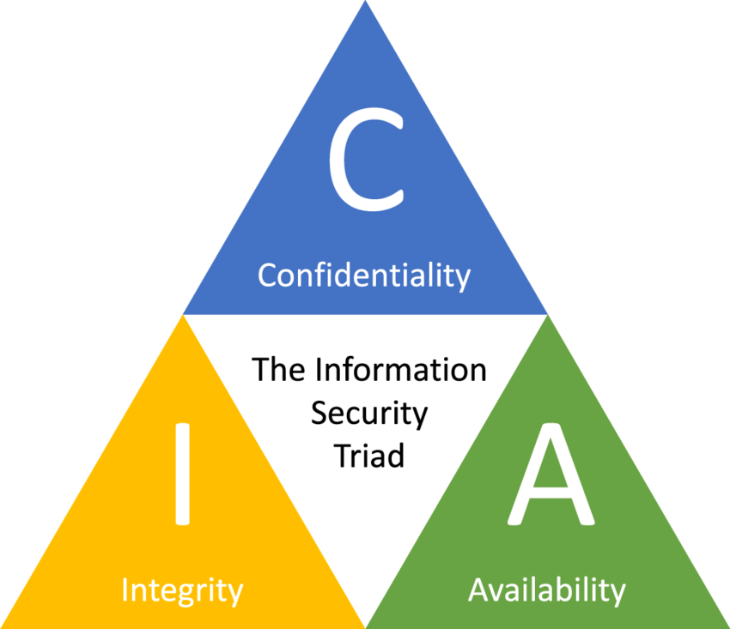
CIA
Notes:
The foundational components of Security which will be explored further in future within the Core Stream as well is from the CIA Triad
Confidentiality
Integrity
Authentication (in this course we have historically used Authentication > Availability)
Mainly due to a debate that in modern society, Authentication is a larger issue that Availability
Both As are part of a larger acronym – CIANA which some security experts have a preference of

Slide 31
Beyond CIA: CIANA
Some security experts prefer CIANA, which includes:
Confidentiality: Ensuring information is accessible only to those authorized.
Integrity: Maintaining the accuracy and completeness of data.
Authentication: Ensuring authorized users have access to information when needed.
Non-repudiation: Guaranteeing that a sender cannot deny the authenticity of their signature on a document or a message they originated.
Availability: Verifying the identity of users and systems.
Notes:
The foundational components of Security which will be explored further in future within the Core Stream as well is from the CIA Triad
Confidentiality
Integrity
Authentication (in this course we have historically used Authentication > Availability)
Mainly due to a debate that in modern society, Authentication is a larger issue that Availability
Both As are part of a larger acronym – CIANA which some security experts have a preference of

Slide 32
Applying CIA Model to Information
Some security experts prefer CIANA, which includes:
Confidentiality: Ensuring information is accessible only to those authorized.
Integrity: Maintaining the accuracy and completeness of data.
Authentication: Ensuring authorized users have access to information when needed.
Non-repudiation: Guaranteeing that a sender cannot deny the authenticity of their signature on a document or a message they originated.
Availability: Verifying the identity of users and systems.
Why should Data/Information be Confidential?
Why should Data/Information have Integrity?
Why should Data/Information have Authentication?
Notes:
The foundational components of Security which will be explored further in future within the Core Stream as well is from the CIA Triad
Confidentiality
Integrity
Authentication (in this course we have historically used Authentication > Availability)
Mainly due to a debate that in modern society, Authentication is a larger issue that Availability
Both As are part of a larger acronym – CIANA which some security experts have a preference of

Slide 33
Applying CIA Model to Information
This week, focus on understanding how Information/Data aligns with each part of the CIA model:
Confidentiality
Why? To prevent unauthorized access to sensitive data.
Example: Medical records, passwords, or personal identifiers must be kept private to protect individual rights and organizational trust.
Integrity
Why? To ensure the data remains accurate and unaltered.
Example: Financial records or sensor data must not be tampered with, or critical decisions may be made on false information.
Authentication
Why? To confirm that users and systems are who they say they are.
Example: Logging into a bank account should require valid credentials to prevent fraud or identity theft.
Notes:
But for this week, focus on the idea of how Information / Data should align for each of the provided CIA
Why should Data/Information be Confidential?
Why should Data/Information have Integrity?
Why should Data/Information have Authentication?

Slide 34
Why is Data/Information So Important to Industry?
Artificial Intelligence (AI)
Purpose: To mimic human behavior and decision-making.
Requirement: Requires large datasets to train and fine-tune models.
Impact: AI systems rely heavily on quality and quantity of data to function accurately and ethically.
Data Analytics
Purpose: Understand consumer behavior and patterns.
Benefit: Helps organizations make targeted, evidence-based decisions.
Application: Supports product development, marketing, and customer engagement strategies.
Notes:
Some fields which require data:
Data Analytics
Understand consumer patterns and behaviour to be able to create more targeted and informed choices in businesses in targeting the right demographics
Artificial Intelligence
Training models that is based on human behaviour such that they can act and think like humans. These models require a large amount of data to process
Data Drives Decision-Making
Businesses rely on accurate data to guide strategic, financial, and operational decisions.
Without it, risk and guesswork increase.
📈 Competitive Advantage
Companies that harness data effectively can predict market trends, improve customer satisfaction, and optimize supply chains.
🔐 Security of Data Protects Assets
Intellectual property, customer information, and trade secrets are critical assets.
A breach can lead to financial loss, reputational damage, and legal consequences.
💼 Regulatory and Compliance Requirements
Many industries (e.g., healthcare, finance) must follow strict data privacy laws (e.g., GDPR, HIPAA).
Poor data handling can result in massive fines.

Slide 35
Data/Information Can Be About People
Personally Identifiable Information (PII)
- Data that can be used to distinguish a specific individual
Name
Date of Birth
Address
Credit Card Information
Gender
Medical History
Searching Patterns
Hobbies
...

Slide 36
Using Data/Information Against Someone
Reconnaissance & Social Engineering
Attackers often gather publicly available data about individuals (aka Recon)
Used in targeted attacks such as:
Phishing: Generic deception messages
Spear-Phishing: Highly targeted campaigns based on personal information
Real-World Examples
- “Happy Birthday! Here’s a free gift for you”
- “Claim your free dog toy – limited time!”
Notes:
Recon / Social Engineering
Consider: What information is there out there about you?
There are attacks such as Phishing and Spear-Phishing which exist
Spear Phishing usually target a particular individual through campaigns which usually take into account information about a particular individual
Their birthday – "Happy Birthday"
They like dogs - "Free Dog"

Slide 37
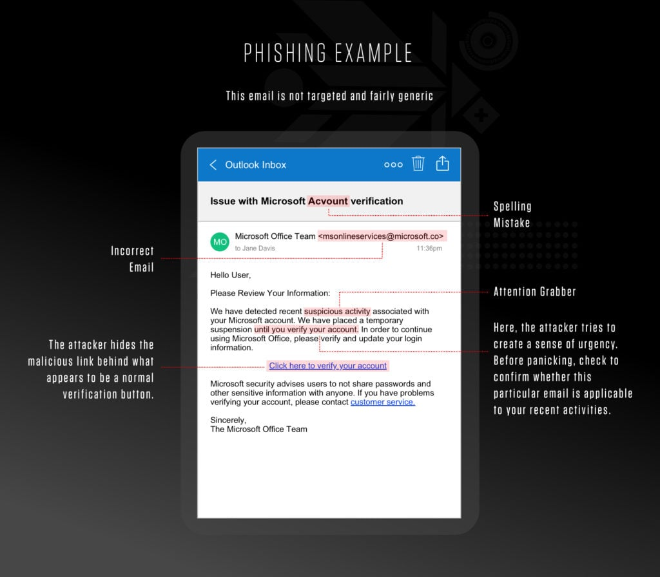
Generic Phishing Email

Slide 38
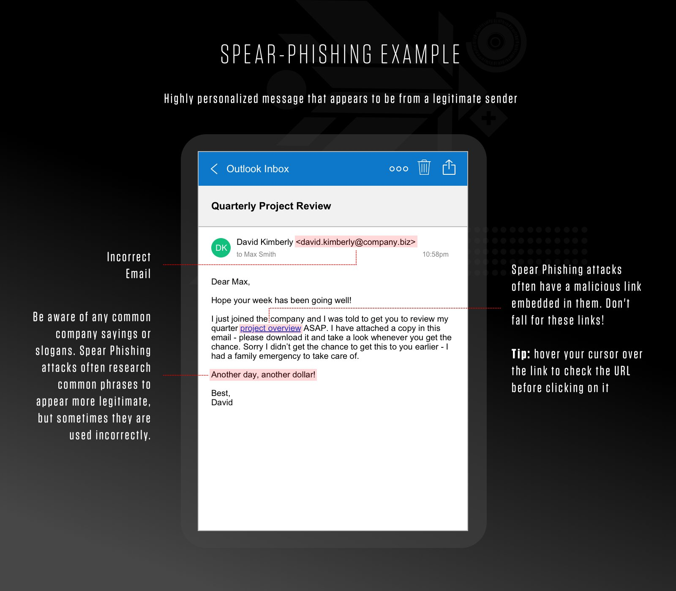
Spear Phishing Email
Notes:
Recon / Social Engineering
Consider: What information is there out there about you?
There are attacks such as Phishing and Spear-Phishing which exist
Spear Phishing usually target a particular individual through campaigns which usually take into account information about a particular individual
Their birthday – "Happy Birthday"
They like dogs - "Free Dog"

Slide 39
Using Data/Information Against Someone
Reconnaissance & Social Engineering
Attackers often gather publicly available data about individuals (aka Recon)
Used in targeted attacks such as:
Phishing: Generic deception messages
Spear-Phishing: Highly targeted campaigns based on personal information
Real-World Examples
- “Happy Birthday! Here’s a free gift for you”
- “Claim your free dog toy – limited time!”
Think About It!
What kind of information is available about YOU online?
Could it be used to gain your trust or trick you?
Notes:
Recon / Social Engineering
Consider: What information is there out there about you?
There are attacks such as Phishing and Spear-Phishing which exist
Spear Phishing usually target a particular individual through campaigns which usually take into account information about a particular individual
Their birthday – "Happy Birthday"
They like dogs - "Free Dog"

Slide 40
Cambridge Analytica Data Scandal (2018)
Cambridge Analytica harvested personal data from up to 87 million Facebook users without explicit consent.
Data was used to create detailed psychological profiles to influence voter behavior in political campaigns, including the 2016 US Presidential Election and the Brexit referendum.
Data was collected via a personality quiz app that harvested not only the quiz taker’s data but also their friends’ data.
Raised global concerns about data privacy, misuse of personal information, and ethical use of social media.
Resulted in major investigations, Facebook facing hefty fines, and renewed debates on regulation of social media and data protection laws.

Slide 41
Cambridge Analytica Data Scandal (2018)
2015
Mar 2018
Apr 2018
Jul 2019
2013
Kogan develops Facebook app collecting user & friend data
2014
Cambridge Analytica acquires millions of profiles without consent
Facebook discovers breach, demands deletion (weak enforcement)
The Guardian & NYT expose scandal; whistleblower speaks out
Zuckerberg testifies before US Congress on privacy issues
Facebook fined $5B by FTC for privacy violations

Slide 42
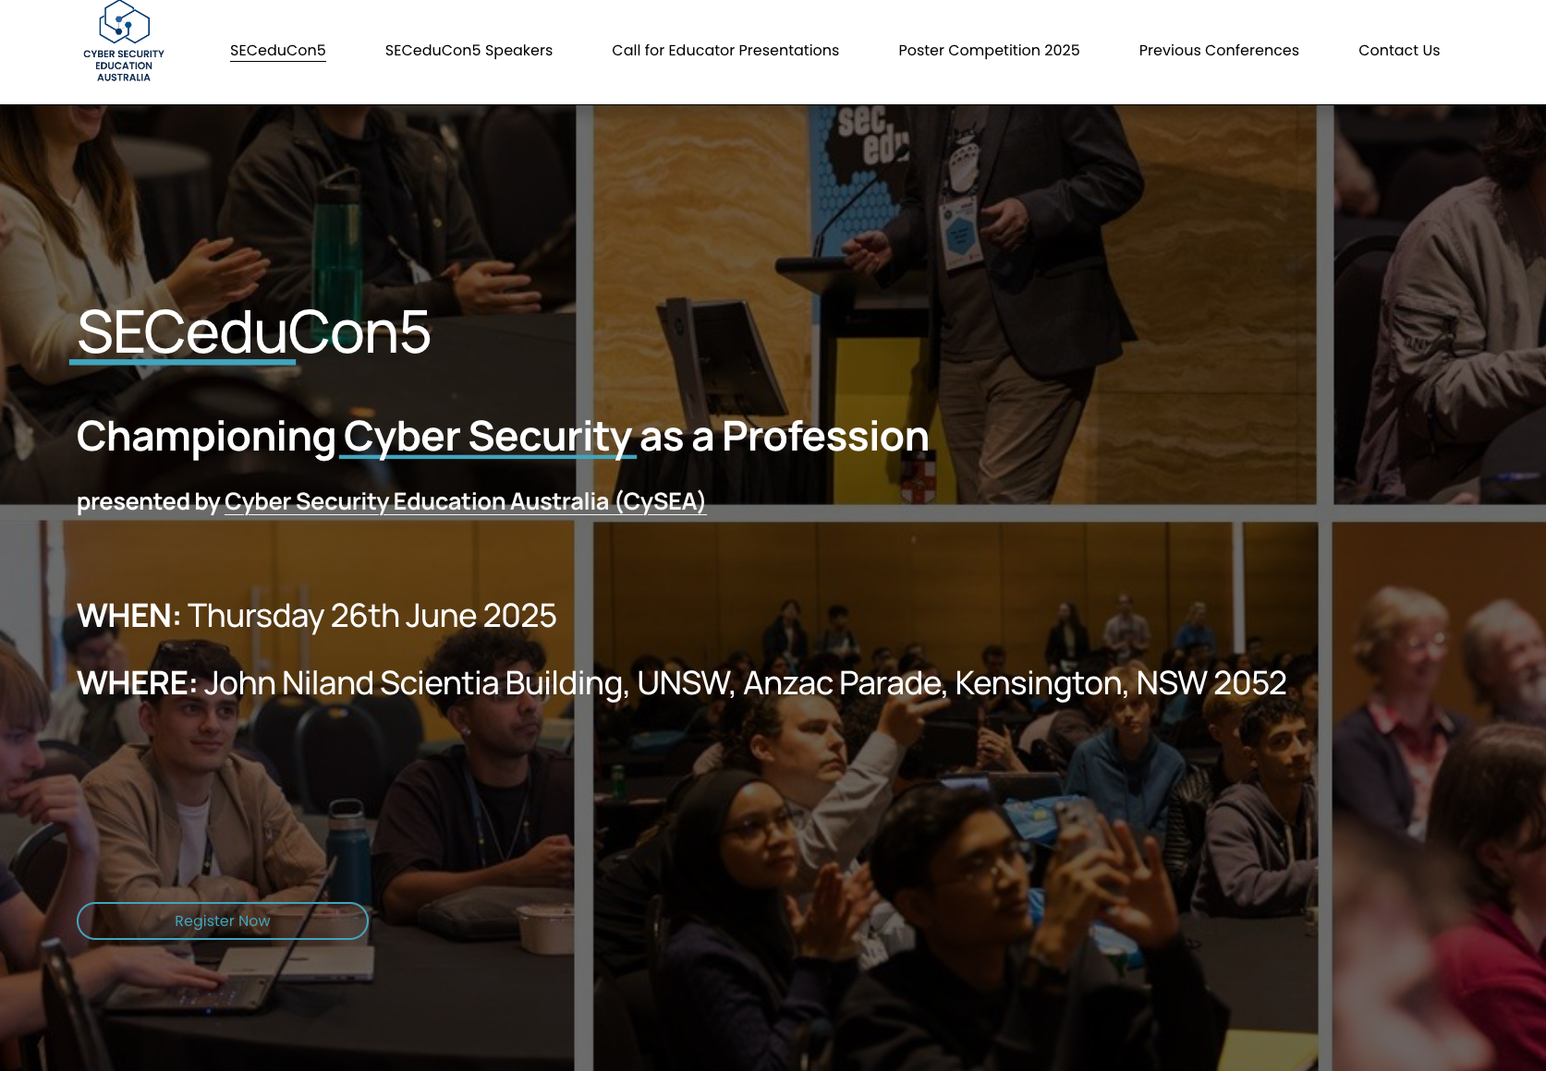
Any Other Business
https://www.seceduconference.com.au/
Notes:
A French Cargo Ship named the SS Mont-Blanc had collided with the Norwegian vessel the SS Imo in the Halifax harbour killing 1,782 people from the blast and an additional 9,000 injured
The blast was one of the largest human-made explosions at that time
The Mont-Blanc collided with the Imo at a low speed of one knot which is also 1.8km/h
The Mont-Blanc was carrying benzol barrels which were stored on the deck of the ship which were damaged on impact causing them to leak. Benzol is highly flammable substance. The resultant sparks from the collision had ignited the sparks leading to a fire on board which rapidly grew and then caused the ship to explode causing an explosion which snapped trees, bent iron and demolished buildings in an 800-metre proximity.

Slide 43

Thank you! Questions?
Rahat Masood rahat.masood@unsw.edu.au

