Slide 1

Váradi Liliána - Lévay Botond - Török Amina

Slide 2
What is BandR
A brand new website where you can find fellow artists and fans
The website is mainly targeted for smaller bands and artists to find collaborators

Slide 3
Our main inspiration came from our teammate Boti, who is an artist himself
He shed light on the difficulty of finding new band members or collaborators as a smaller artist, and not being able to reach people easily
The
inspiration

Slide 4
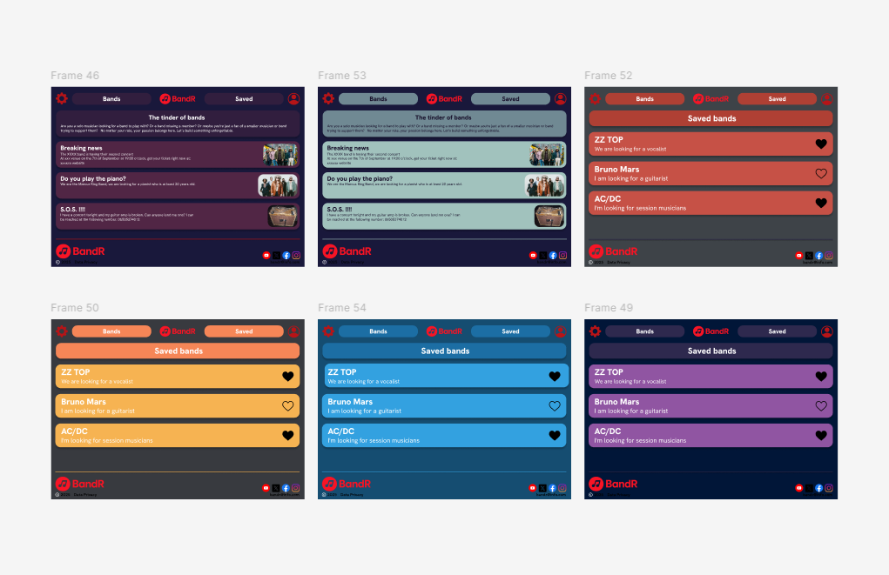
How it began

Slide 5
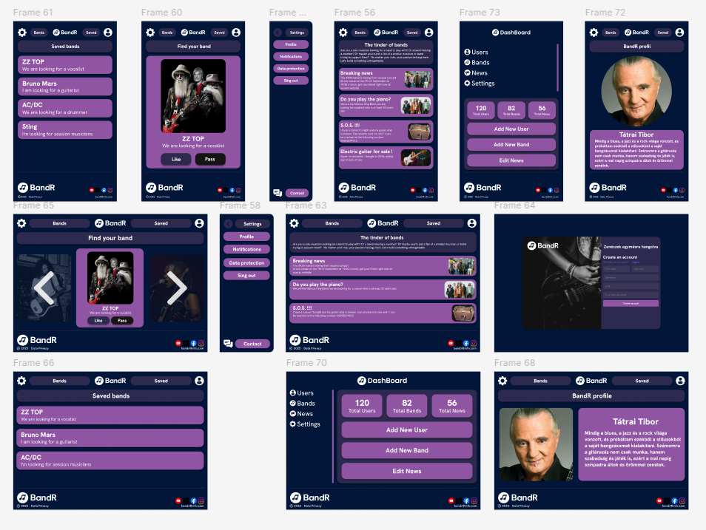
Final design

Slide 6
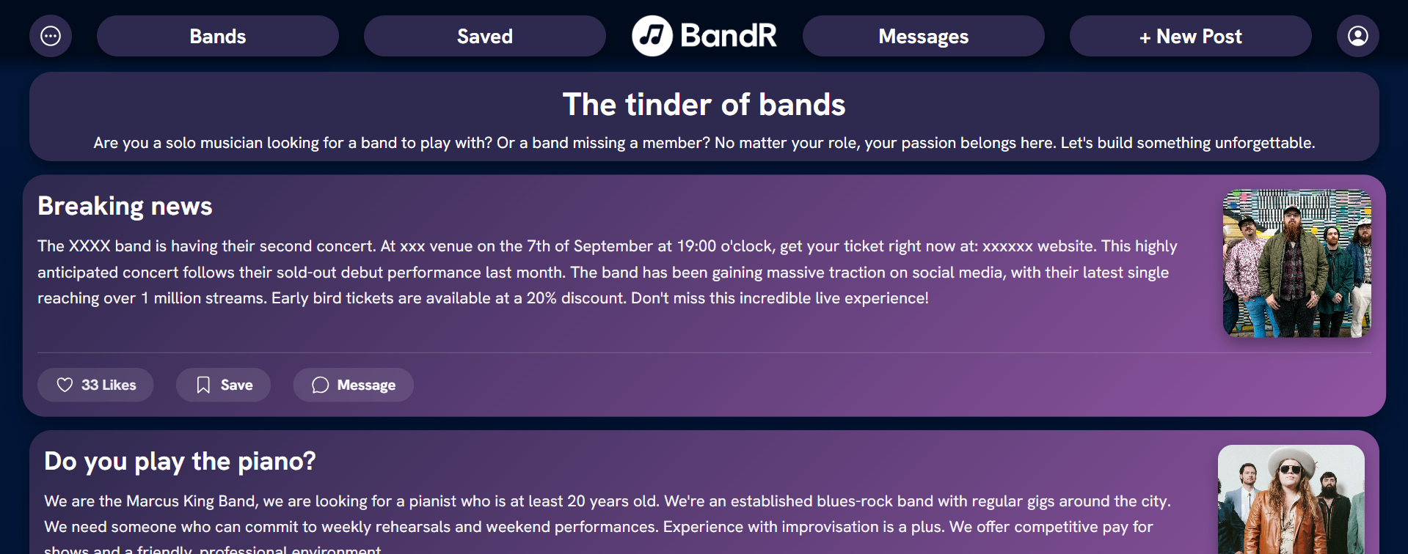
Boti - frontend

Slide 7
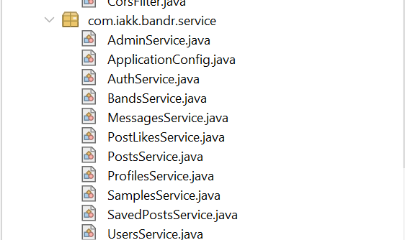
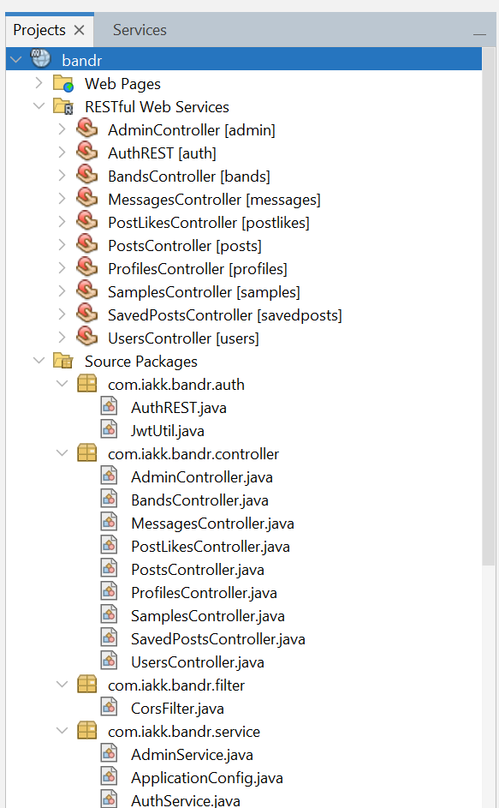
Amina – backend

Slide 8
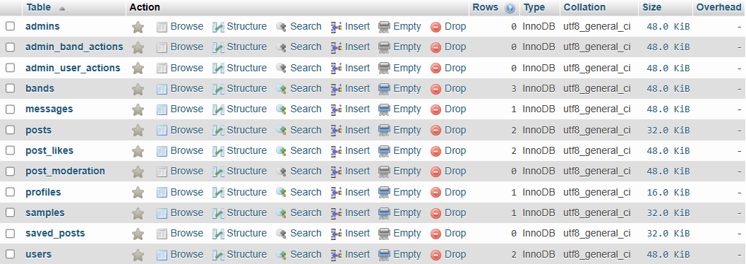
Lili
Project manager – database

Slide 9
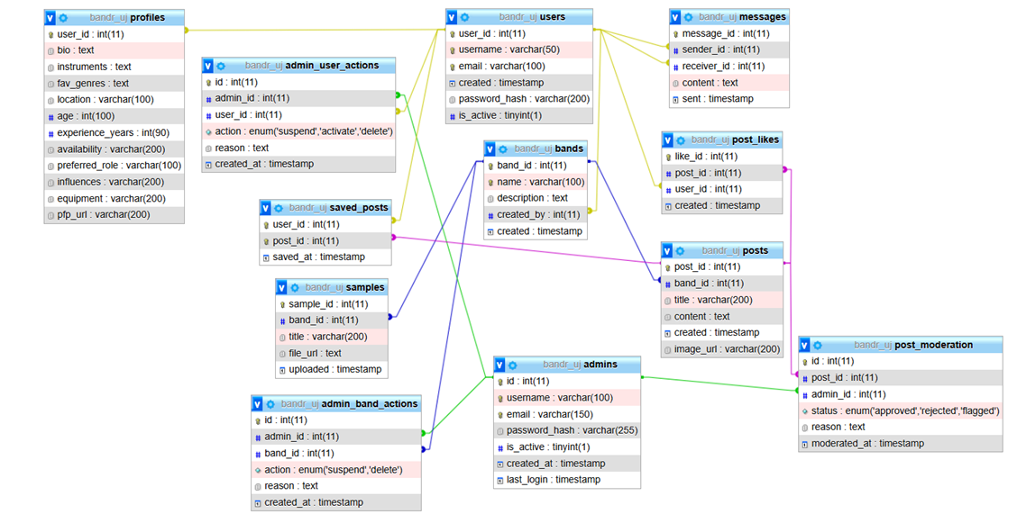
Database structure

Slide 10
HTML/CSS/Bootstarp: We’ve used this so far for frontend, but we might change it later
Architectures we used
MySQL: Flexible, we’re already familiar with it
Java: Object-oriented, safe and stable

Slide 11
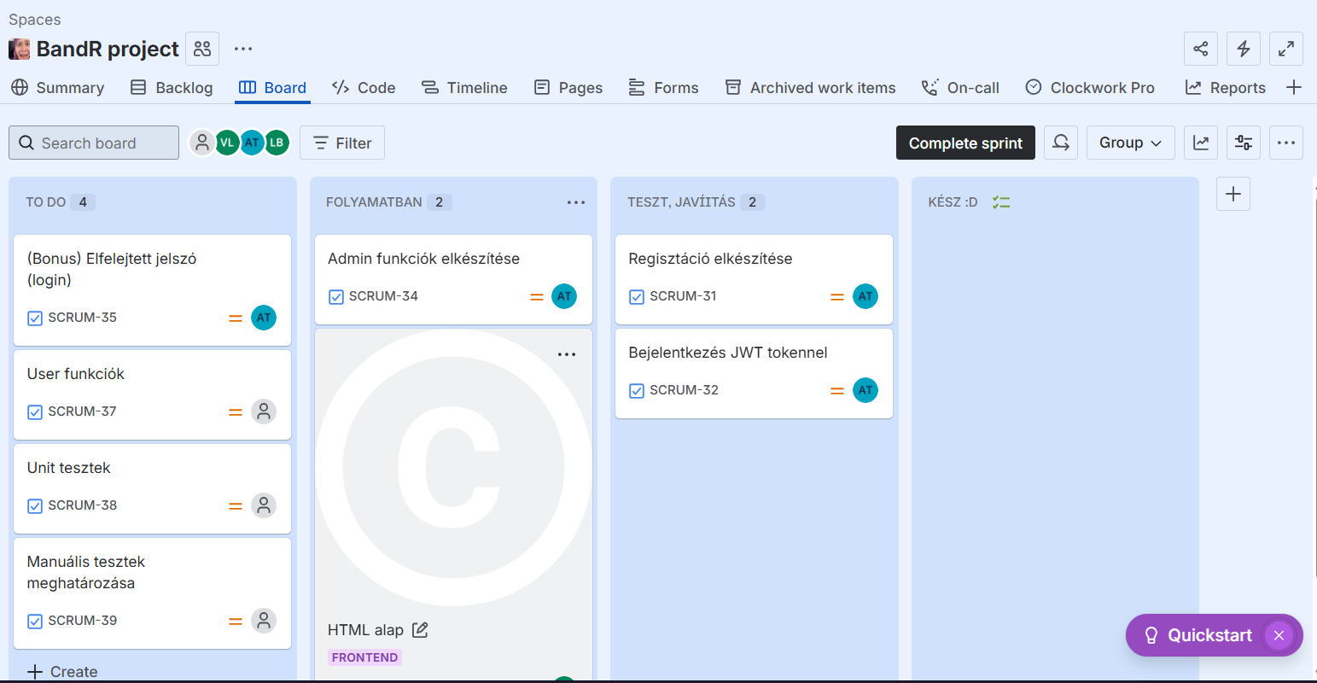
Jira in use

Slide 12
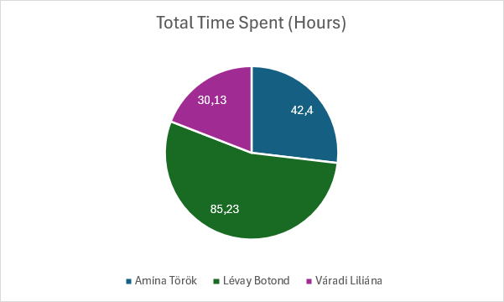
Jira in use

Slide 13
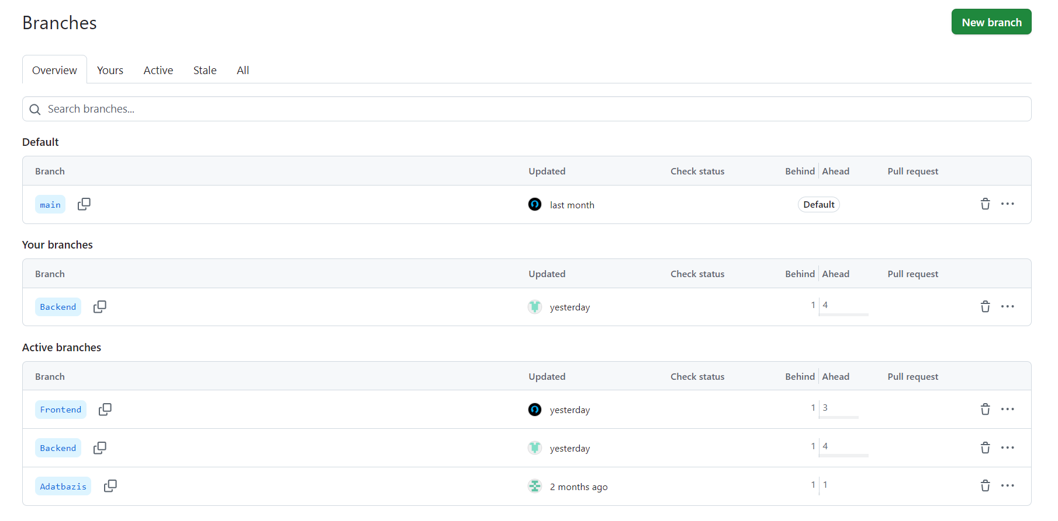
Git in use

Slide 14
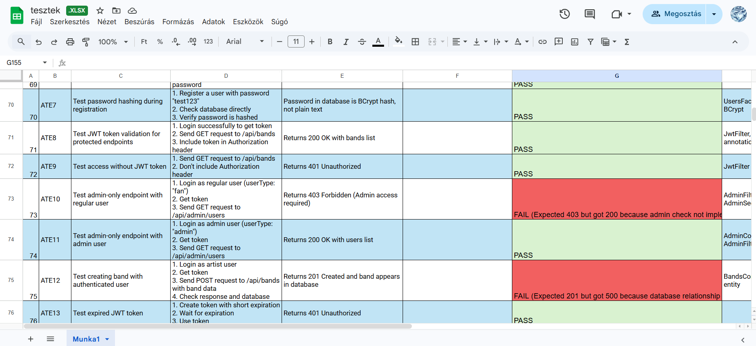
Testing so far

Slide 15
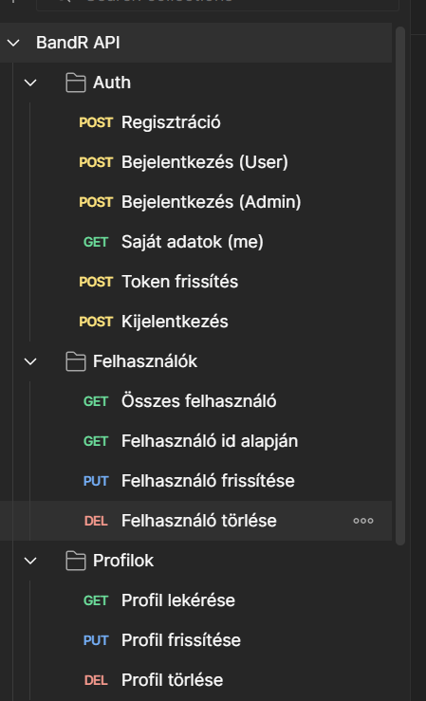
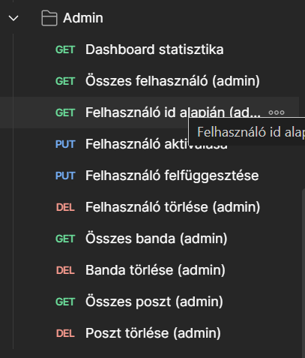
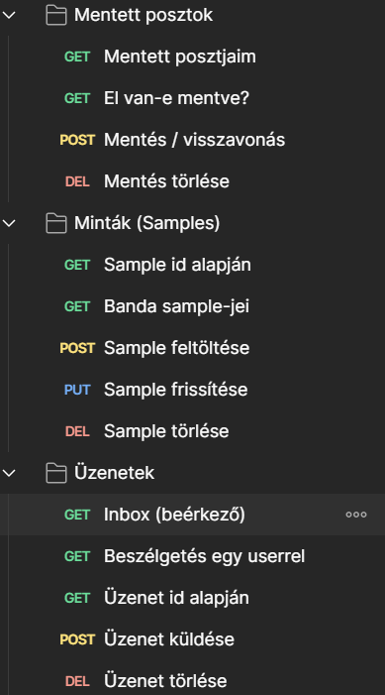
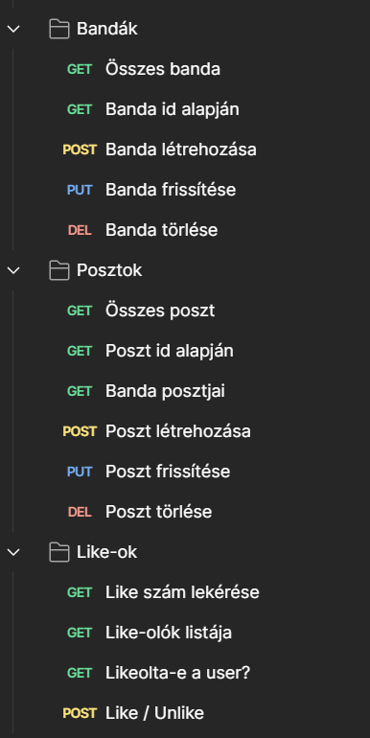
Postman

Slide 16
Future plans
Aligning front and – backend better
Fixing possible issues, continuing testing
Finishing the project

Slide 17
Live design

