Slide 1
🧶
Malina
AI Knitting Pattern Generator
Generate custom knitting patterns in moments. Pick an item, configure your style, and let the generator do the rest.
Hackathon 2026

Slide 2
The Problem
Knitting a custom pattern from scratch is hard — even for experienced knitters
• Professional patterns need precise stitch counts across at least 6 sizes
• Matching yarn gauge manually takes time and expertise
• No tool lets you start from a photo of a style you love

Slide 3
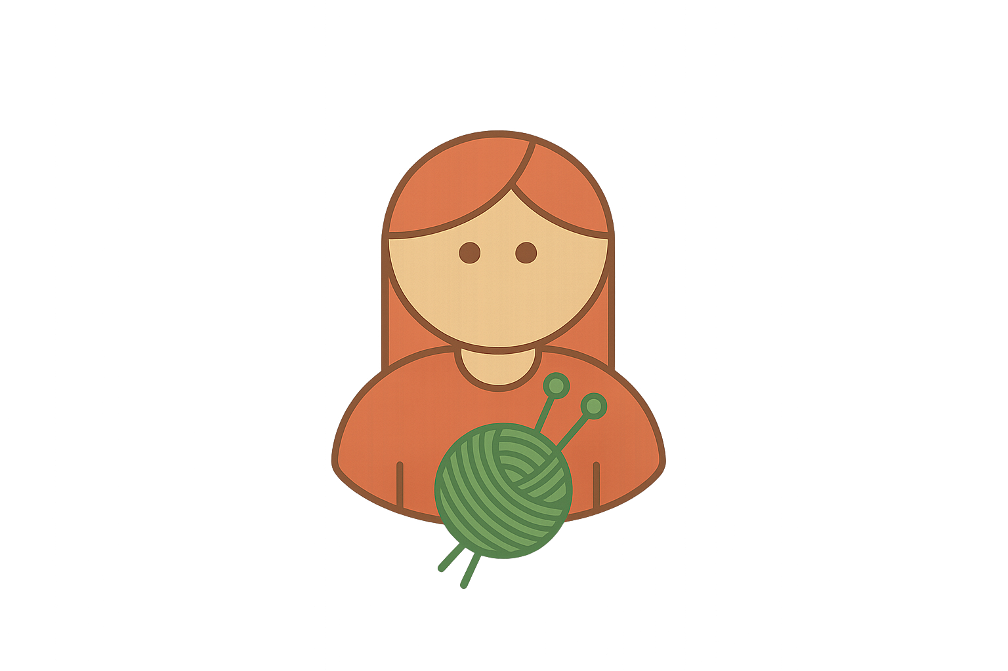
Our Solution
Frontend
Backend
Claude AI
Next.js App Router
API Routes
Anthropic
Pick Item
Analyze Photo
Vision — photo analysis
8 garment types
image → style config
→
↔
Search Yarn
Text — pattern generation
Configure Style
→
form or photo
↔
query → yarn results
→
Ravelry
Select Yarn
HTTP
Generate Pattern
Yarn Database
User
search or manual
config → pattern text
↔
→
Yarn search & details
Node.js
TypeScript
REST
Generate Pattern
preview & render
React Context – shared state
TypeScript
React
SVG
Data Flow
Pick & Configure
›
Select Yarn
›
Send to API
›
Build Prompt
›
Claude Generates
›
Render & Print

Slide 4
Our Solution
Malina generates complete, print-ready knitting patterns in seconds
• Pick an item: sweater, beanie, scarf, gloves and more
• Configure style manually or upload a photo
• Search yarn from the list, or enter weight and gauge manually
• Get a full pattern, sized XS–XXL, ready to print

Slide 5
How It Works
01
02
03
04
Pick
Configure
Yarn
Generate
Choose what to knit: sweater, beanie, scarf, gloves, hood and more
Set style options manually or upload a photo
Search yarn from the list, or enter weight and gauge manually
Get a full pattern ready to print

Slide 6
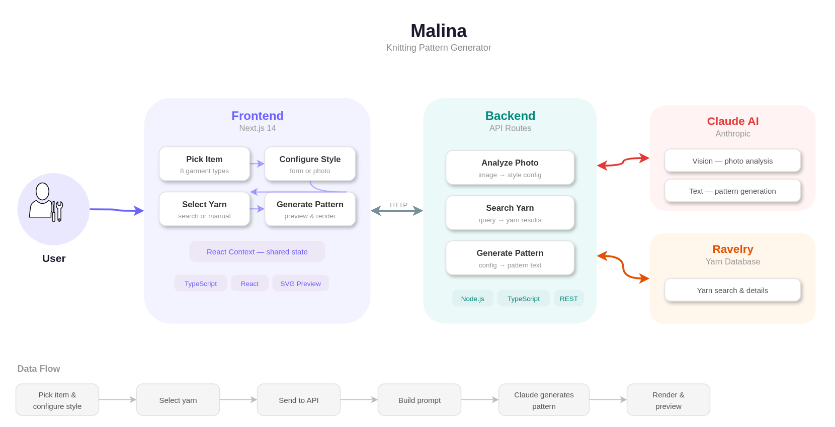

Slide 7
Tech Stack
Next.js + TypeScript
Frontend & API routes (App Router)
Tailwind CSS v4
Styling & responsive layout
Claude API (Anthropic)
Photo vision analysis + pattern generation
Ravelry API
Yarn database — weight, gauge, needle size
react-hook-form
Form state management
Browser Print API
PDF export — no backend needed

Slide 8
Status
What's Working
What's Next
• Complete 4-step flow end-to-end
• Photo upload + Claude vision analysis
• Pattern generation for 7 item types
• Yarn search via Ravelry API
• Print / Save as PDF
• More items (cardigan, socks, pants, shorts)
• Life-like mockup generation
• Ravelry pattern similarity search
• Saved patterns & user accounts
• Mobile
• Diagrams in pattern pdf

Slide 9
Thank you
🧶

