Slide 1

GT02: Group Testing for general $d$ Adaptive deterministic algorithm
Catherine A. Haddad-Zaknoon
Department of Computer Science - Technion, Haifa, Israel

Slide 2

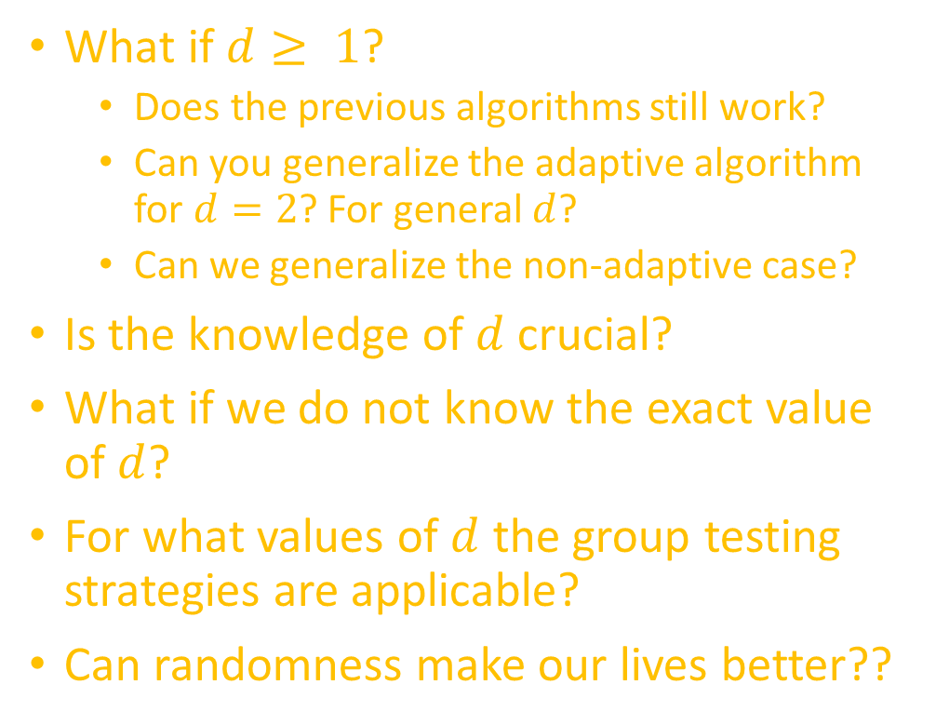
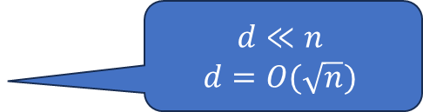
Our agenda
What if $d≥ 1$?
Does the previous algorithms still work?
Can you generalize the adaptive algorithm for $d=2$? For general $d$?
Can we generalize the non-adaptive case?
Is the knowledge of $d$ crucial?
What if we do not know the exact value of $d$?
For what values of $d$ the group testing strategies are applicable?
Can randomness make our lives better??
We’ll see that in a minute…
Yep …
estimate it??
$$d≪n$$
$$d=O(\sqrt{n})$$
Sometimes …

Slide 3



Recall the adaptive algorithm for $d=1$
+
-
Combine the samples into two distinct combinations
Test the two combinations…
Continue with the search in the same manner with the samples that participated in the positive test only

Slide 4


Adaptive algorithm for $d=1$(CONT.)
Start over with a set of n/2 participant..
-
+
$$O(log n)$$
splits
-
+
+
-
+
-

Slide 5

Adaptive algorithm for $d=2$
Case #1
+
+
Case #2
+
-
Combine the samples into two distinct combinations
Test the two combinations…
If you got two positives ..
Continue using the algorithm from last week on each group
Else … (one positive and one negative)
Discard the negative group
Goto step 1

Slide 6



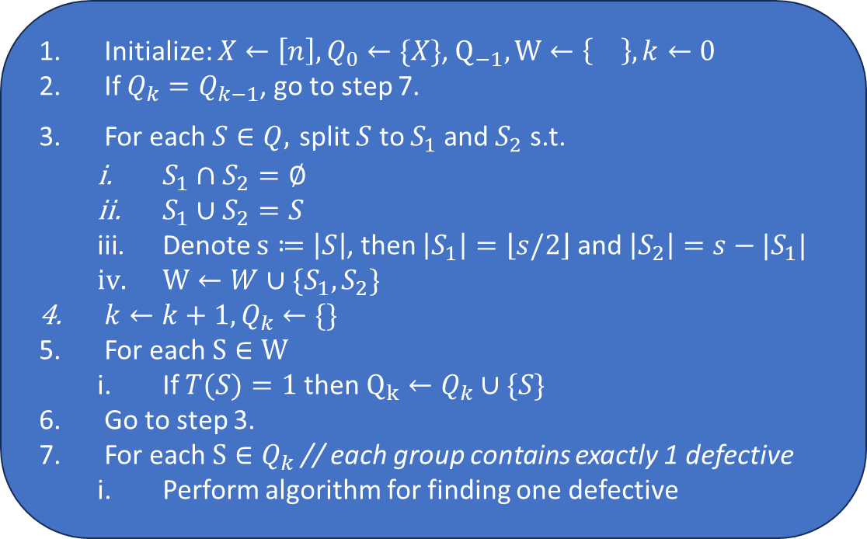














Adaptive algorithm for general $d$
Initialize: $X←\left[n\right], Q_{0}←\{X\}$, $Q_{−1},W←\left\{\right\}, k←0$
If $Q_{k}=Q_{k−1}$, go to step 7.
For each $S∈Q,$ split $S$ to $S_{1}$and $S_{2}$ s.t.
$S_{1}∩S_{2}=∅$
$S_{1}∪S_{2}=S$
Denote $s≔\left|S\right|$, then $\left|S_{1}\right|=\left\lfloor s/2\right\rfloor$ and $\left|S_{2}\right|=s−|S_{1}|$
$W←W∪\{S_{1},S_{2}\}$
$k←k+1, Q_{k}←\{\}$
For each $S∈W$
If $T(S)=1$then $Q_{k}←Q_{k}∪\{S\}$
Go to step 3.
For each $S∈Q_{k}$ // each group contains exactly 1 defective
Perform algorithm for finding one defective
$$X$$
1
$$S_{1}$$
1
$$S_{2}$$
1
$$log d$$
$$⋮$$
$$⋮$$
$$⋮$$
$$⋮$$
$$⋮$$
$$⋮$$
$$⋮$$
$$⋮$$
$$S_{i_{1}}$$
$$S_{i_{2}}$$
$$S_{i_{3}}$$
$$⋯$$
$$S_{i_{d}}$$

Slide 7









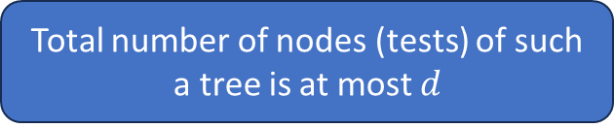

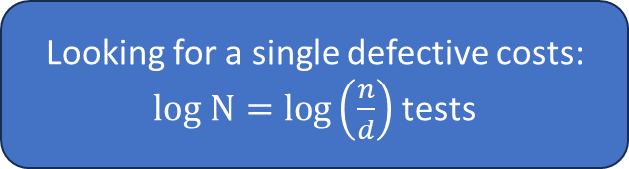







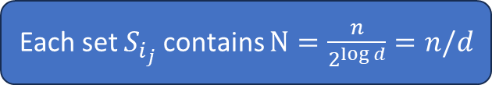



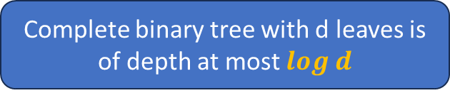

Test complexity analysis
$$X$$
1
$$S_{i_{j}}$$
Each set $S_{i_{j}}$contains $N=\frac{n}{2^{\log{d}}}=n/d$
$$S_{1}$$
1
$$S_{2}$$
1
Looking for a single defective costs: $log N=\log\left(\frac{n}{d}\right)$ tests
$d\log\left(\frac{n}{d}\right)$ tests
$$log d$$
$$⋮$$
$$⋮$$
$$⋮$$
$$⋮$$
+
Complete binary tree with d leaves is of depth at most $log d$
$$⋮$$
$$⋮$$
$$⋮$$
$$⋮$$
$O(d)$ tests
$$S_{i_{1}}$$
$$S_{i_{2}}$$
$$S_{i_{3}}$$
$$⋯$$
$$S_{i_{d}}$$
Total number of nodes (tests) of such a tree is at most $d$
Overall: $O\left(d\log\left(\frac{n}{d}\right)+d\right)$ tests
$d\log\left(\frac{n}{d}\right)$ tests
Notes:
Discuss what happens if d reaches n
Mention that this is a tight bound… meaning we cannot do better than that.

Slide 8
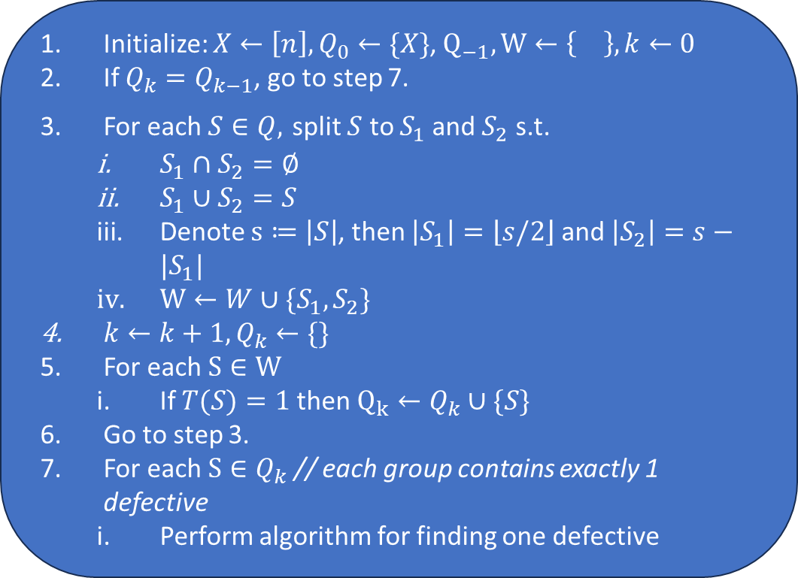
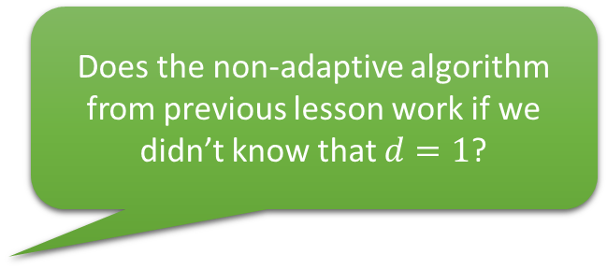
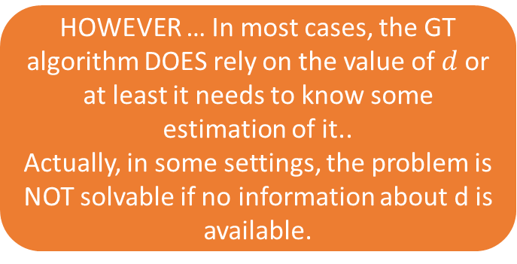

Algorithm analysis
Initialize: $X←\left[n\right], Q_{0}←\{X\}$, $Q_{−1},W←\left\{\right\}, k←0$
If $Q_{k}=Q_{k−1}$, go to step 7.
For each $S∈Q,$ split $S$ to $S_{1}$and $S_{2}$ s.t.
$S_{1}∩S_{2}=∅$
$S_{1}∪S_{2}=S$
Denote $s≔\left|S\right|$, then $\left|S_{1}\right|=\left\lfloor s/2\right\rfloor$ and $\left|S_{2}\right|=s−|S_{1}|$
$W←W∪\{S_{1},S_{2}\}$
$k←k+1, Q_{k}←\{\}$
For each $S∈W$
If $T(S)=1$then $Q_{k}←Q_{k}∪\{S\}$
Go to step 3.
For each $S∈Q_{k}$ // each group contains exactly 1 defective
Perform algorithm for finding one defective
Does this algorithm really needs to know the value of $d$?
Does the non-adaptive algorithm from previous lesson work if we didn’t know that $d=1$?
HOWEVER … In most cases, the GT algorithm DOES rely on the value of $d$or at least it needs to know some estimation of it..
Actually, in some settings, the problem is NOT solvable if no information about d is available.
Notes:
Discuss what happens if d reaches n
Mention that this is a tight bound… meaning we cannot do better than that.

Slide 9

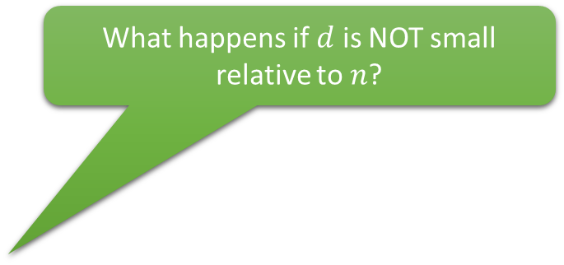
Algorithm analysis
Initialize: $X←\left[n\right], Q_{0}←\{X\}$, $Q_{−1},W←\left\{\right\}, k←0$
If $Q_{k}=Q_{k−1}$, go to step 7.
For each $S∈Q,$ split $S$ to $S_{1}$and $S_{2}$ s.t.
$S_{1}∩S_{2}=∅$
$S_{1}∪S_{2}=S$
Denote $s≔\left|S\right|$, then $\left|S_{1}\right|=\left\lfloor s/2\right\rfloor$ and $\left|S_{2}\right|=s−|S_{1}|$
$W←W∪\{S_{1},S_{2}\}$
$k←k+1, Q_{k}←\{\}$
For each $S∈W$
If $T(S)=1$then $Q_{k}←Q_{k}∪\{S\}$
Go to step 3.
For each $S∈Q_{k}$ // each group contains exactly 1 defective
Perform algorithm for finding one defective
What happens if $d$ is NOT small relative to $n$?
Overall: $O\left(d\log\left(\frac{n}{d}\right)+d\right)$ tests
Notes:
Discuss what happens if d reaches n
Mention that this is a tight bound… meaning we cannot do better than that.

Slide 10
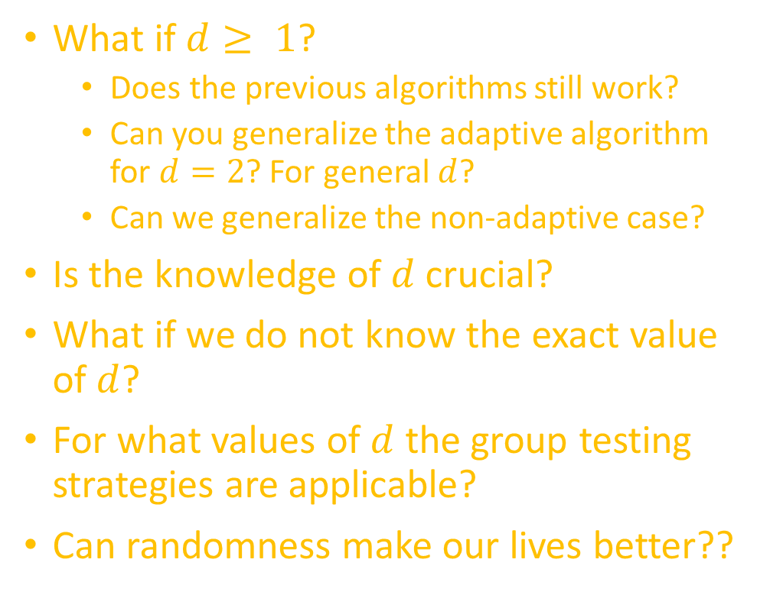

Our agenda
What if $d≥ 1$?
Does the previous algorithms still work?
Can you generalize the adaptive algorithm for $d=2$? For general $d$?
Can we generalize the non-adaptive case?
Is the knowledge of $d$ crucial?
What if we do not know the exact value of $d$?
For what values of $d$ the group testing strategies are applicable?
Can randomness make our lives better??
Just saw the algorithm for adaptive case
Yep …
estimate it??
Later
$$d≪n$$
$$d=O(\sqrt{n})$$
In some cases.. Yes
Later …

