Slide 1
Finding the number of defectives

Slide 2
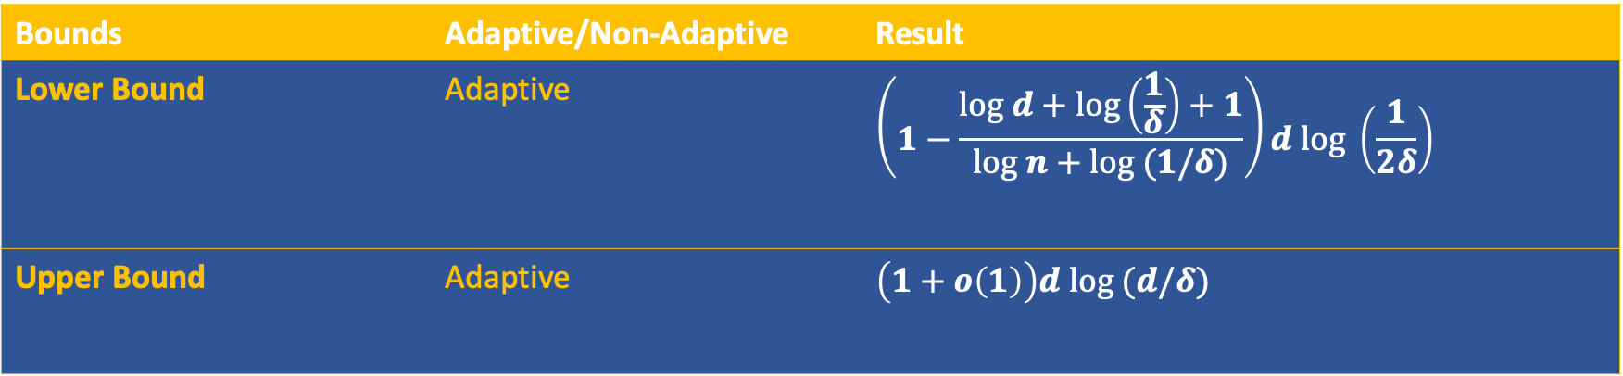
Results on Group Testing: Finding d using Monte Carlo adaptive algorithms
Bounds | Adaptive/Non-Adaptive | Result
Lower Bound | Adaptive | $$\left(1−\frac{log d+log\left(\frac{1}{δ}\right)+1}{log n+log (1/δ)}\right)d log \left(\frac{1}{2δ}\right)$$
Upper Bound | Adaptive | $$\left(1+o\left(1\right)\right)d log (d/δ)$$

Slide 3
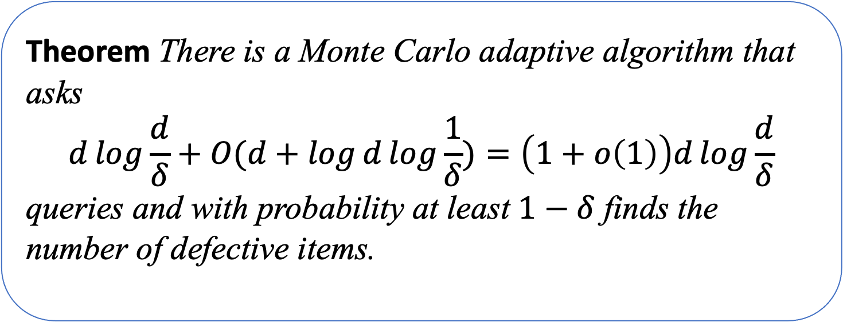
Theorem (Upper bound)
Theorem There is a Monte Carlo adaptive algorithm that asks
$$d\log{\frac{d}{δ}}+O(d+\log{d}\log{\frac{1}{δ})=\left(1+o\left(1\right)\right)d\log{\frac{d}{δ}}}$$
queries and with probability at least $1−δ$ finds the number of defective items.

Slide 4
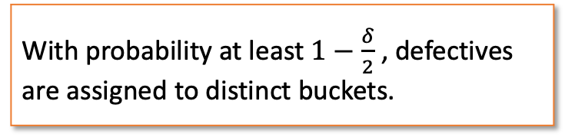
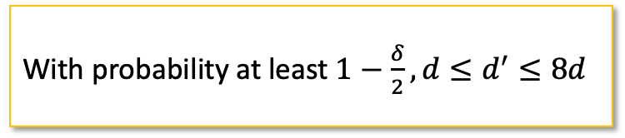

Algorithm $Find−d(n,δ)$
Stage I
Estimate $d$
Stage I
Estimate 𝒅
Stage II
New Variables
Stage III
1. $d′←Estimate(n,δ/2)$
1. 𝑑′←𝐸𝑠𝑡𝑖𝑚𝑎𝑡𝑒(𝑛,𝛿/2)
2. $N←\left\lceil d^{′2}/δ\right\rceil$
2. 𝑁←⌈𝑑^′2/𝛿⌉
5. Run $Find−Defectives$ with $N$ items, for each query $Q⊆[N]$, ask $Q^{′}=\bigcup_{j∈Q}{Y_{j}}$
5. Run 𝐹𝑖𝑛𝑑−𝐷𝑒𝑓𝑒𝑐𝑡𝑖𝑣𝑒𝑠 with 𝑁 items, for each query 𝑄⊆[𝑁], ask 𝑄^′=⋃_(𝑗∈𝑄)▒𝑌_𝑗
3. Choose $f:\left[n\right]→[N]$ uniformly at random.
3. Choose 𝑓:[𝑛]→[𝑁] uniformly at random.
4. Define $Y_{1},…,Y_{N}$ s.t. $Y_{i}=f^{−1}(i)$
4. Define 𝑌_1,…,𝑌_𝑁 s.t. 𝑌_𝑖=𝑓^(−1) (𝑖)
6. Let $Δ$ size of the set of defectives that $Find−Defectives$ outputs.
6. Let Δ size of the set of defectives that 𝐹𝑖𝑛𝑑−𝐷𝑒𝑓𝑒𝑐𝑡𝑖𝑣𝑒𝑠 outputs.
7. Return $Δ$.
7. Return Δ.
With probability at least $1−\frac{δ}{2}, {d≤d}^{′}≤8d$
With probability at least $1−\frac{δ}{2}$ , defectives are assigned to distinct buckets.

Slide 5
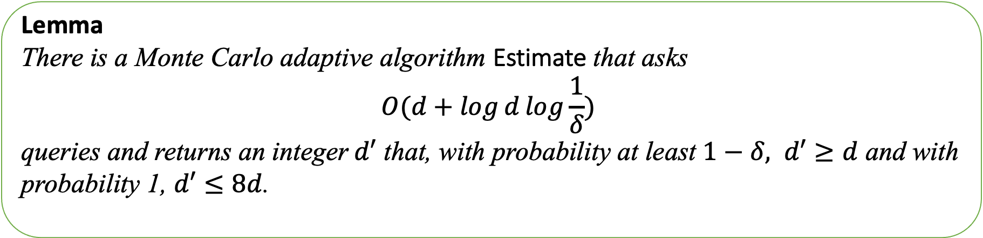
Stage I: Estimate The Number of Defectives
Estimate the number of defective items $d′$
Such that: $d≤d′≤8d$
Estimate the number of defective items 𝑑′
Such that: 𝑑≤𝑑′≤8𝑑
With probability at least $1−δ, d′$ is within the desired range.
With probability at least 1−𝛿, 𝑑′ is within the desired range.
Lemma
There is a Monte Carlo adaptive algorithm Estimate that asks
$$O(d+\log{d}\log{\frac{1}{δ}) }$$
queries and returns an integer$d′$ that, with probability at least $1−δ, d′≥d$ and with probability 1, $d′≤8d$.

Slide 6
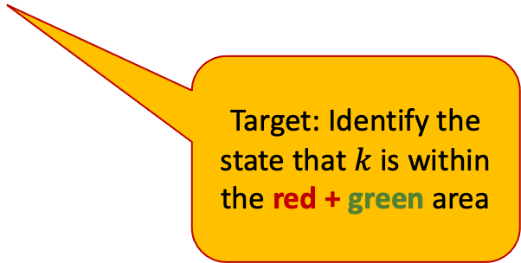
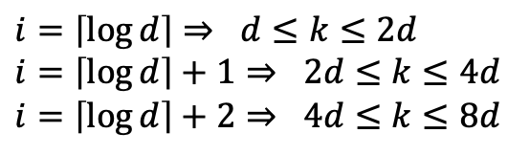







General Idea
$$3$$
$$6$$
$$5$$
$$8$$
$$2$$
$$7$$
$$9$$
$$k=2^{i}, i=1,2,3, …DO$$
$$Q_{1}→1$$
$$Q_{2}→1$$
$$Q_{k}→0$$
$$d$$
$$2d$$
$$4d$$
$$8d$$
$count$: #positive queries
$$count≤d$$
Target: Identify the state that $k$ is within the red + green area
$$i=\left\lceil \log{d}\right\rceil ⇒ d≤k≤2d$$
$$i=\left\lceil \log{d}\right\rceil +1⇒ 2d≤k≤4d$$
$$i=\left\lceil \log{d}\right\rceil +2⇒ 4d≤k≤8d$$
Check:
$$count≥k/4$$

Slide 7
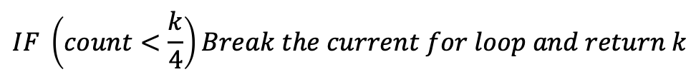



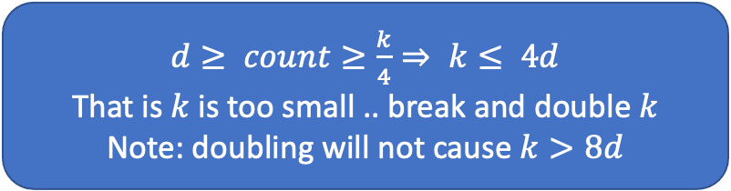
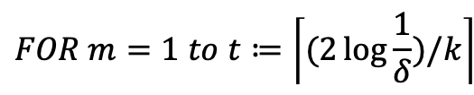











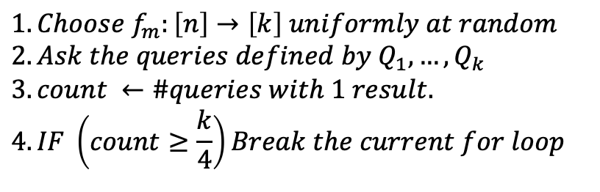


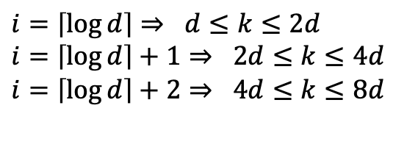
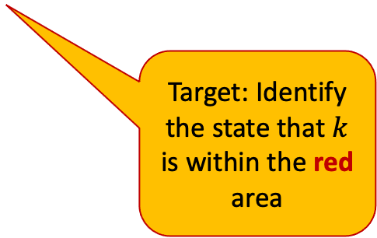


General Idea
Estimate$(n,δ)$
$$k=2^{i}, i=1,2,3, …DO$$
$$FOR k=2^{i}, i=1,2,3, …DO$$
$$d$$
$$2d$$
$$4d$$
$$8d$$
$$FOR m=1 to t≔\left\lceil (2\log{\frac{1}{δ}})/k\right\rceil$$
Target: Identify the state that $k$ is within the red area
$$i=\left\lceil \log{d}\right\rceil ⇒ d≤k≤2d$$
$$i=\left\lceil \log{d}\right\rceil +1⇒ 2d≤k≤4d$$
$$i=\left\lceil \log{d}\right\rceil +2⇒ 4d≤k≤8d$$
$$1. Choose f_{m}:\left[n\right]→\left[k\right] uniformly at random$$
$$2.Ask the queries defined by Q_{1}, …, Q_{k}$$
$$3. count ←\#queries with 1 result.$$
$$4. IF \left(count≥\frac{k}{4}\right)Break the current for loop$$
$$3$$
$$6$$
$$5$$
$$8$$
$$…$$
$$2$$
$$7$$
$$9$$
$$IF \left(count<\frac{k}{4}\right)Break the current for loop and return k$$
$$Q_{1}→1$$
$$Q_{2}→1$$
$$Q_{k}→0$$
$d≥ count≥\frac{k}{4}⇒ k≤ 4d$
That is $k$ is too small .. break and double $k$
Note: doubling will not cause $k>8d$

Slide 8
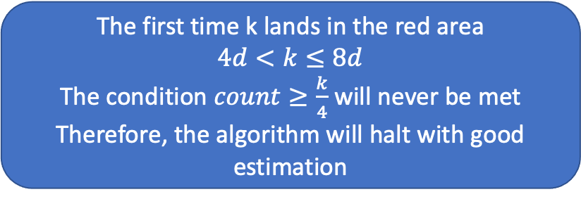
General Idea
Estimate$(n,δ)$
$$k=2^{i}, i=1,2,3, …DO$$
$$FOR k=2^{i}, i=1,2,3, …DO$$
$$d$$
$$2d$$
$$4d$$
$$8d$$
$$FOR m=1 to t≔\left\lceil (2\log{\frac{1}{δ}})/k\right\rceil$$
Target: Identify the state that $k$ is within the red area
$$i=\left\lceil \log{d}\right\rceil ⇒ d≤k≤2d$$
$$i=\left\lceil \log{d}\right\rceil +1⇒ 2d≤k≤4d$$
$$i=\left\lceil \log{d}\right\rceil +2⇒ 4d≤k≤8d$$
$$1. Choose f_{m}:\left[n\right]→\left[k\right] uniformly at random$$
$$2.Ask the queries defined by Q_{1}, …, Q_{k}$$
$$3. count ←\#queries with 1 result.$$
$$4. IF \left(count≥\frac{k}{4}\right)Break the current for loop$$
The first time k lands in the red area
$4d<k≤8d$
The condition $count≥\frac{k}{4}$ will never be met
Therefore, the algorithm will halt with good estimation
$$…$$
$$IF \left(count<\frac{k}{4}\right)Break the current for loop and return k$$

Slide 9
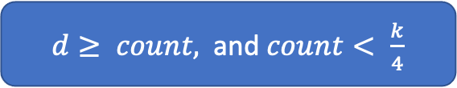
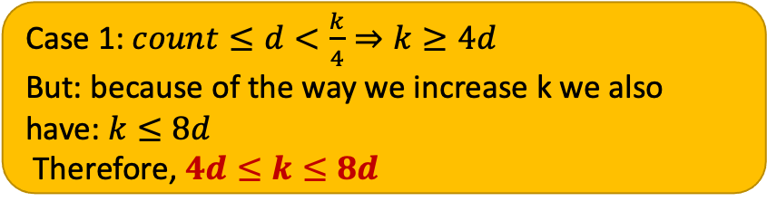
General Idea
Estimate$(n,δ)$
$$k=2^{i}, i=1,2,3, …DO$$
$$FOR k=2^{i}, i=1,2,3, …DO$$
$$d$$
$$2d$$
$$4d$$
$$8d$$
$$FOR m=1 to t≔\left\lceil (2\log{\frac{1}{δ}})/k\right\rceil$$
$d≥ count,$ and $count< \frac{k}{4}$
$$1. Choose f_{m}:\left[n\right]→\left[k\right] uniformly at random$$
$$2.Ask the queries defined by Q_{1}, …, Q_{k}$$
$$3. count ←\#queries with 1 result.$$
$$4. IF \left(count≥\frac{k}{4}\right)Break the current for loop$$
Case 1: $count≤d<\frac{k}{4}⇒k≥4d$
But: because of the way we increase k we also have: $k≤8d$
Therefore, $4d≤k≤8d$
$$IF \left(count<\frac{k}{4}\right)Break the current for loop and return k$$

Slide 10



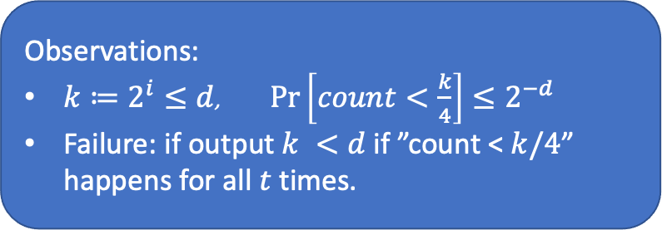
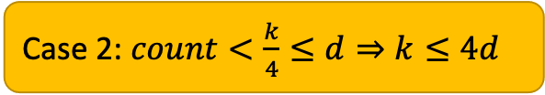

General Idea
$d≥ count,$ and $count< \frac{k}{4}$
Estimate$(n,δ)$
$$k=2^{i}, i=1,2,3, …DO$$
$$FOR k=2^{i}, i=1,2,3, …DO$$
$$d$$
$$2d$$
$$4d$$
$$8d$$
$$FOR m=1 to t≔\left\lceil (2\log{\frac{1}{δ}})/k\right\rceil$$
Case 2: $count<\frac{k}{4}≤d⇒k≤4d$
$$1. Choose f_{m}:\left[n\right]→\left[k\right] uniformly at random$$
$$2.Ask the queries defined by Q_{1}, …, Q_{k}$$
$$3. count ←\#queries with 1 result.$$
$$4. IF \left(count≥\frac{k}{4}\right)Break the current for loop$$
$$d$$
$$2d$$
$$4d$$
Observations:
$k≔2^{i}≤d$, $\operatorname{Pr}\left[count<\frac{k}{4}\right]≤2^{−d}$
Failure: if output$k <d$ if ”count <$k/4$” happens for all $t$ times.
$$IF \left(count<\frac{k}{4}\right)Break the current for loop and return k$$

Slide 11
Estimate failure probablity
Estimate$(n,δ)$
$$FOR k=2^{i}, i=1,2,3, …DO$$
For $k≔2^{i}≤d$:
The probability that the algorithm outputs $k<d$ is at most:
$$FOR m=1 to t≔\left\lceil (2\log{\frac{1}{δ}})/k\right\rceil$$
$$\operatorname{Pr}\left[count<\frac{k}{4}\right]≤\left(\begin{matrix}k \\ k/4\end{matrix}\right){\left(\frac{1}{4}\right)}^{d}≤2^{−d}$$
$$1. Choose f_{m}:\left[n\right]→\left[k\right] uniformly at random$$
$$2.Ask the queries defined by Q_{1}, …, Q_{k}$$
$$3. count ←\#positive queries$$
$$4. IF \left(count≥\frac{k}{4}\right)Break the current for loop$$
$$IF \left(count<\frac{k}{4}\right)Break the current for loop and return k$$
$$\operatorname{Pr}\left[output k\right]≤\sum_{i=1}^{\left\lfloor \log{d}\right\rfloor }{{\left(2^{−d}\right)}^{\left\lceil \frac{2\log{\frac{1}{δ}}}{2^{i}}\right\rceil }} ≤\sum_{i=1}^{\left\lfloor \log{d}\right\rfloor }{δ^{{2d}/{2^{i}}}≤δ}$$
Notes:
The next bullet: the probability that the algorithm output k<d, is the probability that the event count <k/4 happens t=[2log(1/\delta)/k] times for some k=2^i<d. This is at most:

Slide 12
Estimate Query Analysis
The value of $k$ cannot exceed $8d$
Therefore,
$$\#queries≤\sum_{i=1}^{\left\lceil \log{8d}\right\rceil }{2^{i}\left\lceil \frac{2\log{\frac{1}{δ}}}{2^{i}}\right\rceil } ≤\sum_{i=1}^{\left\lceil \log{8d}\right\rceil }{2\log{\frac{1}{δ}}+2^{i}=O\left(d+\log{d}\log{\frac{1}{δ}}\right)∎}$$

Slide 13
Stage II: Reduce the dimension of the problem
Define $N←\left\lceil d^{′2}/δ\right\rceil$
Choose $f:\left[n\right]→[N]$ uniformly at random
$$1$$
$$2$$
$$3$$
$$4$$
$$5$$
$$6$$
$$7$$
$$8$$
$$9$$
$$10$$
$$f$$
$$Y_{1}$$
$$Y_{2}$$
$$Y_{3}$$
$$Y_{4}$$

Slide 14
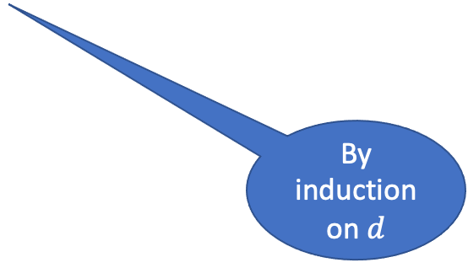
Stage II: The Reduced Problem
With probablity at least $1−δ/2$ each set $Y_{i}$ conrains at most one defective item.
Each set $Y_{i}$ that includes a defective item is called a defective set.
That is, with probablity at least $1−δ/2$, the number of defective items is equal to the number of defective sets.
$$\begin{matrix}Pr⁡[\left(∃i)Y_{i} contains more than one defective\right] & = & 1−\prod_{i=1}^{d−1}{\left(1−\frac{i}{N}\right)}≤\sum_{i=1}^{d−1}{\frac{i}{N}}≤\frac{d^{2}}{2N}≤\frac{δ}{2} \\ & & \end{matrix}$$
By induction on $d$
$$3$$
$$6$$
$$1$$
$$4$$
$$10$$
$$5$$
$$8$$
$$2$$
$$7$$
$$9$$
$$Y_{1}$$
$$Y_{2}$$
$$Y_{3}$$
$$Y_{4}$$

Slide 15
Stage III: Find the Defective Sets
Lemma (8)*:
There is a deterministic algorithm Find-Defectives, that without knowing $d$, asks $d\log\left(n/d\right)+O(d)$queries and finds all the defective items.
* Yongxi Cheng, Ding-Zhu Du, and Yinfeng Xu. A zig-zag approach for competitive group testing, INFORMS Journal of Computing, 2014.
Yongxi Cheng, Ding-Zhu Du, and Feifeng Zheng. A new strongly competitive group testing algorithm with small sequentiality, Annals OR, 2015.

Slide 16

Stage III: Find the Defective Sets - The algorithm
Run the algorithm Find-Defectives from Lemma 8 on the $N$ disjoint sets $Y_{1},…,Y_{N}$ to find the number of the defective sets.
For each query $Q⊆\{1,…,N\}$ that Find-Defectives asks, ask the query: $Q^{′}=\bigcup_{j∈Q}{Y_{j}}$
Let $Δ$ be the size of the set found by Find-Defectives
Output $Δ$
$$3$$
$$6$$
$$1$$
$$4$$
$$10$$
$$5$$
$$8$$
$$2$$
$$7$$
$$9$$
$$Y_{1}$$
$$Y_{2}$$
$$Y_{3}$$
$$Y_{4}$$
$$Q$$
1
4
$$Q′$$
$$3$$
$$6$$
$$2$$
$$7$$
$$9$$
$$Y_{1}$$
$$Y_{4}$$

Slide 17
Algorithm $Find−d(n,δ)$ – Queries
Stage I
Estimate $d$
Stage I
Estimate 𝒅
Stage II
Stage III
1. $d′←Estimate(n,δ/2)$
1. 𝑑′←𝐸𝑠𝑡𝑖𝑚𝑎𝑡𝑒(𝑛,𝛿/2)
2. $N←\left\lceil d^{′2}/δ\right\rceil$
2. 𝑁←⌈𝑑^′2/𝛿⌉
5. Run $Find−Defectives$ with $N$ items, for each query $Q⊆[N]$, ask $Q^{′}=\bigcup_{j∈Q}{Y_{j}}$
5. Run 𝐹𝑖𝑛𝑑−𝐷𝑒𝑓𝑒𝑐𝑡𝑖𝑣𝑒𝑠 with 𝑁 items, for each query 𝑄⊆[𝑁], ask 𝑄^′=⋃8_(𝑗∈𝑄)▒𝑌_𝑗
3. Choose $f:\left[n\right]→[N]$ uniformly at random.
3. Choose 𝑓:[𝑛]→[𝑁] uniformly at random.
4. Define $Y_{1},…,Y_{N}$ s.t. $Y_{i}=f^{−1}(i)$
4. Define 𝑌_1,…,𝑌_𝑁 s.t. 𝑌_𝑖=𝑓^(−1) (𝑖)
6. Let $Δ$ be the output of $Find−Defective.$
6. Let Δ be the output of 𝐹𝑖𝑛𝑑−𝐷𝑒𝑓𝑒𝑐𝑡𝑖𝑣𝑒.
7. Return $Δ$.
7. Return Δ.
By Lemma 9, for $δ/2$
$$O\left(d+\log{d}\log{\frac{2}{δ} }\right)$$
By Lemma 8, for $N=\left\lceil d^{′2}/δ\right\rceil$
$$d\log\left(N/d\right)+O(d)$$
Total Queries $$d\log\left(d/δ\right)+O(d+\log{d}\log{\frac{2}{δ} })$$

