Slide 1
On Detecting some defective items

Slide 2

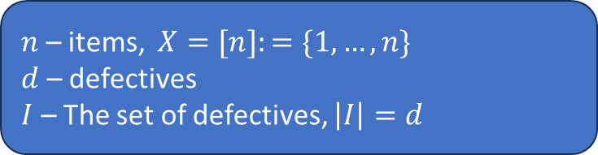
Objective
$n$– items, $X=[n]:=\{1,…,n\}$
$d$ – defectives
$I$ – The set of defectives, $\left|I\right|=d$
Target is:
Find a subset$J⊆ I, s.t |J|=ℓ <d$

Slide 3
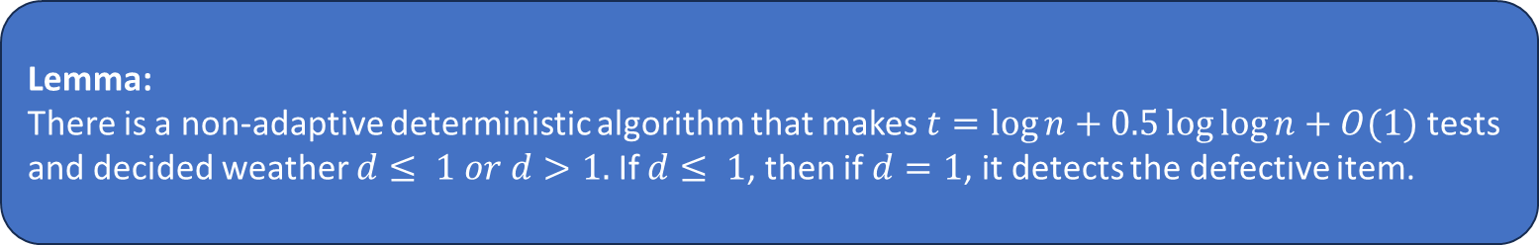

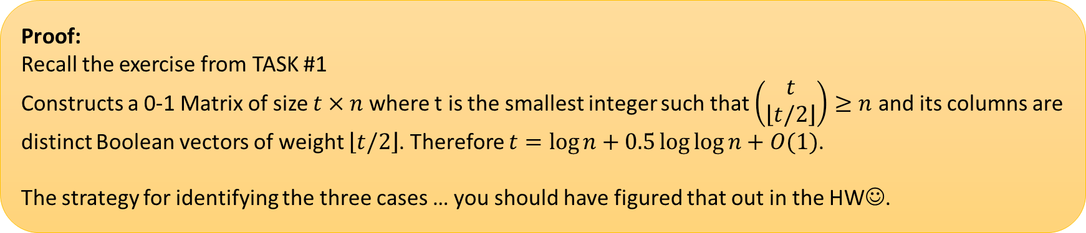
Randomized non-adaptive algorithm – $d$ is known: Step 1
Lemma:
There is a non-adaptive deterministic algorithm that makes $t=\log{n}+0.5\log{\log{n}}+O(1)$ tests and decided weather $d≤ 1 or d>1.$If $d≤ 1$, then if $d=1$, it detects the defective item.
Proof:
Recall the exercise from TASK #1
Constructs a 0-1 Matrix of size $t×n$where t is the smallest integer such that $\left(\begin{matrix}t \\ \left\lfloor t/2\right\rfloor \end{matrix}\right)≥n$ and its columns are distinct Boolean vectors of weight $\left\lfloor t/2\right\rfloor$. Therefore $t=\log{n}+0.5\log{\log{n}}+O(1)$.
The strategy for identifying the three cases … you should have figured that out in the HW☺.

Slide 4
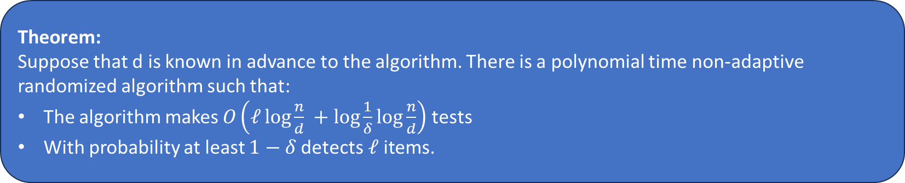

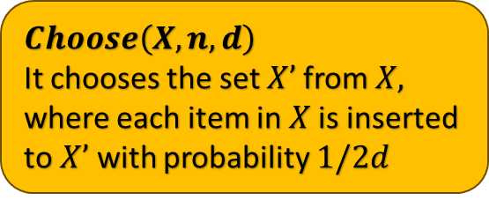
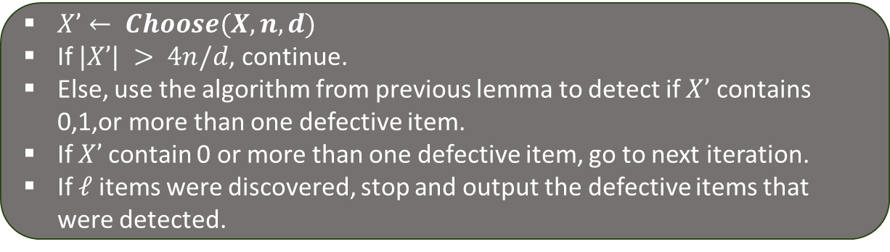

Randomized non-adaptive algorithm – $d$ is known: Step 2
Theorem:
Suppose that d is known in advance to the algorithm. There is a polynomial time non-adaptive randomized algorithm such that:
The algorithm makes $O\left(ℓ\log{\frac{n}{d} }+\log{\frac{1}{δ}}\log{\frac{n}{d}}\right)$ tests
With probability at least $1−δ$detects$ℓ$items.
If $ℓ≥ d/8$, then find all the d defective items using the non-adaptive randomized algorithms that we saw before , stop and output the set $I$ .
For $i=1, …, t=O\left(ℓ +\log{\frac{1}{δ}}\right)$
Is this alg. Non-adaptive?
$$Choose\left(X,n,d\right)$$
It chooses the set $X’$from $X,$ where each item in $X$is inserted to $X’$ with probability $1/2d$
$X’← Choose(X,n,d)$
If $|X’| > 4n/d$, continue.
Else, use the algorithm from previous lemma to detect if $X’$ contains 0,1,or more than one defective item.
If $X’$contain 0 or more than one defective item, go to next iteration.
If $ℓ$items were discovered, stop and output the defective items that were detected.

Slide 5
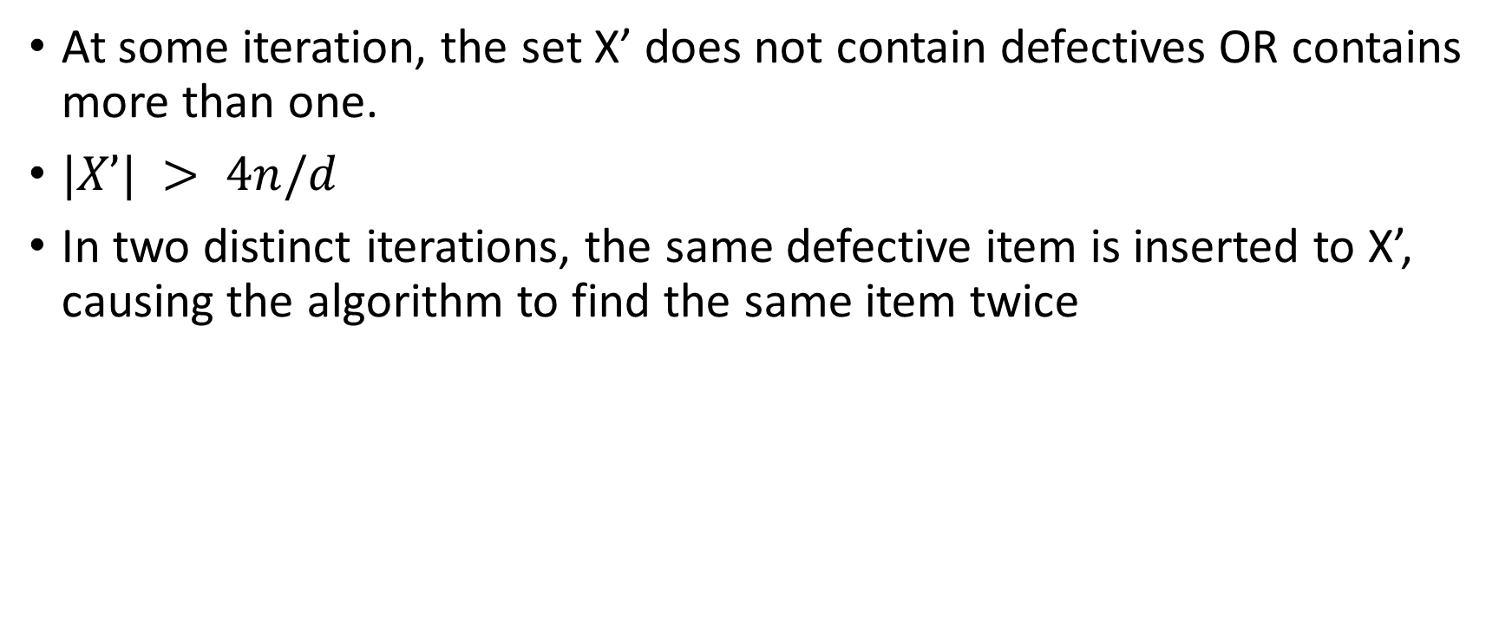
Failure probability – what can go wrong??
At some iteration, the set X’ does not contain defectives OR contains more than one.
$|X’| > 4n/d$
In two distinct iterations, the same defective item is inserted to X’, causing the algorithm to find the same item twice

Slide 6



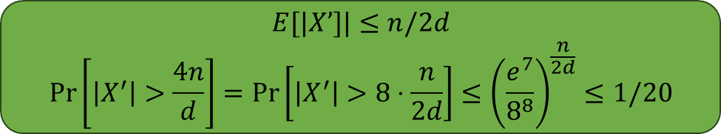
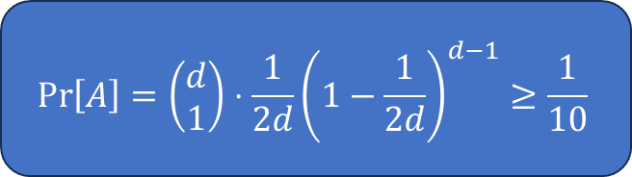
Good iteration
$B_{i}:$ The event that, in iteration i, the algorithm gets new defective item
A: at some iteration, the set X’ contains exactly one defective item
$$\operatorname{Pr}\left[A\right]=\left(\begin{matrix}d \\ 1\end{matrix}\right)⋅\frac{1}{2d}{\left(1−\frac{1}{2d}\right)}^{d−1}≥\frac{1}{10}$$
$$|X’|≤ 4n/d$$
$$E[|X’]|≤n/2d$$
$$\operatorname{Pr}\left[\left|X^{′}\right|>\frac{4n}{d}\right]=\operatorname{Pr}\left[\left|X^{′}\right|>8⋅\frac{n}{2d}\right]≤{\left(\frac{e^{7}}{8^{8}}\right)}^{\frac{n}{2d}}≤1/20$$
Hence we get:
$$\operatorname{Pr}\left[A and \left|X^{′}\right|≤\frac{4n}{d}\right]≥\frac{1}{10}⋅\frac{19}{20}≥\frac{1}{20}$$

Slide 7



Good iteration
$B_{i}:$ The event that, in iteration i, the algorithm gets new defective item
The algorithm finds new defective in the next iteration
Observation: Assuming that A occurs, the defective in X’ is distributed uniformly over the d defectives.
$$\operatorname{Pr}\left[getting the same defective item that was previously found\right]≤\frac{ℓ−1}{d}≤\frac{ℓ}{d}≤\frac{d}{8d}=\frac{1}{8} \left(since ℓ≤\frac{d}{8}\right)$$
Hence we get:
$$\operatorname{Pr}\left[If A occurs, new defective in X\right]≥7/8$$
For $t= O\left(ℓ+\log{\frac{1}{δ}}\right)$ iterations, with probability at least $1−δ$, the algorithm detects$ℓ$ defectives ($t$ Bernoulli trials with success probability of 7/160).
Overall:
$\operatorname{Pr}{[B_{i}]}=\frac{7}{8}⋅Pr\left[A and X^{′}≤\frac{4n}{d}\right]≥\frac{7}{8}⋅\frac{1}{20}=\frac{7}{160}$

