Slide 1

Accelerating Abnormal-Behavior Detection in Surveillance Video via Deep Neural Networks & Group Testing Methods

Slide 2
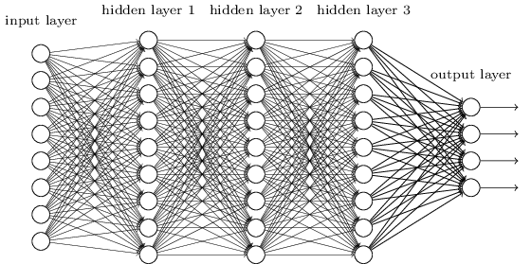
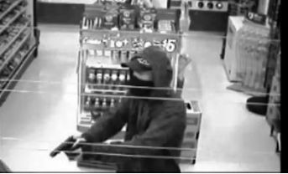
Motivation
Suppose that we have the following machine (CNN):
CNN
Convolutional Neural Network
Image
Firearm? (YES/NO)

Slide 3
Motivation
Can we exploit this machine to look for firearm in CCTV (videos)?
CNN
Convolutional Neural Network
Image
Firearm? (YES/NO)
Sure…
CCTV
Frames

Slide 4
Naive Solution
CNN
Convolutional Neural Network
CCTV
Firearm?
(YES/NO)
Convert the video to frames
Check each frame one by one

Slide 5
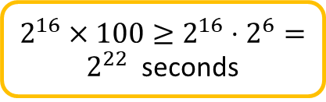
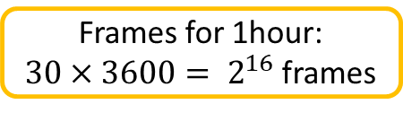
Problems with this solution
Suppose that we are asked to implement an automatic firearm detector to help police department to check CCTV’s from some street where a crime has occurred.
We want to find the exact time when some crime occurred within a range of one hour (e.g. 3:00am -4:00 am)
CNN
Convolutional Neural Network
CCTV
Firearm?
(YES/NO)
Standard CCTV frame rate is 30FPS
Inference GPU time: 100s for a single image
~85days

Slide 6
Solution #1: Choose a subset of the frames
Choose a subset of the frame wisely
Infer only the chosen subset

Slide 7
Research question: How we choose the subset?
Suggestions to examine:
Choose frames randomly according to uniform distribution
Check other distributions, and find their optimal parameters.
Find optimal parameters of the distribution such that the prerequisites of GT continue to hold after the selection.
Make pixel by pixel average
Is this computationally expensive?
Making averages on a subset that was randomly chosen

Slide 8
Solution #2: Reduce inference time
This is an active research topic
Directions considered here are related sometimes of using cutting edge hardware..
NVIDIA HW solutions for AI
Optimizing the structure of the CNN
We will not discuss those, although the solution we are examining will make those solutions even better

Slide 9
Solution #3: Group testing
Image
CNN
Convolutional Neural Network
Firearm? (YES/NO)
Due to the work of:
Weixin Liang, James Zou
Suppose that we can enhance the CNN such that:
Image
CNN
Convolutional Neural Network
Image
Yes: at least one frame includes firearm
No: Firearm clean
Image
Image
Image
Image

Slide 10
Solution #3: Group testing (cont.)
Image
CNN
Convolutional Neural Network
Image
Yes: at least one firearm frame
No: Firearm clean
Image
Image
Image
Image
How we choose the frames in each group, so we can actually determine the desired ones ????
Due to the work of: Bshouty & Haddad-Zaknoon
Do we really need to identify ALL the frames with firearm image?

Slide 11

What is Group Testing?
YES (positive)
NO (negative)
A group test is a subset of elements form the pile.
A group test result is positive
if there is at least one “red” (defective) item in this subset and negative otherwise.
Target: identify the set of defective items using minimum number of group tests

Slide 12
Let’s take a deeper look…
Assume that we have reduced the number frames.
By choosing frames uniformly at random or ..
Making some kind of average on images (for example pixel based average)
We order the chosen frames according to their original timeline.
The blue frames are ones that capture the abnormal event.
They are consecutive, because we ordered the chosen frame according to their time.
We need to determine this time frame within the video
3:00
It is enough to find a single frame that captured the event
4:00

Slide 13


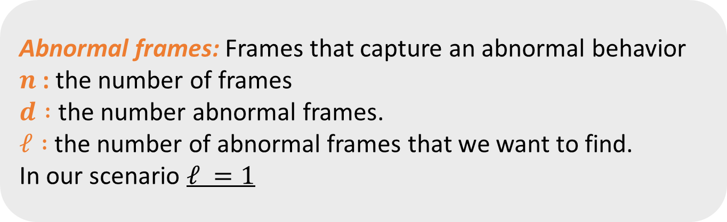
Formal Notations
Later, we will call those defective items

Slide 14
Possible solutions - Summary
Choose a subset of the frames
We don’t really need to infer all the frames .. We might be able to chose a subset of the frame wisely, and infer those only.
Make inference time more efficient
Many efforts is been done on this topic today.
After selecting a subset of frames, can we infer more than one frame in a single inference round?
Use group testing methods to group images together and infer them as a composite image
Groups are NOT necessarily consecutive!!!

Slide 15
Project stages – Stage 1: Building the CNN
CNN
Convolutional Neural Network
CNN
Convolutional Neural Network
Firearm?
(YES/NO)
CCTV
Firearm?
(YES/NO)
CCTV
A. Collect and enhance a dataset for CCTV videos that contain firearm events
B. Extract from the CCTV videos frames that include firearms and normal frames
With a proper set, we can train a CNN that can distinguish between firearm frames and normal ones

Slide 16
Sage 1 output
After the training process we will have the following machine (CNN):
CNN
Convolutional Neural Network
Image
Firearm? (YES/NO)

Slide 17
Stage 2: Preparing CCTV frames for CNN
CNN
Convolutional Neural Network
CNN
Convolutional Neural Network
Firearm?
(YES/NO)
CCTV
Firearm?
(YES/NO)
CCTV
Choose a subset of the frame wisely
Infer only the chosen subset
CCTV

Slide 18

Stage 3: Apply group testing in the inference
CNN
Convolutional Neural Network
CNN
Convolutional Neural Network
Firearm?
(YES/NO)
CCTV
Firearm?
(YES/NO)
CCTV
?
Enhance the CNN to cope with GT – Due to the work of:
Weixin Liang, James Zou
Apply GT algorithm to find an abnormal frame – Due to the work of:
Nader Bshouty & Catherine Haddad-Zaknoon
Image
CNN
Convolutional Neural Network
Image
Image
Yes / No
Image
Image
Image

Slide 19


