Slide 1

GT03: Group Testing for general $d$ Non-adaptive randomized algorithm
Bounds on the number of tests in non-adaptive randomized Group Testing*
[*] Nader H. Bshouty, George Haddad, and Catherine A. Haddad-Zaknoon. Bounds for the number of tests in non-adaptive randomized algorithms for group testing, SOFSEM 2020, Limassol, Cyprus, January 20-24, Proceedings, volume 12011 of Lecture Notes in Computer Science, pages 101–112. Springer, 2020

Slide 2

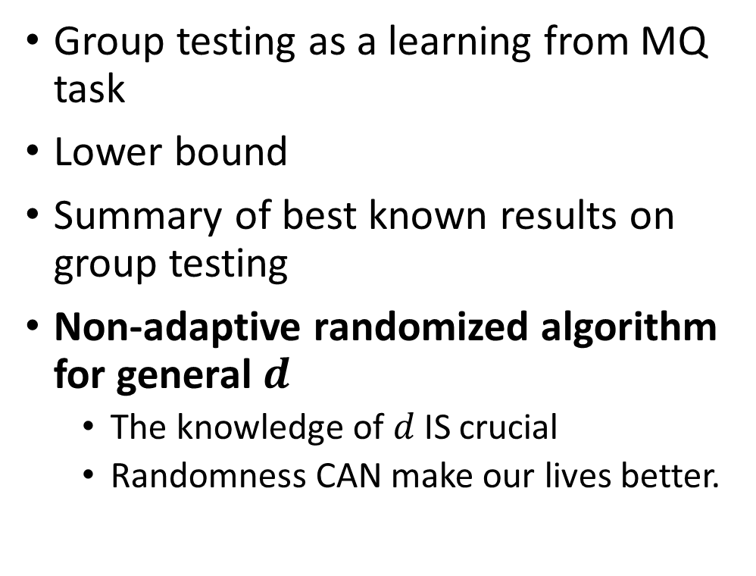
Our agenda
Group testing as a learning from MQ task
Lower bound
Summary of best known results on group testing
Non-adaptive randomized algorithm for general $d$
The knowledge of $d$ IS crucial
Randomness CAN make our lives better.

Slide 3
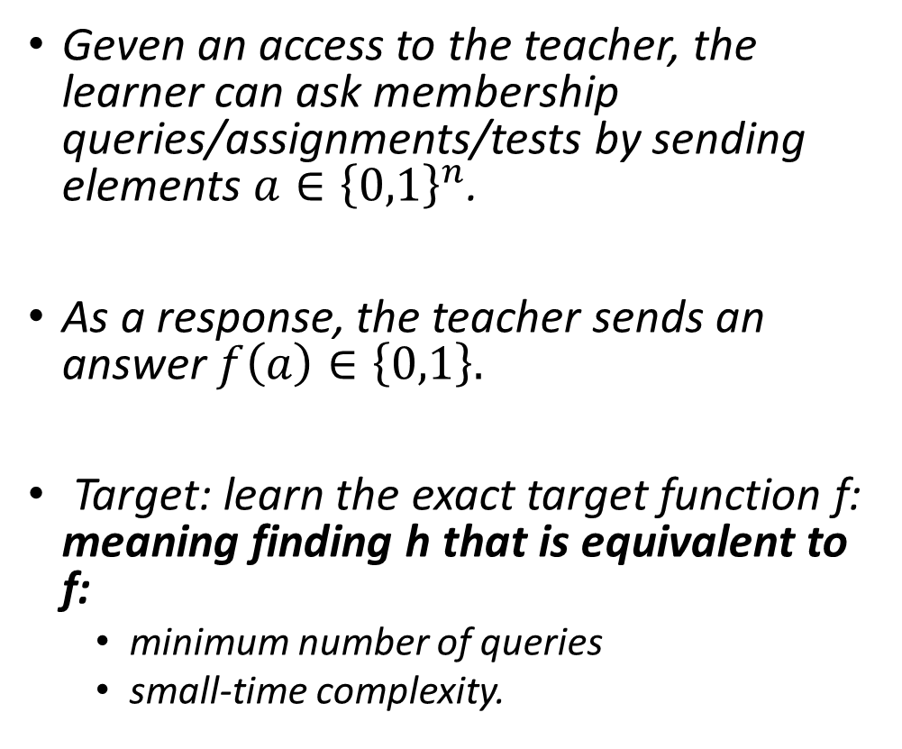
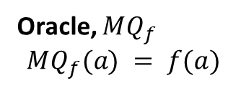



Introduction: The Learning model
Geven an access to the teacher, the learner can ask membership queries/assignments/tests by sending elements $a∈{\left\{0,1\right\}}^{n}$.
As a response, the teacher sends an answer $f\left(a\right)∈\left\{0,1\right\}.$
Target: learn the exact target function f: meaning finding h that is equivalent to f:
minimum number of queries
small-time complexity.
Learning algorithm
Oracle, $MQ_{f}$
$$MQ_{f}(a) = f(a)$$
Learner
$$a∈{\left\{0,1\right\}}^{n}$$
Teacher
$$f(a)$$
$$f∈C$$
Notes:
בהינתן גישה למורה, הלומד יכול לשלוח למורה השמה a
וכתגובה, המורה שולח את הערך של הפונקציה f על ההשמה a.
השאילתות מהסוג הזה נקראת שאילתות השמה או membership queries.
המטרה של הלומד היא למצוא פונקציה h שהיא שקולה לוגית ל f בעזרת כמה שפחות שאילתות .
הלומד נקרא גם האלגוריתם הלומד
והמורה נקרא גם אורקל ומסומן ע:י MQ_f

Slide 4
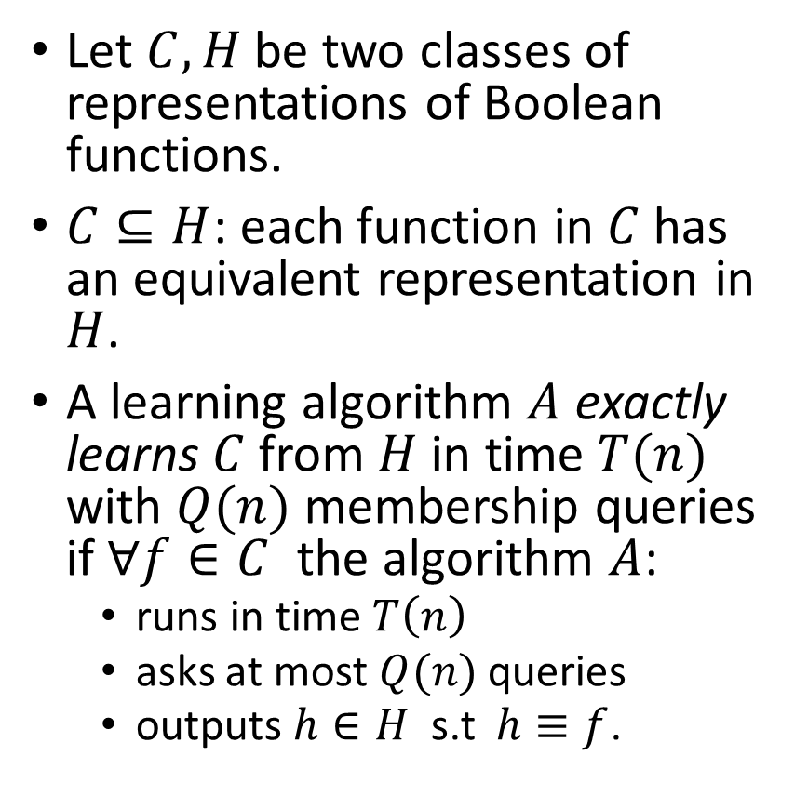



Learnability – formal definition
Let $C, H$ be two classes of representations of Boolean functions.
$C⊆H$: each function in $C$ has an equivalent representation in $H$.
A learning algorithm $A$ exactly learns $C$ from $H$ in time $T(n)$ with $Q(n)$ membership queries if $∀f∈C$ the algorithm $A$:
runs in time $T\left(n\right)$
asks at most $Q(n)$ queries
outputs $h∈H$ s.t $h≡f$.
$$C$$
$$H$$
Proper Learning : when $H=C$.
If such an algorithm exists, we say that the class $C$ is learnable from $H$ in time $T(n)$ with $Q(n)$ membership queries.

Slide 5

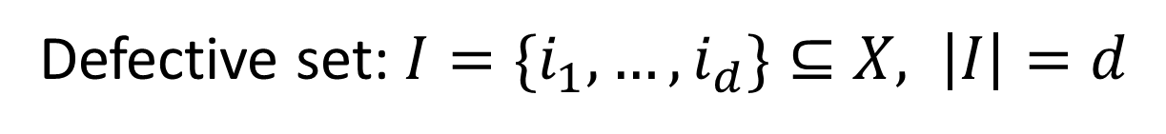


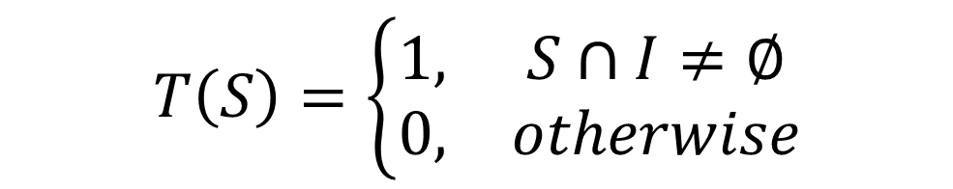

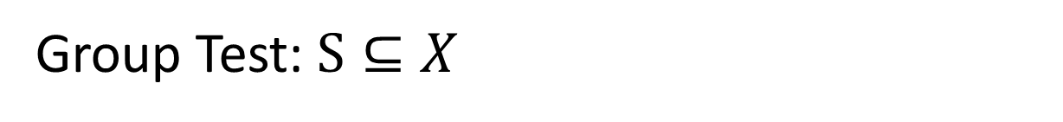
Group Testing
Items set: $X=[n]:=\{1,2,⋯, n\}$
Defective set: $I=\{i_{1},…, i_{d}\}⊆X, \left|I\right|=d$
Group Test: $S⊆X$
Test Result: $T\left(S\right)∈\{0, 1\}$ s.t:
$$T\left(S\right)=\left\{\begin{matrix}1, & S∩I≠∅ \\ 0, & otherwise\end{matrix}\right.$$
Test Representation $S$: $(a_{1},⋯,a_{n})∈{\left\{0, 1\right\}}^{n}$
$$a_{i}=1⟺i∈S$$

Slide 6



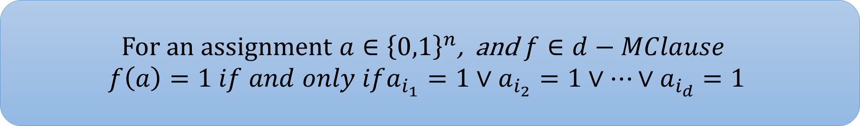
Learning the class $d−MClause$
$$d−MClause ≔\left\{ f:{\left\{0,1\right\}}^{n}→\left\{0,1\right\}\right| f=x_{i_{1}}∨x_{i_{2}}∨…∨x_{i_{d}}\}$$
For an assignment $a∈{\left\{0,1\right\}}^{n}$, and $f∈d−MClause$
$$f\left(a\right)=1 if and only ifa_{i_{1}}=1∨a_{i_{2}}=1∨…∨a_{i_{d}}=1$$
Group testing problem is equivalent to learning the class $d−MClause$from membership queries

Slide 7
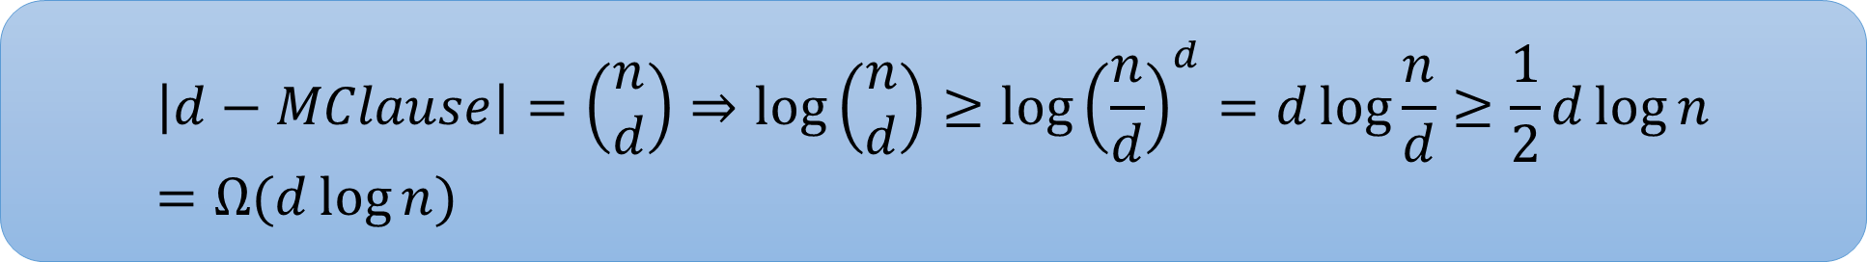


Lower bound for the group testing problem
Theorem:
Let $C$ be a finite class of Boolean functions. Then, any deterministic learning algorithm from MQ must ask at least$log⁡|C|$membership queries.
$$\left|d−MClause\right|=\left(\begin{matrix}n \\ d\end{matrix}\right)⇒\log\left(\begin{matrix}n \\ d\end{matrix}\right)≥\log{{\left(\frac{n}{d}\right)}^{d}=d\log{\frac{n}{d}}≥\frac{1}{2}d\log{n}}=Ω(d\log{n})$$
Information theoretic lower bound
$$d<\sqrt{n}$$

Slide 8
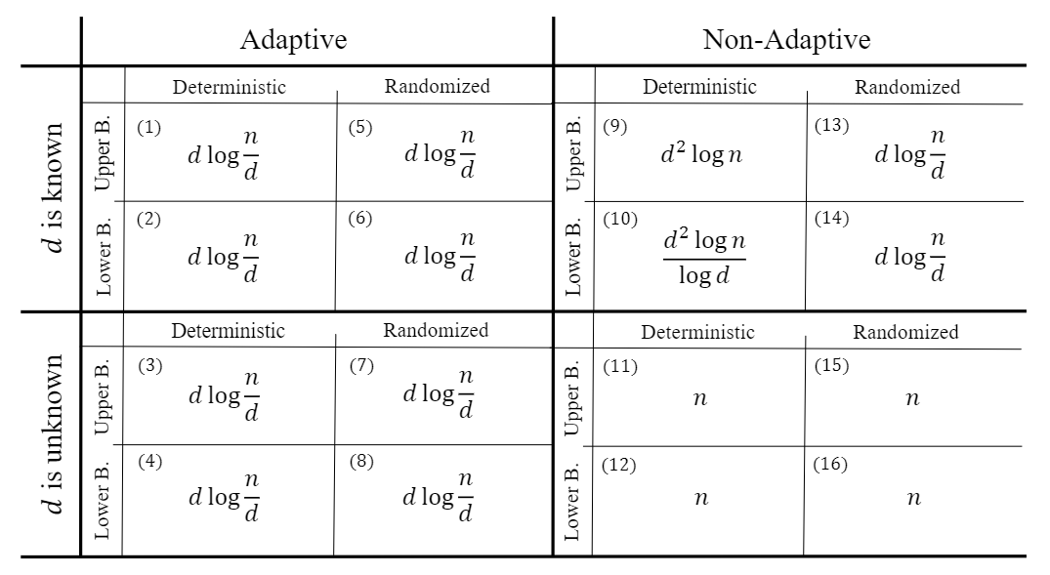

Known results on GT problem
Due to Hwang 1972
Notice how randomness reduces the test complexity
We cannot do better if d is unknown
Estimate d, then use the above $↑$ algorithms

Slide 9

Non-adaptive deterministic algorithm for general $d$

Slide 10



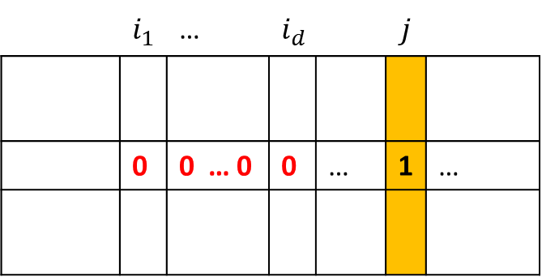
Non-adaptive deterministic algorithm – existence proof
Suppose we can build a test matrix $M$ of size $m×n$ such that:
To prove that such matrix exists, we need to prove that:
Event A:
$$\left(∀i_{1}, …, i_{d}\right)\left(∀j∉\left\{i_{1},…, i_{d}\right\}\right) \left(∃k∈\left\{1, …, m\right\}\right) M_{k,i_{1}}=…=M_{k, i_{d}}=0 and M_{k,j}=1$$
$$\operatorname{Pr}\left[A\right]>0$$
$$I=\left\{i_{1},…, i_{d}\right\}$$
 | $$i_{1}$$ | … | $$i_{d}$$ |  | $$j$$
 | 0 | 0 … 0 | 0 | … | 1 | …

Slide 11
Non-adaptive deterministic algorithm – existence proof
Suppose we can build a test matrix $M$ of size $m×n$ such that:
To prove that such matrix exists, we need to prove that:
Event A:
$$\left(∀i_{1}, …, i_{d}\right)\left(∀j∉\left\{i_{1},…, i_{d}\right\}\right) \left(∃k∈\left\{1, …, m\right\}\right) M_{k,i_{1}}=…=M_{k, i_{d}}=0 and M_{k,j}=1$$
$$\operatorname{Pr}\left[A\right]>0$$
$$I=\left\{i_{1},…, i_{d}\right\}$$
 | $$i_{1}$$ | … | $$i_{d}$$ |  | $$j$$
 | 0 | 0 … 0 | 0 | … | 1 | …

Slide 12
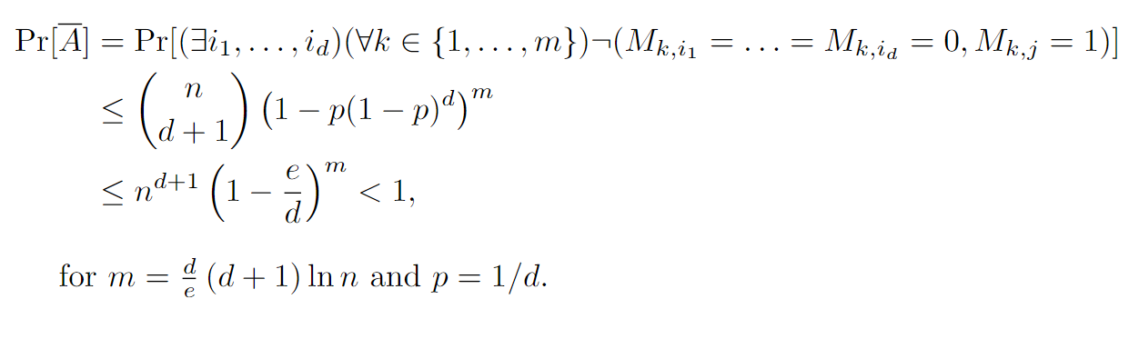
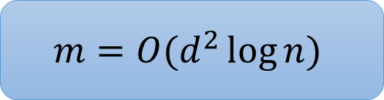
Non-adaptive deterministic algorithm – existence proof
$$m=O(d^{2}\log{n})$$

Slide 13

Non-adaptive random MC algorithm for general $d$

Slide 14
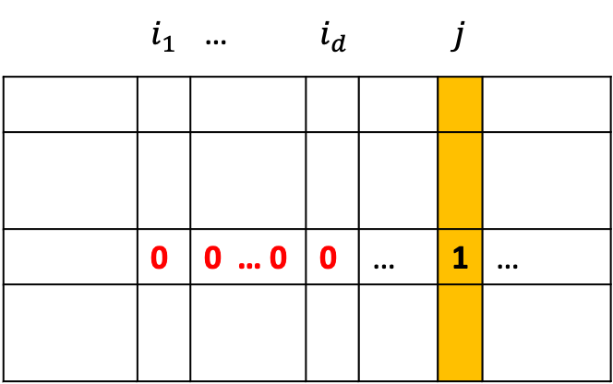

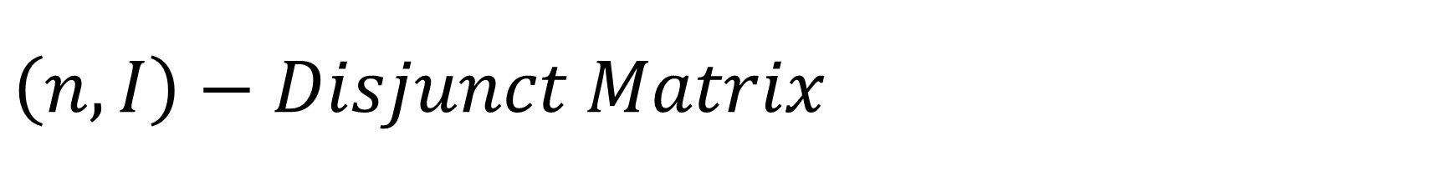

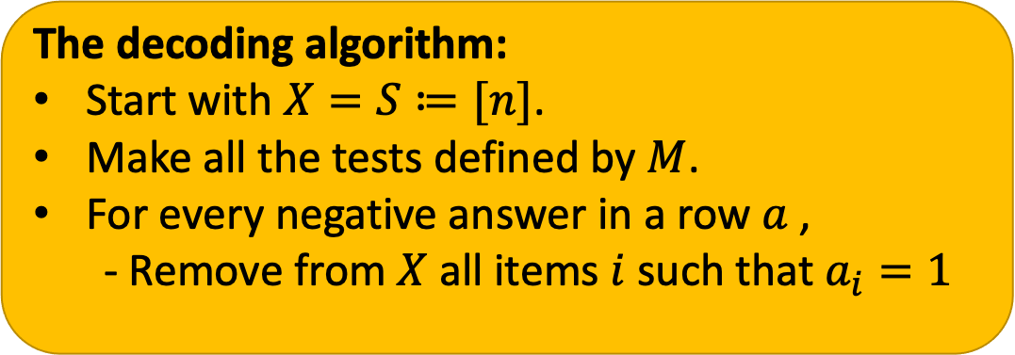
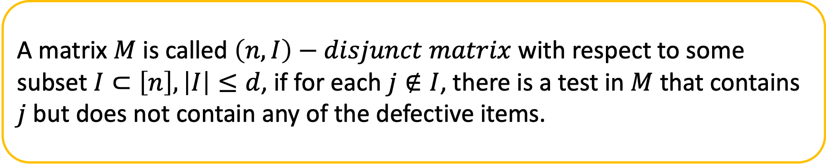
$$\left(n,I\right)−Disjunct Matrix$$
A matrix $M$ is called $\left(n,I\right)−disjunct matrix$ with respect to some subset $I⊂\left[n\right], \left|I\right|≤d$, if for each $j∉I$, there is a test in $M$ that contains $j$ but does not contain any of the defective items.
The decoding algorithm:
Start with $X=S≔[n]$.
Make all the tests defined by $M$.
For every negative answer in a row $a$ ,
- Remove from $X$ all items $i$ such that $a_{i}=1$
Assume that $\left\{i_{1},…, i_{d}\right\}⊆[n]$ is the set of defectives
 | $$i_{1}$$ | … | $$i_{d}$$ |  | $$j$$
 | 0 | 0 … 0 | 0 | … | 1 | …
Such test guarantees to eliminate $j$ from $X$.

Slide 15
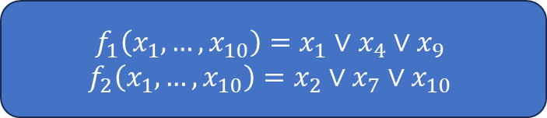

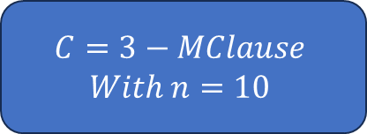
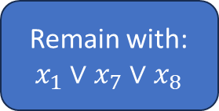
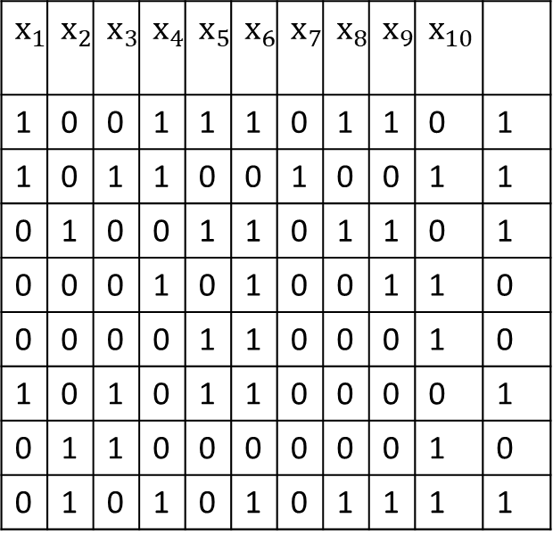
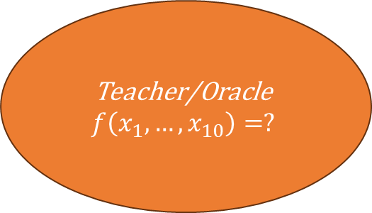
Example
$$C=3−MClause$$
$$With n=10$$
$$f_{1}\left(x_{1},…, x_{10}\right)=x_{1}∨x_{4}∨x_{9}$$
$$f_{2}\left(x_{1},…, x_{10}\right)=x_{2}∨x_{7}∨x_{10}$$
$$x_{1}$$ | $$x_{2}$$ | $$x_{3}$$ | $$x_{4}$$ | $$x_{5}$$ | $$x_{6}$$ | $$x_{7}$$ | $$x_{8}$$ | $$x_{9}$$ | $$x_{10}$$
1 | 0 | 0 | 1 | 1 | 1 | 0 | 1 | 1 | 0 | 1
1 | 0 | 1 | 1 | 0 | 0 | 1 | 0 | 0 | 1 | 1
0 | 1 | 0 | 0 | 1 | 1 | 0 | 1 | 1 | 0 | 1
0 | 0 | 0 | 1 | 0 | 1 | 0 | 0 | 1 | 1 | 0
0 | 0 | 0 | 0 | 1 | 1 | 0 | 0 | 0 | 1 | 0
1 | 0 | 1 | 0 | 1 | 1 | 0 | 0 | 0 | 0 | 1
0 | 1 | 1 | 0 | 0 | 0 | 0 | 0 | 0 | 1 | 0
0 | 1 | 0 | 1 | 0 | 1 | 0 | 1 | 1 | 1 | 1
Teacher/Oracle
$$f\left(x_{1},…, x_{10}\right)=?$$
4,6,9,10
5,6,10
Remain with:
$$x_{1}∨x_{7}∨x_{8}$$
2,3,10
This matrix is:
$$\left(10, \left\{1,7,8\right\}\right)−disjunct$$

Slide 16

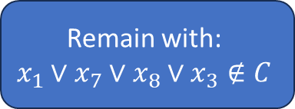
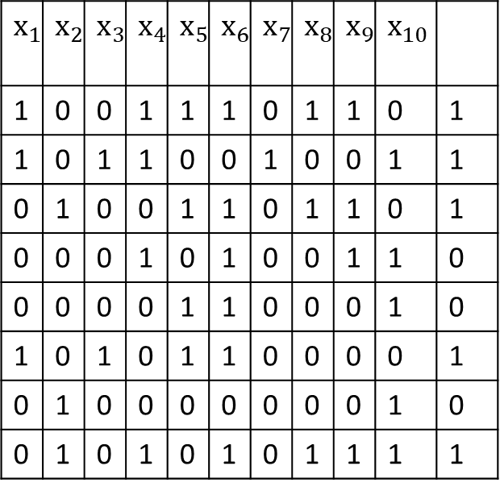
Example
$$C=3−MClause$$
$$With n=10$$
$$f_{1}\left(x_{1},…, x_{10}\right)=x_{1}∨x_{4}∨x_{9}$$
$$f_{2}\left(x_{1},…, x_{10}\right)=x_{2}∨x_{7}∨x_{10}$$
$$x_{1}$$ | $$x_{2}$$ | $$x_{3}$$ | $$x_{4}$$ | $$x_{5}$$ | $$x_{6}$$ | $$x_{7}$$ | $$x_{8}$$ | $$x_{9}$$ | $$x_{10}$$
1 | 0 | 0 | 1 | 1 | 1 | 0 | 1 | 1 | 0 | 1
1 | 0 | 1 | 1 | 0 | 0 | 1 | 0 | 0 | 1 | 1
0 | 1 | 0 | 0 | 1 | 1 | 0 | 1 | 1 | 0 | 1
0 | 0 | 0 | 1 | 0 | 1 | 0 | 0 | 1 | 1 | 0
0 | 0 | 0 | 0 | 1 | 1 | 0 | 0 | 0 | 1 | 0
1 | 0 | 1 | 0 | 1 | 1 | 0 | 0 | 0 | 0 | 1
0 | 1 | 0 | 0 | 0 | 0 | 0 | 0 | 0 | 1 | 0
0 | 1 | 0 | 1 | 0 | 1 | 0 | 1 | 1 | 1 | 1
Teacher/Oracle
$$f\left(x_{1},…, x_{10}\right)=?$$
4,6,9,10
5,6,10
Remain with:
$$x_{1}∨x_{7}∨x_{8}∨x_{3}∉C$$
2,10
This matrix is NOT:
$$\left(10, \left\{1,7,8\right\}\right)−disjunct$$

Slide 17
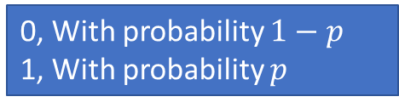
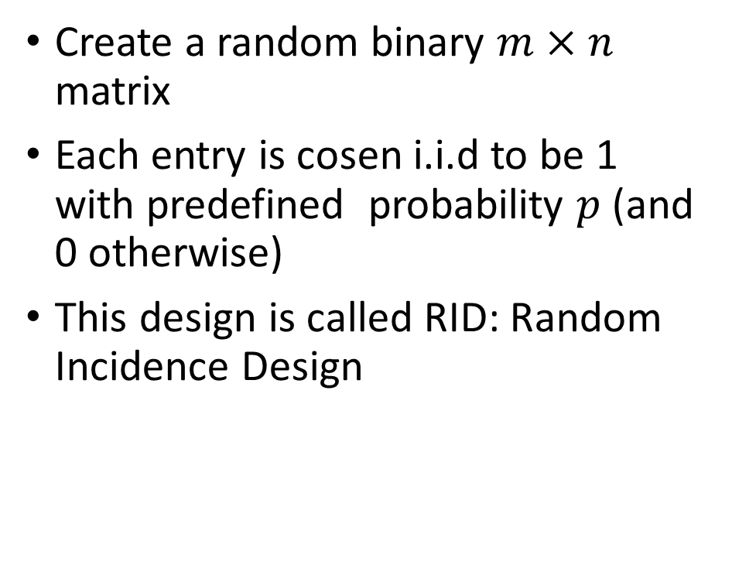

Non-adaptive algorithm: RID model
RID
Create a random binary $m×n$ matrix
Each entry is cosen i.i.d to be 1 with predefined probability $p$ (and 0 otherwise)
This design is called RID: Random Incidence Design
 | …
 | …
. .
 | …
0, With probability $1−p$
1, With probability $p$
We need to choose $p$ and $m$ such that with probability $≥ 1−δ$, the design matrix is $\left(n,I\right)−$ disjunct

Slide 18
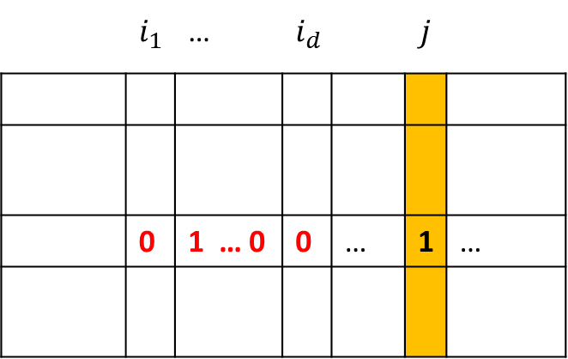

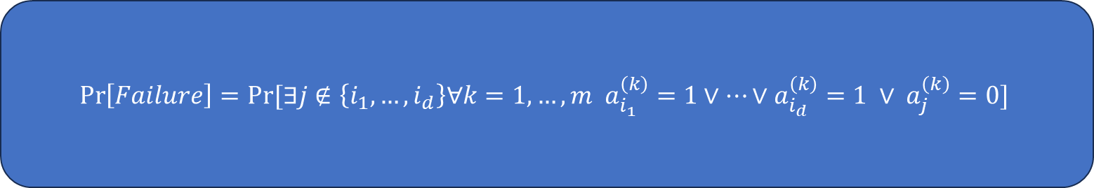

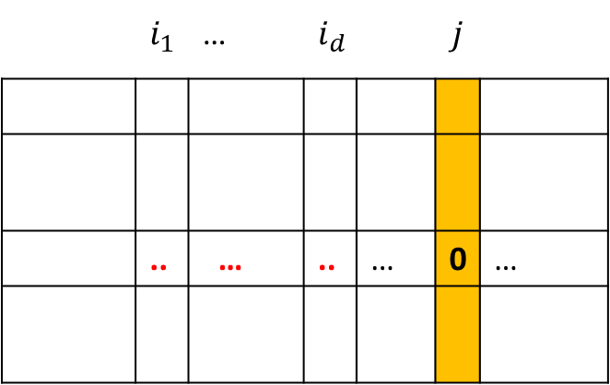

Failure probability analysis
Recall that $\left\{i_{1},…, i_{d}\right\}⊆[n]$ is the set of defectives
 | $$i_{1}$$ | … | $$i_{d}$$ |  | $$j$$
 | 0 | 1 … 0 | 0 | … | 1 | …
 | $$i_{1}$$ | … | $$i_{d}$$ |  | $$j$$
 | .. | … | .. | … | 0 | …
$$k$$
$$k$$
$$\operatorname{Pr}\left[Failure\right]=Pr⁡[∃j∉\left\{i_{1},…, i_{d}\right\}∀k=1,…,m a_{i_{1}}^{\left(k\right)}=1∨…∨a_{i_{d}}^{\left(k\right)}=1 ∨ a_{j}^{\left(k\right)}=0]$$

Slide 19
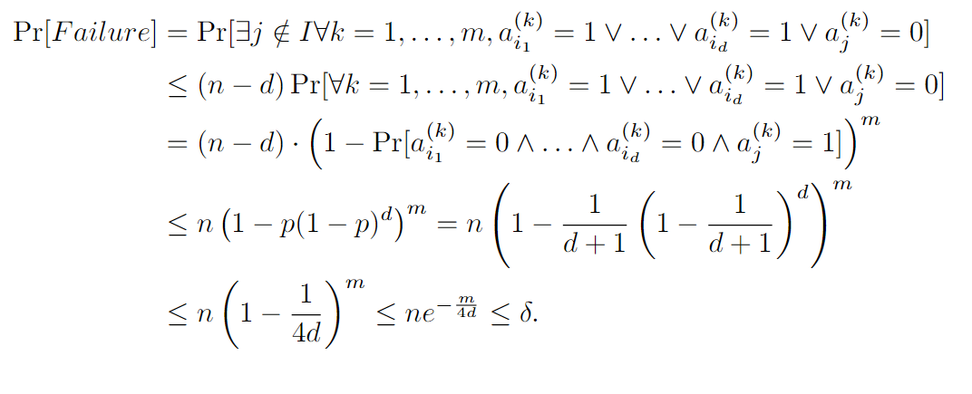

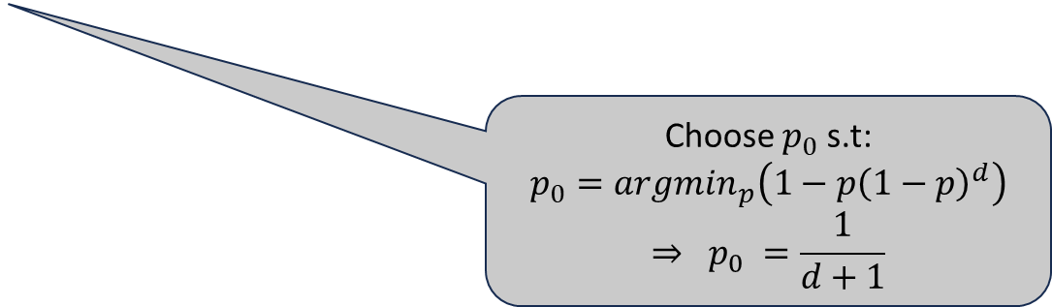

Failure probability analysis
$$\operatorname{Pr}\left[Failure\right]=Pr⁡[∃j∉\left\{i_{1},…, i_{d}\right\}∀k=1,…,m a_{i_{1}}^{\left(k\right)}=1∨…∨a_{i_{d}}^{\left(k\right)}=1 ∨ a_{j}^{\left(k\right)}=0]$$
Union bound
$$\operatorname{Pr}\left[A_{1}∧…∧A_{m}\right]=\operatorname{Pr}\left[A_{1}\right]⋅…⋯Pr⁡[A_{m}]$$
Choose $p_{0}$ s.t:
$$p_{0}=argmin_{p}\left(1−p{\left(1−p\right)}^{d}\right)$$
$$⇒ p_{0} =\frac{1}{d+1}$$
$$m=4d\ln{n}=O(d\log{n})$$

Slide 20
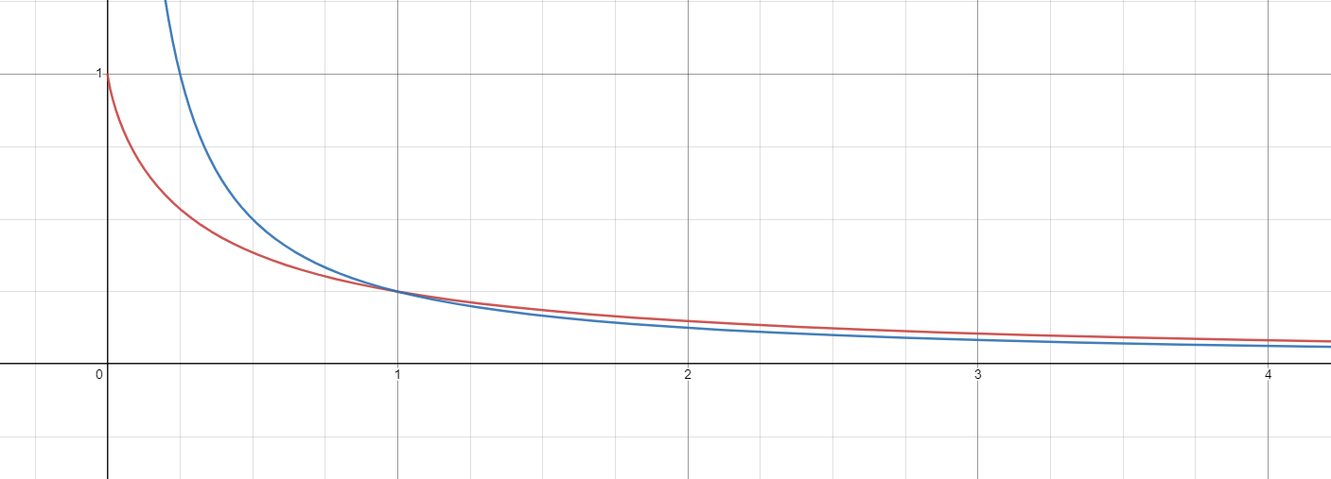
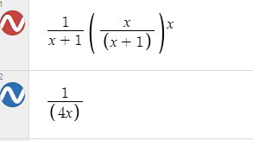
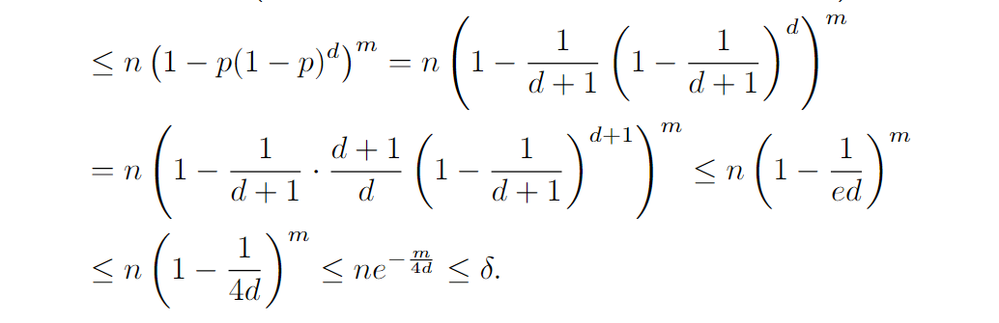

Slide 21
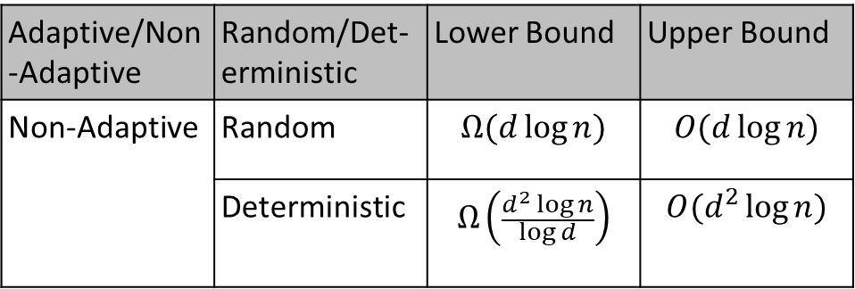
Random vs. Deterministic Non adaptive Algorithms for GT
In practice, tests are time consuming, therefore, non-adaptive algorithms are highly desired.
Lower bound for non-adaptive deterministic vs. non-adaptive random algorithm motivates the interest in non-adaptive random algorithms.
In many studies, optimality in the number of tests is “chased” up to the leading constant.
Adaptive/Non-Adaptive | Random/Det-erministic | Lower Bound | Upper Bound
Non-Adaptive | Random | $$Ω(d\log{n)}$$ | $$O(d\log{n)}$$
 | Deterministic | $$Ω\left(\frac{d^{2}\log{n}}{\log{d}}\right)$$ | $$O(d^{2}\log{n)}$$
Notes:
In practice, tests are time consuming and therefore nonadaptive algorithms are highly desired. Where by non-adaptive algorithm we mean that the tests are independent, that is, the decision of making a specific test does not involve the results of previous tests.
In the table we summarize the known lower and upper bound on the number of tests required to identify at most d defectives. And we can see the advantage of the random non-adaptive algorithms over the deterministic ones… this actually motivates our interest in non-adaptive random algorithms for GT.
Practically, the tests might take one-two days till getting the results, therefore, many studies including ours, focus their efforts on reducing the hidden constants in the O and omega notations.

Slide 22

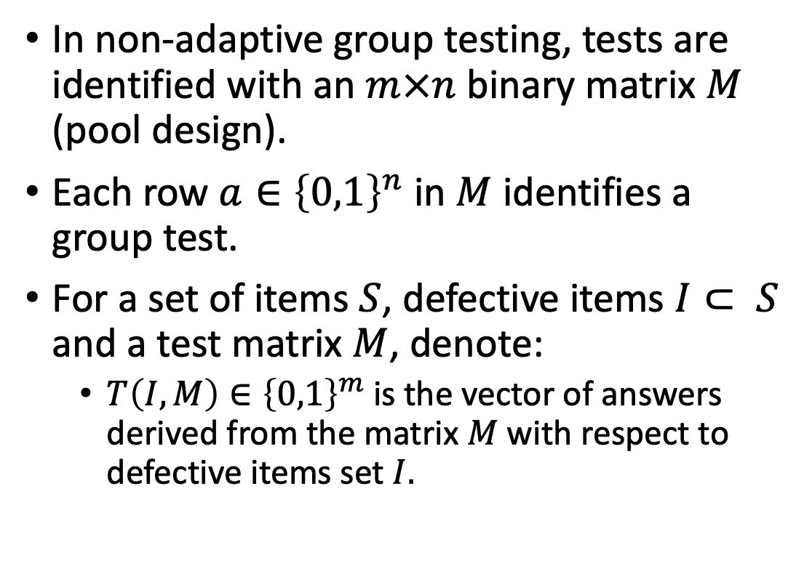



Finding the defective set: the test matrix (pool design)
In non-adaptive group testing, tests are identified with an $m×n$ binary matrix $M$ (pool design).
Each row $a∈{\left\{0,1\right\}}^{n}$ in $M$ identifies a group test.
For a set of items $S$, defective items $I⊂ S$ and a test matrix $M$, denote:
$T\left(I,M\right)∈{\left\{0,1\right\}}^{m}$ is the vector of answers derived from the matrix $M$ with respect to defective items set $I.$
$$n$$
$$m$$
$$M$$
$$T\left(I,M\right)$$

Slide 23
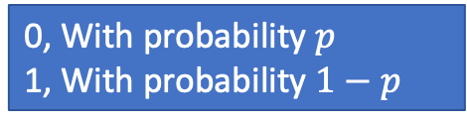
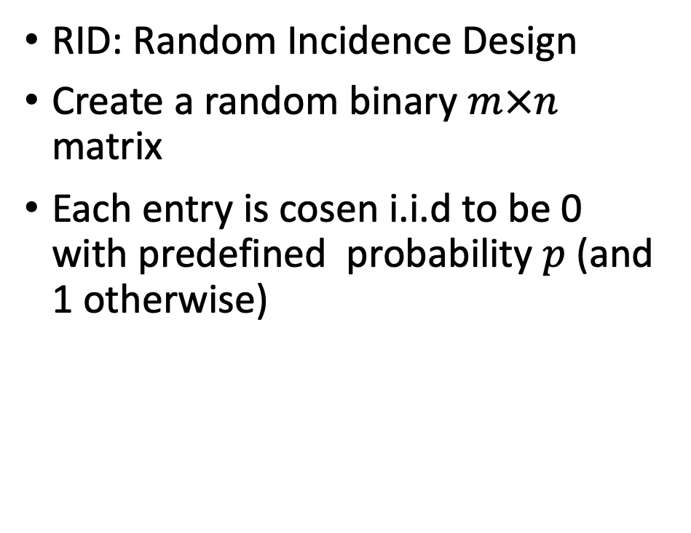
Pool Design Models: RID
RID
RID: Random Incidence Design
Create a random binary $m×n$ matrix
Each entry is cosen i.i.d to be 0 with predefined probability $p$ (and 1 otherwise)
 | …
 | …
. .
 | …
0, With probability $p$
1, With probability $1−p$

Slide 24
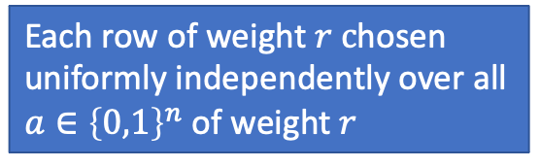
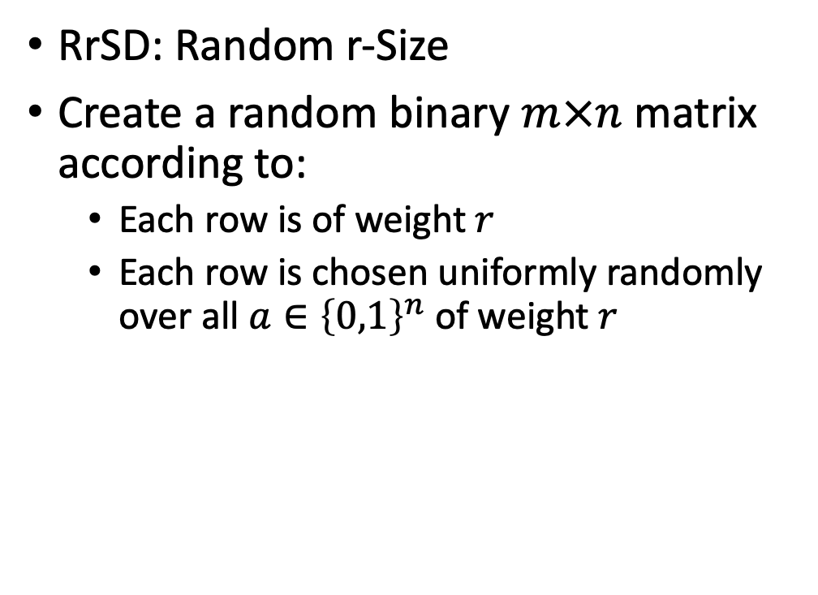
Pool Design Models: RrSD
RrSD: Random r-Size
Create a random binary $m×n$ matrix according to:
Each row is of weight$r$
Each row is chosen uniformly randomly over all $a∈{\left\{0,1\right\}}^{n}$ of weight $r$
RrSD
. .
Each row of weight $r c$hosen uniformly independently over all $a∈{\left\{0,1\right\}}^{n}$ of weight $r$

Slide 25
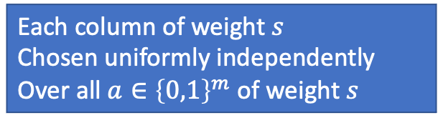
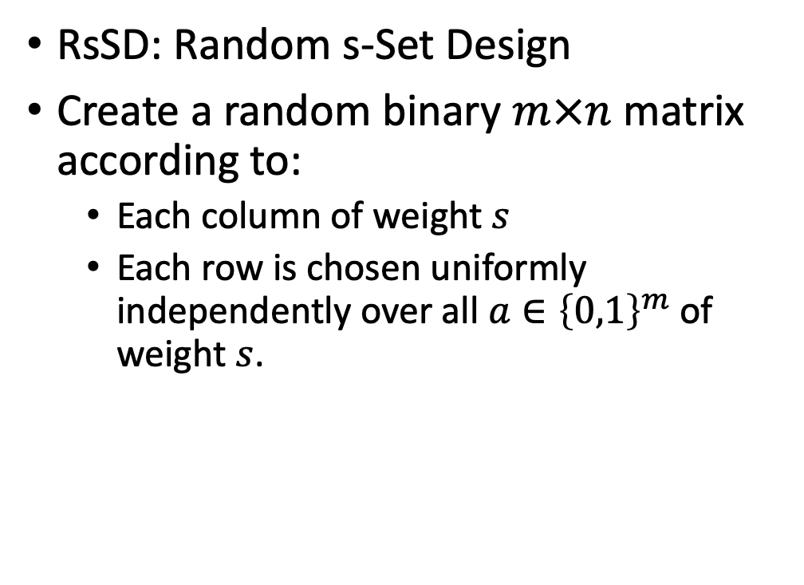
Pool Design Models: RsSD
RsSD
RsSD: Random s-Set Design
Create a random binary $m×n$ matrix according to:
Each column of weight $s$
Each row is chosen uniformly independently over all $a∈{\left\{0,1\right\}}^{m}$ of weight $s$.
 | … |  | …
Each column of weight $s$
Chosen uniformly independently
Over all $a∈{\left\{0,1\right\}}^{m}$ of weight $s$

Slide 26
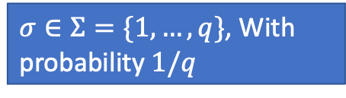
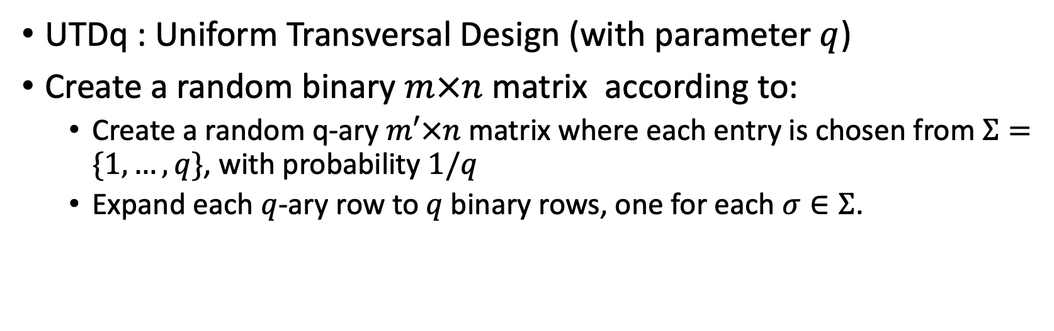
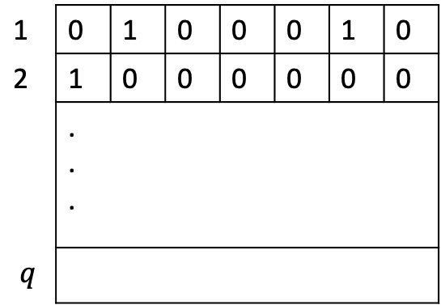

Pool Design Models: UTDq
UTDq : Uniform Transversal Design (with parameter $q$)
Create a random binary $m×n$ matrix according to:
Create a random q-ary $m′×n$ matrix where each entry is chosen from $Σ=\{1,…, q\}$, with probability $1/q$
Expand each $q$-ary row to $q$binary rows, one for each $σ∈Σ$.
UTDq
1 | 0 | 1 | 0 | 0 | 0 | 1 | 0
2 | 1 | 0 | 0 | 0 | 0 | 0 | 0
 | . . .
$$q$$
 | …
 | …
. .
 | …
$σ∈Σ=\{1,…, q\}$, With probability $1/q$
2 | $$1$$ | 4 | 3 | q | $$1$$ | q

Slide 27
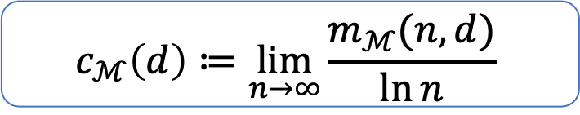
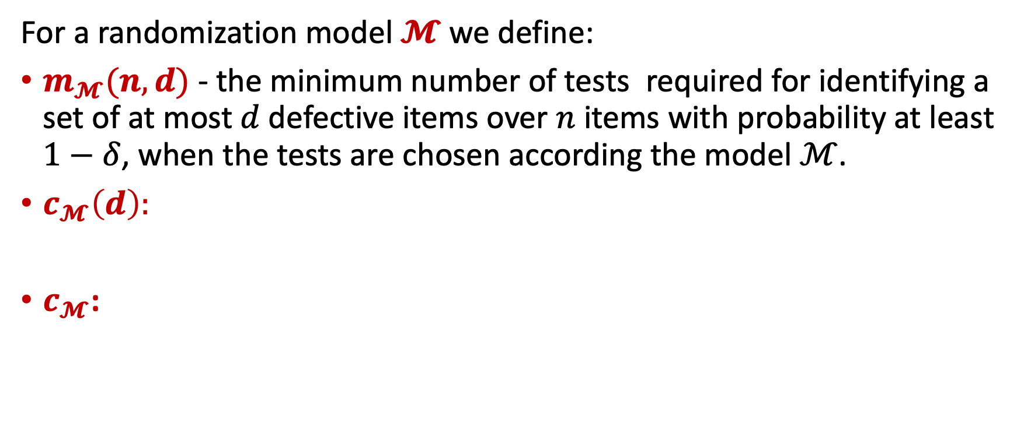


Objective
For a randomization model $𝓜$ we define:
$m_{𝓜}(n,d)$ - the minimum number of tests required for identifying a set of at most$d$defective items over $n$ items with probability at least $1−δ$, when the tests are chosen according the model $ℳ$.
$c_{𝓜}\left(d\right):$
$c_{𝓜}$:
$$c_{ℳ}\left(d\right)≔\lim_{n→∞}{\frac{m_{ℳ}(n,d)}{\ln{n}}}$$
$$c_{ℳ}≔\lim_{d→∞}{\frac{c_{ℳ}(d)}{d}}$$
Our objective is to study the constant $c_{ℳ}$ over the models RID, RrSD, RsSD and UTDq

Slide 28



$$\left(n,I\right)−Separable Matrix$$
A matrix $M$ is called $\left(n,I\right)−separable matrix$ with respect to some subset $I⊂\left[n\right], \left|I\right|≤d$, if:
for each $J⊆\left[n\right], \left|J\right|≤d$ and $J≠I$, it holds that $T\left(J,M\right)≠T(I,M)$
- Recall $T(I,M)$ the vector of answers derived from the matrix $M$ with respect to defective items set $I.$
That is, the only set of up to $d$ elements that is consistent with the answers of $M$ is $I$.
This property is hard to analyze!!!

Slide 29
$$\left(n,I\right)−Disjunct Matrix$$
A matrix $M$ is called $\left(n,I\right)−disjunct matrix$ with respect to some subset $I⊂\left[n\right], \left|I\right|≤d$, if for each $j∉I$, there is a test in $M$ that contains $j$ but does not contain any of the defective items.
The decoding algorithm:
Start with $X=S≔[n]$.
Make all the tests defined by $M$.
For every negative answer in a row $a$ ,
- Remove from $X$ all items $i$ such that $a_{i}=1$
 | $$i_{1}$$ | … | $$i_{d}$$ |  | $$j$$
 | 0 | 0 … 0 | 0 | … | 1 | …
Such test guarantees to eliminate $j$ from $X$.

Slide 30




Disjunct matrices parameters
For a randomization model $𝓜$ we define:
$m_{𝓜}^{D}(n,d)$ - the minimum number of tests required to ensure that for any defective set $I$ of size at most$d$over $n$ items, with probability at least $1−δ$, the test matrix is $\left(n,I\right)−Disjunct$ when the tests are chosen according the model $ℳ$.
$c_{𝓜}^{D}\left(d\right):$
$c_{𝓜}^{D}$:
$$c_{ℳ}^{D}\left(d\right)≔\lim_{n→∞}{\frac{m_{ℳ}^{D}(n,d)}{\ln{n}}}$$
$$c_{ℳ}^{D}≔\lim_{d→∞}{\frac{c_{ℳ}^{D}(d)}{d}}$$
We will study the constant $c_{ℳ}$ over the previous models via the constant $c_{ℳ}^{D}$

Slide 31






Disjunct vs. Seperable: why $c_{ℳ}^{D}$ is good enough?
Property #1:
If $M$ is $(n,I)−disjunct$, then $M$ is $(n,I)−seperable$
$$c_{ℳ}\left(d\right)≤c_{ℳ}^{D}\left(d\right)$$
Property #2:
Let $M$ be an $m×n$ matrix that is chosen according to a model $ℳ$ such that $m=m_{ℳ} (n,d+1).$
Let $I$ be any set of size $d.$
Then, with probability at least $1−δ$ , $M$ is $(n,I)$-disjucnt.
$$m_{ℳ}^{D}\left(n,d\right)≤m_{ℳ}^{}\left(n,d+1\right)$$
$c_{ℳ}^{D}\left(d\right)≤$ $c_{ℳ}\left(d+1\right)$
$$c_{ℳ}\left(d\right)≤c_{ℳ}^{D}\left(d\right)≤c_{ℳ}\left(d+1\right)$$
$c_{ℳ}\left(d+1\right), c_{ℳ}\left(d\right)=O\left(d\right)⇒$ $c_{ℳ}=c_{ℳ}^{D}$

Slide 32


Good Rows
 | $$i_{1}$$ | … | $$i_{d}$$
 | 0 | 0 … 0 | 0 | … |  | …
Suppose that $I= \{i_{1}, …, i_{d}\}$
Good row: a row $t$ in $M$ such that:
$M_{t,i_{k}}=0$for all $1≤ k≤ d$
Event B: There is an item $j∉ I$such that no good row includes it.
For upper bounds: we calculated $m$ such that $\operatorname{Pr}\left[B\right]<δ$
For lower bounds: we find $m$ such $\operatorname{Pr}\left[B\right]>\frac{1}{3}$

Slide 33

RID Upper Bound
Lemma:
$$Let M be an m×n RID random design with p=e^{−\frac{1}{d}} where$$
$$m−\sqrt{2emln\left(\frac{2}{δ}\right)}=edln\left(\frac{2n}{δ}\right).$$
$$Then, for any defective items set I⊆\left[n\right], \left|I\right|≤d, with probability at least 1−δ, M is an \left(n,I\right)−disjunct matrix.$$
$$In particular:$$
$m=edln\left(\frac{2n}{δ}\right)+θ\left(\sqrt{dln\left(\frac{n}{δ}\right)\ln\left(\frac{1}{δ}\right)}\right),$ $c_{RID}^{D}\left(d\right)≤ed and c_{RID}≤e.$

Slide 34


RID Upper Bound – Proof
For an $m×n$ RID random design $M$,
Let $p$ (the probability that a bit gets the value 0 in the design)
$X_{i}$ - random variable that gets the value 1 if the row $i$ is a good row and 0 otherwise.
$X=\sum_{i=1}^{m}{X_{i}}$ - the number of the good rows in $M$.
Therefore:
$\operatorname{Pr}\left[X_{i}=1\right]=𝔼[X_{i}]=p^{d}$
$μ:=𝔼[X]=p^{d}m$
 | $$i_{1}$$ | … | $$i_{d}$$
 | 0 | 0 … 0 | 0 | … |  | …

Slide 35














RID Upper Bound – Failure probability
Let $m^{′}=\left(1−λ\right)m<m$ for some $0>λ>1$
Define the events:
$A:$ indicates $X<{p^{d}m}^{′}$.
$B:$ indicates $M$ is not $\left(n,I\right)−disjunct$.
 | $$i_{1}$$ | … | $$i_{d}$$ |  | $$j$$
…
$$…$$
$$0$$
$$⋮$$
$$0$$
$$0$$
$$⋮$$
$$0$$
$$0$$
$$⋮$$
$$0$$
$$x$$
$$…$$
$$m$$
$$…$$
$$\operatorname{Pr}\left[B\right|\overline{A}]≤\left(n−d\right)p^{x}≤np^{m^{′}p^{d}}≤\frac{δ}{2}$$
$$m^{′}= \frac{\ln\left(\frac{2n}{δ}\right)}{p^{d}\ln\left(\frac{1}{p}\right)}$$
$$p=e^{−\frac{1}{d}}$$
good rows
$$m^{′}=ed\ln\left(\frac{2n}{δ}\right)$$
$$m^{′}=\left(1−λ\right)m$$

Slide 36






$$\operatorname{Pr}\left[A\right]$$
$μ=𝔼\left[X\right]=e^{−1}m$
$$λ=1−\frac{m^{′}}{m}$$
$A:$ is the event $X<{e^{−1}m}^{′}$.
$$\operatorname{Pr}\left[A\right]=\operatorname{Pr}\left[X<{e^{−1}m}^{′}\right]=\operatorname{Pr}\left[X<\left(1−λ\right)me^{−1}\right]=\operatorname{Pr}\left[X<\left(1−\left(1−\frac{m^{′}}{m}\right)\right)μ\right]≤e^{−\frac{{\left(1−\frac{m^{′}}{m}\right)}^{2}m}{2e}}=δ/2$$
Chernoff
$$e^{−\frac{{\left(1−\frac{m^{′}}{m}\right)}^{2}m}{2e}}=\frac{δ}{2}⇒m=m^{′}+\sqrt{2me\ln{\frac{2}{δ}}}=ed\ln\left(\frac{2n}{δ}\right)+ \sqrt{2me\ln{\frac{2}{δ}}}$$

Slide 37

Lower bound lemma (4.1.2)
$Let M be an m×n RID random design with 0≤p≤1$. If
$$m=ed\ln\left(n\right)−e^{3}\sqrt{3m},$$
$Then, with probability at least \frac{1}{3}$ ,$M is not \left(n,I\right)−disjunct matrix.$
$$In particular, to have success probability at least\frac{1}{3}we must have:$$
$m≥ed\ln{n}−Θ\left(\sqrt{d\ln{n}}\right)⇒$ $c_{RID}^{D}\left(d\right)≥ed and c_{RID}≥e.$

Slide 38




Lower Bound Development
As before …
$F$ – event that indicates that the matrix $M$ is not $\left(n,I\right)−disjunct$
$A$ – event that indicates that $X≤p^{d}m′$
$X_{i}=\left\{\begin{matrix}1 & row i is a good row \\ 0 & otherwise\end{matrix}\right.$
$X=\sum_{i=1}^{m}{X_{i}}$ - the number of the good rows in $M$.
$$μ≔𝔼\left[X\right]=p^{d}m$$
$$m^{′}=\left(1+λ\right)m=m+λm=m+w$$
For $1>λ>0$
Target:
We need to find for which $m$ we get
$Pr⁡[F]>1/3$
$$\operatorname{Pr}\left[F\right]≥\operatorname{Pr}\left[F∧X≤p^{d}m^{′}\right]=\operatorname{Pr}\left[F | X≤p^{d}m^{′}\right]⋅\operatorname{Pr}{[X≤p^{d}m^{′}]}$$

Slide 39












Lower Bound Development (cont.)
 | $$i_{1}$$ | … | $$i_{d}$$ |  | $$j$$
…
$$\operatorname{Pr}\left[F\right]≥\operatorname{Pr}\left[F∧X≤p^{d}m^{′}\right]=\operatorname{Pr}\left[F | X≤p^{d}m^{′}\right]⋅\operatorname{Pr}{[X≤p^{d}m^{′}]}$$
$$…$$
$$0$$
$$⋮$$
$$0$$
$$0$$
$$⋮$$
$$0$$
$$0$$
$$⋮$$
$$0$$
$$x$$
$$…$$
$$m$$
$$…$$
The probability that M is (n, I)-disjunct when X=x:
$$\operatorname{Pr}\left[\overline{F} | X=x\right]={\left(1−p^{x}\right)}^{n−d}$$
$$\operatorname{Pr}\left[F | X≤p^{d}m^{′}\right]=1−\operatorname{Pr}\left[\overline{F} | X≤p^{d}m^{′}\right]≥\left(1−{\left(1−p^{p^{d}m^{′}}\right)}^{n−d}\right)$$
We are aiming at having:
$${\left(1−p^{p^{d}m^{′}}\right)}^{n−d}≤{\left(1−\frac{1}{n}\right)}^{n−d}⇒\left(1−{\left(1−p^{p^{d}m^{′}}\right)}^{n−d}\right)≥\left(1−e^{−1+o\left(1\right)}\right)$$

Slide 40





$${\left(1−p^{p^{d}m^{′}}\right)}^{n−d}≤{\left(1−\frac{1}{n}\right)}^{n−d}⇒p^{p^{d}m^{′}}≥\frac{1}{n}⇒m^{′}≤\frac{d⋅ln{n}}{p^{d}d⋅\ln{\frac{1}{p}}}$$
Denote: $c=d⋅\ln{\frac{1}{p}}⇒p=e^{−\frac{c}{d}}$
$$m^{′}≤e^{c}c^{−1}d\ln{n}⇒m^{′}=ed\ln{n}$$
for $c=1 , m’$ gets the minimum value.
Case: $c≤6$
$$\operatorname{Pr}\left[F | X≤p^{d}m^{′}\right]≥\left(1−{\left(1−p^{p^{d}m^{′}}\right)}^{n−d}\right)≥\left(1−{\left(1−n^{−ce^{1−c}}\right)}^{n−d}\right)≥\left(1−{\left(1−\frac{1}{n}\right)}^{n−d }\right)$$
$$ce^{1−c}≤1$$
For $c≤6$

Slide 41






Lower Bound Development (cont.)
$$\operatorname{Pr}\left[F\right]≥\operatorname{Pr}\left[F∧X≤p^{d}m^{′}\right]=\operatorname{Pr}\left[F | X≤p^{d}m^{′}\right]⋅\operatorname{Pr}{[X≤p^{d}m^{′}]}$$
$$m^{′}=\left(1+λ\right)m=m+λm=m+w$$
For $1>λ>0$
$$\operatorname{Pr}\left[X≤p^{d}m^{′}\right]=\operatorname{Pr}\left[X≤e^{−c}m^{′}\right]=(1−\operatorname{Pr}{[X>e^{−c}m^{′}])}=\left(1−\operatorname{Pr}\left[X>e^{−c}m\left(1+\frac{w}{m}\right)\right]\right)$$
$$\operatorname{Pr}\left[X>e^{−c}m\left(1+\frac{w}{m}\right)\right]≤e^{−\frac{e^{−c}w^{2}}{3m}}≤e^{−1}⇒w≥\sqrt{{3e}^{c}m}$$
$$c≤6$$
$$w=e^{3}\sqrt{3m}$$
$$\operatorname{Pr}\left[X≤p^{d}m^{′}\right]≥(1−e^{−1})$$

Slide 42







Lower Bound Development (cont.)
By Markov:
$$\operatorname{Pr}\left[X≤2e^{−c}m\right]≥\text{ 1/2}$$
Case: $c>6$
$$\operatorname{Pr}\left[F\right]≥\operatorname{Pr}\left[F∧X≤2e^{−c}m\right]≥\operatorname{Pr}\left[F|X≤2e^{−c}m\right]⋅\operatorname{Pr}\left[X≤2e^{−c}m\right]≥…≥\left(1−{\left(1−p^{2e^{−c}m}\right)}^{n−d}\right)⋅\frac{1}{2}$$
$$\left(1−{\left(1−p^{2e^{−c}m}\right)}^{n−d}\right)≥\left(1−{\left(1−n^{−2ce^{1−c}}\right)}^{n−d}\right)≥\left(1−{\left(1−\frac{1}{n^{0.1}}\right)}^{n\left(1−\frac{d}{n}\right)}\right)=\left(1−{\left(1−\frac{1}{n^{0.1}}\right)}^{n^{0.1}\left(1−\frac{d}{n}\right)n^{0.9}}\right)$$
$$c≥6$$
$$2ce^{1−c}<0.1$$
$$\left(1−{\left(1−\frac{1}{n^{0.1}}\right)}^{n^{0.1}\left(1−\frac{d}{n}\right)n^{0.9}}\right)≥\left(1−e^{−\left(1−\frac{d}{n}\right)n^{0.9}}\right)>2/3$$
$$f\left(x\right)=1−e^{−\left(1−\frac{d}{x}\right)x^{0.9}}$$

