Slide 1
How Neural Networks train: The perceptron use case
Slides are based on the course: Deep Learning A to Z by Kirill Eremenko AND Hadelin de Ponteves

Slide 2
Learning algorithm vs. Regular algorithms
Suppose we want to build an application that can differentiate between dogs and cats
Classic approach:
Go through all the distinctive properties of cats and dogs and come out with a logic that can actually “calculate” whether the image is a cat or a dog!
Learning algorithm:
Decide on a model, and introduce that model to huge number of labeled images of cats and dogs.
Apply learning on that dataset and let the model enhance its internal state accordingly.

Slide 3






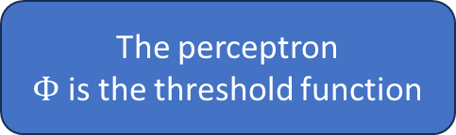




How neural networks learn – The perceptron case
$X_{1}$
$$w_{1}$$
$$φ\left(\sum_{i=1}^{m}{w_{i}X_{i}}\right)$$
$X_{2}$
$$w_{2}$$
$$\hat{y}$$
Output value
$$⋮$$
$$w_{m}$$
$X_{m}$
$$y$$
Actual value
The perceptron
$Φ$is the threshold function

Slide 4
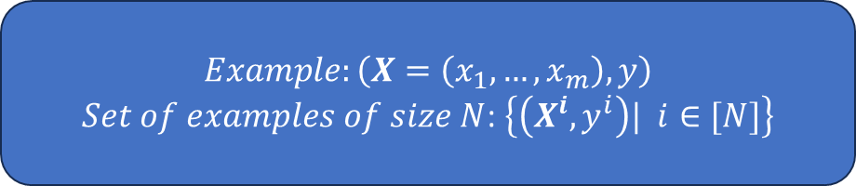
Training set
Is a set of labeled example data
Formally, if the NN has m entries at the input layer, then the dataset is defined:
Row ID | Study hours | Sleep Hours | Quiz | Exam
1 | 12 | 6 | 78 | 93
2 | 4 | 12 | 45 | 40
3 | 9 | 6 | 88 | 90
… | … | .. | … | …
$$Example:\left(X=\left(x_{1},…,x_{m}\right),y\right)$$
$Set of examples of size N$: $\left\{\left(X^{i},y^{i}\right)| i∈[N]\right\}$

Slide 5
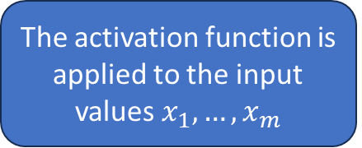
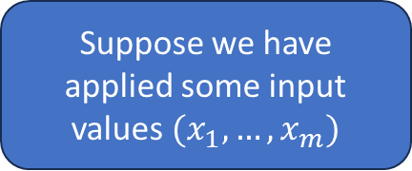
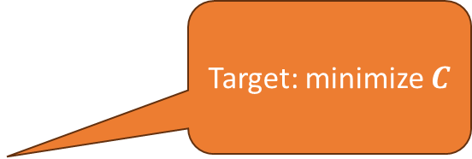
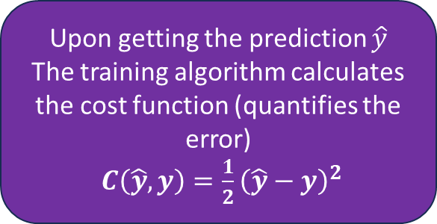
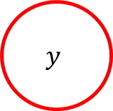

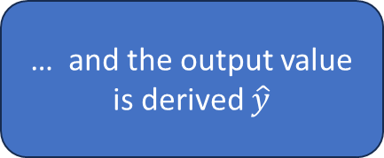
Suppose we have applied some input values $(x_{1}, …, x_{m})$
The activation function is applied to the input values $x_{1}, …, x_{m}$
… and the output value is derived $\hat{y}$
$X_{1}$
$$w_{1}$$
$$φ\left(\sum_{i=1}^{m}{w_{i}X_{i}}\right)$$
$X_{2}$
$$w_{2}$$
$$\hat{y}$$
Output value
$$⋮$$
$$y$$
$$w_{m}$$
Actual value
$X_{m}$
Upon getting the prediction $\hat{y}$
The training algorithm calculates the cost function (quantifies the error)
$C\left(\hat{y},y\right)=\frac{1}{2}{\left(\hat{y}−y\right)}^{2}$
Target: minimize $C$
$$\{\left(x_{1}, …, x_{m}\right), y\}$$

Slide 6

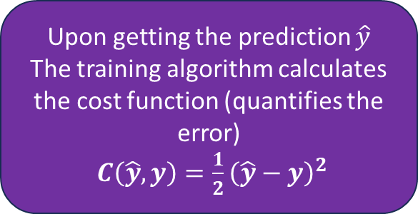










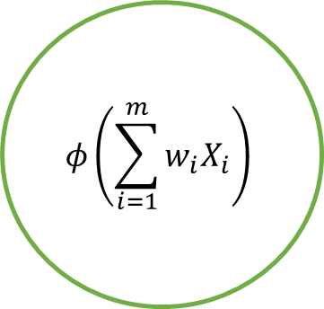
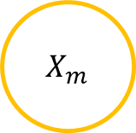


Row ID | Study hours | Sleep Hours | Quiz | Exam
1 | 12 | 6 | 78 | 93
$X_{1}$
$${w′}_{1}$$
$$φ\left(\sum_{i=1}^{m}{w_{i}X_{i}}\right)$$
$$w_{1}$$
$X_{2}$
$${w′}_{2}$$
$$w_{2}$$
$$\hat{y}$$
Output value
$$w_{m}$$
$$⋮$$
$${w′}_{m}$$
$$y$$
Actual value
$X_{m}$
Upon getting the prediction $\hat{y}$
The training algorithm calculates the cost function (quantifies the error)
$C\left(\hat{y},y\right)=\frac{1}{2}{\left(\hat{y}−y\right)}^{2}$
Target: minimize $C$
$$\{\left(x_{1}, …, x_{m}\right), y\}$$

Slide 7
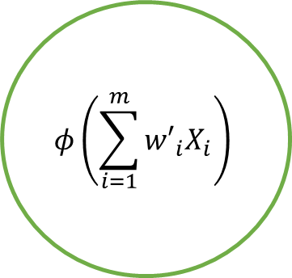
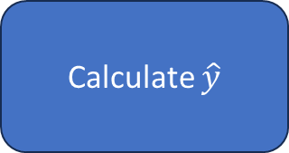

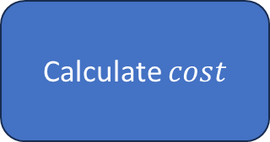
Row ID | Study hours | Sleep Hours | Quiz | Exam
1 | 12 | 6 | 78 | 93
$X_{1}$
$${w′}_{1}$$
$$φ\left(\sum_{i=1}^{m}{{w′}_{i}X_{i}}\right)$$
$X_{2}$
$${w′}_{2}$$
$$\hat{y}$$
Output value
$$⋮$$
$${w′}_{m}$$
$$y$$
Actual value
$X_{m}$
Until the cost is sufficiently small
Feed the SAME example again
Calculate $\hat{y}$
Calculate $cost$
Update the weights ..

Slide 8



























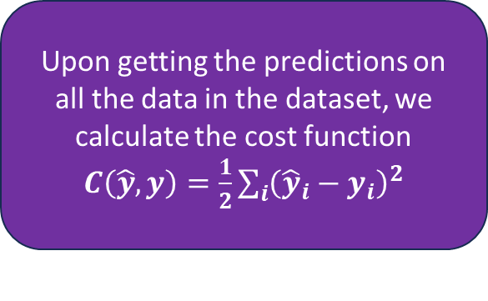
$X_{1}$
Row ID | Study hours | Sleep Hours | Quiz | Exam
1 | 12 | 6 | 78 | 93
2 | 4 | 12 | 45 | 40
3 | 9 | 6 | 88 | 90
4 | 9 | 8 | 75 | 87
$$w_{1}$$
$X_{2}$
$$w_{2}$$
$$\hat{y}$$
$${\hat{y}}_{1},y_{1}$$
$$w_{m}$$
$$y$$
$X_{m}$
$X_{1}$
$$w_{1}$$
$X_{2}$
$$w_{2}$$
$$\hat{y}$$
$${\hat{y}}_{2},y_{2}$$
$$w_{m}$$
$$y$$
$X_{m}$
$X_{1}$
epoch
$$w_{1}$$
$X_{2}$
$$w_{2}$$
Upon getting the predictions on all the data in the dataset, we calculate the cost function $C\left(\hat{y},y\right)=\frac{1}{2}\sum_{i}{{\left({\hat{y}}_{i}−y_{i}\right)}^{2}}$
$$\hat{y}$$
$${\hat{y}}_{3},y_{3}$$
$$w_{m}$$
$$y$$
$X_{m}$
$X_{1}$
Backpropagation
$$w_{1}$$
$X_{2}$
$$w_{2}$$
$$\hat{y}$$
$${\hat{y}}_{4},y_{4}$$
$$w_{m}$$
$$y$$
Adjust the weights
$X_{m}$

