Slide 1
Objective 1
•Start with a story from the problem of finding abnormal behavior in a CCTV (Firearm)..
•CNNs as a potential solution for image classification
•At this point, talk about CNN in abstract level - just as a black box machine that knows to classify images
•Describe the problem of the inference time of CNNs and the challenge to apply those to CCTV

Slide 2
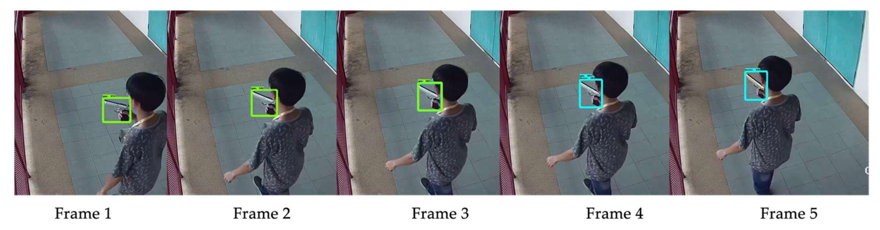
Motivation: The Firearm Detection Problem in CCTV
Challenge: Efficiently detecting abnormal behavior within vast surveillance footage.
Target: Detect and locate this in hours of footage.

Slide 3
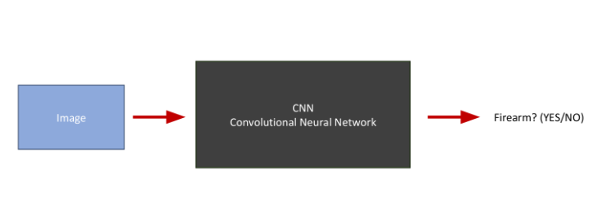
CNN: A High-level Overview
Suppose that we have the following machine (CNN)
Image -> CNN -> Classification Result

Slide 4
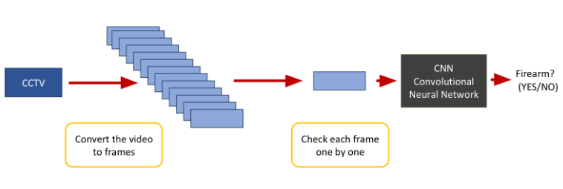
Naive Solution

Slide 5
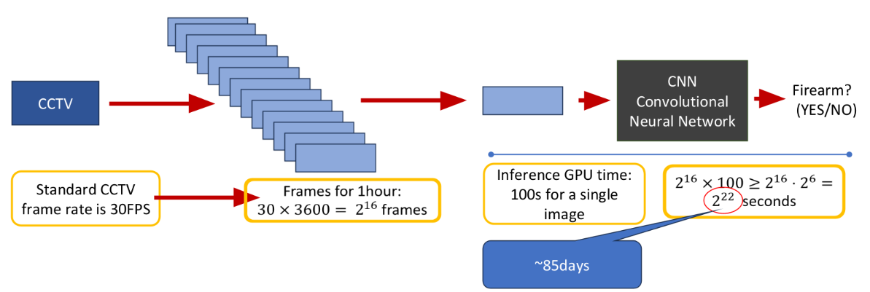
Inference Time Bottleneck
Suppose that we are asked to implement an automatic firearm detector to check CCTV’s from some street where a crime has occurred.
We want to find the exact time when some crime occurred within one hour.

Slide 6
Inference Time Bottleneck
Issue: High inference time. Not suitable for real-time CCTV analysis.
Millions of frames = Significant delay.

Slide 7
Objective 2
•Talk about Group testing in very high level and try to describe:
•Why Group testing can be good direction for reducing inference time
•Explain why this is applicable to CCTV detection
•Too many good frames vs. very very few bad ones (these settings are ideal for group testing)

Slide 8
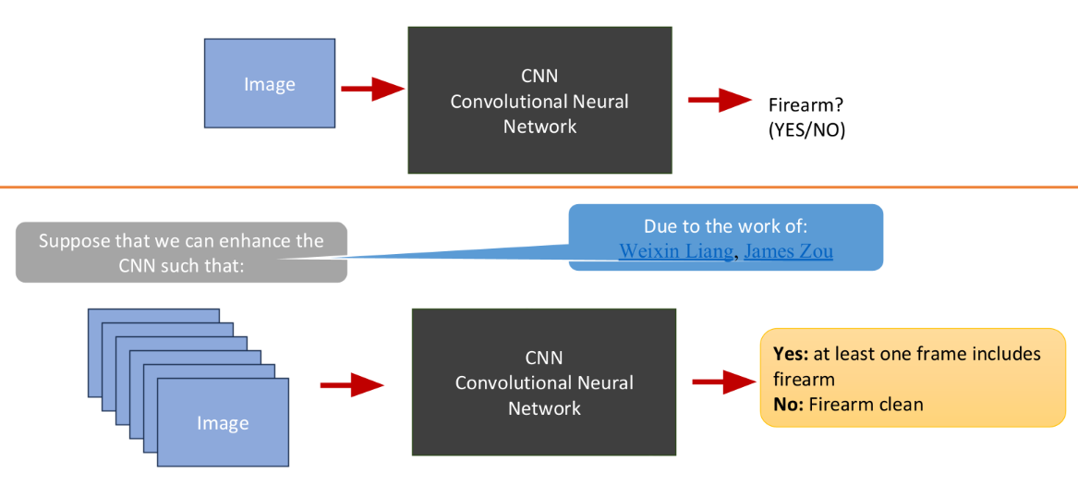
Solution: Group Testing
Efficiently process groups of frames to pinpoint abnormal behavior

Slide 9
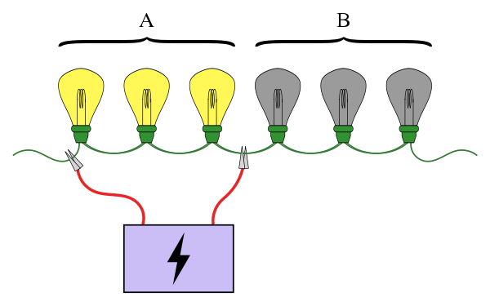
What is group Testing?
Group testing is any procedure that breaks up the task of identifying certain objects into tests on groups of items, rather than on individual ones.

Slide 10
Group Testing works well for a small number of defective items; usually, the abnormal frames only account for a small portion of the whole frames.
Abnormal frames are consecutive, so it is enough to find a single frame that captured the event.

Slide 11
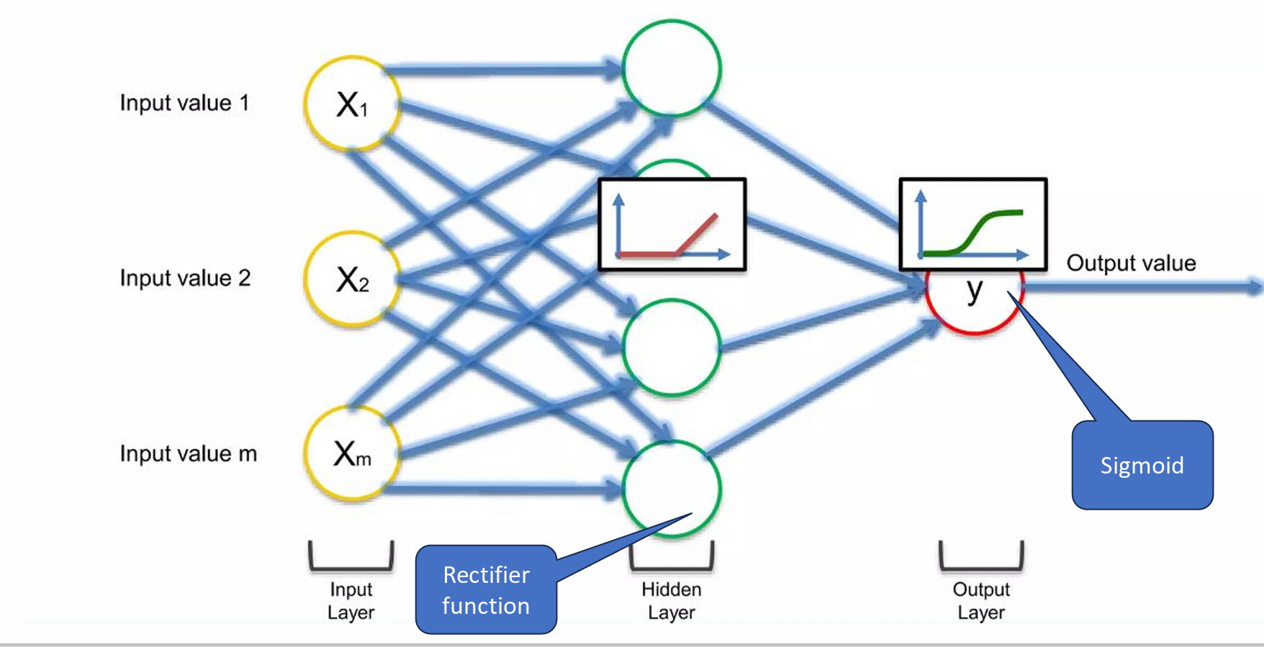
The Structure of Neural Network

Slide 12
Let’s take a deeper look…
Assume that we have reduced the number frames.
By choosing frames uniformly at random or ..
Making some kind of average on images (for example pixel based average)
We order the chosen frames according to their original timeline.
The blue frames are ones that capture the abnormal event.
They are consecutive, because we ordered the chosen frame according to their time.
We need to determine this time frame within the video
3:00
It is enough to find a single frame that captured the event
4:00

Slide 13
