Slide 1
CNN
Slides are based on the course: Deep Learning A to Z by Kirill Eremenko AND Hadelin de Ponteves

Slide 2
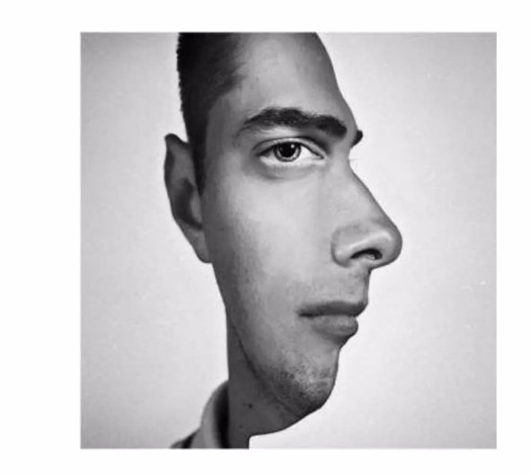
Motivation

Slide 3
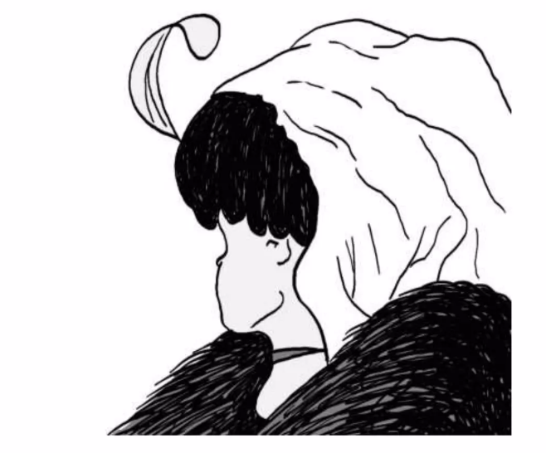
Motivation

Slide 4
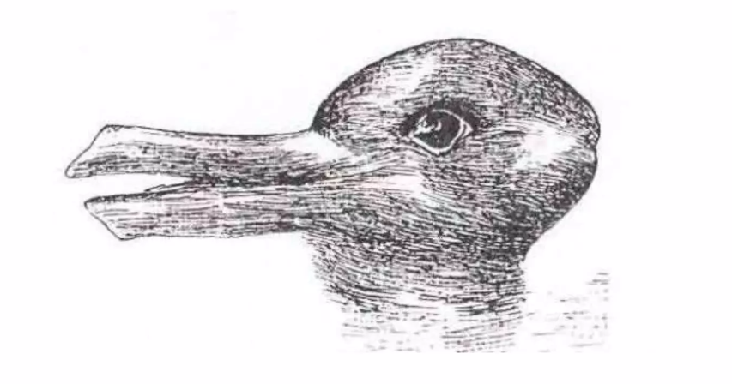
Motivation

Slide 5
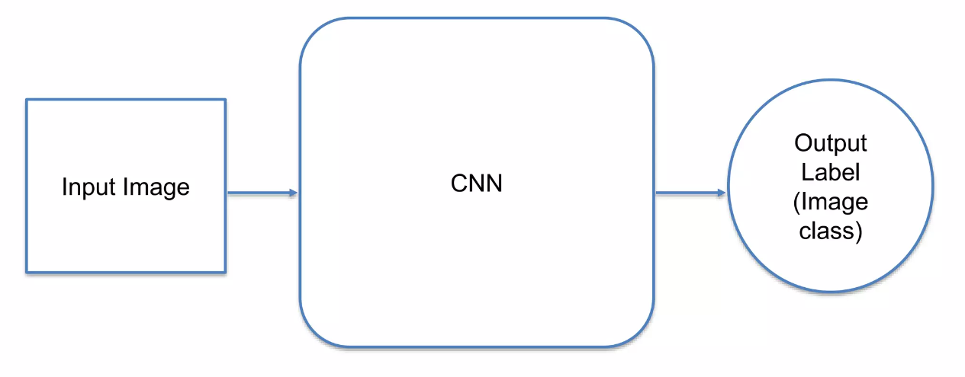
CNN

Slide 6
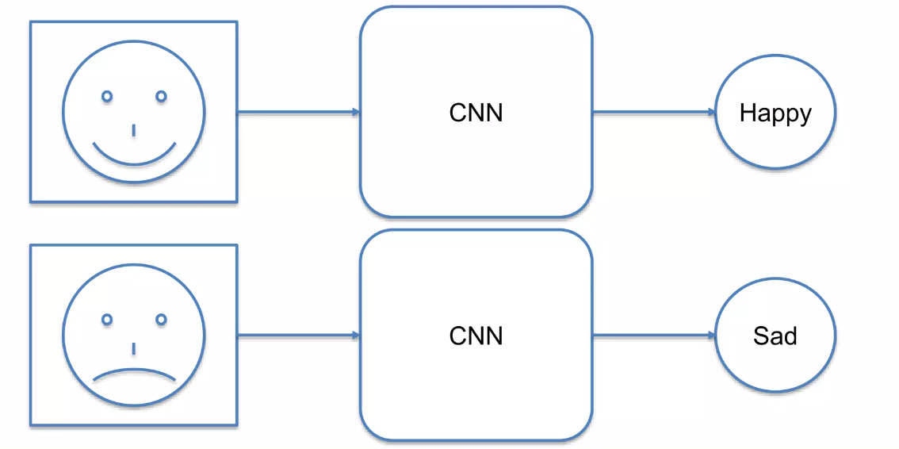
Emotion detectors ☺ ☹

Slide 7
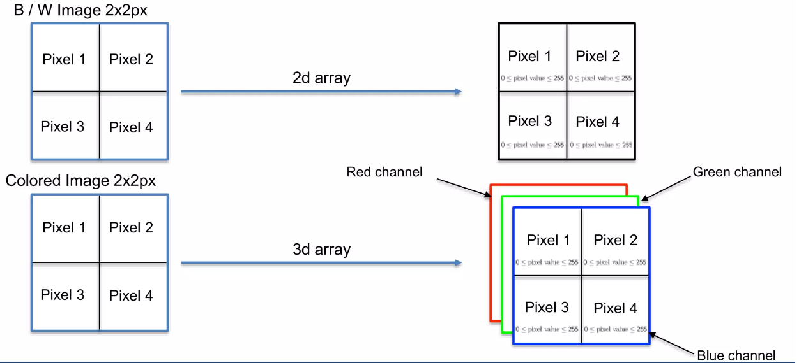
Image representation

Slide 8
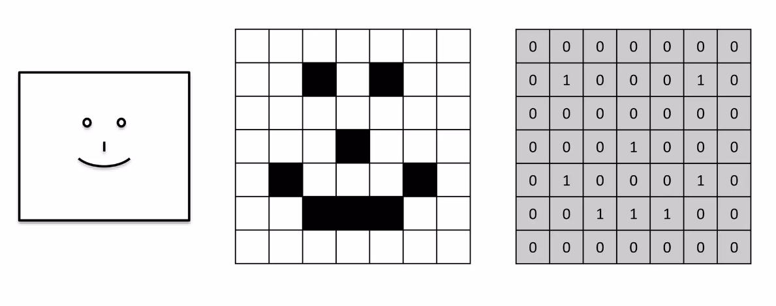
Image representation: simplified example

Slide 9
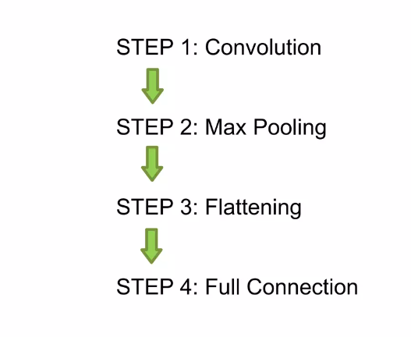
CNN – general structure

Slide 10
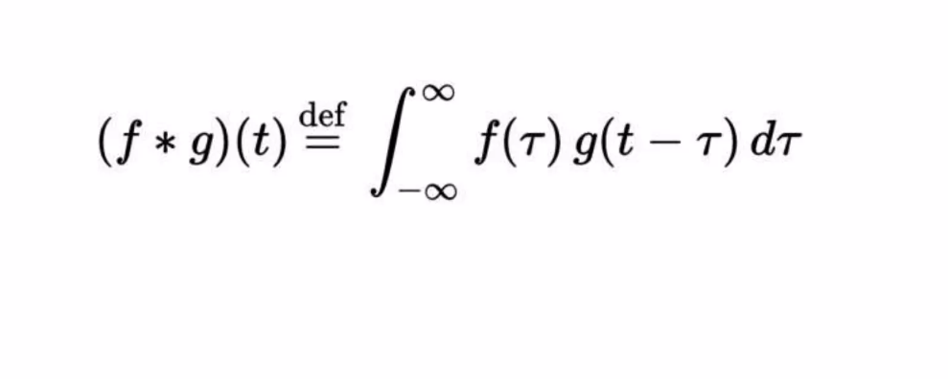
Step #1 - Convolution
Convolution function

Slide 11
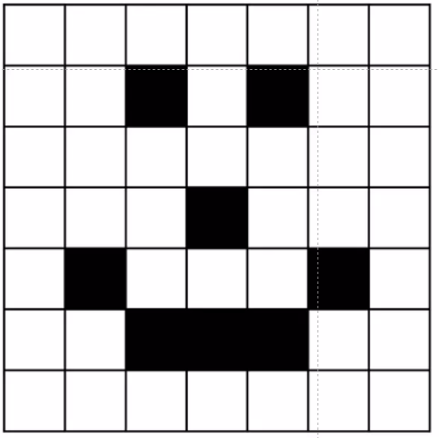
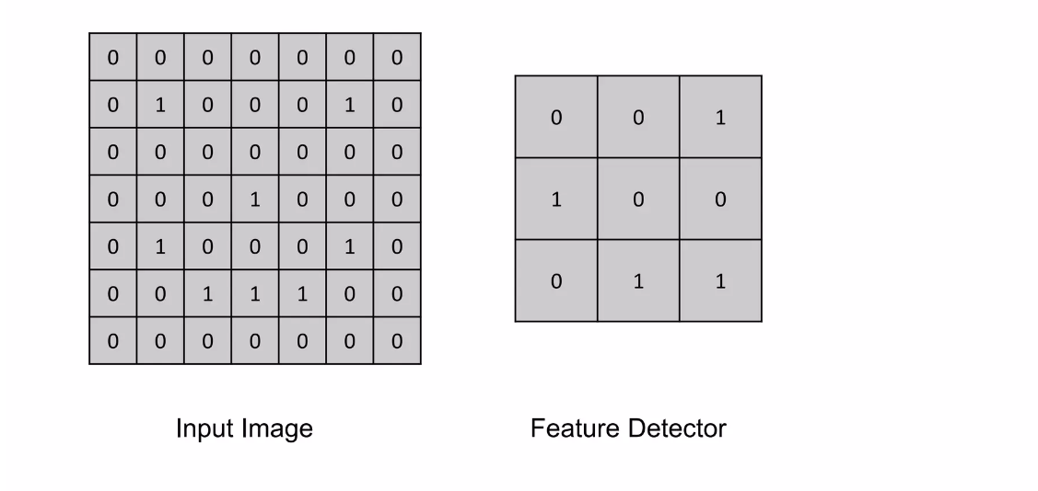
Step 1: Convolution

Slide 12
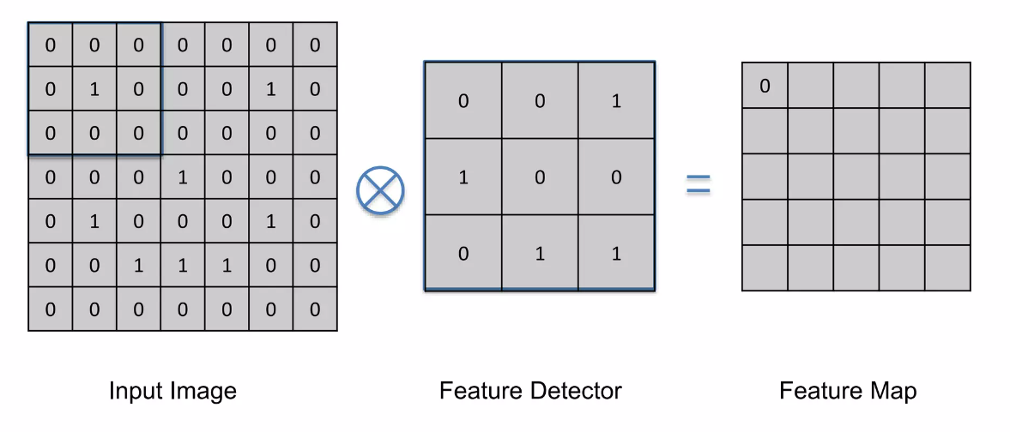
Step 1: Convolution

Slide 13
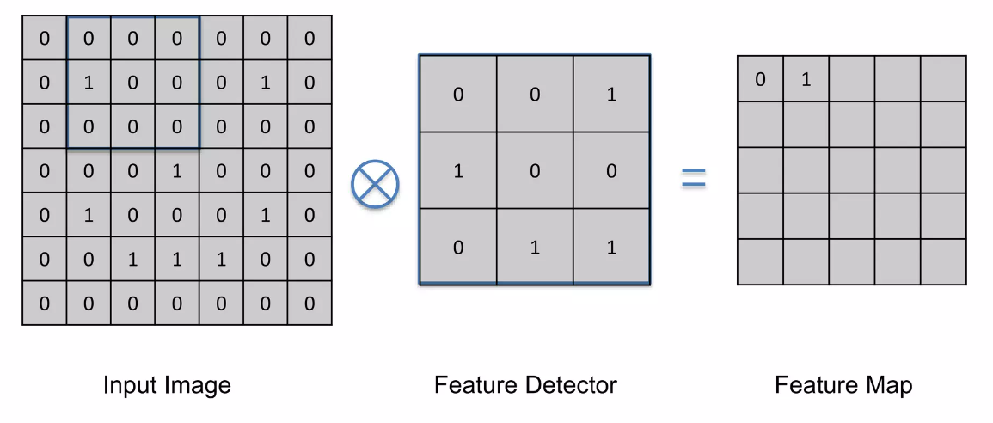
Step 1: Convolution
Stride

Slide 14
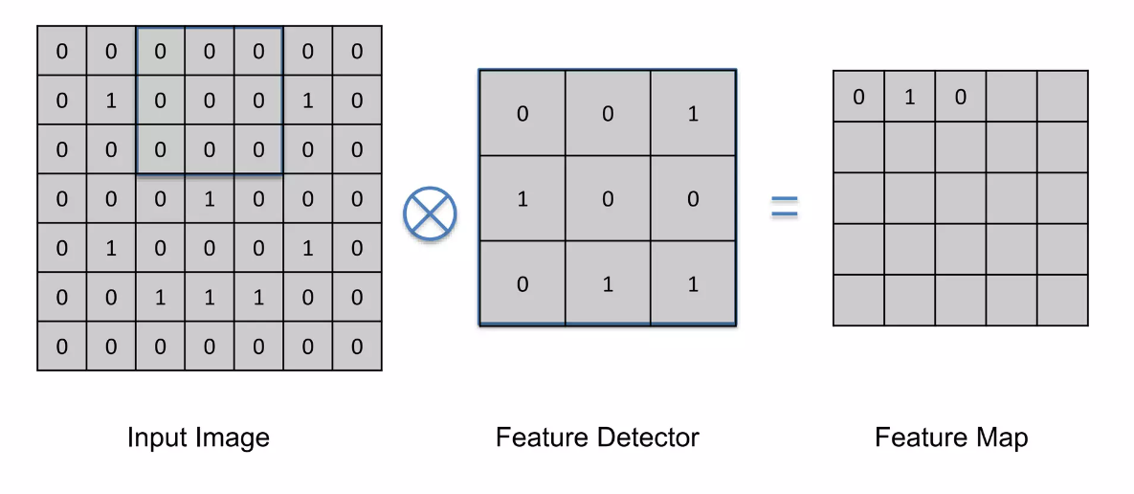
Step 1: Convolution

Slide 15
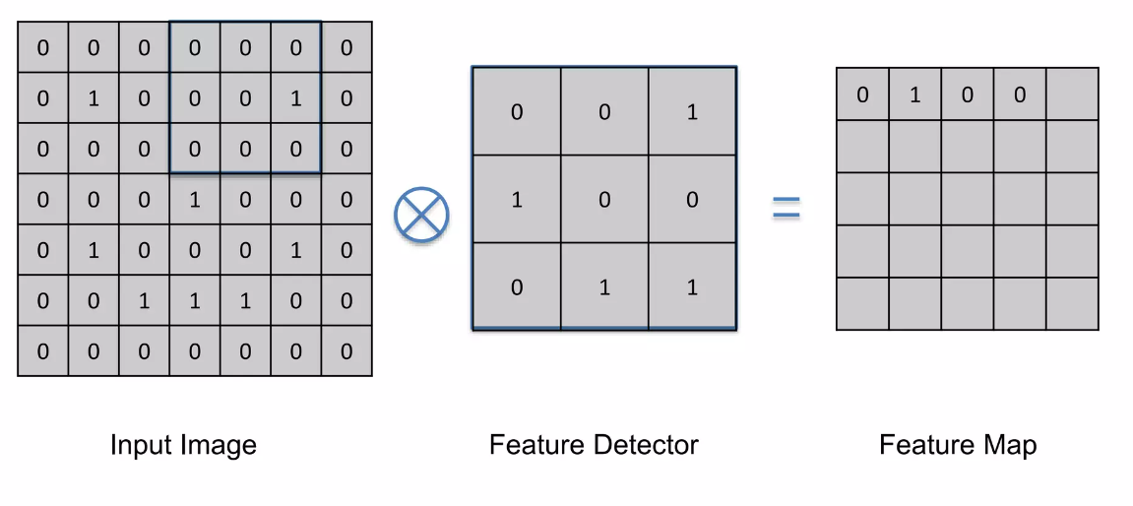
Step 1: Convolution

Slide 16
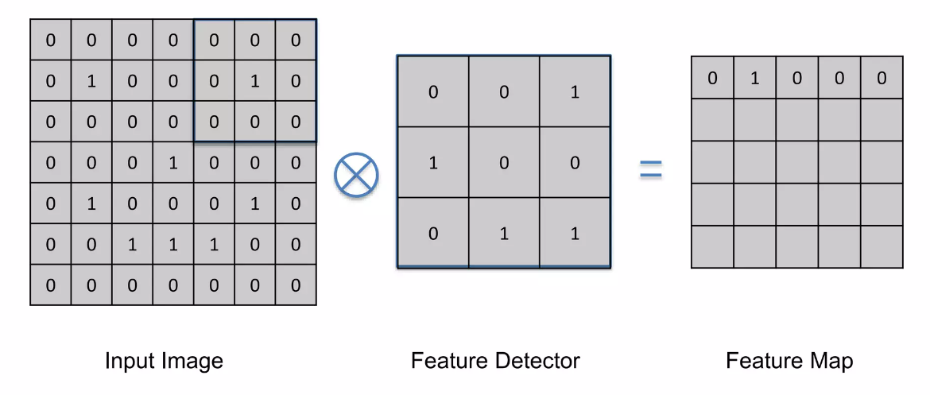
Step 1: Convolution

Slide 17
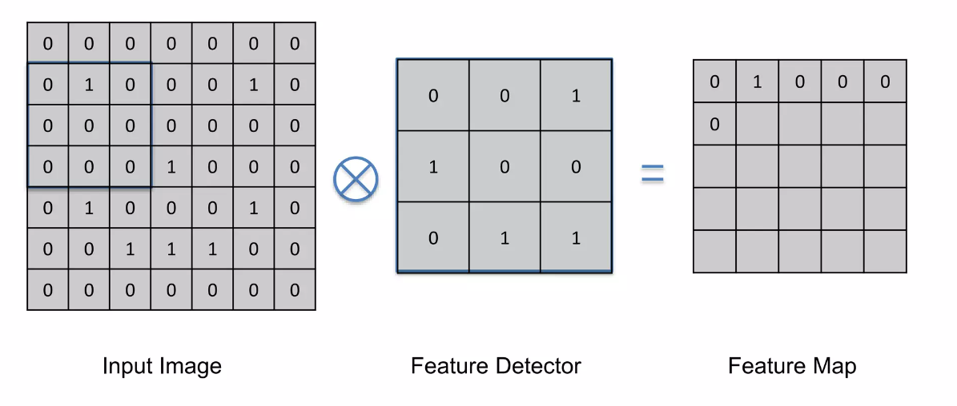
Step 1: Convolution

Slide 18
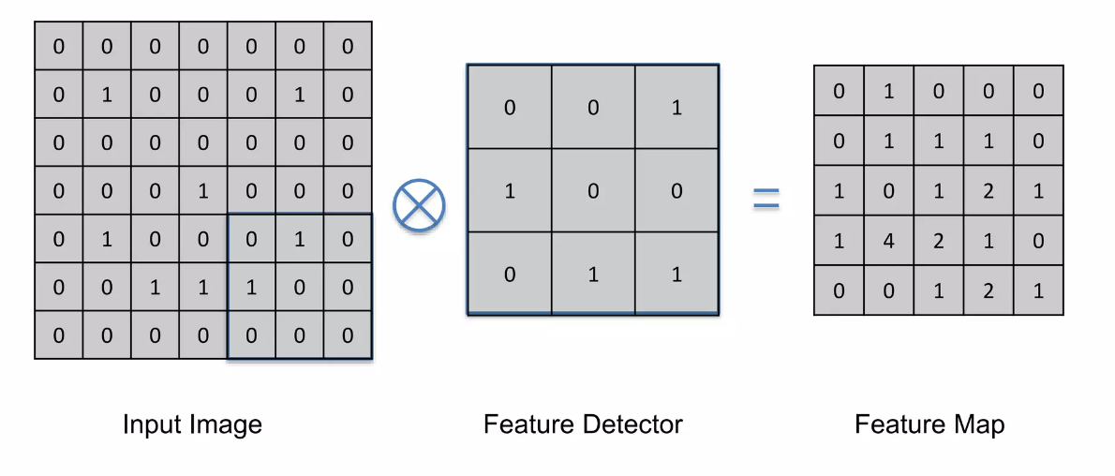
Step 1: Convolution

Slide 19
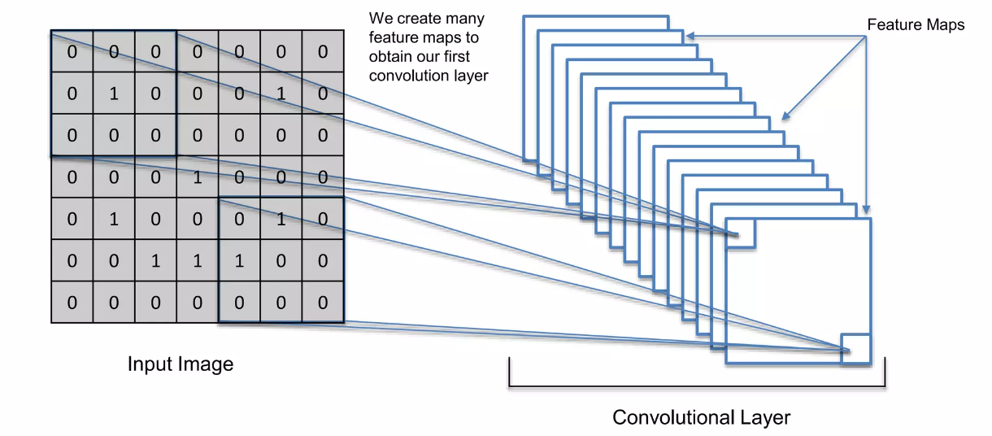
Feature Map

Slide 20
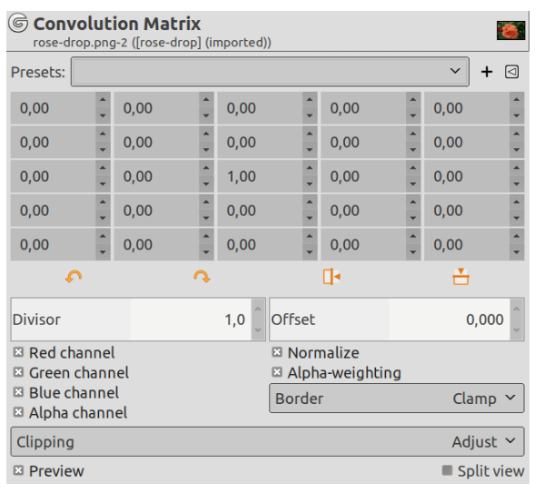
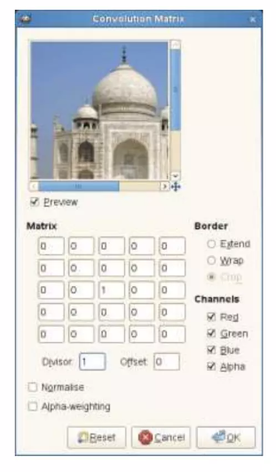
Filter examples
GIMP.org documentation:
https://docs.gimp.org/2.10/en/gimp-filter-convolution-matrix.html

Slide 21
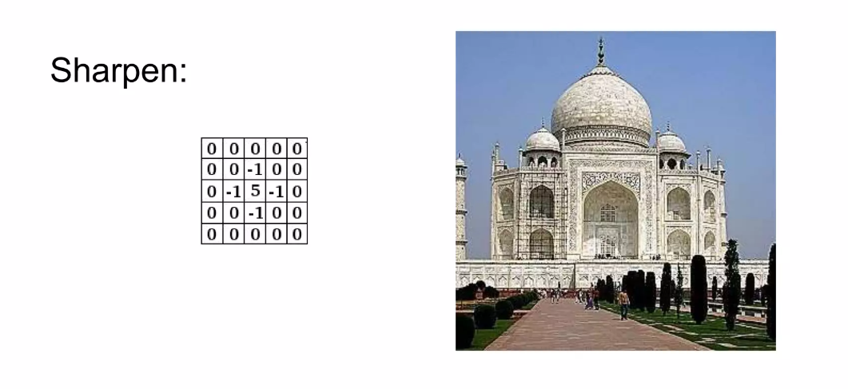

Slide 22
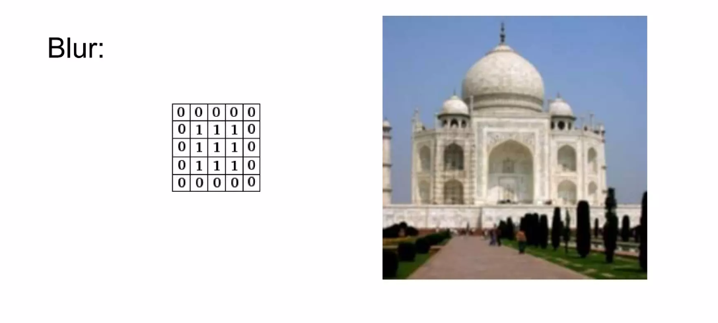

Slide 23
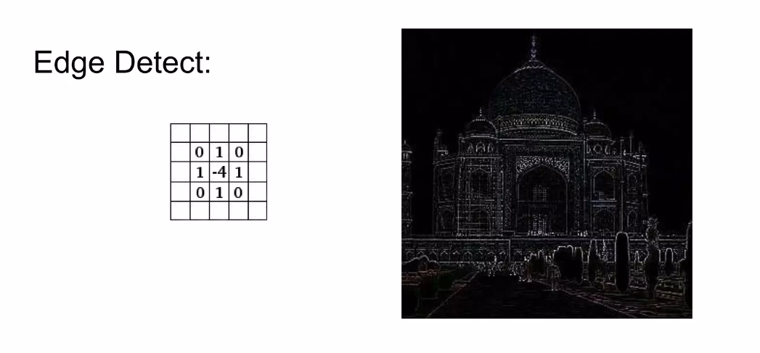
Edge enhance filter

Slide 24
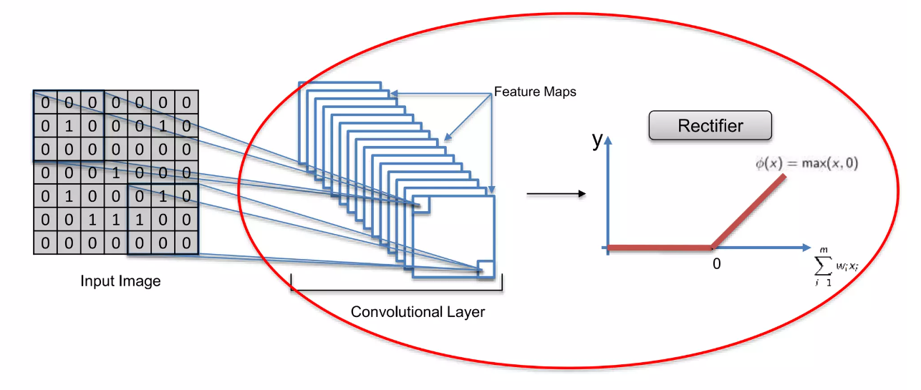
Step 1(b) – ReLU layer (Rectifier Linear units)

Slide 25
Further reading tasks
The Ultimate Guide to Convolutional Neural Networks
https://ieeexplore.ieee.org/document/726791 (By Yann Lecun)
Yann Lecun – The father of CNNs
Introduction to Convolutional Neural Networks (Jianxin Wu) https://cs.nju.edu.cn/wujx/paper/CNN.pdf
Description and simplification of the math behind CNNs.
Understanding Convolutional Neural Networks with A Mathematical Model https://arxiv.org/abs/1609.04112
More about ReLU

