Slide 1
Introduction to group testing
Catherine A. Haddad-Zaknoon
Department of Computer Science - Technion, Haifa, Israel

Slide 2




Example 1: The COVID-19 scenario
Suppose we have $n=4000$ soldiers in a specific unit that we want to test for COVID-19 virus Suppose that only $d=1$ is infected
Our target is identify the 1 patient, to give him proper treatment, without taking the risk of the virus spreading among the whole unit.

Slide 3
Attitude #1
Test each soldier one by one.
Perform 4000 tests to identify only 1 patient!!
Can we do better?

Slide 4
Attitude #2
+
-
Combine the samples into two distinct combinations
Test the two combinations…
Continue with the search in the same manner with the samples that participated in the positive test only

Slide 5

Attitude #2 (CONT.)
Start over with a set of n/2 participant..
-
+
$$O(log n)$$
splits
-
+
+
-
+
-

Slide 6



Example 2: The king and the wine riddle
The King of a small country invites 1000 senators to his annual party.
Each senator brings the King a bottle of wine.
The queen discovers that one of the senators is trying to assassinate the King by giving him a bottle of poisoned wine
Unfortunately, they do not know which bottle of wine is poisoned, and the poison is completely indiscernible.
The King has 10 prisoners he plans to execute. He decides to use them as taste testers to determine which bottle of wine contains the poison.

Slide 7
The poison when taken has no effect on the prisoner until exactly 24 hours later when the infected prisoner suddenly dies.
The King needs to determine which bottle of wine is poisoned by tomorrow so that the festivities can continue as planned.
How can the King administer the wine to the prisoners to ensure that 24 hours from now he is guaranteed to have found the poisoned wine bottle?

Slide 8
Poison needs 24 hours to take effect
Target: find the poisonous bottle within 24 hours from now!!
?
Does the previous strategy work here too?

Slide 9

Poisoned?
24 hours
Yes
No
Proceed with left group
Proceed with right group

Slide 10
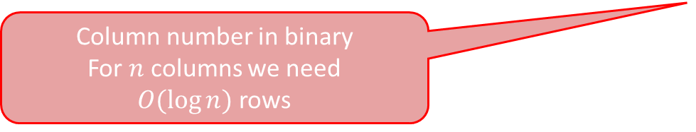
Bottle # | 1 | 2 | 3 | 4 | 5 | 6 | 7 | 8 | 9 | 10 | 11 | … | 1000
Prisoner #1 | 0 | 0 | 0 | 0 | 0 | 0 | 0 | 0 | 0 | 0 | 0 | … | 1
Prisoner #2 | 0 | 0 | 0 | 0 | 0 | 0 | 0 | 0 | 0 | 0 | 0 | … | 1
Prisoner #3 | 0 | 0 | 0 | 0 | 0 | 0 | 0 | 0 | 0 | 0 | 0 | … | 1
Prisoner #4 | 0 | 0 | 0 | 0 | 0 | 0 | 0 | 0 | 0 | 0 | 0 | … | 1
Prisoner #5 | 0 | 0 | 0 | 0 | 0 | 0 | 0 | 0 | 0 | 0 | 0 | … | 1
Prisoner #6 | 0 | 0 | 0 | 0 | 0 | 0 | 0 | 0 | 0 | 0 | 0 | … | 0
Prisoner #7 | 0 | 0 | 0 | 0 | 0 | 0 | 0 | 1 | 1 | 1 | 1 | … | 1
Prisoner #8 | 0 | 0 | 0 | 1 | 1 | 1 | 1 | 0 | 0 | 0 | 0 | … | 0
Prisoner #9 | 0 | 1 | 1 | 0 | 0 | 1 | 1 | 0 | 0 | 1 | 1 | … | 0
Prisoner #10 | 1 | 0 | 1 | 0 | 1 | 0 | 1 | 0 | 1 | 0 | 1 | … | 0
Column number in binary
For $n$ columns we need $O(log⁡n)$rows
Each row indicates a mixture (A single cocktail)
1 – used in the cocktail
0- not used in the cocktail

Slide 11
Results vectors = binary code of the poisoned bottle
Bottle # | 1 | 2 | 3 | 4 | 5 | 6 | 7 | 8 | 9 | 10 | … | 1000
Prisoner #1 | 0 | 0 | 0 | 0 | 0 | 0 | 0 | 0 | 0 | 0 | … | 1
Prisoner #2 | 0 | 0 | 0 | 0 | 0 | 0 | 0 | 0 | 0 | 0 | … | 1
Prisoner #3 | 0 | 0 | 0 | 0 | 0 | 0 | 0 | 0 | 0 | 0 | … | 1
Prisoner #4 | 0 | 0 | 0 | 0 | 0 | 0 | 0 | 0 | 0 | 0 | … | 1
Prisoner #5 | 0 | 0 | 0 | 0 | 0 | 0 | 0 | 0 | 0 | 0 | … | 1
Prisoner #6 | 0 | 0 | 0 | 0 | 0 | 0 | 0 | 0 | 0 | 0 | … | 0
Prisoner #7 | 0 | 0 | 0 | 0 | 0 | 0 | 0 | 1 | 1 | 1 | … | 1
Prisoner #8 | 0 | 0 | 0 | 1 | 1 | 1 | 1 | 0 | 0 | 0 | … | 0
Prisoner #9 | 0 | 1 | 1 | 0 | 0 | 1 | 1 | 0 | 0 | 1 | … | 0
Prisoner #10 | 1 | 0 | 1 | 0 | 1 | 0 | 1 | 0 | 1 | 0 | … | 0
0
0
0
0
0
0
0
1
0
1
After 24h
Poisonous cocktails are the ones who has samples from bottle no. 5
Define:
Poisoned = 1
Healthy = 0

Slide 12
Discussion
Bottle # | 1 | 2 | 3 | 4 | 5 | 6 | 7 | 8 | 9 | 10 | … | 1000
Prisoner #1 | 0 | 0 | 0 | 0 | 0 | 0 | 0 | 0 | 0 | 0 | … | 1
Prisoner #2 | 0 | 0 | 0 | 0 | 0 | 0 | 0 | 0 | 0 | 0 | … | 1
Prisoner #3 | 0 | 0 | 0 | 0 | 0 | 0 | 0 | 0 | 0 | 0 | … | 1
Prisoner #4 | 0 | 0 | 0 | 0 | 0 | 0 | 0 | 0 | 0 | 0 | … | 1
Prisoner #5 | 0 | 0 | 0 | 0 | 0 | 0 | 0 | 0 | 0 | 0 | … | 1
Prisoner #6 | 0 | 0 | 0 | 0 | 0 | 0 | 0 | 0 | 0 | 0 | … | 0
Prisoner #7 | 0 | 0 | 0 | 0 | 0 | 0 | 0 | 1 | 1 | 1 | … | 1
Prisoner #8 | 0 | 0 | 0 | 1 | 1 | 1 | 1 | 0 | 0 | 0 | … | 0
Prisoner #9 | 0 | 1 | 1 | 0 | 0 | 1 | 1 | 0 | 0 | 1 | … | 0
Prisoner #10 | 1 | 0 | 1 | 0 | 1 | 0 | 1 | 0 | 1 | 0 | … | 0
What makes this solution work?
Is this the only way to design the cocktails?
Does the solution work if we only had 9 prisoners?
0
0
0
0
0
0
0
1
0
1
Can we still distinguish between bottle #5 and #7?
0

Slide 13

So far …
We have$n$items
Among which we have $d=1$ defective item
Target: Identify the defective item (sick soldier, poisoned bottle)
Strategy #1
Strategy #2
Define a single group test
Perform the group test
Upon getting the result, decided on your next test
Adaptive strategy
Define ALL group tests in advance
Perform all the group tests in parallel
Upon getting the results, decode the result WITHOUT any further testing
Non-adaptive strategy

Slide 14

What is Group Testing?
YES (positive)
NO (negative)
$n$ items
A group test is a subset of elements form the pile.
A group test result is positive
if there is at least one “red” (defective) item in this subset and negative otherwise.
Target: identify the set of defective items using minimum number of group tests

Slide 15

What is Group Testing?
A strategy to identify $d$ defective items from a pile of $n$ elements …
… by testing groups of items rather than testing each one individually.

Slide 16







Group Testing
Items set: $X=[n]:=\{1,2,⋯, n\}$
Defective set: $I⊆X, \left|I\right|=d$
Group Test: $S⊆X$
Formal Definition
Test Result: $T\left(S\right)∈\{0, 1\}$ s.t:
$$T\left(S\right)=\left\{\begin{matrix}1, & S∩I≠∅ \\ 0, & otherwise\end{matrix}\right.$$
Test Representation $S$: $(x_{1},⋯,x_{n})∈{\left\{0, 1\right\}}^{n}$
$$x_{i}=1⟺i∈S$$

Slide 17

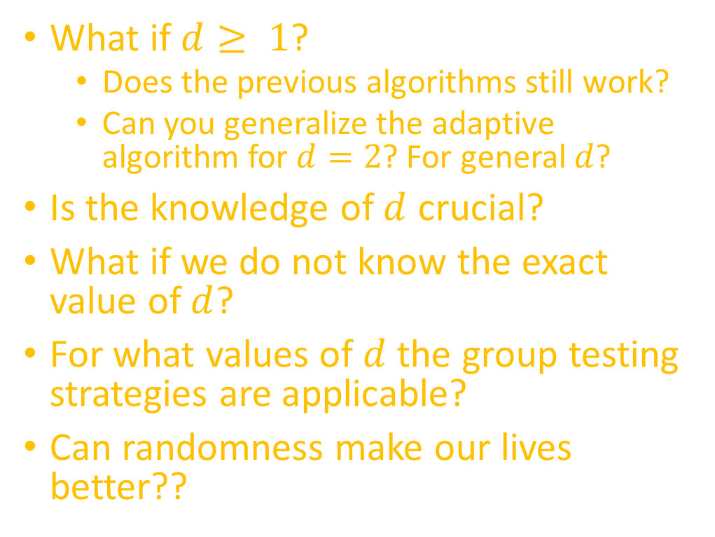
Next time …
What if $d≥ 1$?
Does the previous algorithms still work?
Can you generalize the adaptive algorithm for $d=2$? For general $d$?
Is the knowledge of $d$ crucial?
What if we do not know the exact value of $d$?
For what values of $d$ the group testing strategies are applicable?
Can randomness make our lives better??

