Slide 1
Introduction to Neural Networks: The Neuron
Slides are based on the course: Deep Learning A to Z by Kirill Eremenko AND Hadelin de Ponteves

Slide 2
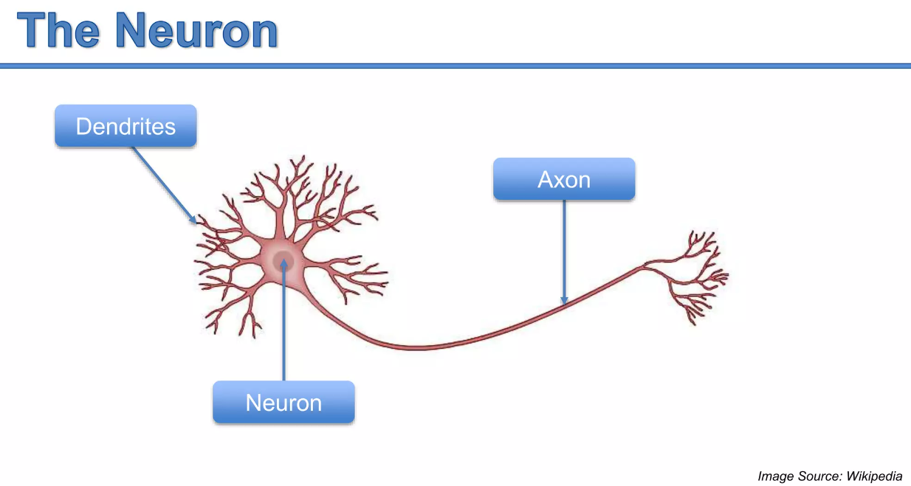

Slide 3
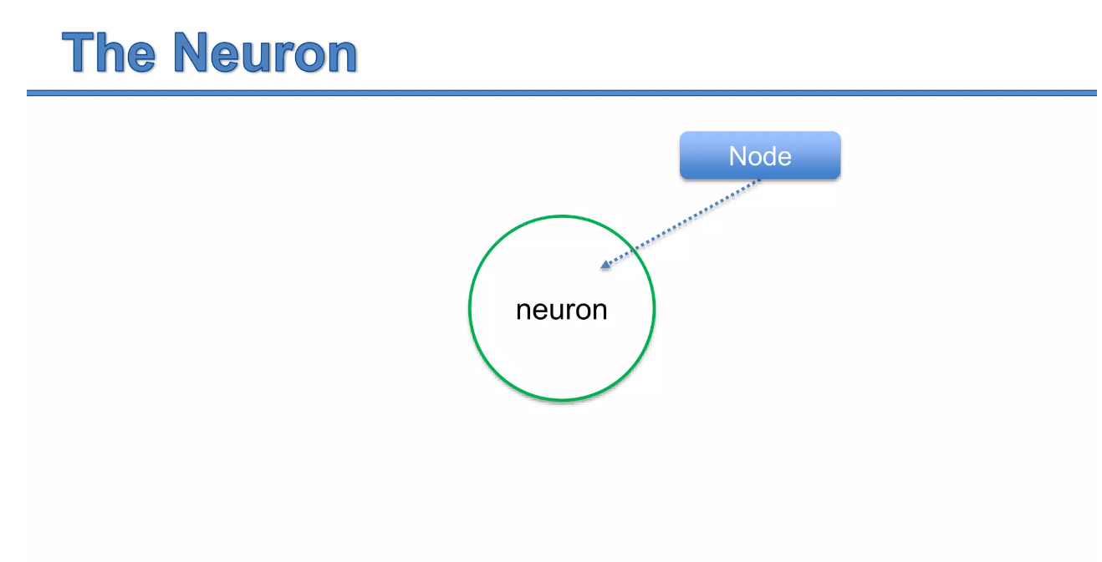
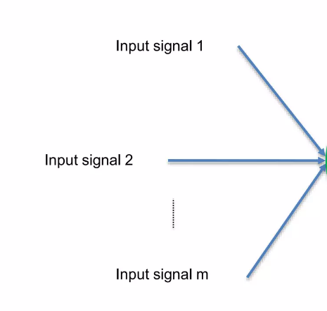
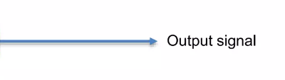

Slide 4
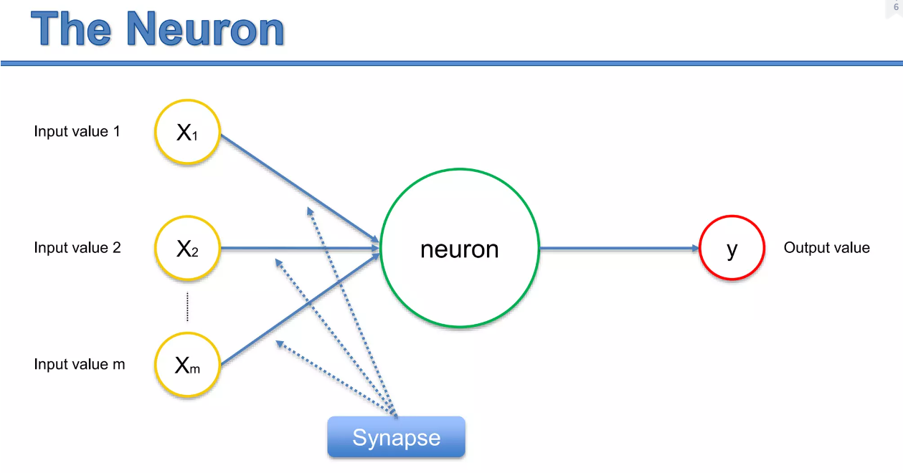

Slide 5




The Neuron - input
Input value 1
Independent variable 2
$X_{1}$
neuron
Input value 2
Independent variable 2
$X_{2}$
y
Output value
$$⋮$$
Input value m
Independent variable m
$X_{m}$
Standardize these values
Make sure they have the mean 0 and variance 1 / Normalize them (so you get them between 0 and 1)

Slide 6
The Neuron - output
$X_{1}$
neuron
$X_{2}$
y
Output value
$$⋮$$
$X_{m}$
Can be:
Continuous (Price)
Binary (Spam/Non-spam)
Categorical (fish/cat/dog)

Slide 7



The Neuron – categorical output
$X_{1}$
$Y_{1}$
neuron
$X_{2}$
$Y_{2}$
$$⋮$$
$Y_{3}$
$X_{m}$
Can be:
Continuous (Price)
Binary (Spam/Non-spam)
Categorical (fish/cat/dog)

Slide 8
The Neuron
Input value 1
Independent variable 2
$X_{1}$
neuron
Input value 2
Independent variable 2
$X_{2}$
y
Output value
$$⋮$$
Input value m
Independent variable m
$X_{m}$
Single observation
Relate to the same observation
Single observation

Slide 9



The Neuron – the synapsis
$X_{1}$
$$w_{1}$$
neuron
$X_{2}$
$$w_{2}$$
y
Output value
$$⋮$$
$$w_{m}$$
$X_{m}$
Each synopsis line have weight
Weights are crucial for NN –those weights is how the model learns.
According to those weights, the network decides what signal passes through and who is not..
The training process is all about adjusting those weight – so they are determined after the training phase of the model

Slide 10



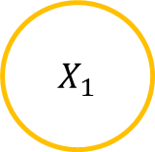


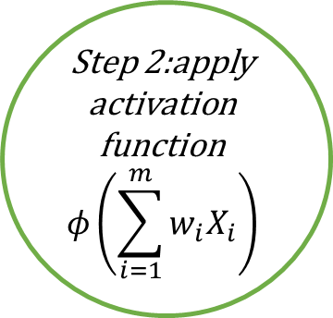

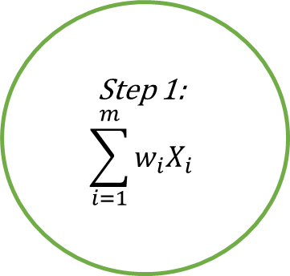
The Neuron – what happens inside the neuron?
$X_{1}$
$$w_{1}$$
Step 2:apply activation function
$$φ\left(\sum_{i=1}^{m}{w_{i}X_{i}}\right)$$
Step 1:
$$\sum_{i=1}^{m}{w_{i}X_{i}}$$
$X_{2}$
$$w_{2}$$
?
y
Output value
$$⋮$$
$$w_{m}$$
$X_{m}$

Slide 11
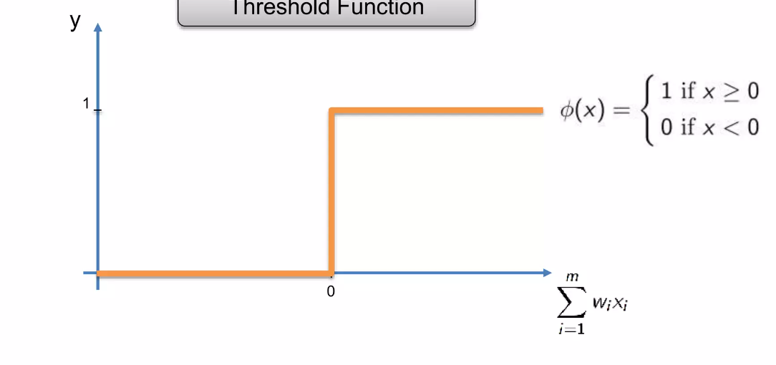
what happens inside the neuron: the activation function
Threshold Function

Slide 12
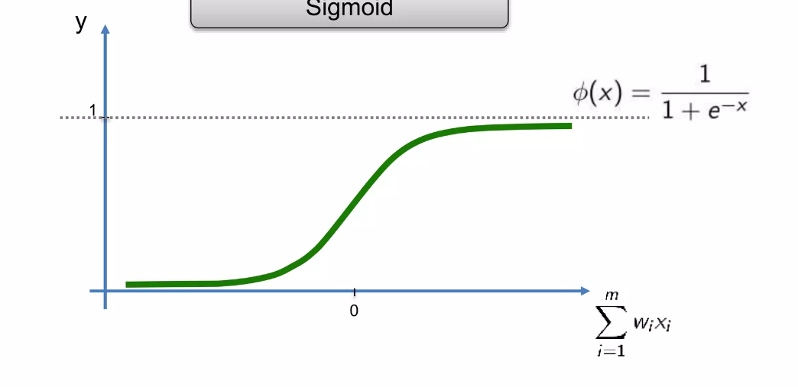
what happens inside the neuron: the activation function
Sigmoid function

Slide 13
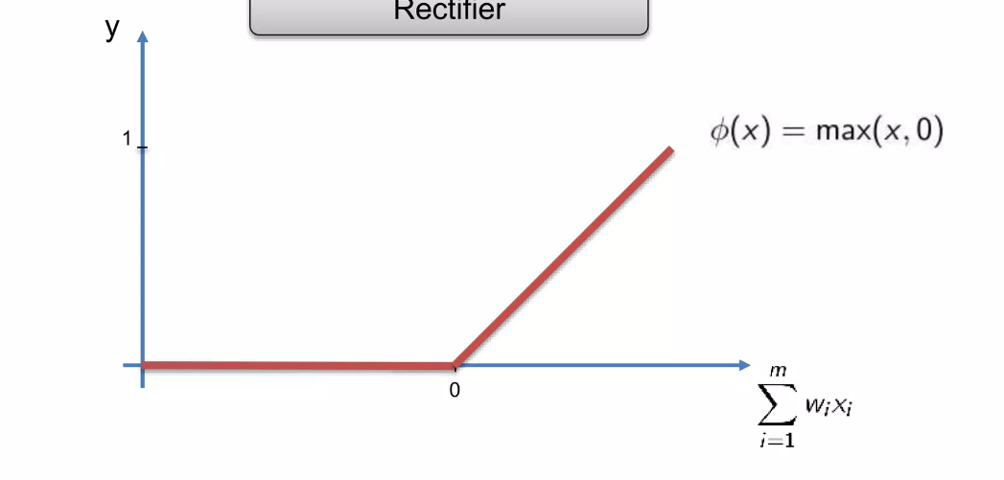
what happens inside the neuron: the activation function
Rectifier function

Slide 14
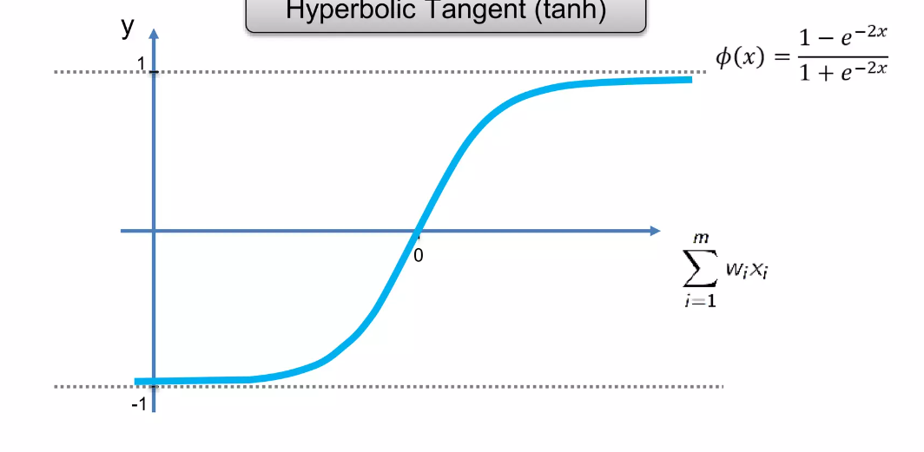
what happens inside the neuron: the activation function
Hyperbolic tangent (tanh)

Slide 15





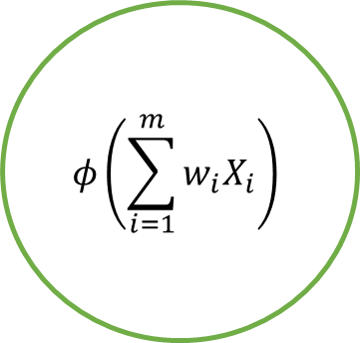


The Neuron – what happens inside the neuron?
$X_{1}$
$$w_{1}$$
$$φ\left(\sum_{i=1}^{m}{w_{i}X_{i}}\right)$$
$X_{2}$
$$w_{2}$$
y
Output value
$$⋮$$
$$w_{m}$$
$X_{m}$
If Y is binary (0,1) value, what activation function suit your problem?
Notes:
Threshold function (it is either 0 or 1)
Sigmoid function (Pr(y=1))

Slide 16
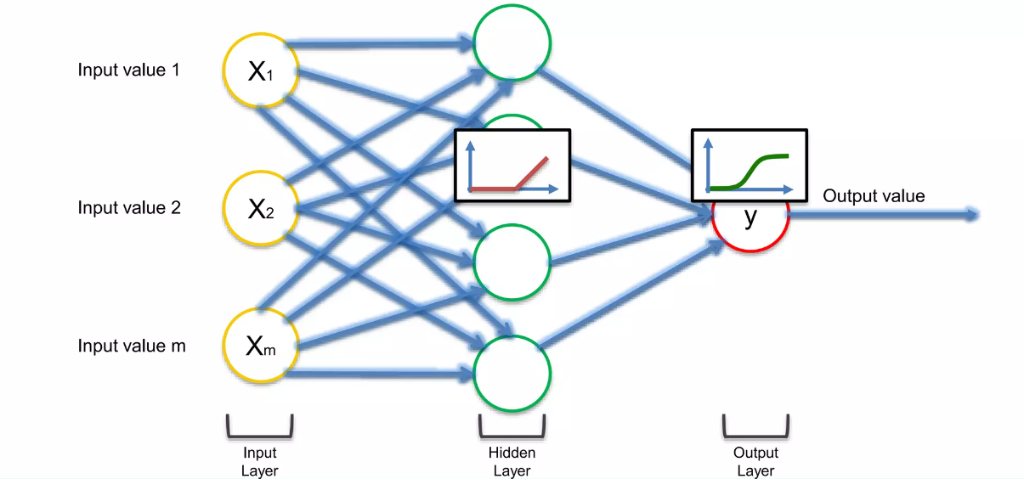
Common choices
Sigmoid
Rectifier function

Slide 17
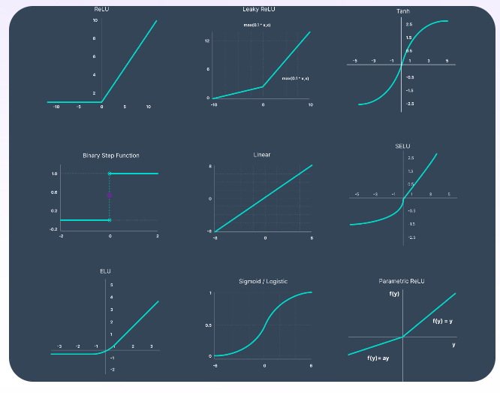
More about activation functions
For mode information and examples of other activation functions, please visit:
https://www.v7labs.com/blog/neural-networks-activation-functions
A good read about rectifier functions: Deep sparse rectifier neural networks. By Xafier Glorot et.al.

