Slide 1
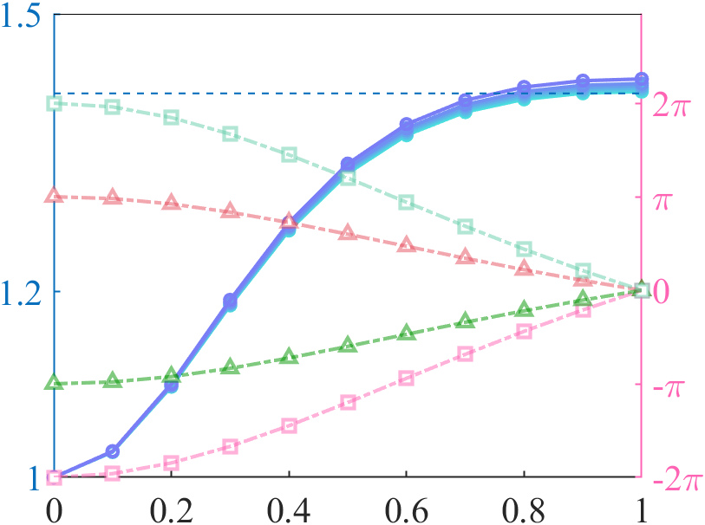
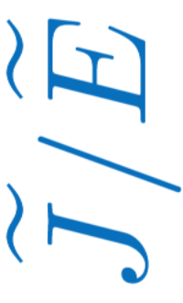






$$\tilde{E}=0.004,0.008,0.012,0.016,0.02,0.03$$
$$\sqrt{2}$$
$$φ_{0,−1}$$
$$φ_{λ,+1}$$
Berry phase
$$φ_{λ,−1}$$
$$φ_{0,+1}$$
$$α$$

