Slide 1
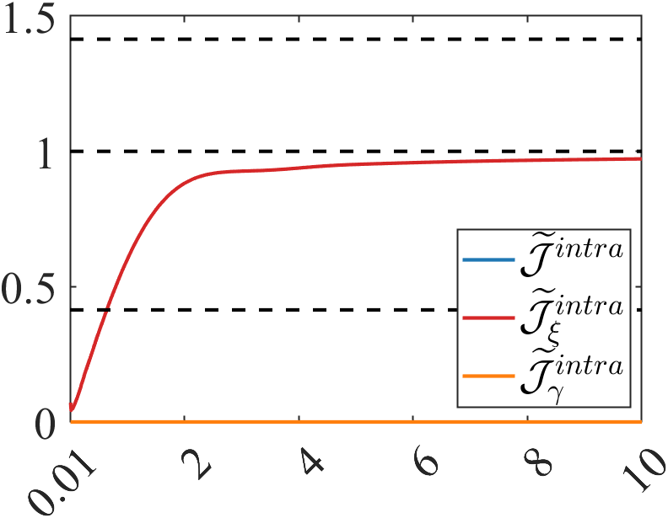
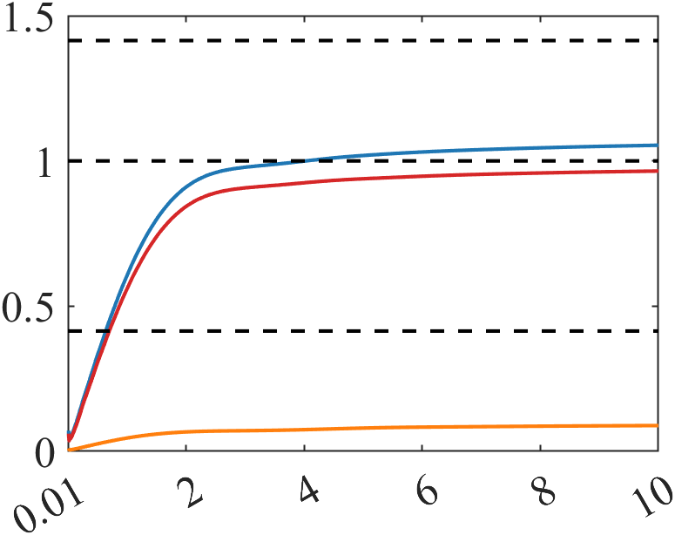
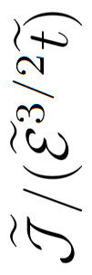

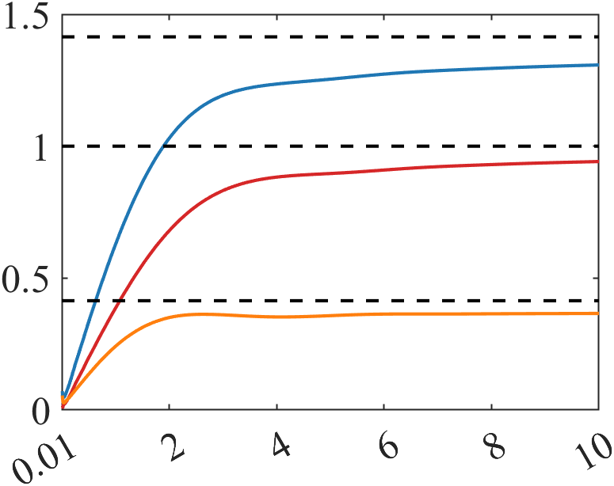
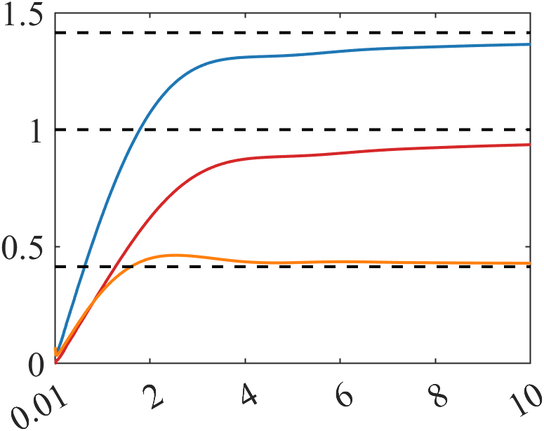










$$(a)$$
$$(b)$$
$$\sqrt{2}$$
$$α=0$$
$$α=0.2$$
$$\sqrt{2}−1$$
$$(c)$$
$$(d)$$
$$α=0.6$$
$$α=1$$

