Slide 1
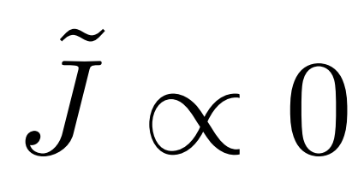
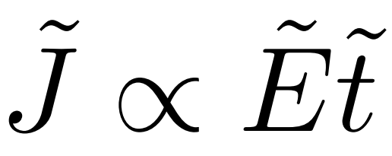
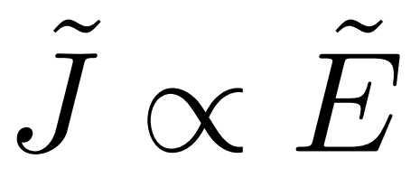



Bloch-Zener oscillation
initial
transient
linear
nonlinear
Fermi surface
$$\tilde{E}\tilde{t}$$

