Slide 1




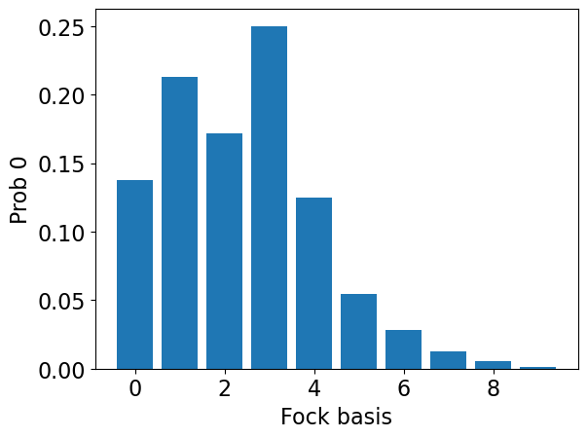
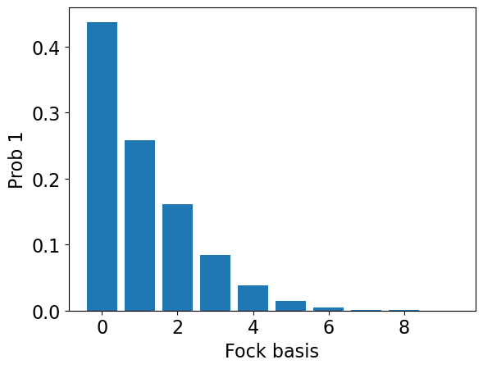
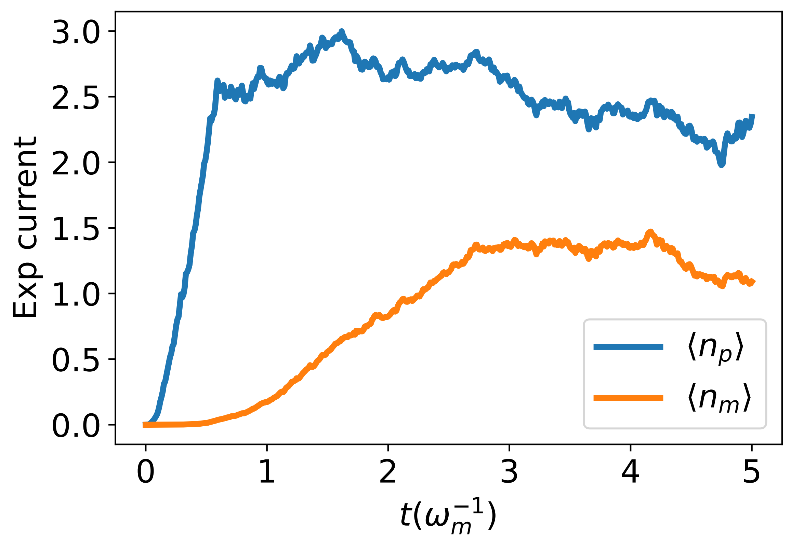









$$(a)$$
$$(b)$$
$$(c)$$
$$(d)$$
$Δ$
$α_{L}$
$$(e)$$
$$(f)$$
$$(g)$$

