Slide 1
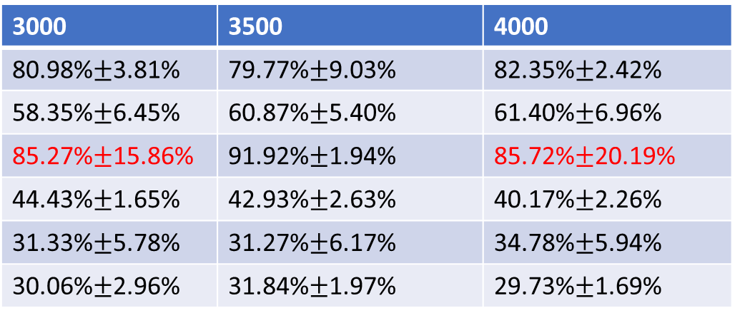
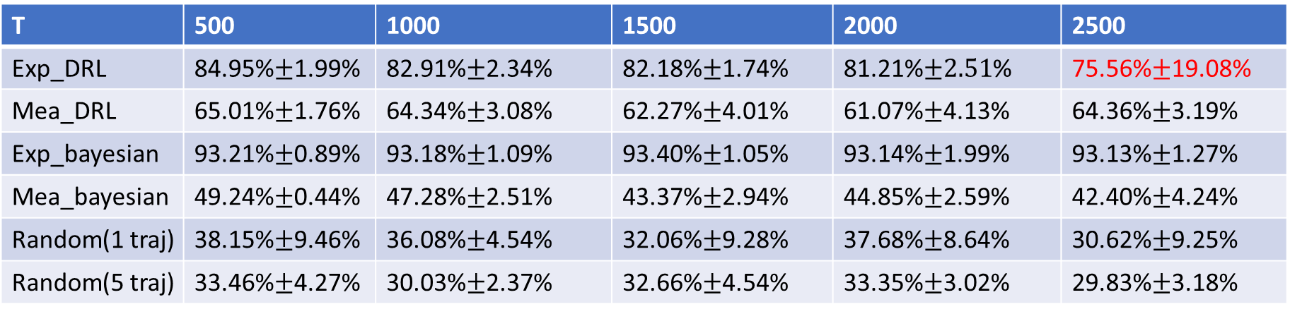
T | 500 | 1000 | 1500 | 2000 | 2500
Exp_DRL | 84.95%$±$1.99% | 82.91%$±$2.34% | 82.18%$±$1.74% | 81.21%$±2.51$% | 75.56%$±$19.08%
Mea_DRL | 65.01%$±$1.76% | 64.34%$±$3.08% | 62.27%$±$4.01% | 61.07%$±$4.13% | 64.36%$±$3.19%
Exp_bayesian | 93.21%$±$0.89% | 93.18%$±$1.09% | 93.40%$±$1.05% | 93.14%$±$1.99% | 93.13%$±$1.27%
Mea_bayesian | 49.24%$±$0.44% | 47.28%$±$2.51% | 43.37%$±$2.94% | 44.85%$±$2.59% | 42.40%$±$4.24%
Random(1 traj) | 38.15%$±$9.46% | 36.08%$±$4.54% | 32.06%$±$9.28% | 37.68%$±$8.64% | 30.62%$±$9.25%
Random(5 traj) | 33.46%$±$4.27% | 30.03%$±$2.37% | 32.66%$±$4.54% | 33.35%$±$3.02% | 29.83%$±$3.18%
3000 | 3500 | 4000
80.98%$±$3.81% | 79.77%$±$9.03% | 82.35%$±$2.42%
58.35%$±$6.45% | 60.87%$±$5.40% | 61.40%$±$6.96%
85.27%$±$15.86% | 91.92%$±$1.94% | 85.72%$±$20.19%
44.43%$±$1.65% | 42.93%$±$2.63% | 40.17%$±$2.26%
31.33%$±$5.78% | 31.27%$±$6.17% | 34.78%$±$5.94%
30.06%$±$2.96% | 31.84%$±$1.97% | 29.73%$±$1.69%

