Slide 1




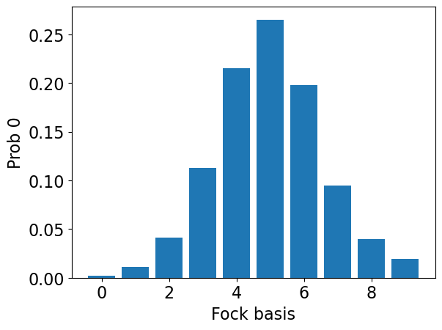
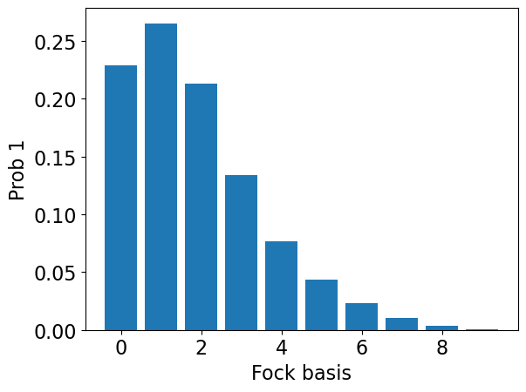
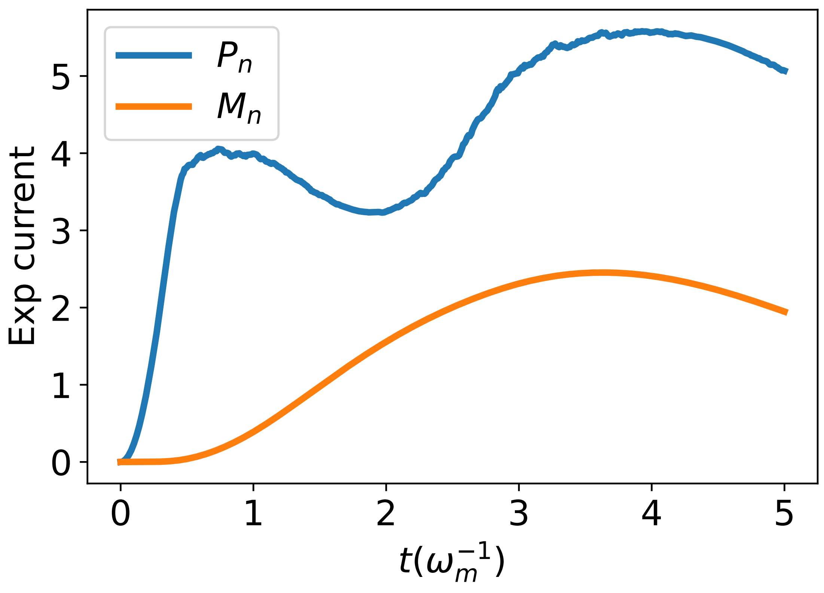







$$(a)$$
$$(b)$$
$$(c)$$
$$(d)$$
$$(e)$$
$$(f)$$
$$(g)$$

