Slide 1
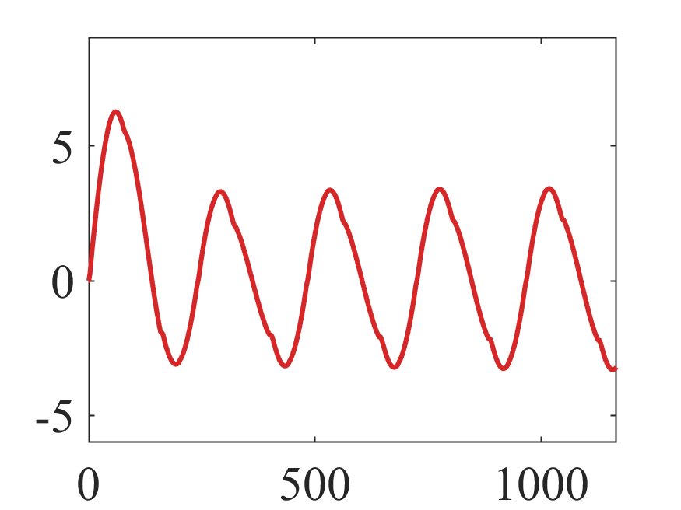
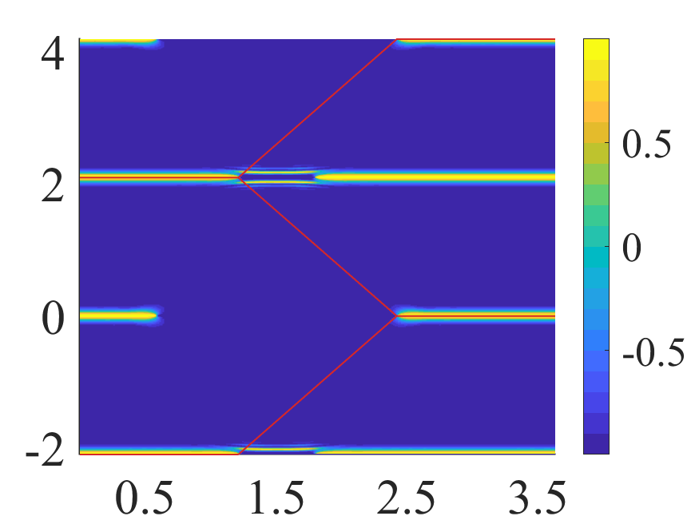


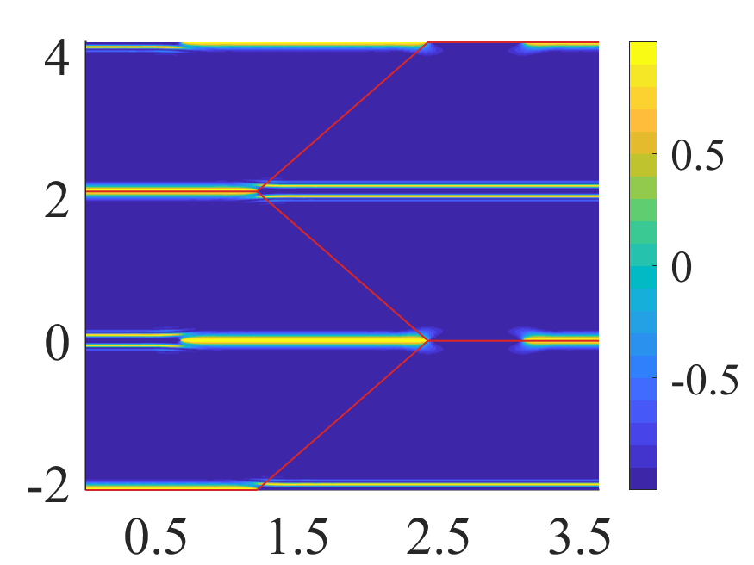
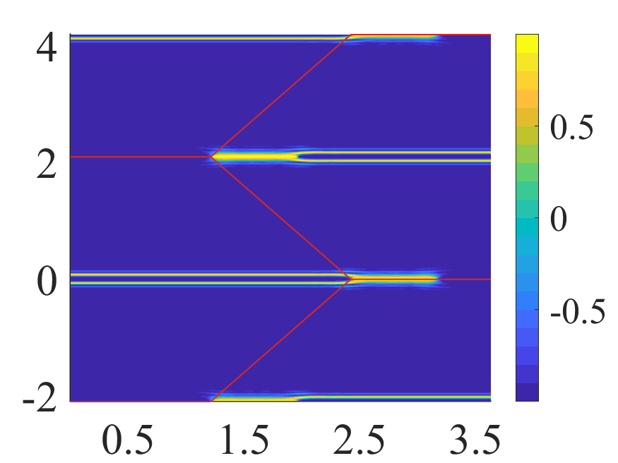










$$(a)$$
$$(b)$$
$${\tilde{k}}_{y}$$
$${\tilde{k}}_{x}$$
$$(c)$$
$$(d)$$
$${\tilde{k}}_{y}$$
$${\tilde{k}}_{y}$$
$${\tilde{k}}_{x}$$
$${\tilde{k}}_{x}$$

