Slide 1
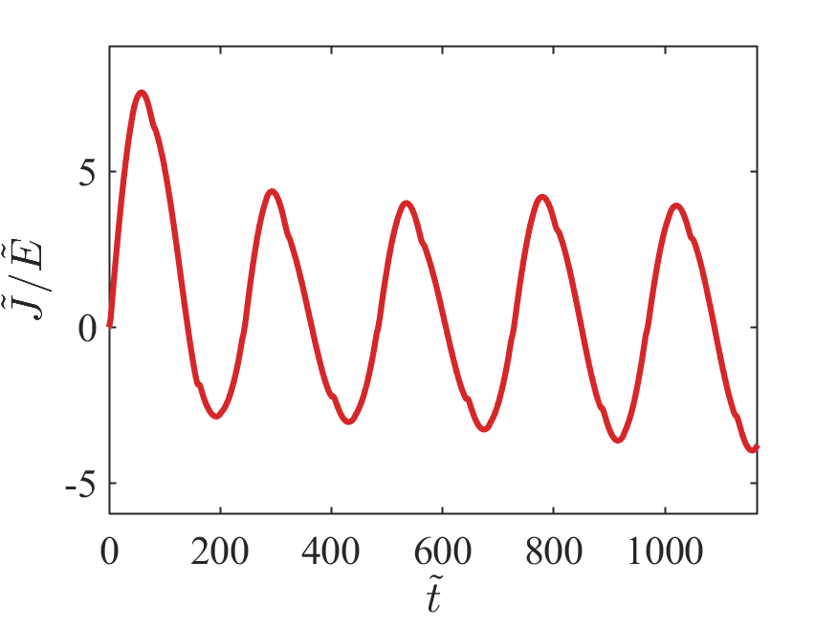
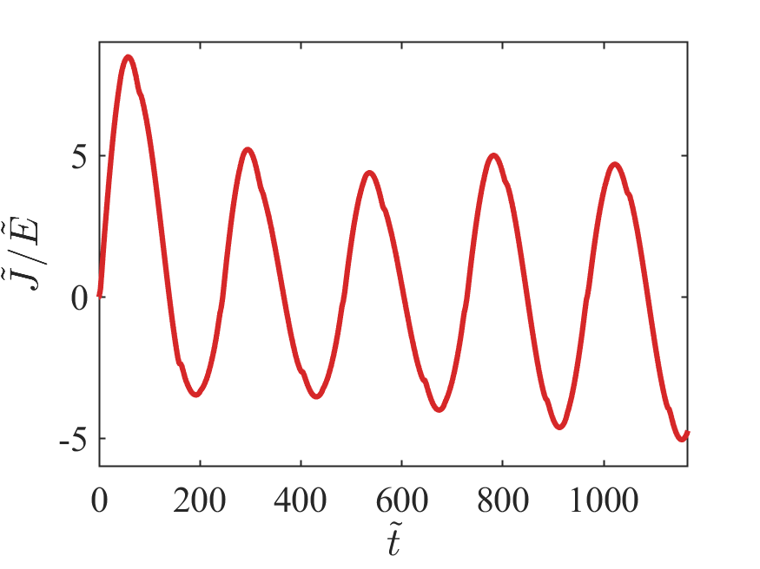
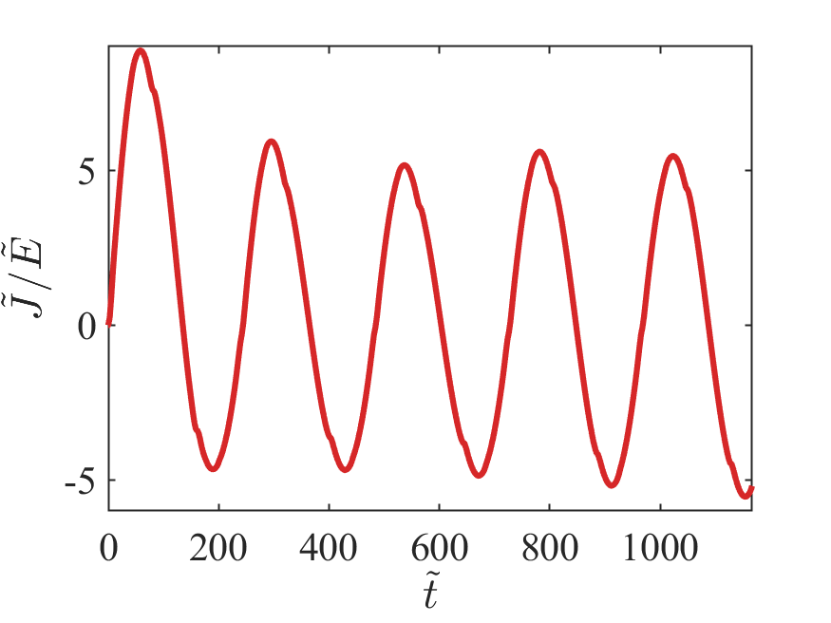
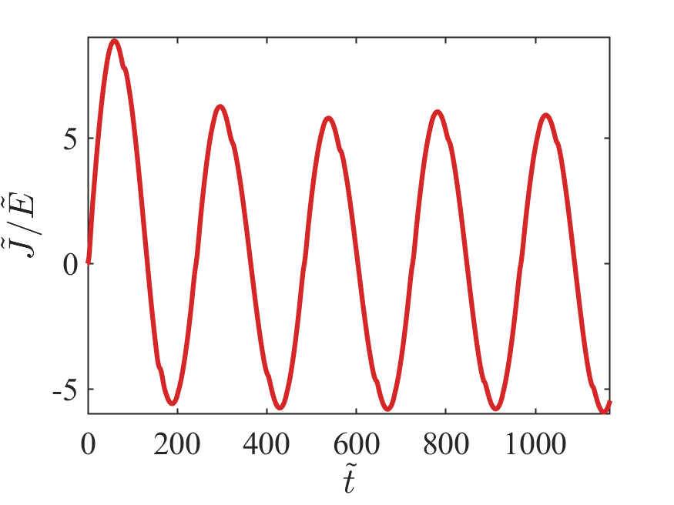
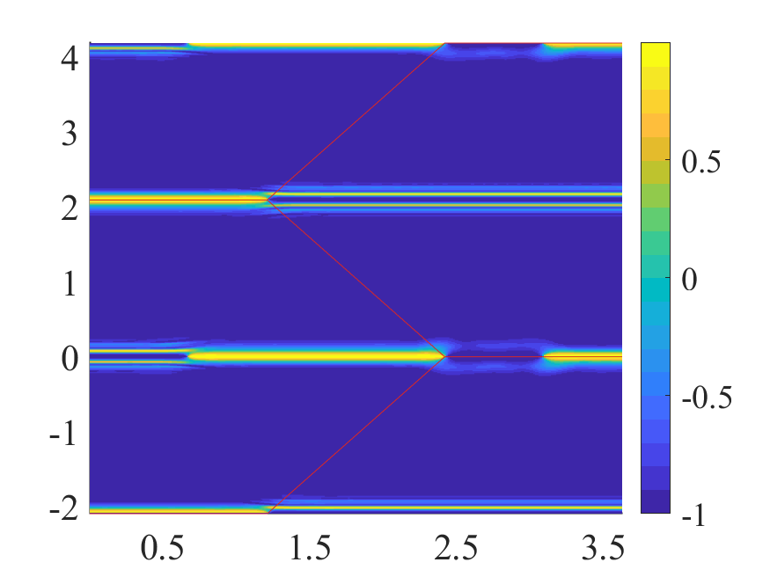
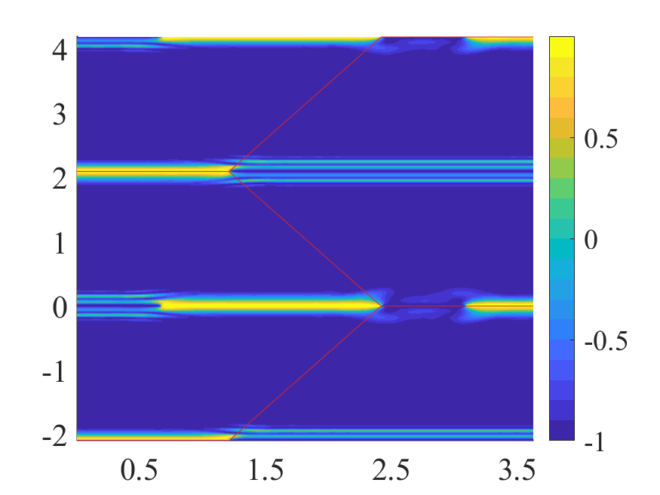
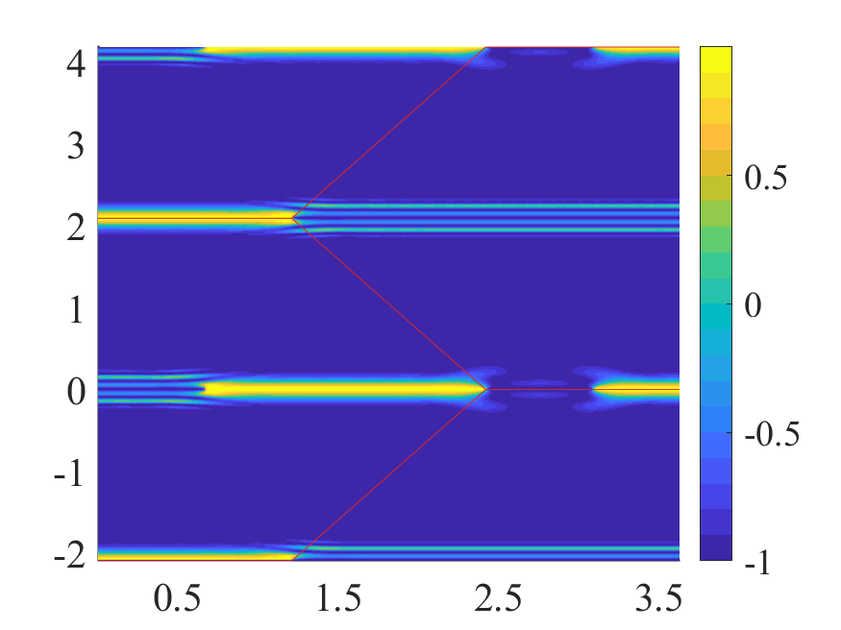
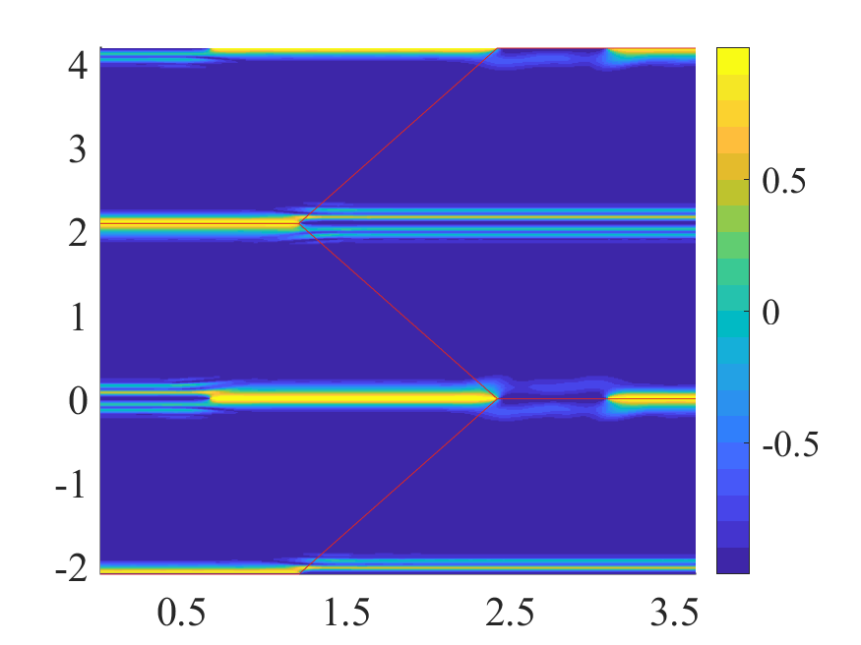




















$$(a)$$
$$(b)$$
$$(c)$$
$$(d)$$
$$(e)$$
$$(f)$$
$$(g)$$
$$(h)$$
$${\tilde{k}}_{y}$$
$${\tilde{k}}_{y}$$
$${\tilde{k}}_{y}$$
$${\tilde{k}}_{y}$$
$$α=0.3$$
$$α=0.7$$
$$α=1$$
$$α=0.5$$
$${\tilde{k}}_{x}$$
$${\tilde{k}}_{x}$$
$${\tilde{k}}_{x}$$
$${\tilde{k}}_{x}$$

