Slide 1
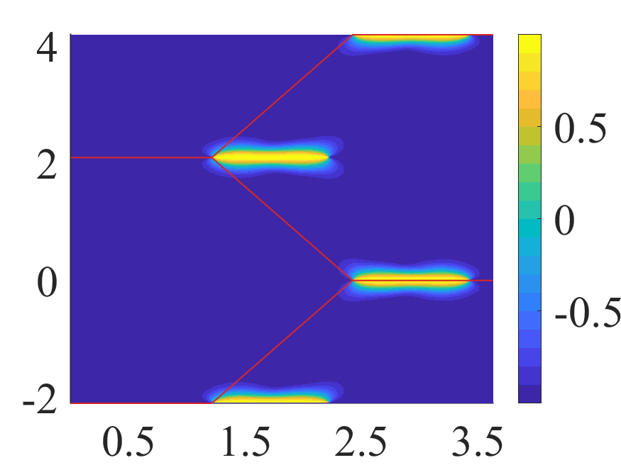
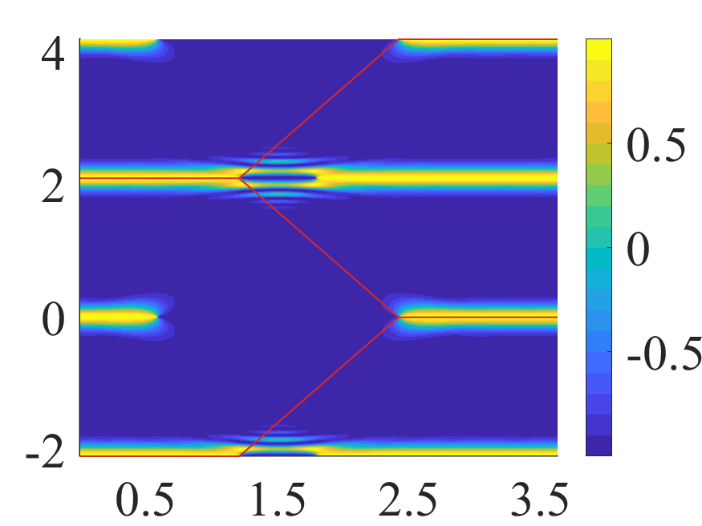
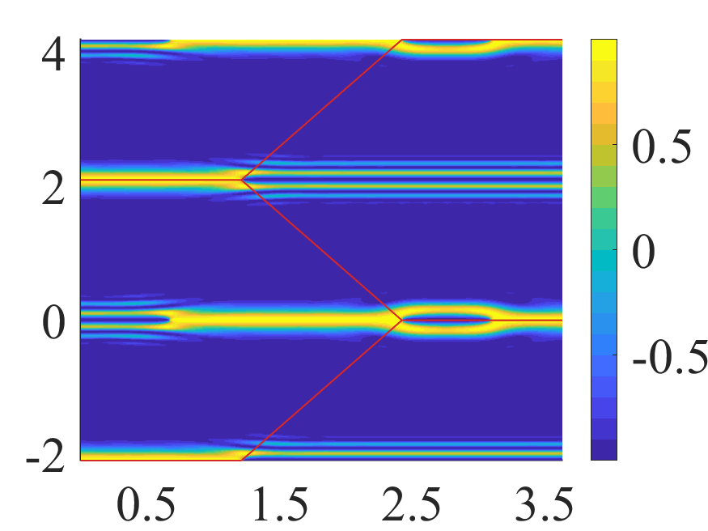
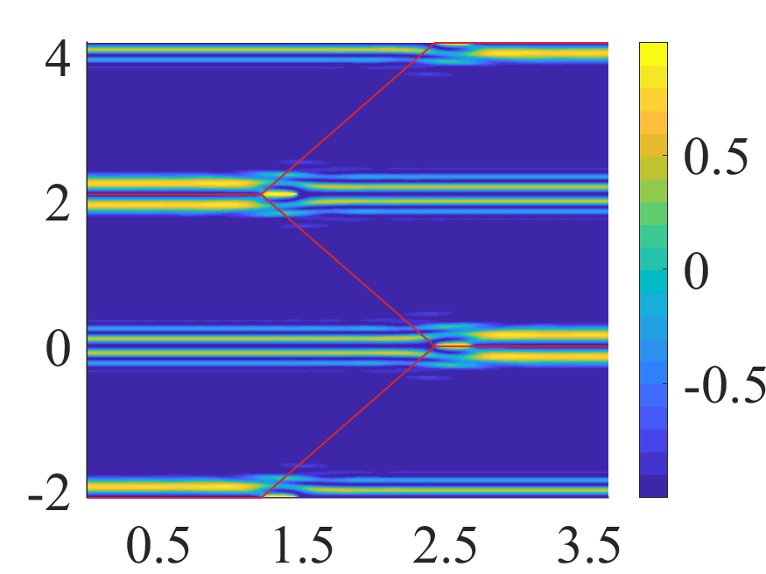
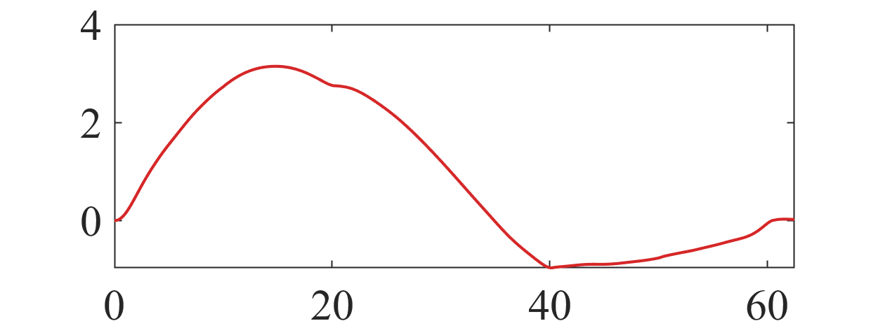


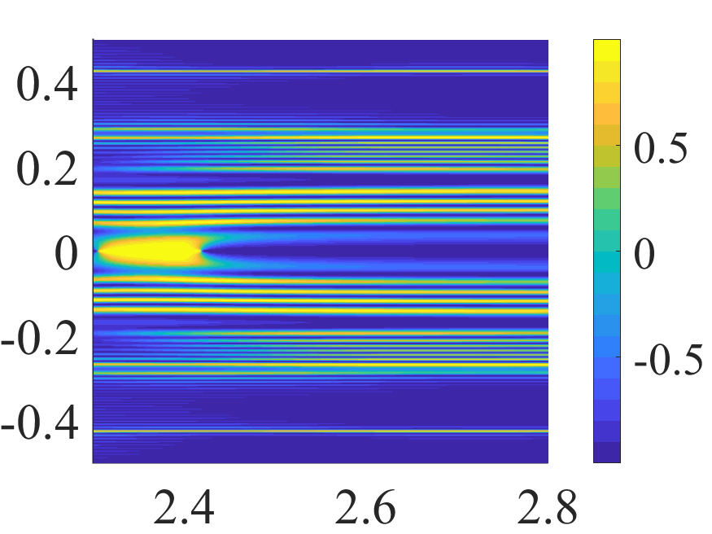
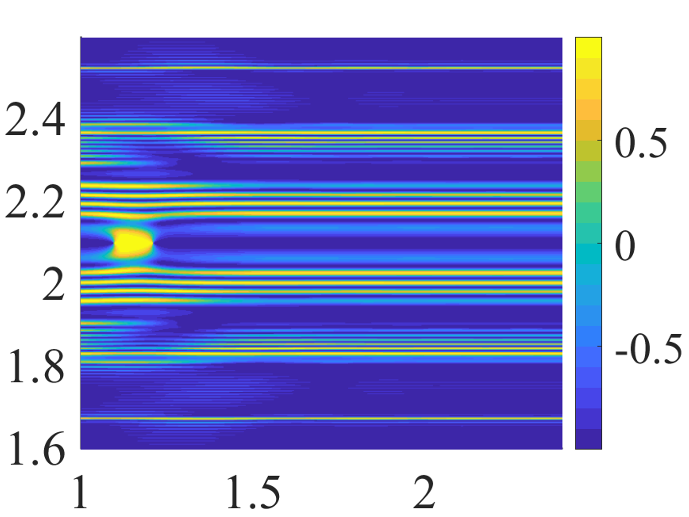





















$$(a)$$
$$(b)$$
$${\tilde{k}}_{y}$$
$${\tilde{k}}_{y}$$
$$(c)$$
$${\tilde{k}}_{x}$$
$$(d)$$
$${\tilde{k}}_{x}$$
$${\tilde{k}}_{y}$$
$${\tilde{k}}_{y}$$
$${\tilde{k}}_{x}$$
$${\tilde{k}}_{x}$$
$$(e)$$
$$(f)$$
$$+K$$
$$(g)$$
$$−K$$
$${\tilde{k}}_{y}$$
$${\tilde{k}}_{y}$$
$${\tilde{k}}_{x}$$
$${\tilde{k}}_{x}$$

