Slide 1
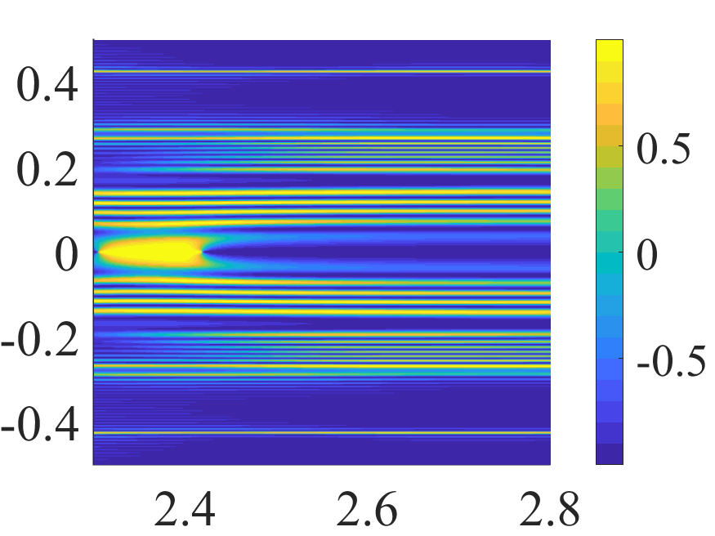
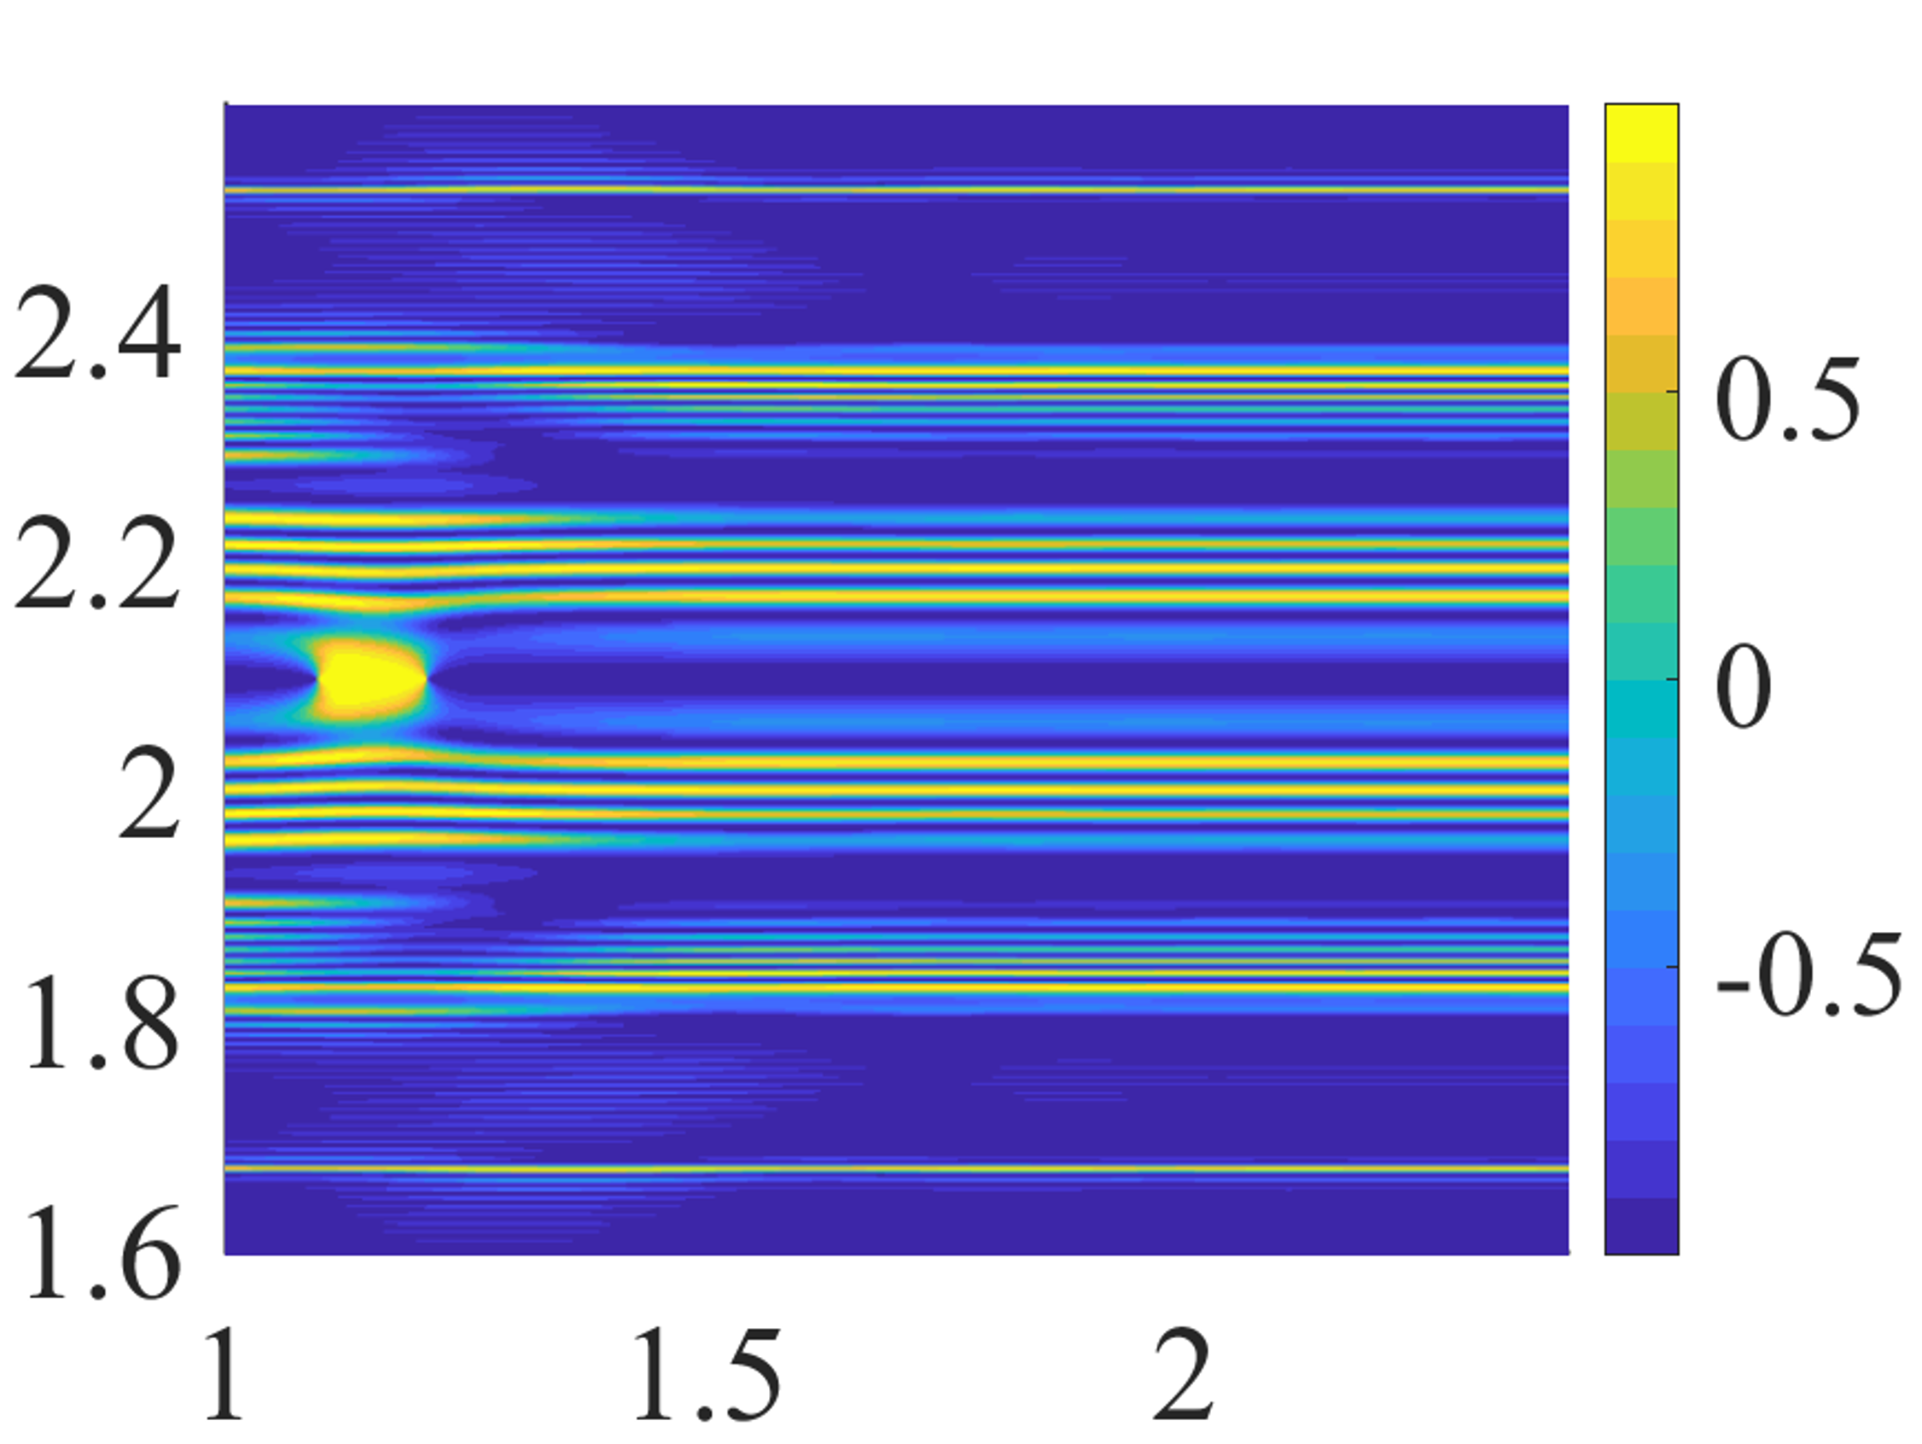








$$(a)$$
$$+K$$
$${\tilde{k}}_{y}$$
$${\tilde{k}}_{x}$$
$$(b)$$
$$−K$$
$${\tilde{k}}_{y}$$
$${\tilde{k}}_{x}$$

