Slide 1

Robot Navigation by Reinforcement Learning
Final project 1 by Team 10
EEE 598, Fall 2024
Kannak Sharma, Lili Ye, and Zeming Zhou
School of Electrical, Computer, and Energy Engineering,
Arizona State University
Contacts: [ksharm88, liliye, zzhou157]@asu.edu

Slide 2
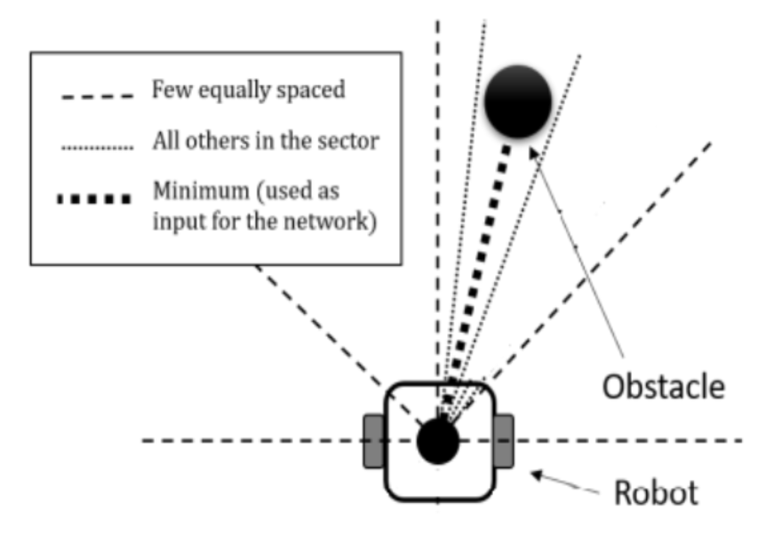
What is the issue/prompt under discussion
Objective
Develop adaptable, collision-free navigation for robots in unstructured settings using RL and PPO algorithms.
Key Challenges
Obstacle Avoidance: Navigate around static (e.g., walls) and dynamic obstacles (e.g., people, other robots).
Real-Time Decision Making: Rapidly process continuous data for immediate response.
Limited Sensory Data: Operate with incomplete view of surroundings using local sensors (e.g., LiDAR).
Adaptability: Generalize navigation strategies across various environments without reprogramming.
Our Approach
Proximal Policy Optimization (PPO): Reliable for continuous action spaces, ideal for dynamic navigation.
Actor-Critic Model: Enhances decision-making by evaluating actions for a balanced, adaptive response.
LiDAR Integration: Enables real-time adjustments without reliance on pre-defined maps.
current practice
Fig. LiDAR-based obstacle detection: minimum distance in sector used as input for PPO network

Slide 3
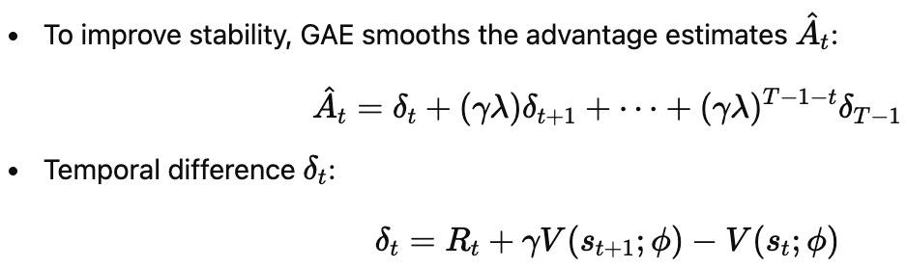
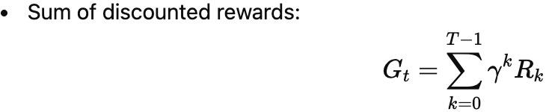
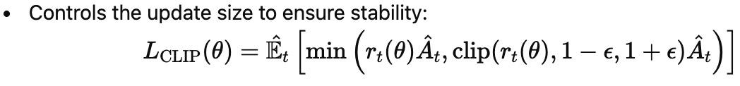

PPO Algorithm - Key Components and Formulas
Generalized Advantage Estimation (GAE)
2. Return Calculation
3. Clipped Surrogate Objective
4. Value Function Loss
‹#›

Slide 4
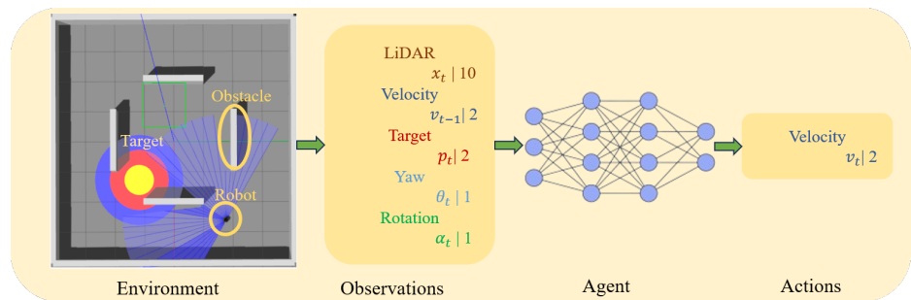
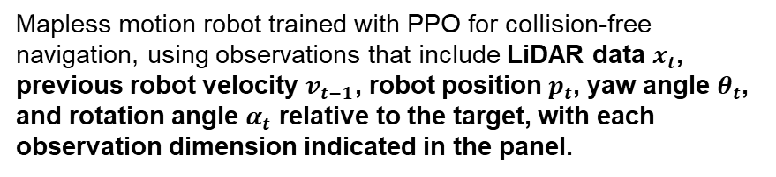
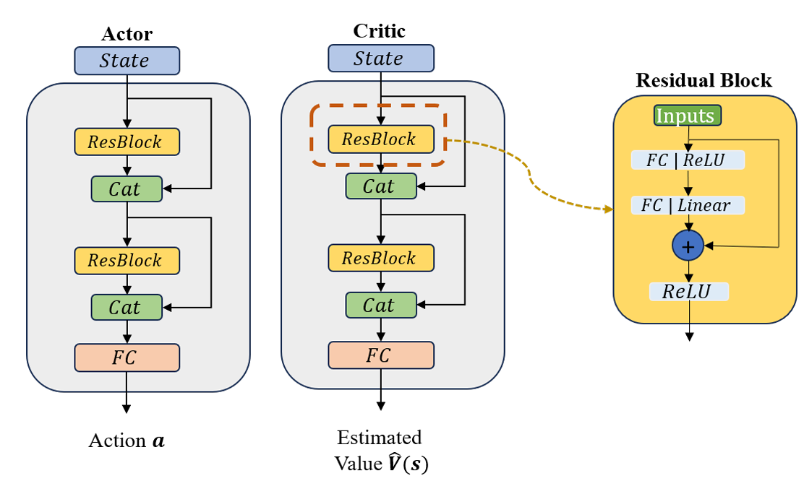
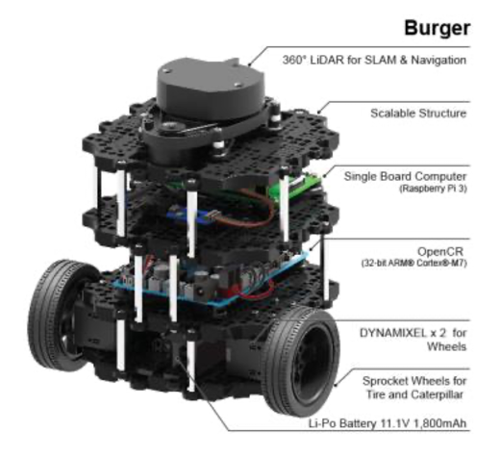
Problem Setup
The PPO algorithm’s neural network architecture. This setup uses an actor-critic framework where both networks apply ResBlocks, retaining key features by adding the input back to the output of two layers, enhancing stability and performance with a final ReLU activation.

Slide 5
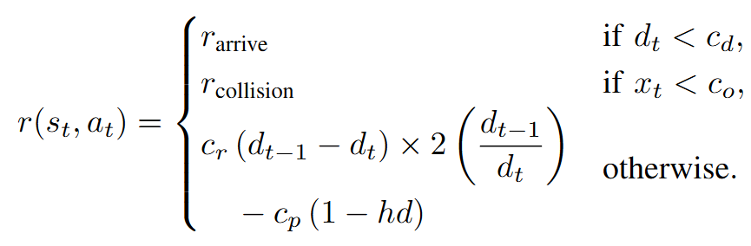
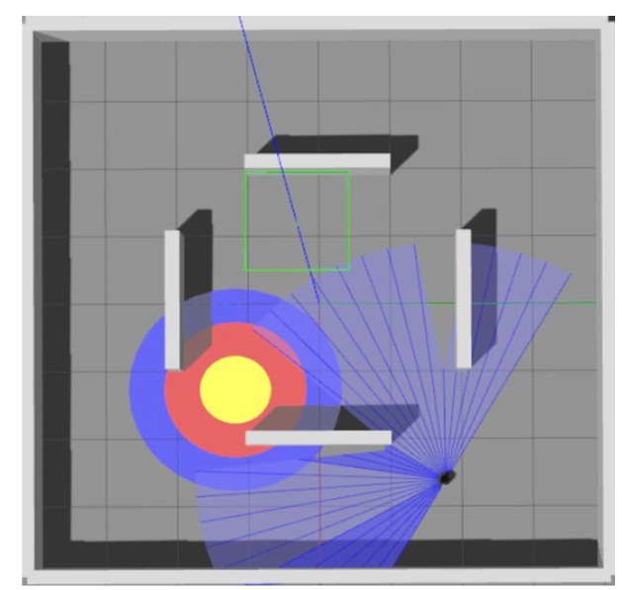
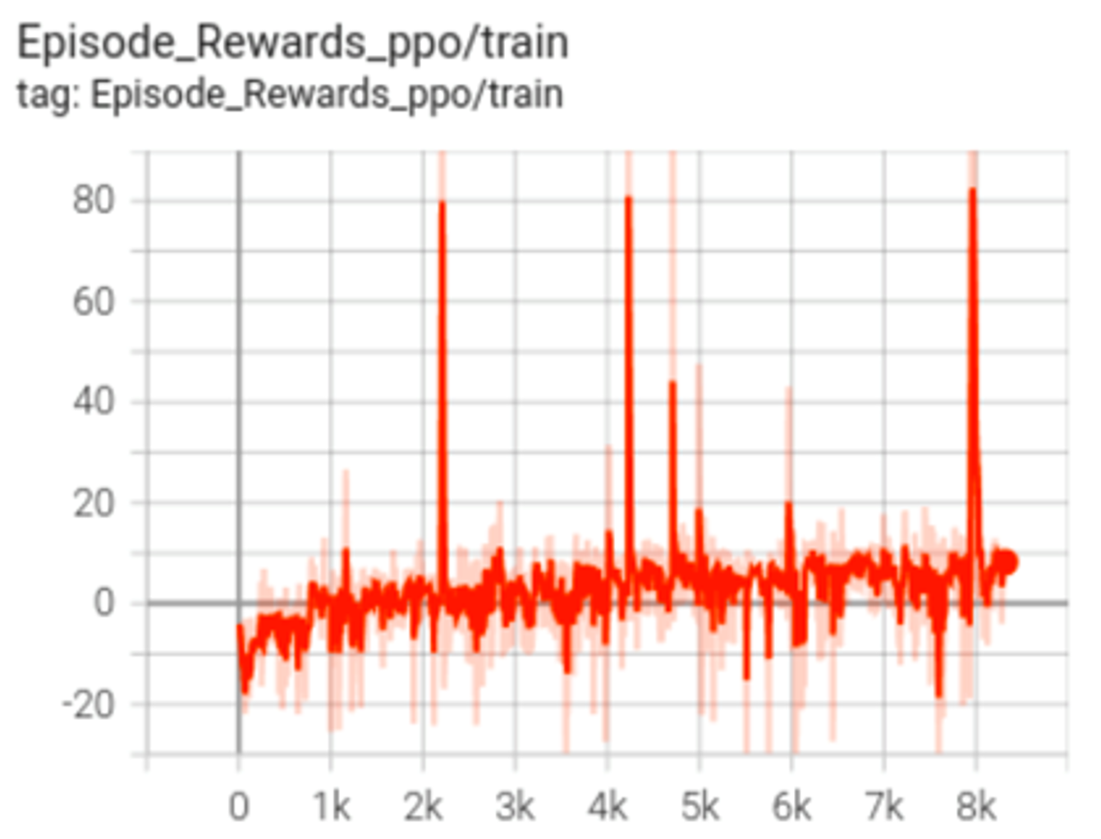
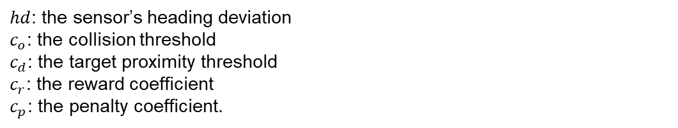
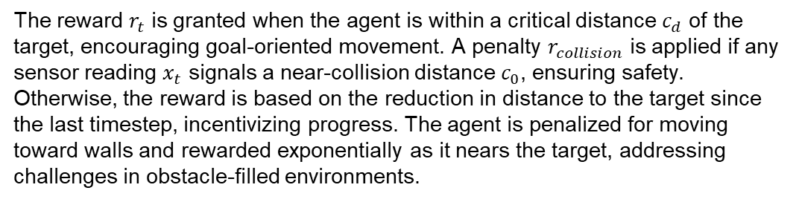
Experimental Results
The converged learning curve of the episode cumulative reward for PPO, plotted over the number of episodes in the environment

Slide 6
Future Work
Following insights from Taheri et al.[1], we focus on the challenge of safe and efficient robot navigation using reinforcement learning (RL) in the Gazebo simulation with LiDAR data. Our approach uses Proximal Policy Optimization (PPO) to enhance navigation by detailing observations, rewards, actions, and training methods, aiming to optimize decision-making across various scenarios.
Key challenges in deep reinforcement learning (DRL) for robotics include limited state information, low sample efficiency, safety in unpredictable environments, and the lack of standardized benchmarks. Overcoming these requires technical improvements and collaborative efforts to ensure reliable deployment of autonomous robots in real-world tasks like industrial automation and search and rescue.
For our next step, we plan to learn the Deep Deterministic Policy Gradient (DDPG) method and compare its performance with PPO across different reward structures and varying environment complexities, aiming to gain a deeper understanding of this work.

Slide 7
References
Papers cited | How is the paper used (specifics) | Remarks (if any)
[1] H. Taheri and S. R. Hosseini, “Deep reinforcement learning with enhanced PPO for safe mobile robot navigation,” arXiv preprint arXiv:2405.16266, 2024 | We relied extensively on this paper across Sections I through V to develop the PPO agent for robot navigation.
[2] Z. Liu, Y. Zhai, J. Li, G. Wang, Y. Miao, and H. Wang, “Graph relational reinforcement learning for mobile robot navigation in large-scale crowded environments,” IEEE Transactions on Intelligent Transportation Systems, 2023. | We use this paper to introduce Graph Relational Reinforcement Learning (GRRL) for robot navigation in Section I.
[3] Z. Wang, Y. Wang, Z. Wang, H. Yan, Z. Xu, and Z. Wu, “Research on autonomous robots navigation based on reinforcement learning,” in 2024 3rd International Conference on Robotics, Artificial Intelligence and Intelligent Control (RAIIC). IEEE, 2024. | We use this paper to introduce Deep Q-Networks for robot navigation in Section I.

