Slide 1
US Food & Drug Administration
Animal & Veterinary API Endpoints
Lilla Bartko, Twilla Gerling, Carla Hampton
November 10, 2021

Slide 2
Executive Summary

Slide 3
Analysis of sample cat data
Using the openFDA API, extracted data regarding random 500 cats
Gender
Age
Weight
Breed of cat
Drug used
Outcome
Date treatment began

Slide 4
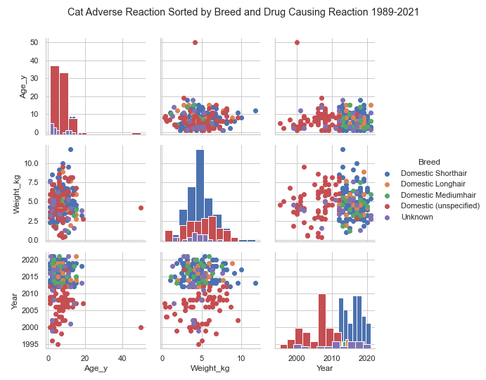
Distrobution of the Data

Slide 5
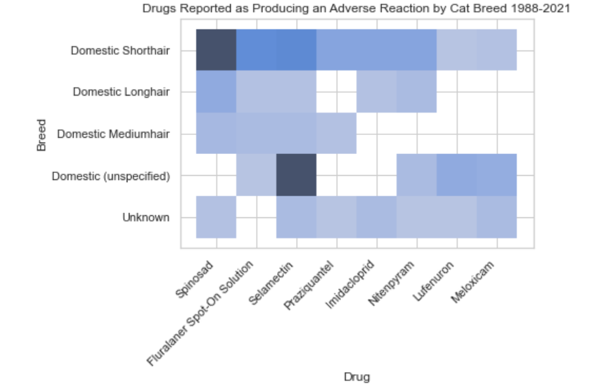
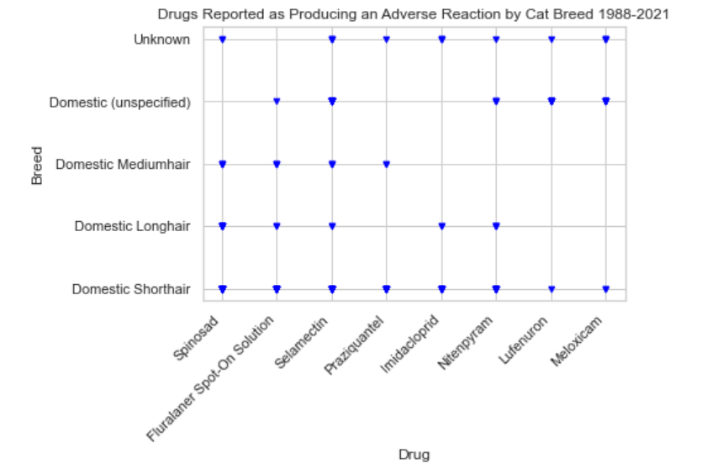
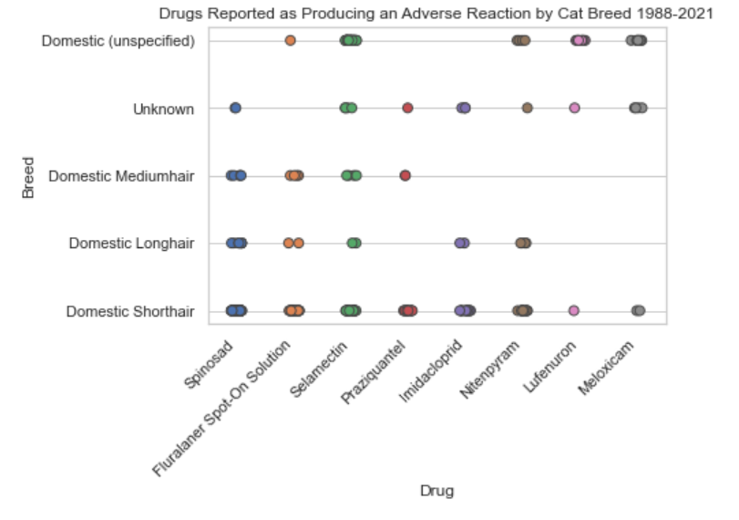
What Drugs are Reported as Causing a Reaction in Cats?

Slide 6
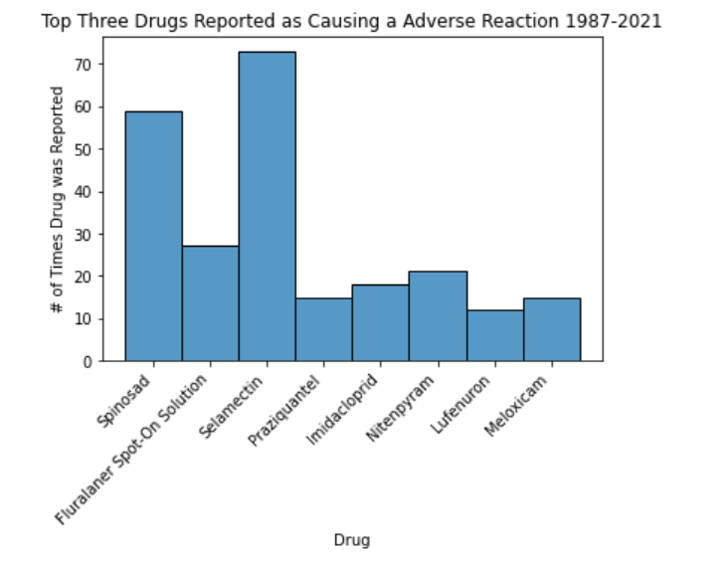
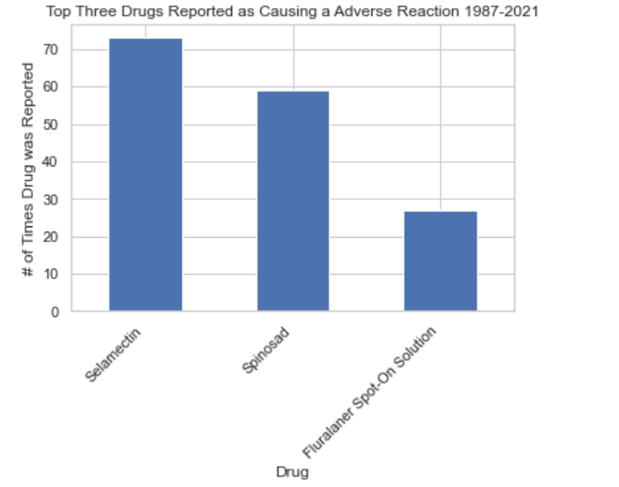
Top 3 Drugs that Produce an Adverse Reaction in Cats?

Slide 7
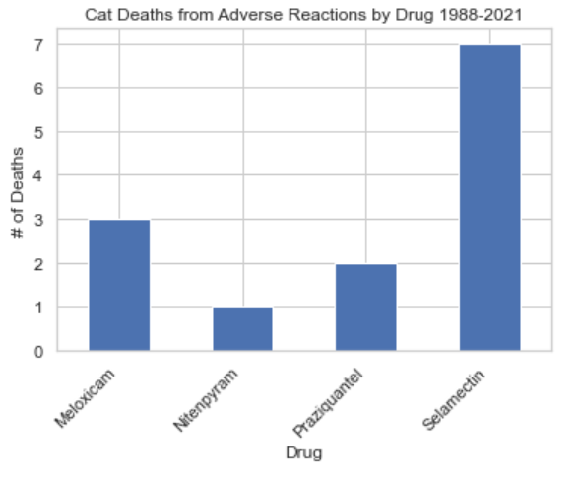
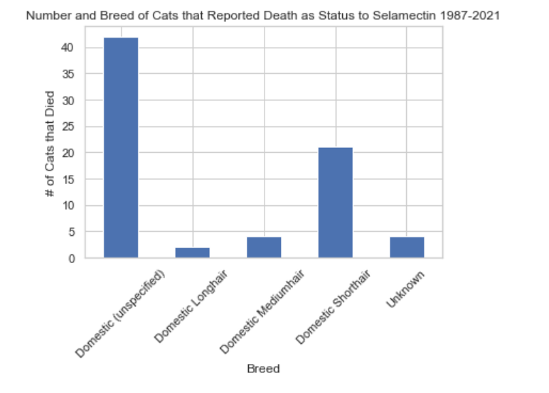
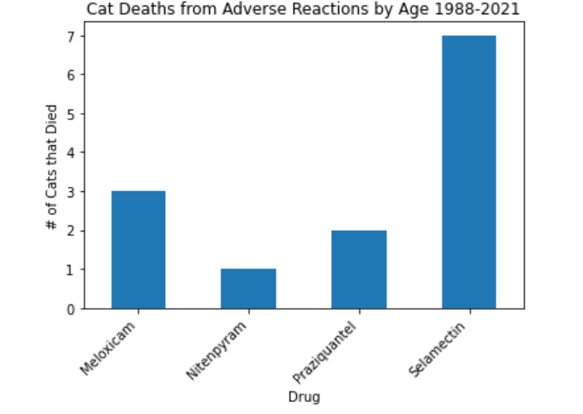
Which Drugs Result in Death?

Slide 8
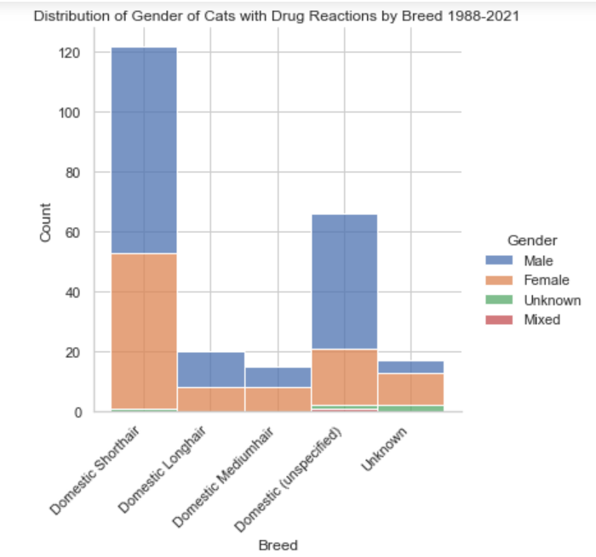
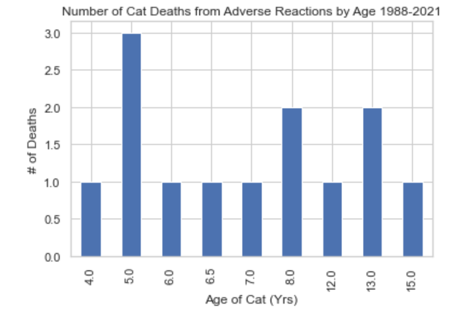
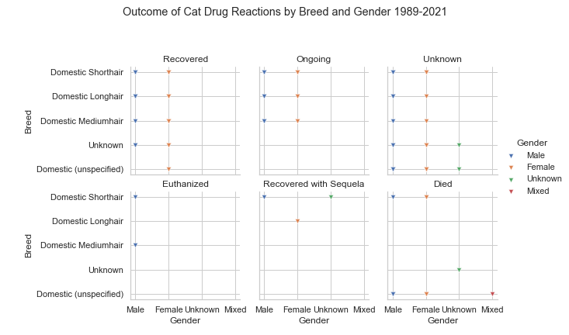
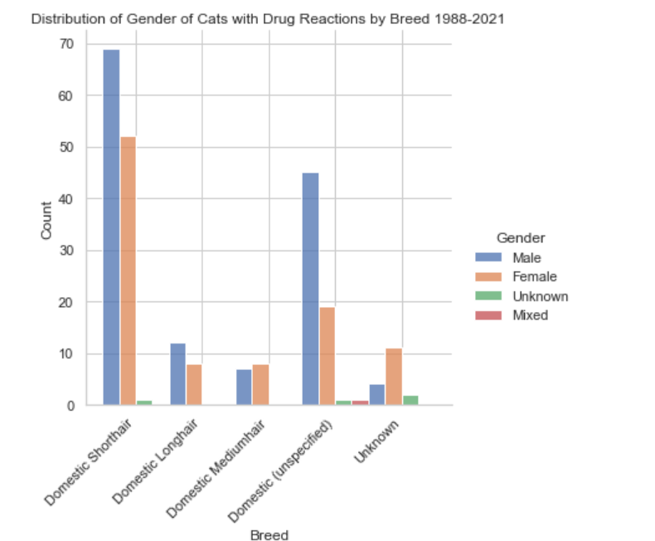
What are the Ages of the Cats that Died? Does Gender Affect Outcome?

Slide 9
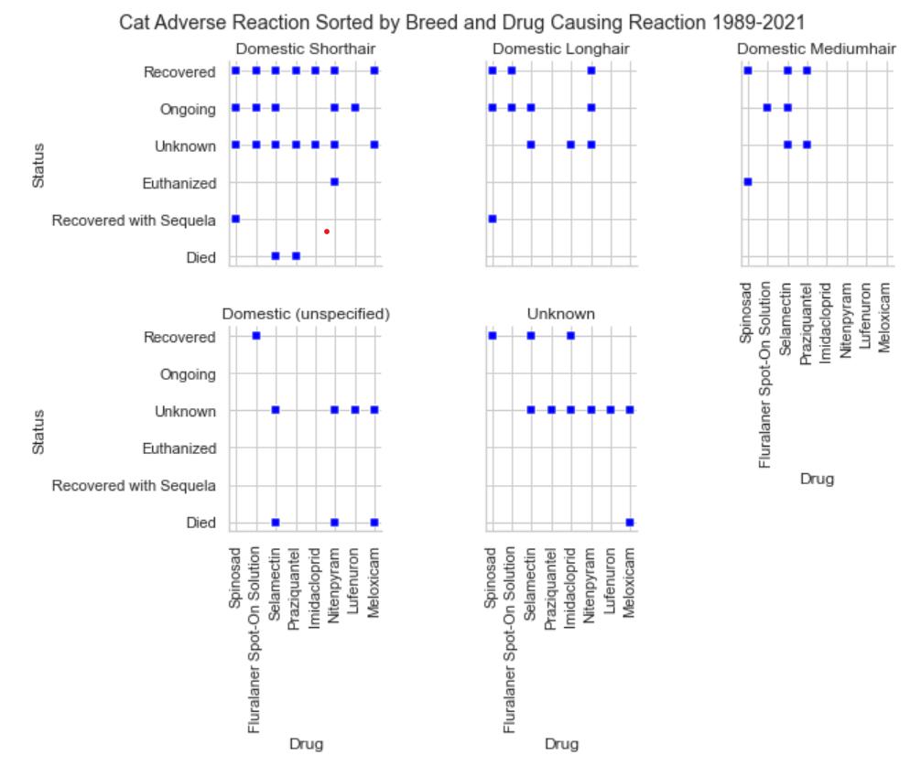
Does the Breed Effect the Outcome?

