Slide 1
US Food & Drug Administration
Animal & Veterinary API Endpoints
Lilla Bartko, Twilla Gerling, Carla Hampton
November 10, 2021

Slide 2
Executive Summary

Slide 3
Analysis of sample cat data
Using the openFDA API, extracted data regarding random 500 cats
Gender
Age
Weight
Breed of cat
Drug used
Outcome
Date treatment began

Slide 4
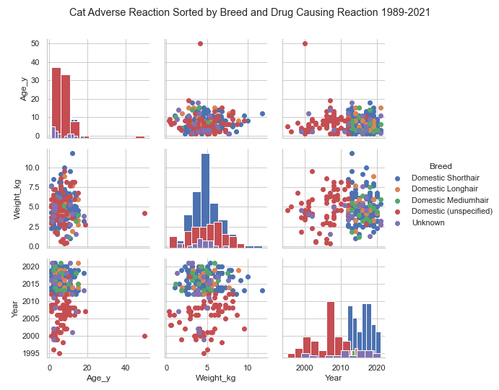
Distribution of the Data

Slide 5
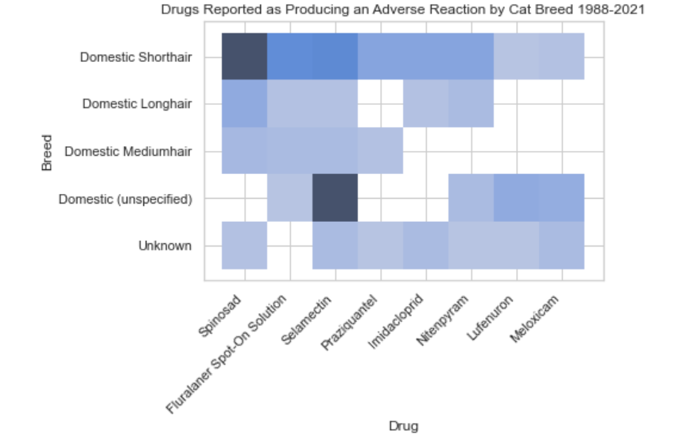
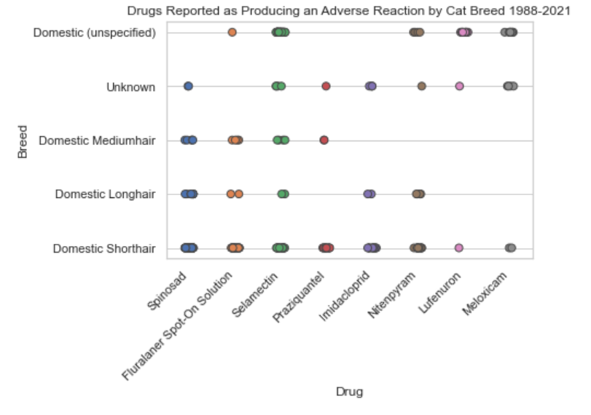
What Drugs are Reported as Causing a Reaction in Cats?

Slide 6
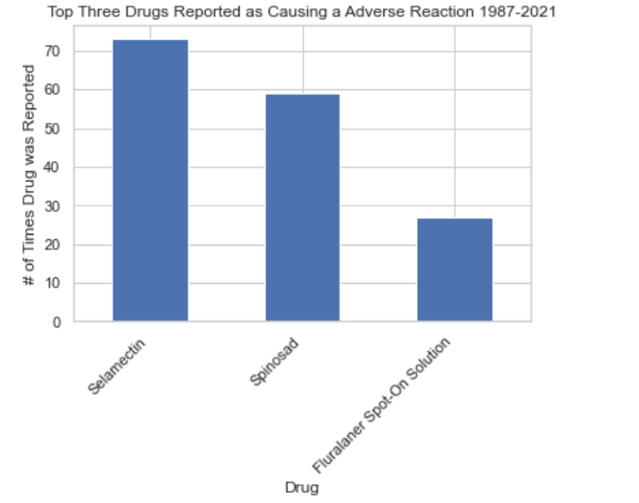
Top 3 Drugs that Produce an Adverse Reaction in Cats?
Put pie chart here with all of the drugs showing

Slide 7
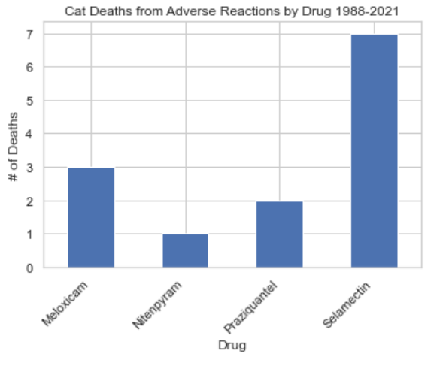
Which Drugs Result in Death?

Slide 8
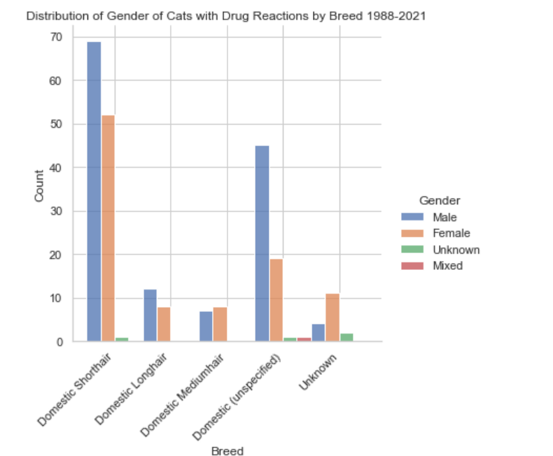
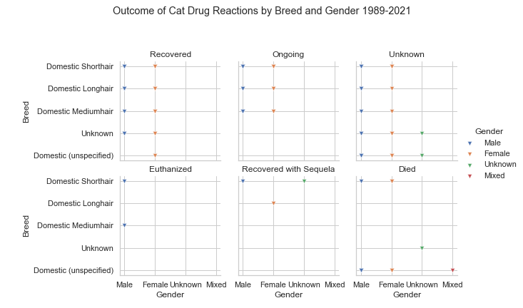
What are the Ages of the Cats that Died? Does Gender Affect Outcome?
This one needs to have the bar chart that shows number of deaths with Age (red in the notebook) for one of the graphs here. If this slide is about death only, there are too many results in the left graph

Slide 9
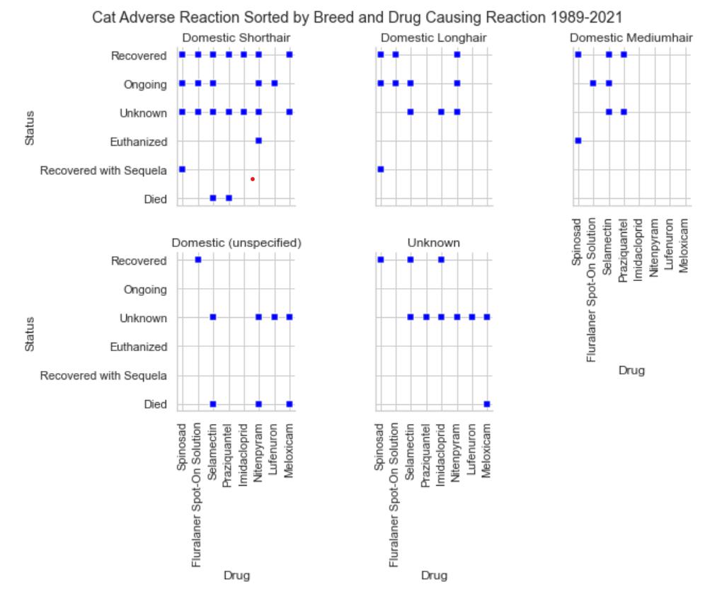
Does the Breed Effect the Outcome?

