Slide 1
US Food & Drug Administration
Animal & Veterinary API Endpoints
Lilla Bartkó, Twilla Gerling, Carla Hampton
November 10, 2021

Slide 2
Analysis of sample cat data
Using the openFDA API, extracted data regarding random 500 cats
Gender
Age
Weight
Breed of cat
Drug used
Outcome
Date treatment began

Slide 3
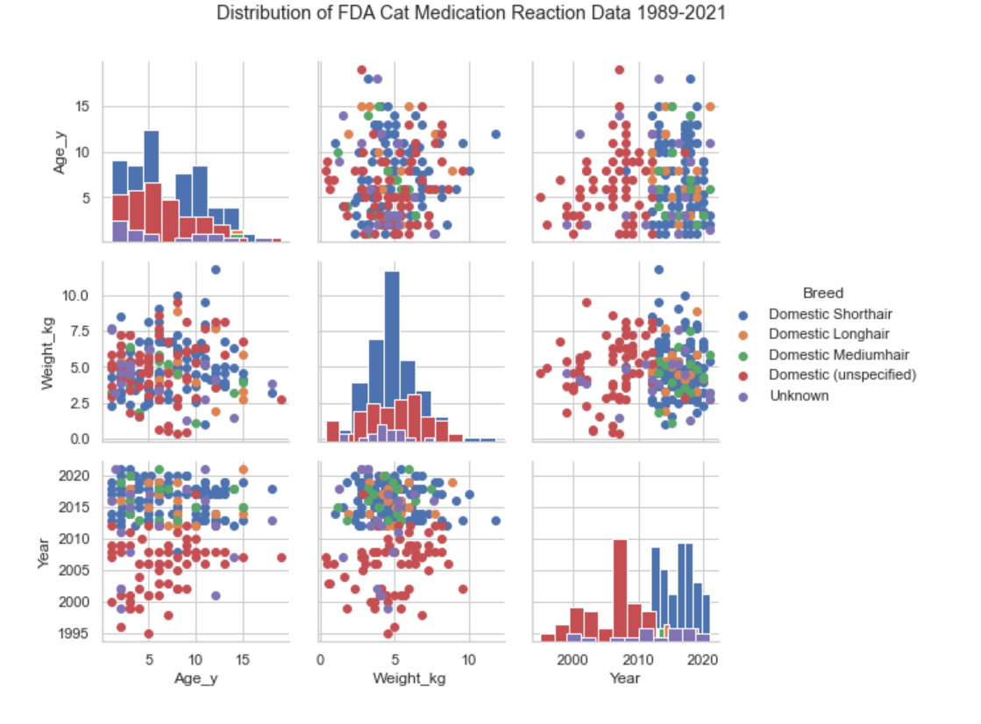
Distribution of the Data

Slide 4
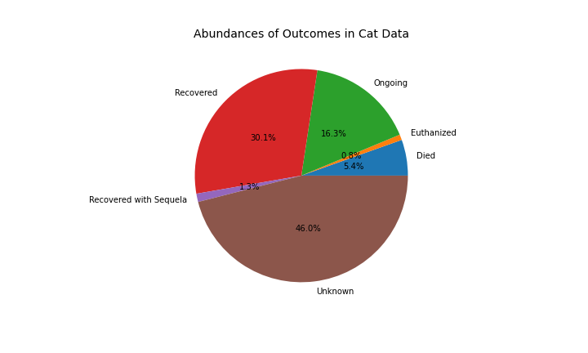
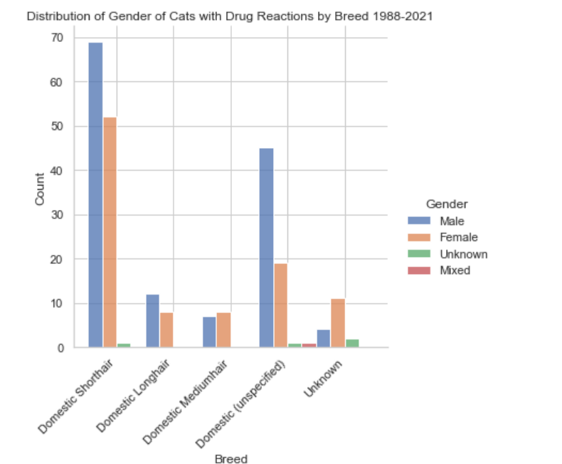
Background Data

Slide 5
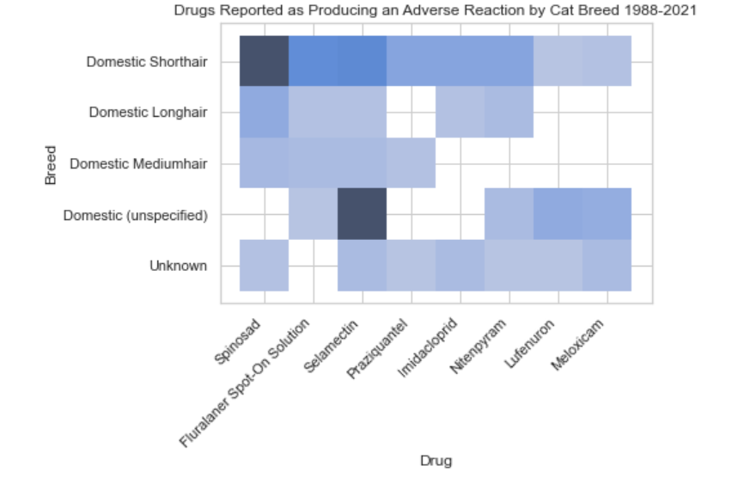
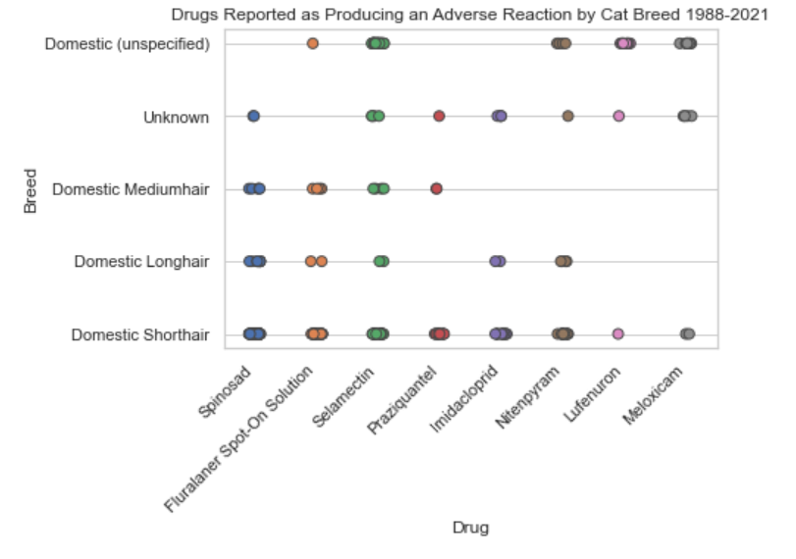
What Drugs are Reported as Causing a Reaction in Cats?

Slide 6
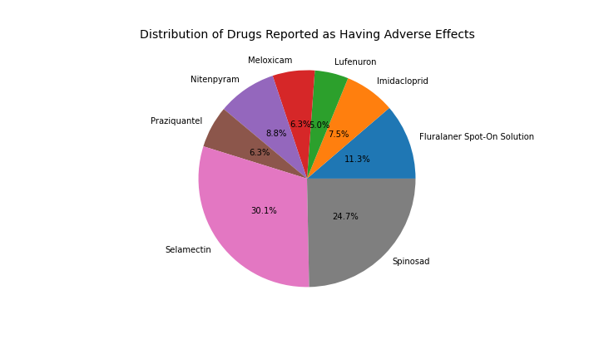
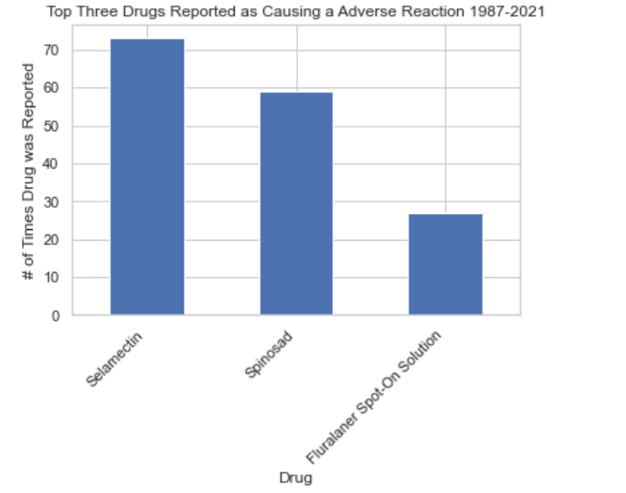
Top 3 Drugs that Produce an Adverse Reaction in Cats?

Slide 7
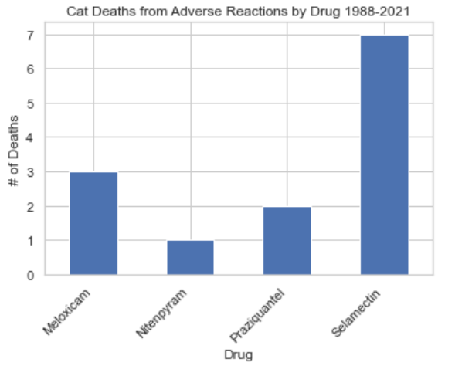
Which Drugs Result in Death?

Slide 8
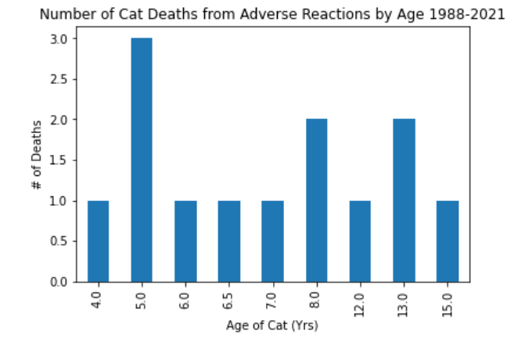
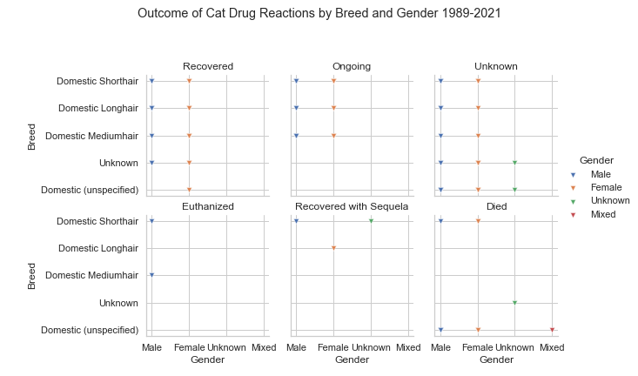
What are the Ages of the Cats that Died? Does Gender Affect Outcome?

Slide 9
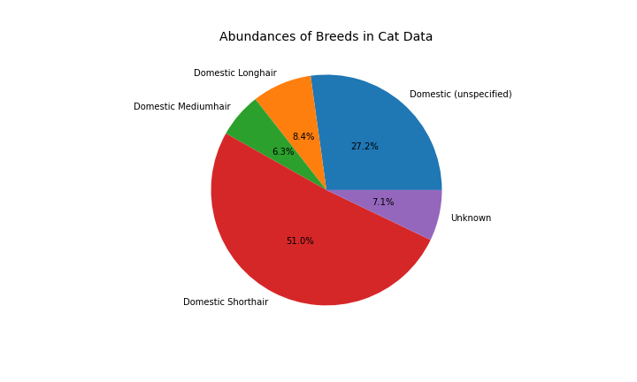
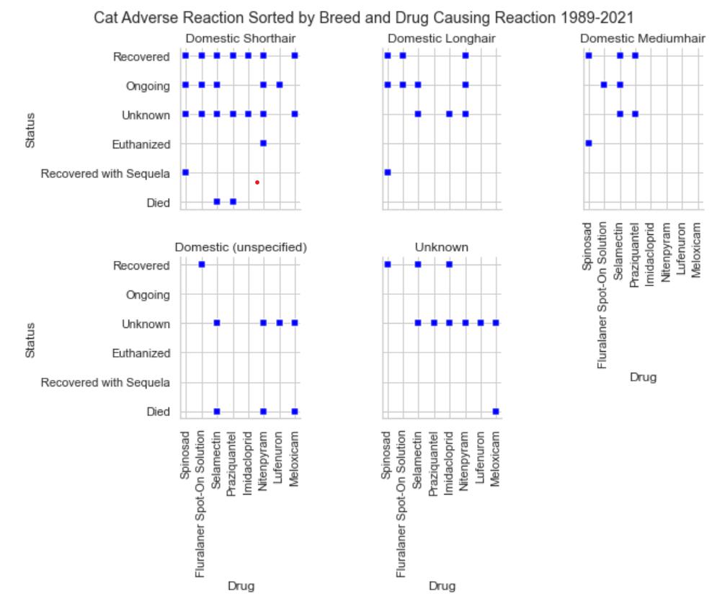
Does the Breed Effect the Outcome?

