Slide 1

Docker: an overview
Data Science Retreat
Jacopo Farina

Slide 2
The problem of the state
You try a library or a different version of Python, and:
You cannot easily reconstruct what exactly is installed now and communicate it
Different versions of the same thing are installed, and sometimes one or the other is used
A newer version of a software X has been released, if you install X on a new machine, it’s not the same you used in development, and may break

Slide 3
The problem of the state
You developed a software, (e.g. a web application) depending on a few libraries and maybe requiring databases and frameworks installed on the system
How can you install it on a new machine and be reasonably sure it will work the same way?
Can you make it easy for someone else to run it?
  Or for yourself in the future...

Slide 4
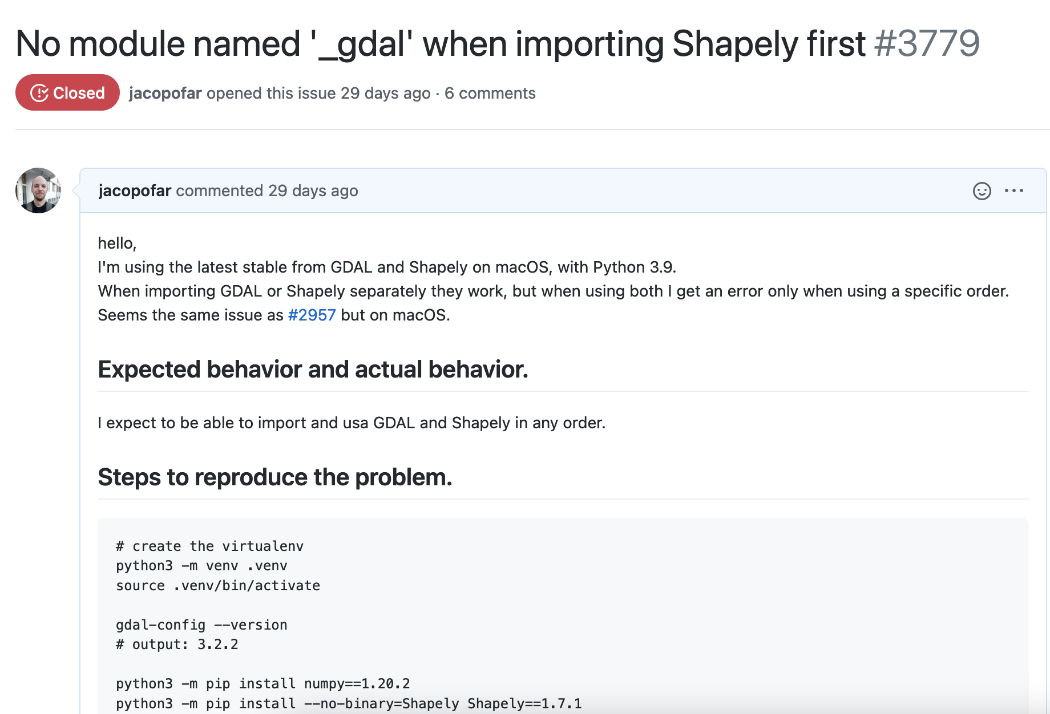

Slide 5
Your application
Databases
Python interpeter
System libraries
(e.g. glibc)
User libraries
(ML, GIS, LLVM, etc.)
Linux kernel

Slide 6
What is Docker
Runs a Linux process in an isolated and controlled way
Separates applications from Infrastructure
Can be used during development and/or production
Allows reproducible build and execution (no „works on my machine“)
Available for macOS and Windows using a virtual machine
(There is also a native Docker for Windows, but is not that common)

Slide 7
Daemon and client
The daemon (dockerd) is the process that manages all docker resources
  Also known as engine
  On macOS and Windows, it runs in a Linux VM
The Docker client (docker) is the primary way that Docker users interact with the Daemon
  Can run directly on non-Linux system
  Communicate with the engine via HTTP
In our case, the daemon and the client will be on the same machine: our laptops!

Slide 8
Images and containers
An image is a template to create containers to run. Most importantly, it contains all the files visible to the running app (including libraries and intepreters)
Public images are on hub.docker.com, including official ones
A container is a running image, you can have multiple containers from the same image
Every container is based on one and only one image, but an image can be executed in many different containers

Slide 9
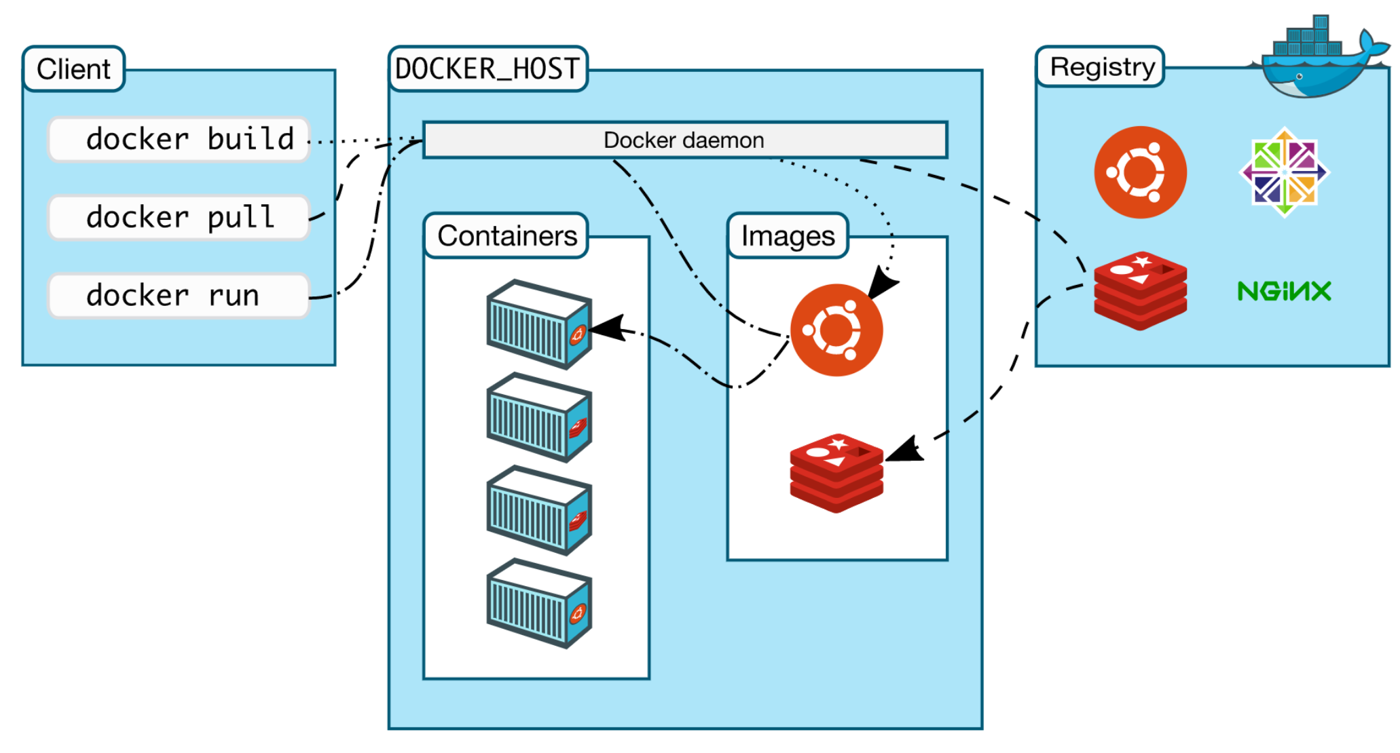

Slide 10
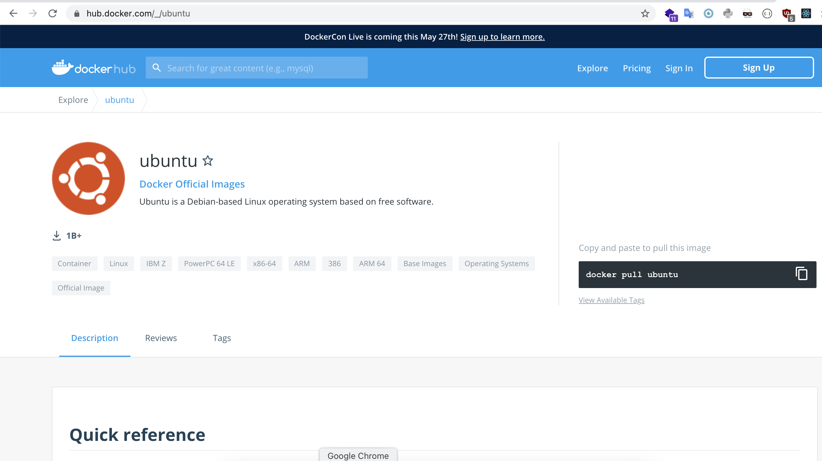

Slide 11
Example
Let’s say we want to check how this code behaves in different Python versions:
print(f'this is {3+2}')
installing Python 3.5 and 3.9 on the same machine can be messy.
It’s a good use case for Docker

Slide 12
Step 0: find the image details
We need to find the image name and tag on the docker hub.
The complete name of an image is
{docker hub username}/{image}:{tag}
If the tag is omitted, it is „latest“ by default
When an image is official, you can omit the username

Slide 13
Step 1: download the image
Use:
docker pull to download an image
docker images to list the downloaded images
docker rmi to delete an image
Notice that images are versioned and have an hash.

Slide 14
Step 2: run a container
Use:
docker run to start a container from an image
  -it to run it in interactive mode
  --rm to delete upon exit
  --name to give it a name (if not it uses a random one)
docker ps to see the running containers
docker stop / kill / rm to delete the containers
docker inspect to see all the details (extremely useful)
docker rm $(docker ps -aq) can delete all stopped containers to save space

Slide 15
Exercise: play with the FS
Create a container with:
docker run -it --name mypython python:3.9
Use docker ps in another window to see the running container
Use docker exec to start bash in this container, and write to a file
  e.g. docker exec -it mypython bash
Can you read the file from python?
What happens if you start another container, is the file there?
Use docker ps -a to see stopped containers, docker rm to eliminate them

Slide 16
The filesystem
From „inside“ a container, you see the filesystem from the image
A container can write files, but changes are only for that container and are ephemeral
  This is by design, to make every process reproducible
If you need to configure/install components not provided by the image, you need to create your own image (we are going to see this)
However, you can mount volumes to process data from the outside

Slide 17
Exercise: run a database
Find the image for Mariadb, see the instructions to run it
It will run in the background (becase of the -d flag)
Run a mysql client inside the same container (see the instructions)
Run SHOW DATABASES, try creating a table
Exit the mysql client
Stop the container
What happens to the data when the container is gone?

Slide 18
See the output
We use -it to create an interactive terminal, so that we can read and write on the standard input/output
We use instead -d to detach it and run in background
It is still possible to read the output using docker logs.
Useful: docker logs -f, (like tail -f for files), shows the live log (f is for follow)

Slide 19
Environment variables
A container does not see the system environment variables
It receives the environment variables defined in the image
Further environment variables can be passed using the -e flag when running a container
  This is the recommended way to pass the configuration (tokens, connection strings, etc.)

Slide 20
Networking
A container is isolated also in terms of networking
A server running in a container is not visible on the host, unless you pass the -p flag to expose a specific port.
  A container by default has its own IP address.
You can also expose services on different host ports (e.g.: -p 3000:80), useful to run different instances of the same type of service at the same time
You can also keep a container offline, create networks of containers and much more

Slide 21
Network - linking
Often your app requires services (e.g. a database), and you want to connect to a container from another.
In this case, the --link flag can help:
docker run --name somemysql \
-e MYSQL_ROOT_PASSWORD=my-secret-pw -d mariadb:latest
docker run -it --link somemysql python:3.9
Now the second container can use „somemysql“ as an hostname to connect to the first

Slide 22
Docker compose
When you need to start multiple containers together, a tool called docker compose can help.
It uses a YAML file to get the definition of the containers to run, and how to link them.
In short it replaces a list of long commands with a config file.
It also takes care of aggregating the logs and shut down the containers in a single step.
https://docs.docker.com/compose/

Slide 23
Kubernetes
Companies with a complex setup often use kubernetes to manage a cluster and the deployment on it.
It’s based on YAML definitions like docker compose, it deploys one or more container on one or more machines, the user only needs to specify what they want, not the implementation details.
Relatively easy to use, but quite hard to maintain. Handles:
Restarting and health monitoring
Load balancing
Cronjobs
Services
Node eviction / scaling
It’s possible to try it using minikube

Slide 24
Building an image
So far, we used images from the docker hub. There are many for the most common open source tools and libraries, but what if you want to create one with your own code?
That way, you can allow the user (or yourself) to run it using a single command, without worrying about they having different versions of the dependencies.
It can also be useful during development, to quickly build and test some code in a reproducible way.

Slide 25
Building an image
Docker allows you to build an image, that can be then published on the Docker Hub or private registries.
It’s possible to snapshot a container FS to get an image, but not recommended because it’s much harder to maintain and rebuild.
Instead, the traditional way is to define a Dockerfile.
This file is basically a recipe to build an image, a list of steps which are executed in sequence

Slide 26
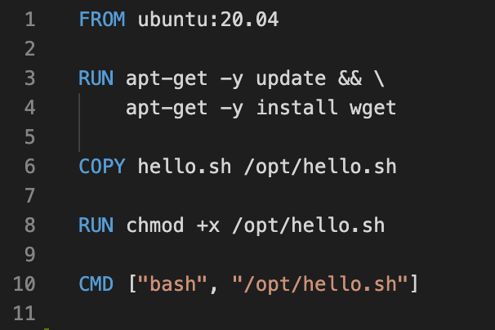
Dockerfile: an example

Slide 27
Building an image
Exercise: Try to build a simple image yourself
Three tips from experience:
Put the dockerfile in the root of your project, or the code subfolder if any
Use a .dockerignore file to ignore files, same logic and syntax as .gitignore
Use intermediate images to troubleshoot the build process
  NOTE: docker shows the id of each intermediate image if you build with the environment variable DOCKER_BUILDKIT=0

Slide 28
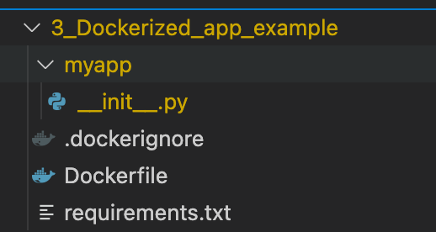
Exercise: dockerize a Flask app
Let’s create a small Flask app that generates a Numpy array and return the median from a GET endpoint, and then dockerize it.
First let’s focus on having the app run outside Docker.
Suggestion: create a new folder for this, with this structure to avoid confusion

Slide 29
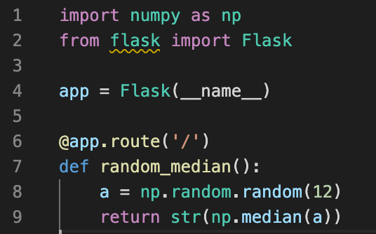
Exercise: dockerize a Flask app
You can write your own logic, here’s a minimal example

Slide 30
Exercise: dockerize a Flask app
To run it (without Docker) you should:
Create a virtualenv with python3 -m venv .venv
Activate it with source .venv/bin/activate
Install flask and numpy with pip
Write the dependencies in the requirements.txt to pin them (e.g. numpy==1.20.3)
Run it with FLASK_APP=myapp:app flask run --host 0.0.0.0
Visit http://localhost:5000 to see the result
Or use Conda,
if you prefer

Slide 31
Exercise: dockerize a Flask app
Now we can replicate the setup in a Dockerfile, to build an image with all the logic.
Try to write the Dockerfile yourself
Tips:
For a starting image you can use python:3.9
You don’t need the virtualenv, install on the whole container because the isolation is already provided by Docker. Use the requirements.txt
You can run an arbitrary command with docker run, not just the default one specified in the Dockerfile CMD. Useful to run bash and get a shell for troubleshooting
The --host flag for Flask is not always needed. Use docker exec and then curl to call the app from inside the container
Bonus: try to use gunicorn to run the app, once you can run it using only flask.

