Slide 1

INTRODUCTION
TO DOCKER
2021-02-13
Jacopo Farina, DSR
Based on the original material from Abhijit Agarwal, Data Science Retreat

Slide 2
What is Docker
Runs a Linux process in an isolated and controlled environment
Separates applications from Infrastructure
Can be used during development and/or production
Allows reproducible build and execution (no „works on my machine“)
Available for macOS and Windows using a virtual machine
(There is also a native Docker for Windows, but is not that common)

Slide 3
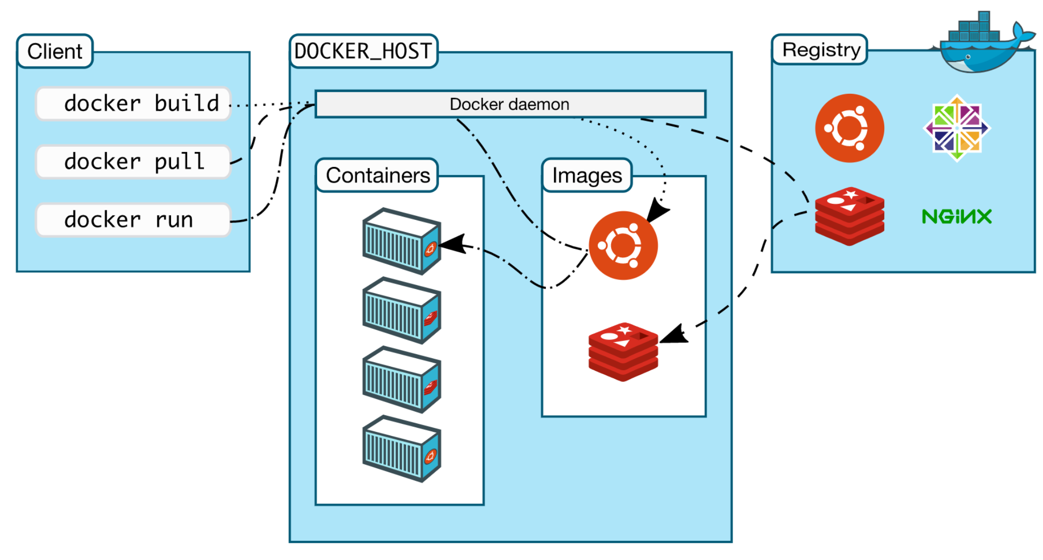

Slide 4
Daemon and client
The daemon (dockerd)is the process that manages all docker resources
The Docker client (docker) is the primary way that Docker users interact with the Daemon
In our case, the daemon and the client will be on the same machine: our laptops!

Slide 5
Images and containers
An image is a template to create containers to run. Most importantly, it contains the files visible to the running app (including libraries and intepreters)
An image is often based on another, e.g. Ubuntu or Python. You can build images layer by layer
Public images are on hub.docker.com, including official ones
A container is a running image, you can have multiple containers from the same image

Slide 6
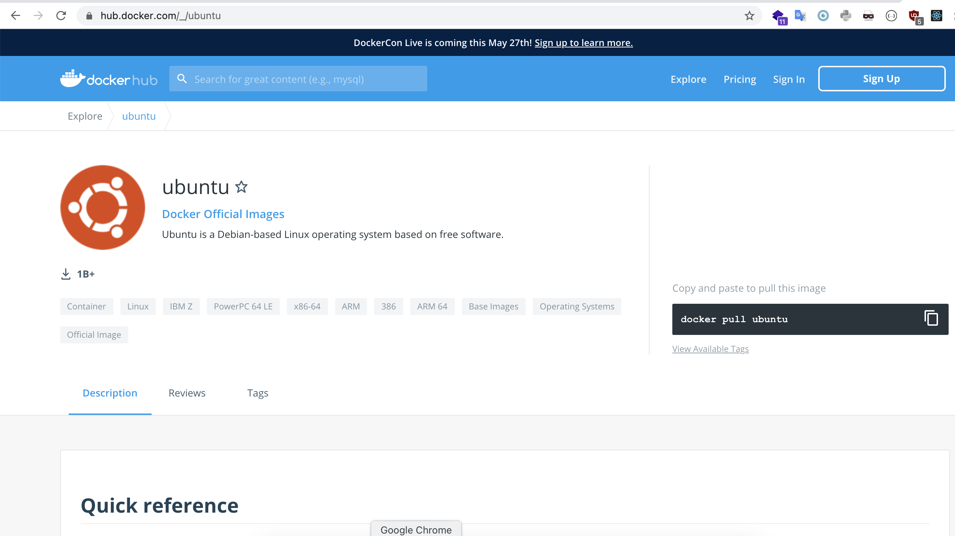
The Docker Hub

Slide 7
# List all docker images
docker images
# Pull a docker image
docker pull ubuntu:latest
# List all running containers
docker ps
# List all running and stopped containers
docker ps -a
# Start a container from an image
docker run -it --rm --name ubuntu-container ubuntu:16.04 /bin/bash
# Execute commands on an already-running container
docker exec -it <container-name-or-id> /bin/bash
# Stop a running container, from outside the container
docker stop <container-name-or-id>

Slide 8
Exercise 1
Find the image for Ubuntu on Docker Hub (use google)
Start a container with Ubuntu. Version 20.04
Install wget utility inside this container
Exit this container
The container is now stopped. Restart the container
Install python 3.9 in this container
Exit this container again
Delete this container
Delete the image

Slide 9
Exercise 2
Find the image for Mysql
Read instruction on “How to use this image”
Start a container with Mysql. Version 5.7
Run a mysql container in the background
Run mysql client inside the same container, using “root” user
Run `SHOW DATABASES`, try creating a table
Exit the mysql client
Stop the container
What happens to the data when the container is gone?

